Slide 1
Apollo missions
To the moon! Or bust…. *foreboding tone*

Slide 2
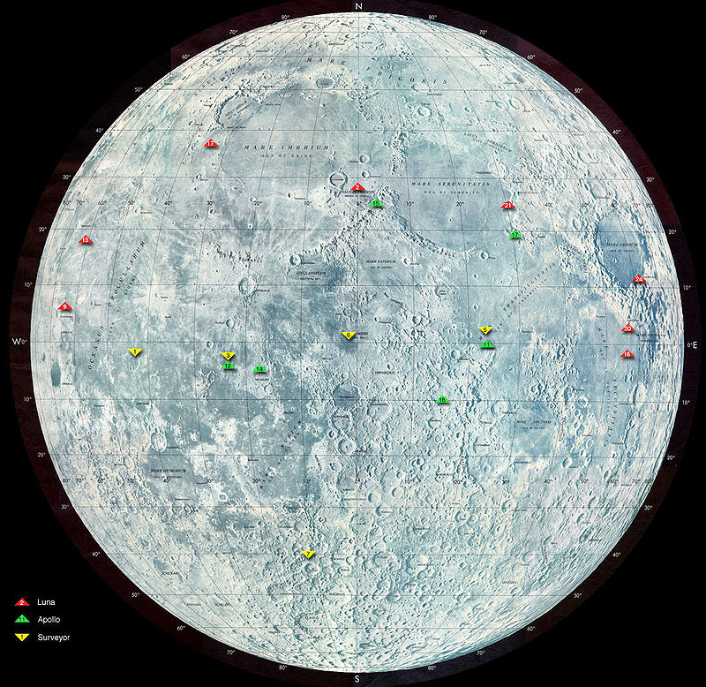
The Apollo missions
The Apollo program included both manned and unmanned space missions, flown by NASA between 1961 and 1975. They culminated with a series of manned Moon landings between 1969 and 1972.

Slide 3
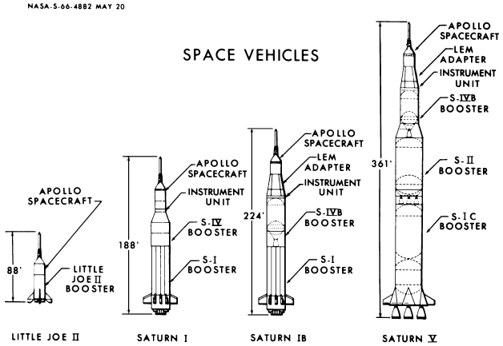
Launch vehicles
These carry the space payload into space
The Apollo program used four types of launch vehicles:
  Little Joe II – unmanned suborbital launch escape system development.
  Saturn I – unmanned suborbital and orbital hardware development.
  Saturn IB – preparatory unmanned missions, and Apollo 7, the first manned (Earth orbit) mission.
  Saturn V – unmanned and manned earth orbit and lunar missions.

Slide 4
Unmanned missions
From 1961 to 1968, the Saturn launch vehicles and components of the Apollo spacecraft were tested in unmanned flights.
These involved carrying “Dummy” modules called boilerplates into space
It also tested engine boosting and shut down
These missions were dubbed SA (Saturn-Apollo) 1-10

Slide 5
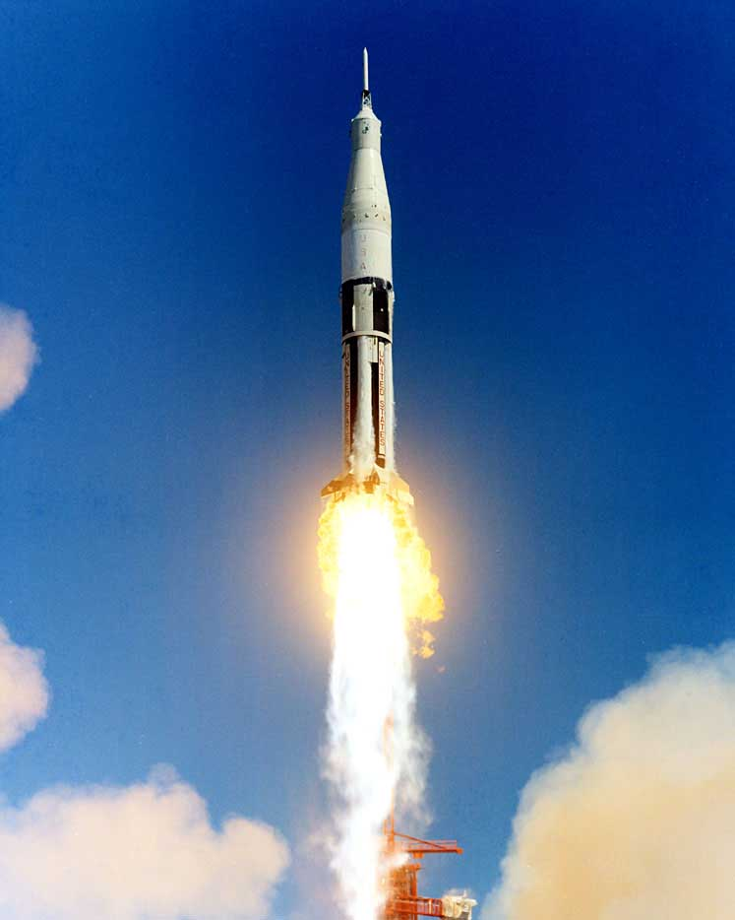
Saturn ib and Saturn V rockets
Some incongruity in the numbering and naming of the first three unmanned Apollo-Saturn (AS), or Apollo flights, is due to the posthumous honorary renaming of the flight which would have been AS-204, to Apollo 1
Therefore we will bounce around in the numbering a little
← this is a Saturn IB rocket. Neat, huh.
Most Saturn IB rocket missions were unmanned and used to test heat shield, propulsion system and the reaction control systems
Two, however, dealt with planned manned missions, Apollo 1 + 7

Slide 6
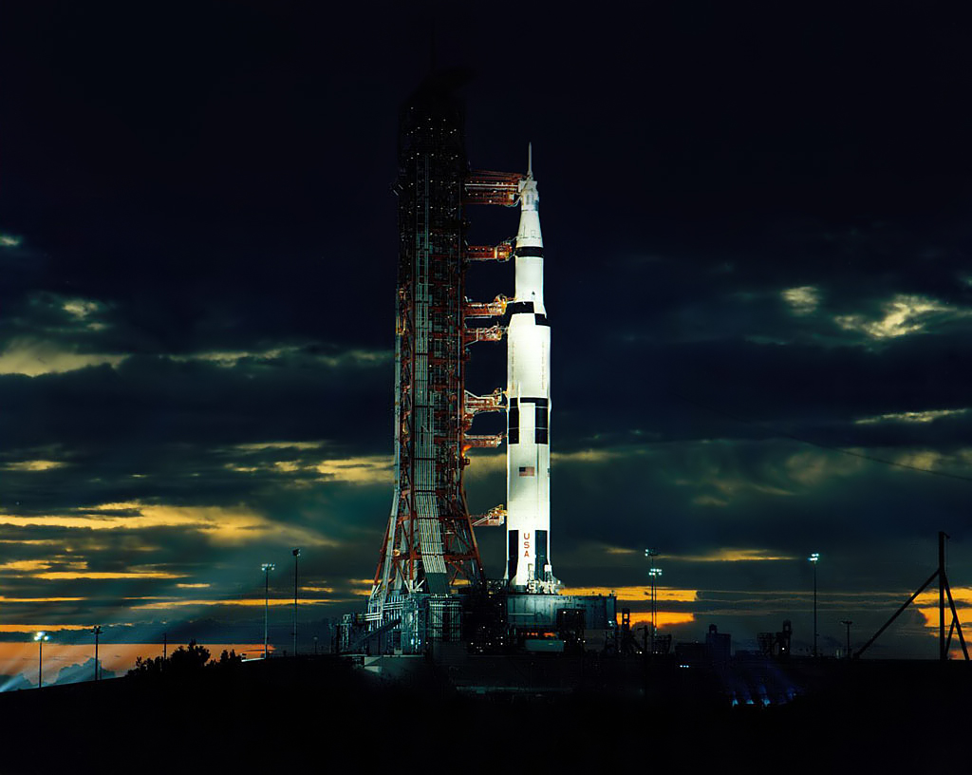
Saturn v
All manned missions to the moon used this rocket
It was a three-stage rocket
What does that mean?

Slide 7
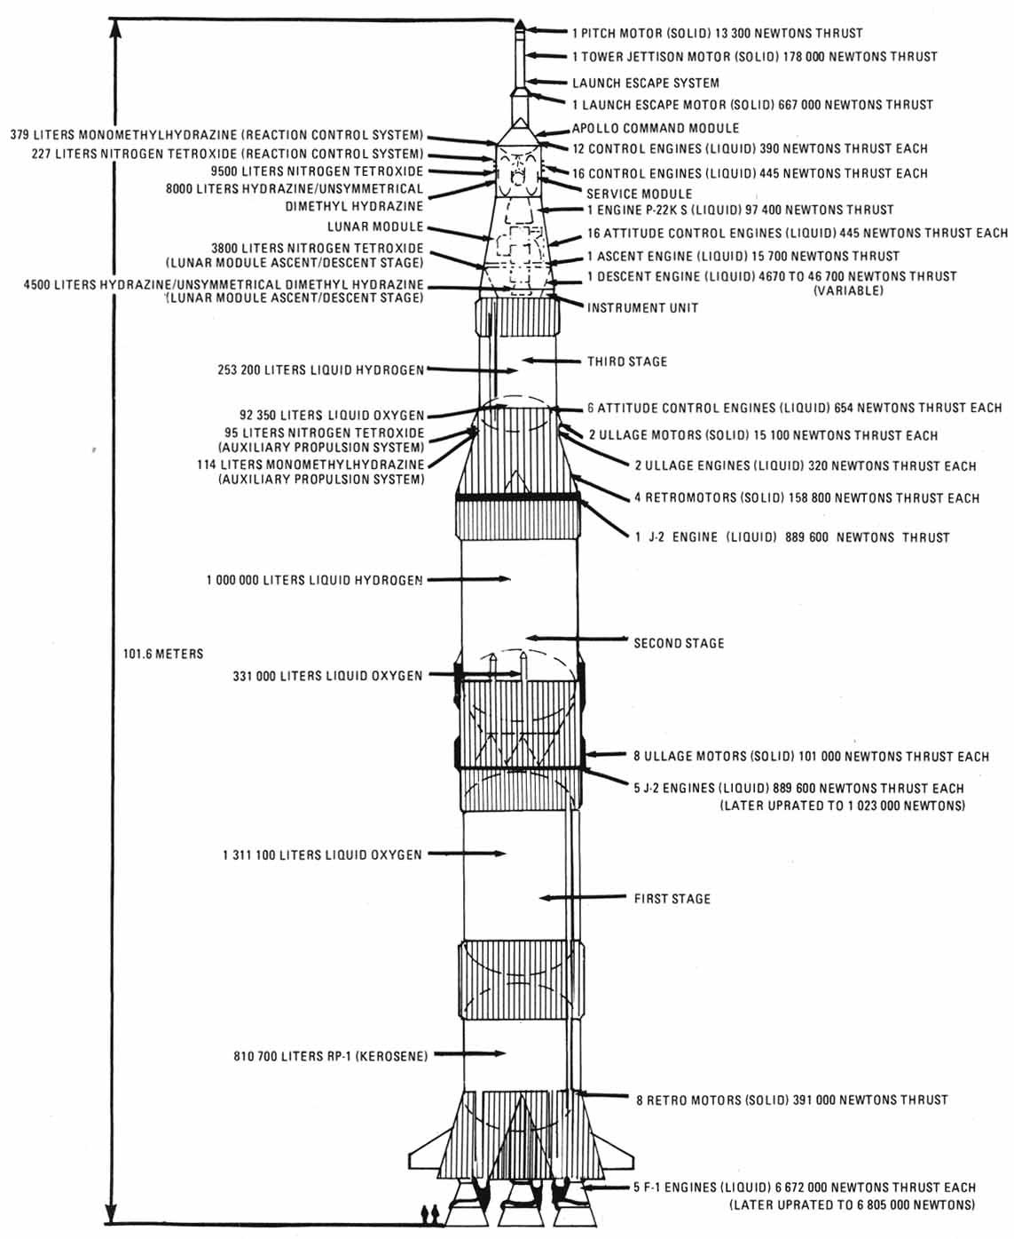
…it has three stages
Let’s use the magnifying glass to check em all out.

Slide 8
Manned Apollo missions
Thirty-two astronauts were assigned to fly in the Apollo manned lunar landing program.
Twenty-four of them left Earth's orbit and flew around the Moon on nine missions. (Of the other manned missions, Apollo 1 did not launch and Apollo 7 and Apollo 9 were low Earth orbit spacecraft testing missions).- these are the ones we care about
Nine astronauts flew Apollo spacecraft in the Apollo Applications Programs Skylab and Apollo–Soyuz Test Project.

Slide 9
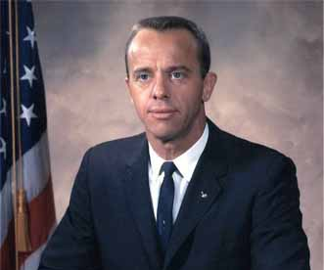
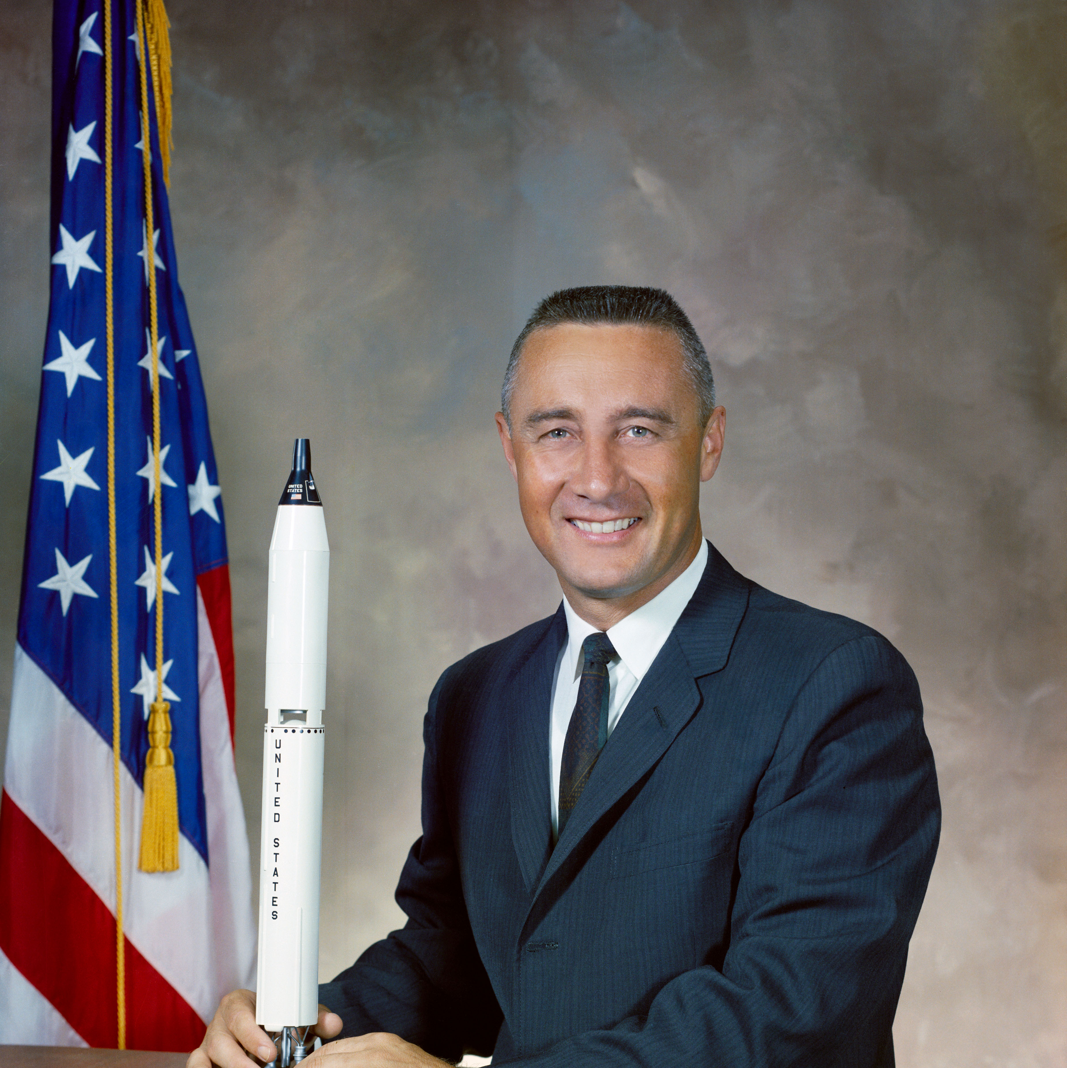
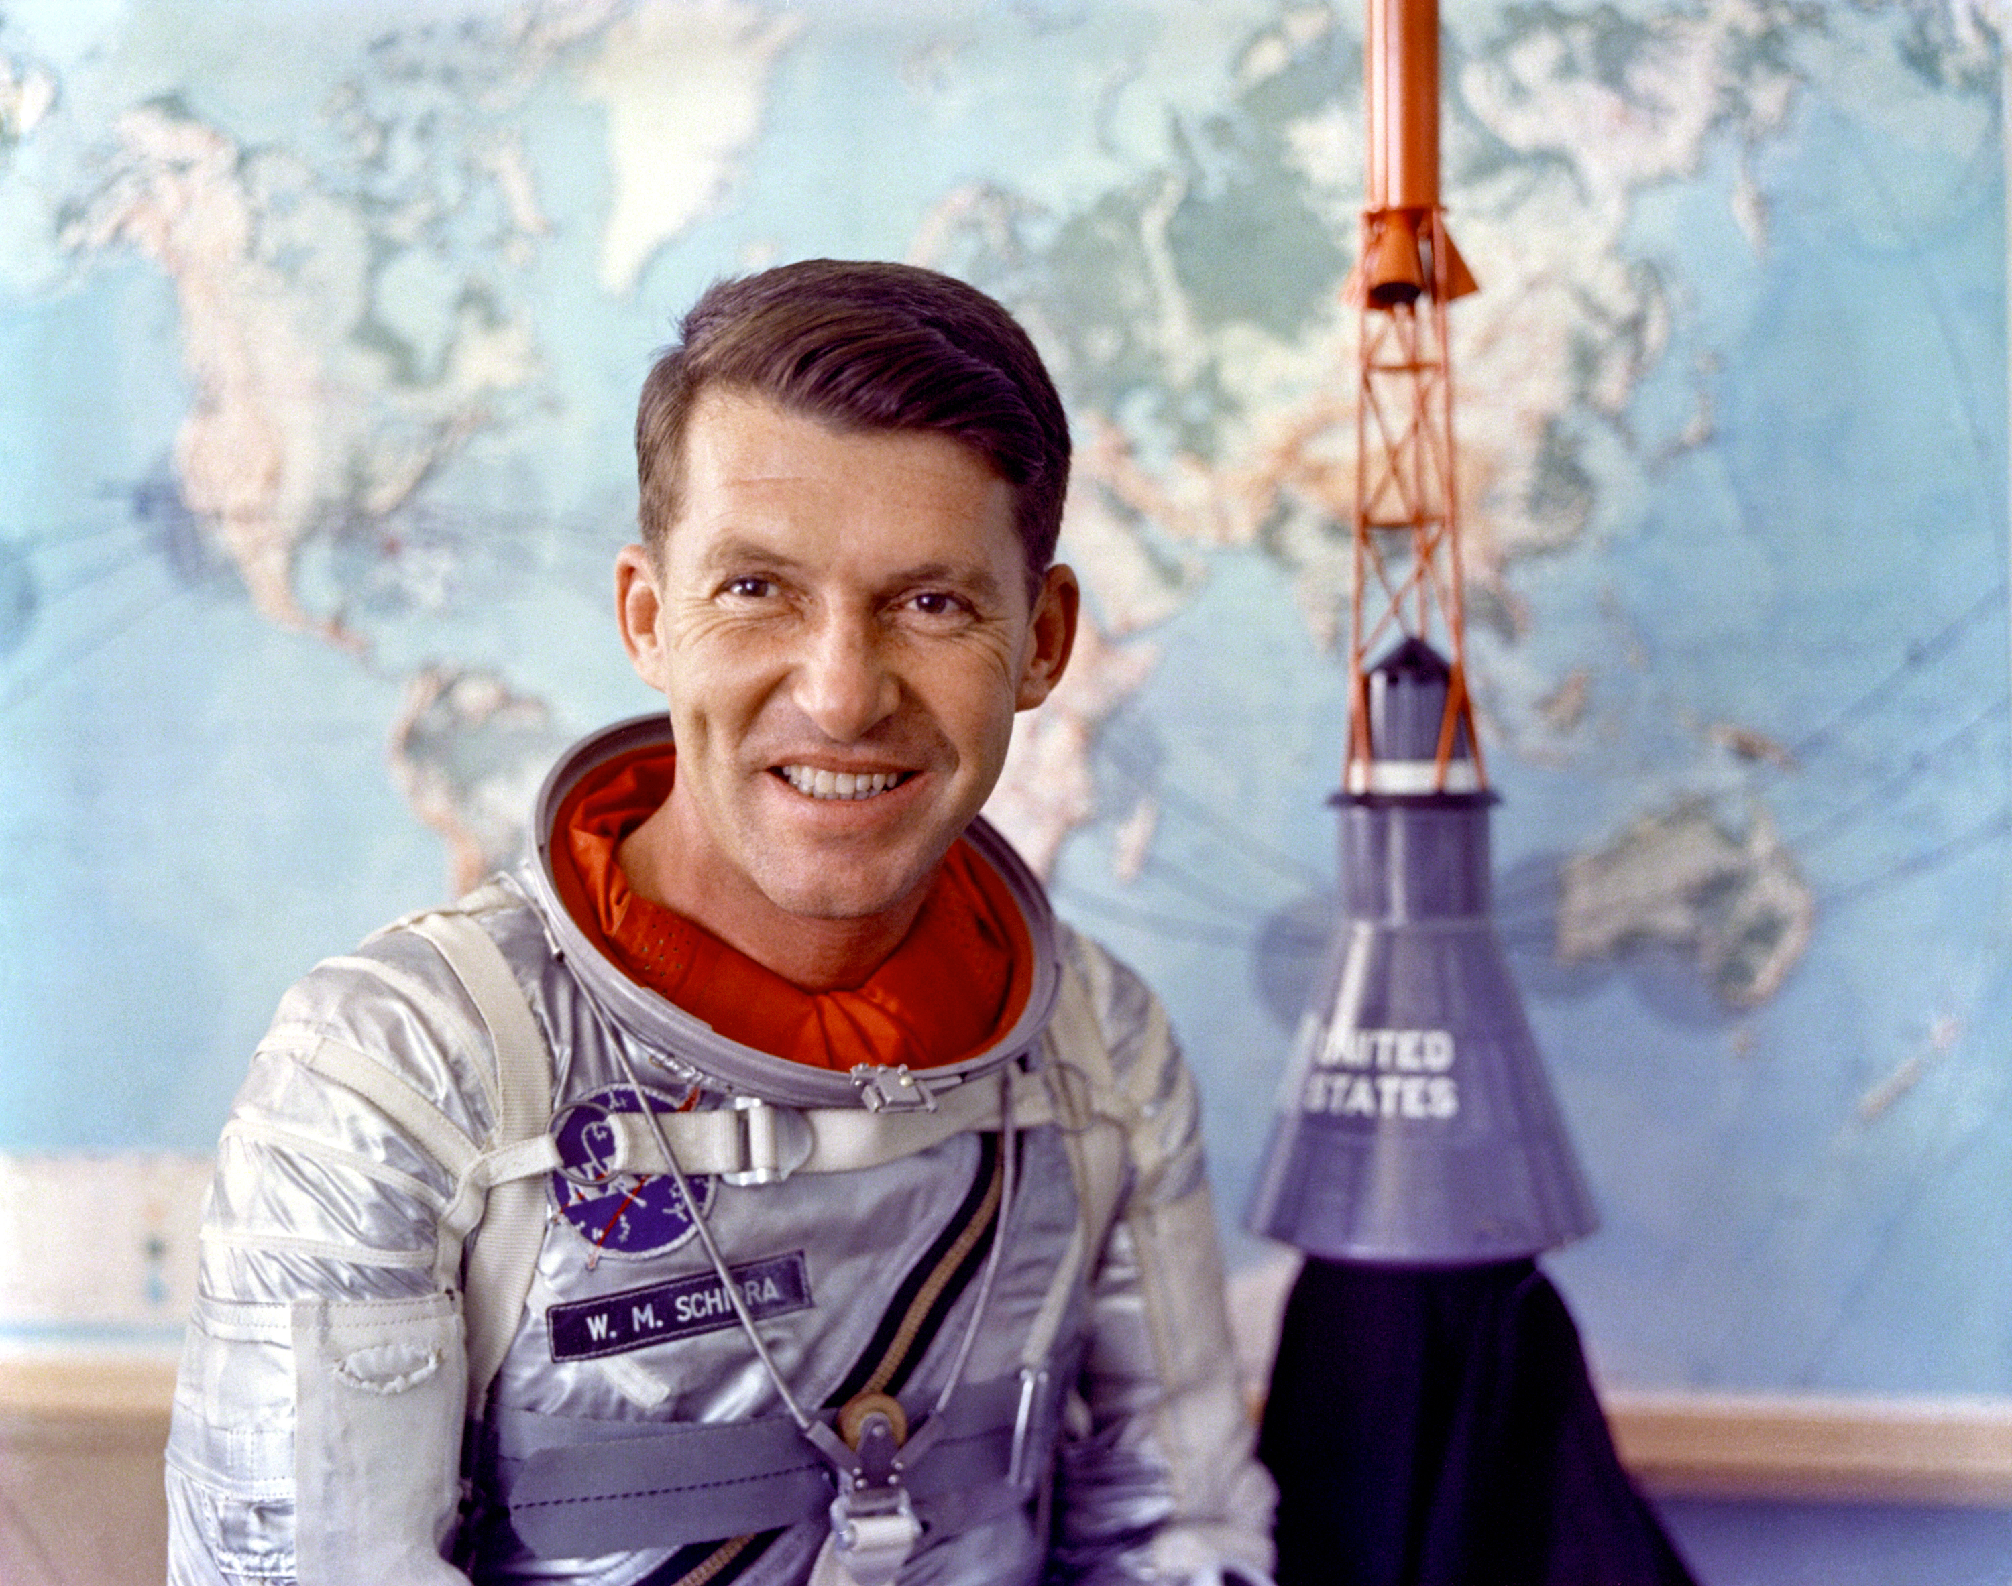
Mercury seven leftovers
Gus Grissom
Walter Schirra
Alan Shepard

Slide 10
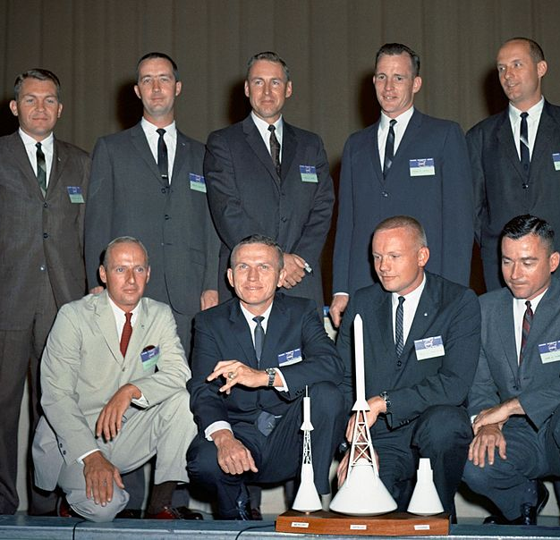
Gemini leftovers
Edward H. White II
James A. McDivitt
Frank F. Borman II
James A. Lovell Jr.
Thomas P. Stafford
John W. Young
Neil A. Armstrong
Charles "Pete" Conrad Jr.
David R. Scott
Eugene A. Cernan
Michael Collins
Edwin E. "Buzz" Aldrin Jr.
Richard F. Gordon Jr.

Slide 11
…the rest
T. Kenneth Mattingly
John L. "Jack" Swigert Jr
Fred W. Haise Jr
Stuart A. Roosa
Edgar D. Mitchell
Alfred M. Worden
James B. Irwin
Charles M. Duke Jr
Ronald E. Evans Jr
Roger B. Chaffee
Donn F. Eisele
R. Walter Cunningham
Russell L. "Rusty"
William A. Anders
Alan L. Bean

Slide 12
We’ll talk about them as they become important

Slide 13
Apollo 1
Gus Grissom, Ed White, and Roger Chaffee
….didn’t go great
https://www.youtube.com/watch?v=lIk9sP9pEPM

Slide 14
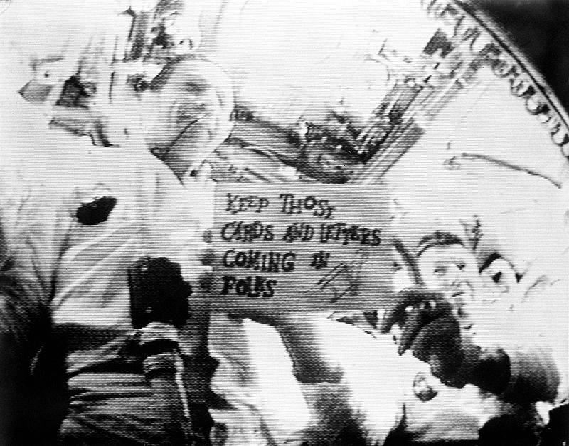
Apollo 7
Mission: Will it blow up?
  Needed to test new equipment and rocket on 11-day orbit flight
  Walter M. Schirra, Donn F. Eisele, R. Walter Cunningham
  1st live television from space!

Slide 15
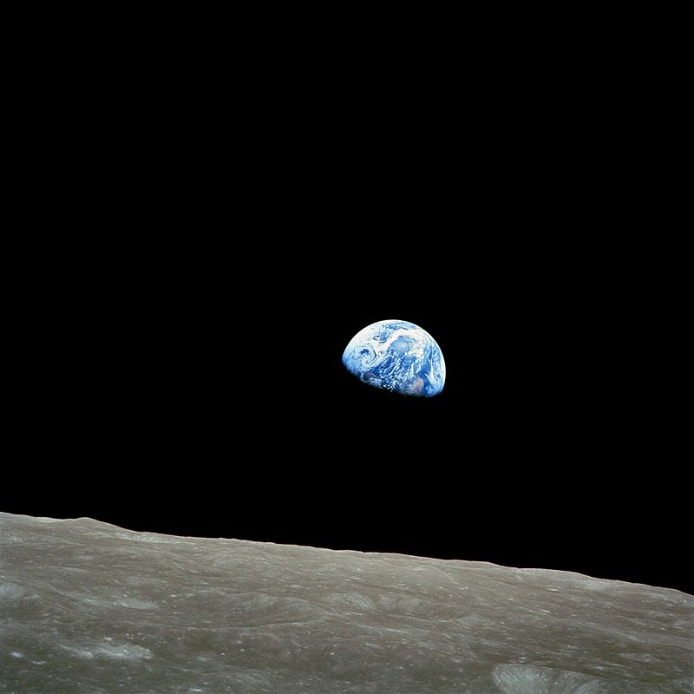
APOLLO 8
First manned flight to Moon; CSM made 10 lunar orbits in 20 hours.
But wait… I thought Apollo 11 was the first to the moon!!!
They didn’t land. Essentially they were looking for a parking spot.
Frank Borman
James Lovell
William Anders
First astronauts to witness an “Earthrise”

Slide 16
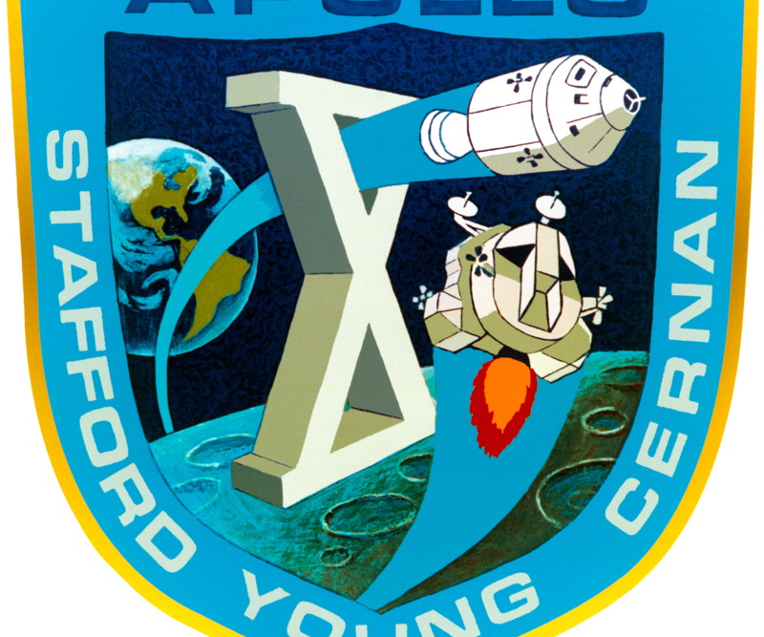
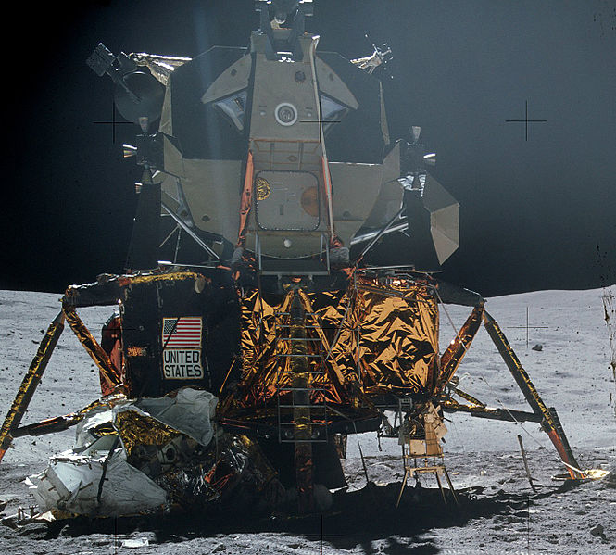
Apollo 9 & 10
Dress rehearsals for the Lunar Module
Can these new technologies survive the conditions of space?
Apollo 10 actually launched the LM at the moon and had it redock.

Slide 17
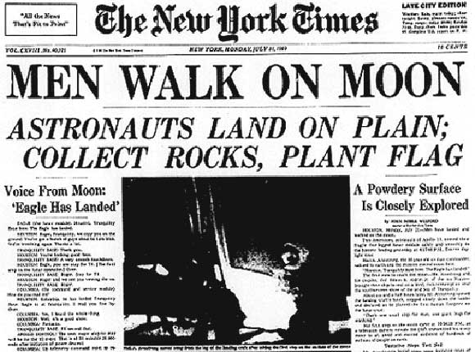
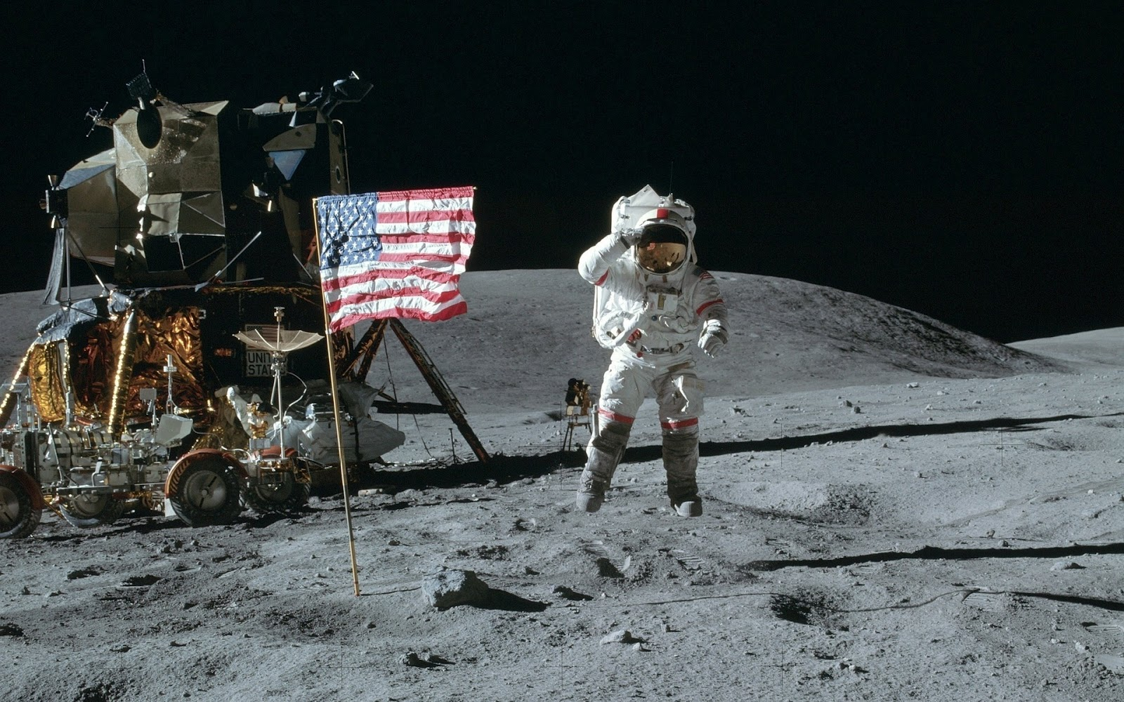
Apollo 11
First man on the moon!
Take that Commies!
Jul 16–24, 1969
Neil Armstrong, Buzz Aldrin, and that other guy!
Colin something…
Michael Collins that was it! He flew the command module.. That’s cool too I guess…
We’ll look at the paths/processes they took at the end of this unit.

Slide 18
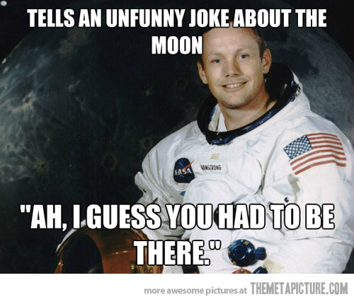
We won the space race!

Slide 19
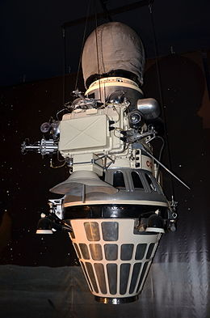
….sorta
Luna 9-was an unmanned space mission of the Soviet Union's Luna programme.
On 3 February 1966 the Luna 9 spacecraft became the first spacecraft to achieve a soft landing on the Moon, or any planetary body other than Earth, and to transmit photographic data to Earth from the surface of another planetary body.
Didn’t have a flag

Slide 20
Apollo 13
A Failed success
Jim Lovell (Tom Hanks), Fred Haise (Bill Paxton) and Jack Swigert (Kevin Bacon)
Thermocoil in oxygen tank sparks and explodes, shooting valuable oxygen into space
This both altered their course and depleted needed O2 for fuel burn and breathing
Through careful manipulation of power, were able to use the moon’s gravity to slingshot them back to earth and hit a crucial angle for safe reentry
All astronauts survived

Slide 21
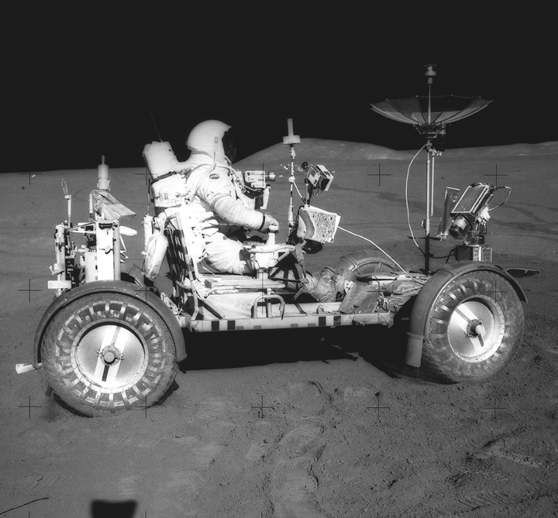
Apollo 15
The successful Apollo 15 manned lunar landing mission was the first in a series of three advanced missions planned for the Apollo program..
David Scott, Alfred Worden, James Irwin
Traverses during the three EVA periods were enhanced by use of a Lunar Roving Vehicle (LRV).

Slide 22
Apollo 17
The Last Manned Lunar Landing.
Eugene Cernan, Ronald Evans, Harrison Schmitt
Apollo 17 was the last Apollo mission to land men on the Moon. It carried the only trained geologist to walk on the lunar surface, lunar module pilot Harrison Schmitt.
All remaining Apollo missions cancelled due to $$$

