Slide 1
Astronomy 101
Daaa basics.

Slide 2
OUR SOLAR SYSTEM
Consists of 8 planets and one celestial dwarf
Revolves around a star (sol)
Has its rotating bodies separated by an asteroid belt.

Slide 3
The planets
Mercury
Venus
Mars
Earth
Jupiter
Saturn
Uranus
Neptune (and friends)

Slide 4
The asteroid belt
Seperates the “terrestrial” planets and the “Jovian” planets
Circumstellar disc in the Solar System located roughly between the orbits of the planets Mars and Jupiter. It is occupied by numerous irregularly shaped bodies called asteroids or minor planets.

Slide 5
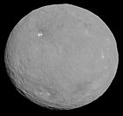
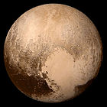
Ceres “the jealous younger brother”

Slide 6
Comets and asteroids
Asteroids are made up of metals and rocky material
Comets are made up of ice, dust and rocky material.
Both asteroids and comets were formed early in the history of the solar system about 4.5 billion years ago.

Slide 7
Basically….
A comet is a wet asteroid.

Slide 8
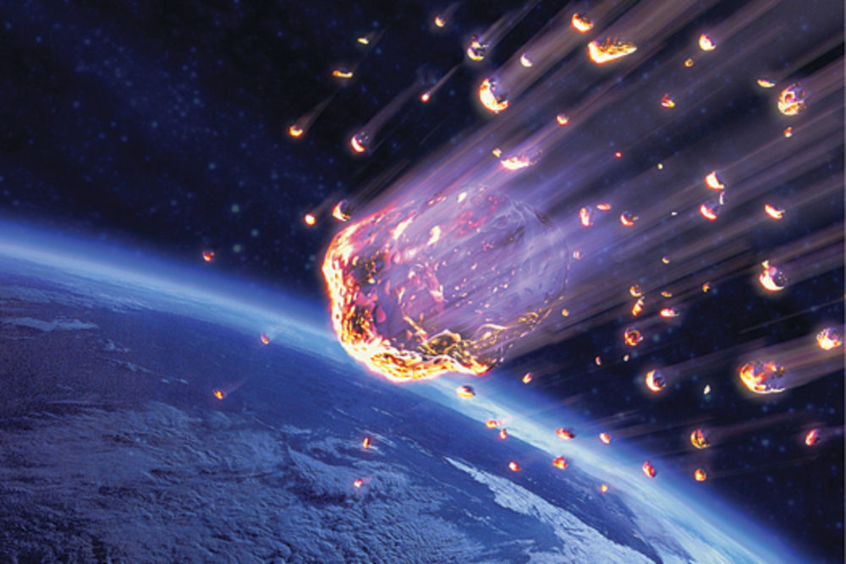
Meteors

Slide 9
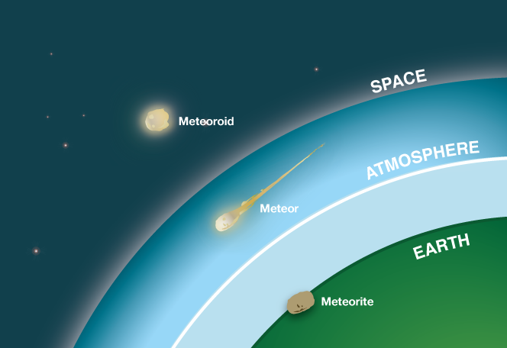
Meteor vs meteoroid vs meteorite

Slide 10
Astronomical theories
There’re tons of theories about space. You know some of them
The earth is round
We revolve around the sun
Gravity affects light
Stars explode
My ex wouldn’t fit in it
Mostly empty space
Like my ex’s head
Universe is expanding
Etc.. Etc.. Etc…

Slide 11
“On the heavens”
Around 350 BC, the great Aristotle declared that the Earth was a sphere (based on observations he made about which constellations you could see in the sky as you travelled further and further away from the equator)
Besides the constallations… during a lunar eclipse, the shadow of the earth is circular, objects disappeared as they traveled farther from a fixed point

Slide 12
