Slide 2
Biomass energy
Biomass energy has great potential for addressing our energy challenges
Biomass = organic material that makes up living organisms
People harness biomass energy from many types of plant matter
  Wood from trees, charcoal from burned wood, and matter from agricultural crops, as well as combustible animal waste products

Slide 3
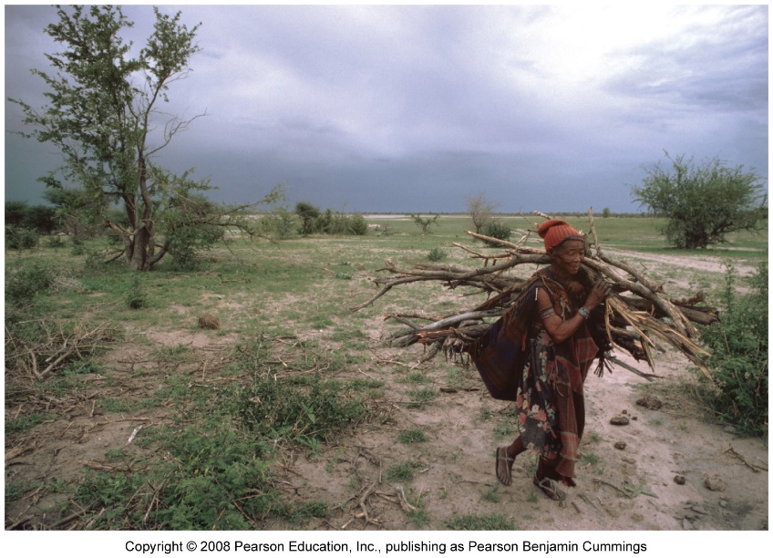
Biomass sources are widely used
More than 1 billion people use wood from trees as their principal energy source
In developing nations, families gather fuelwood for heating, cooking, and lighting
Fuelwood, charcoal, and manure account for 35% of energy use
Fuelwood and other biomass sources constitute 80% of all renewable energy used worldwide

Slide 4
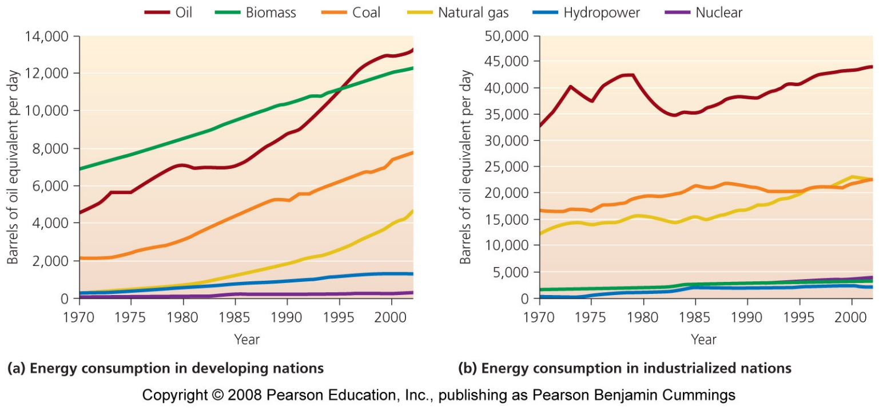
Biomass can be overharvested
Biomass is only renewable when it is not overharvested
  With rapid deforestation, soil erosion, and forest failures to regrow, biomass is not replenished
As developing nations industrialize, fossil fuels are replacing traditional energy sources
Biomass use is growing more slowly than overall energy use

Slide 5
New biomass strategies
Biomass sources include a variety of materials
Biopower = produced when biomass sources are burned in power plants, generating heat and electricity
Biofuels = biomass sources converted into fuels to power automobiles

Slide 6
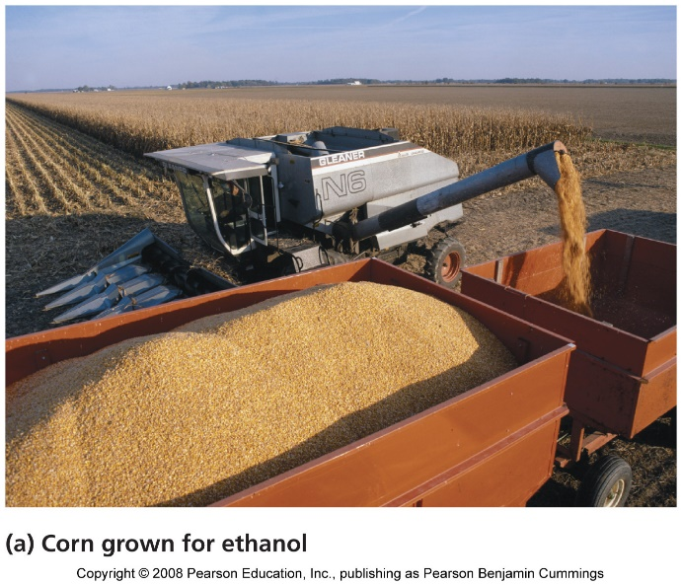
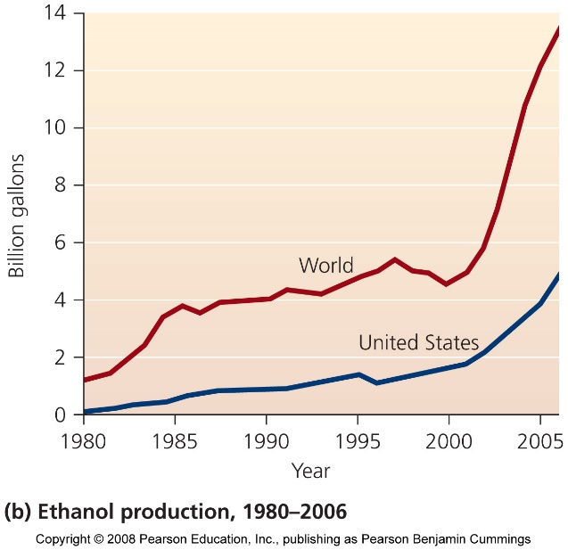
Biofuels can power automobiles
Ethanol = produces as a biofuel by fermenting carbohydrate-rich crops
  Ethanol is widely added to U.S. gasoline to reduce emissions
  Any vehicle will run well on a 10% ethanol mix

Slide 7
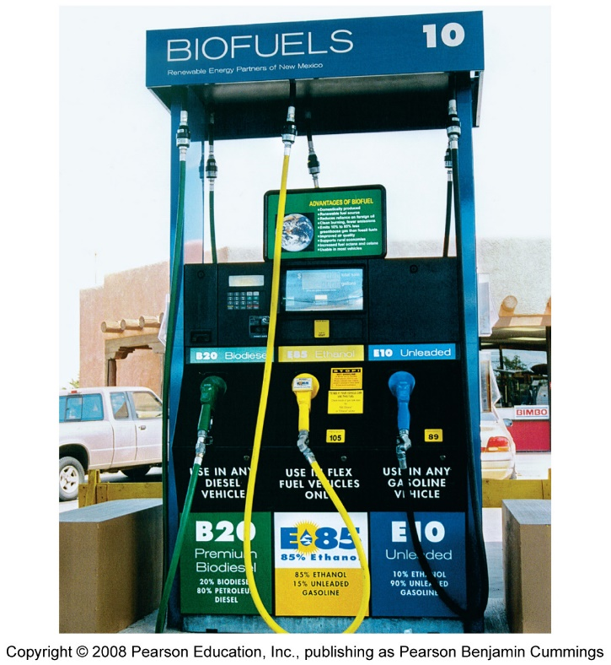
Cars can run on ethanol
Flexible fuel vehicles = run on 85% ethanol
  But, very few gas stations offer this fuel
Researchers are refining techniques to produce ethanol from cellulose, so ethanol could be made from low-value crops, instead of high-value crops

Slide 8
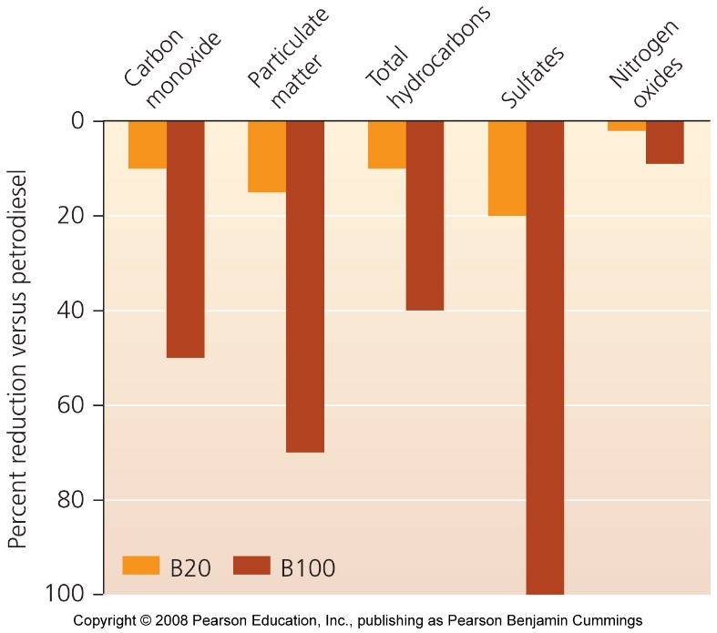
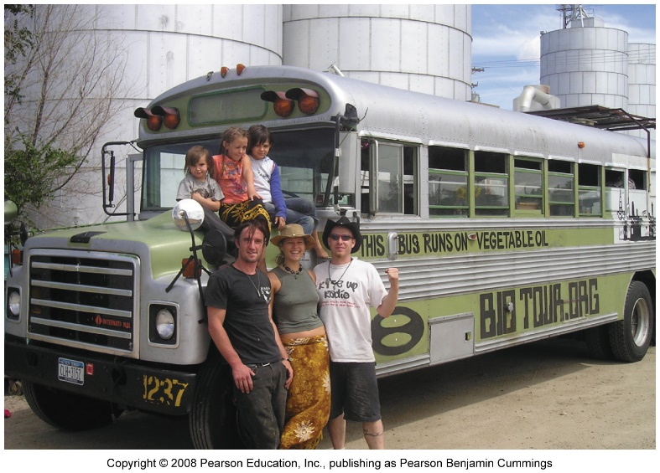
Biodiesel is produced from vegetable oil
U.S. biodiesel producers use soybean oil
  Animal fats, used grease, and cooking oil can also be used
  Vehicles can run on 100% biodiesel, but the engine needs to be modified
  Biodiesel cuts down on emissions; its fuel economy is almost as good and costs slightly more than gasoline

Slide 9
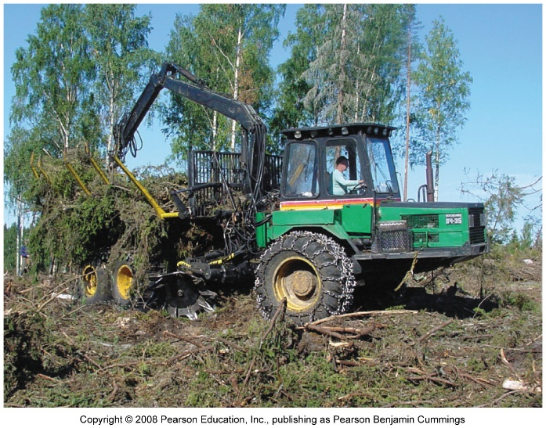
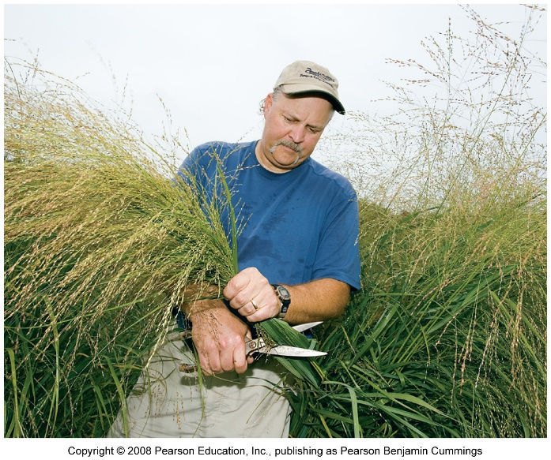
Biopower generates electricity
Many sources of biomass can be used
  Waste products of existing industries or processes
  Woody debris from logging operations and sawmills
  Crops can be specifically grown, such as fast-growing willow trees or bamboo
  Co-firing combines biomass with coal
  Bacterial breakdown of waste to produce methane

Slide 10
Biomass energy brings benefits
It is essentially carbon-neutral, releasing no net carbon into the atmosphere
  Only if biomass sources are not overharvested
  Capturing landfill gases reduces methane emissions
Economic benefits include
  Supporting rural communities
  Reducing dependence of fossil fuel imports
  Improved energy efficiency
  Reduces air pollutants such as sulfur dioxide

Slide 11
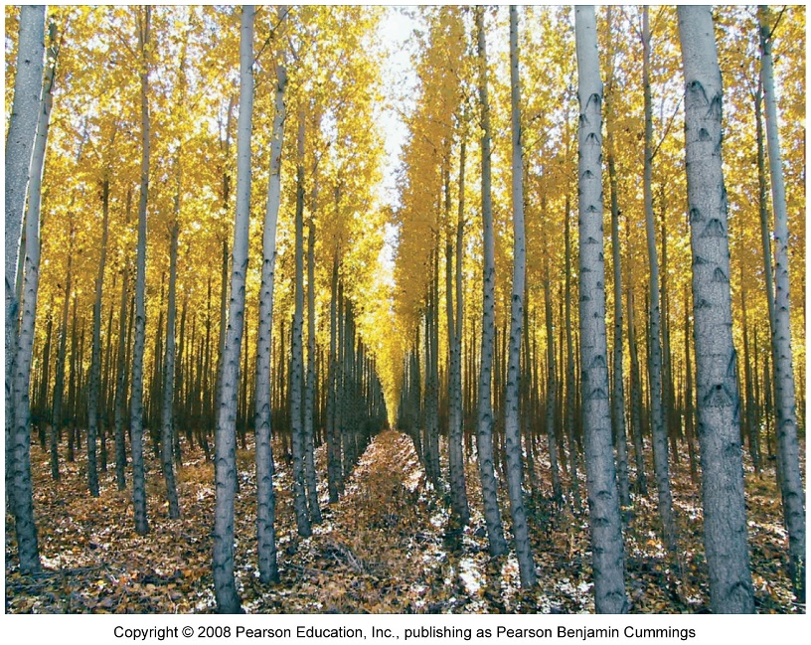
Drawbacks of biomass energy
Health hazards from indoor air pollution
Rapid harvesting can lead to deforestation
Growing crops exerts tremendous impacts on ecosystems
  Fertilizers and pesticides
  Land is converted to agriculture
Biofuel is competing with food production
Substantial inputs of energy are required

Slide 12
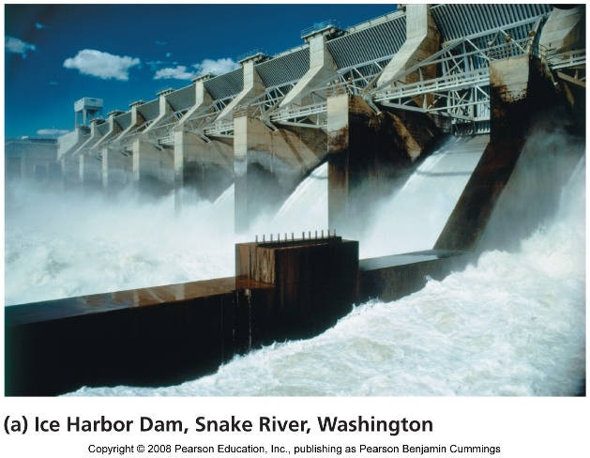
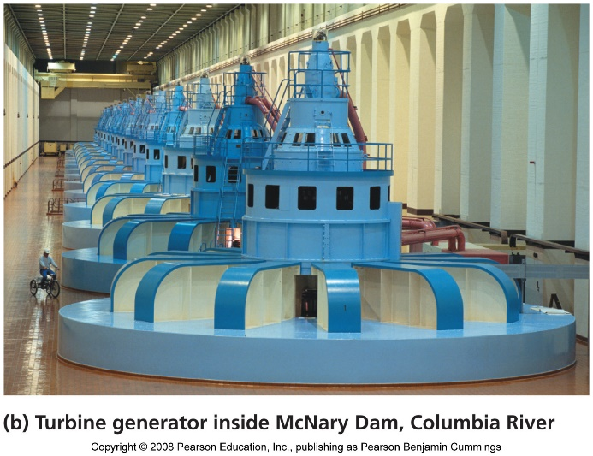
Hydroelectric power
Hydroelectric power = uses the kinetic energy of moving water to turn turbines and generate electricity
Storage technique = impoundments harness energy by storing water in reservoirs behind dams
  Water passing through the dam turns turbines
Run-of-river approaches generates energy without greatly disrupting the flow of river water

Slide 13
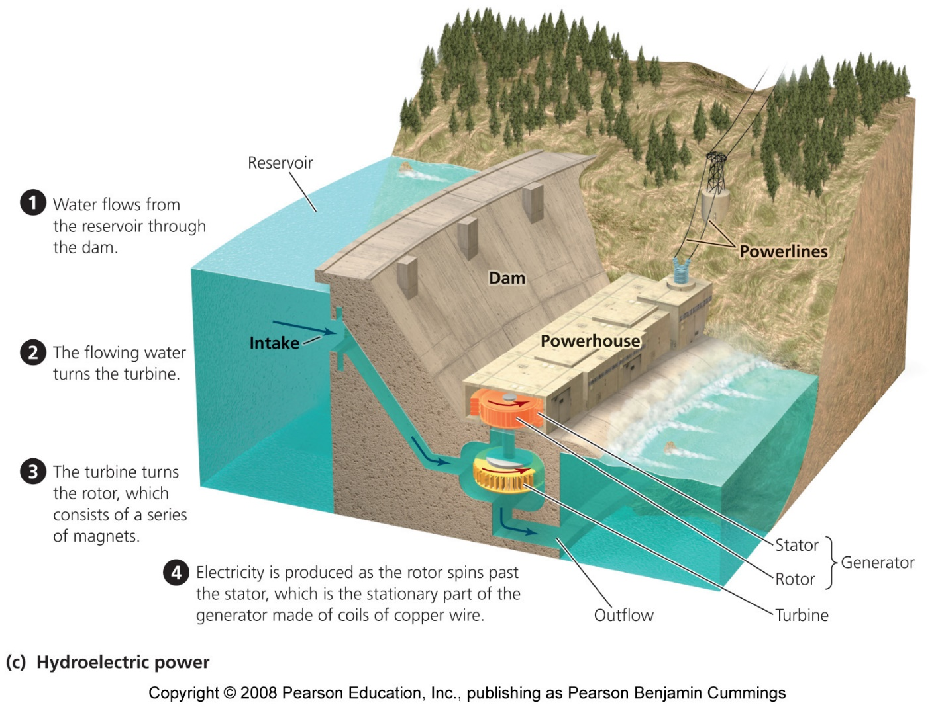
A typical dam

Slide 14
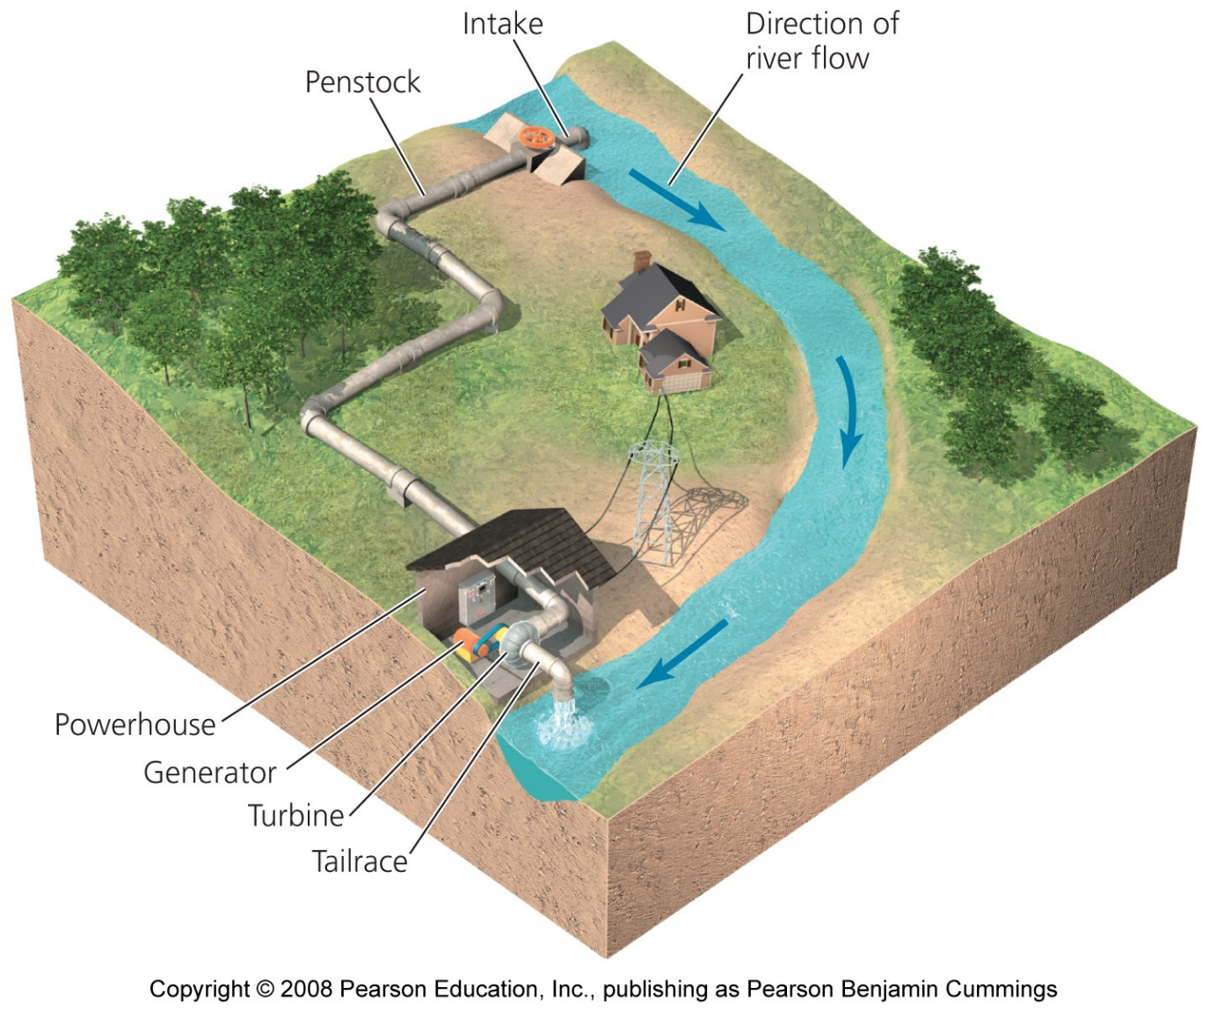
A run-of-river system

Slide 15
Hydroelectric power is widely used
Hydropower accounts for 2.2% of the world’s energy supply
  And 16% of the world’s electricity production
Nations with large rivers and economic resources have used dams
  However, many countries have dammed their large rivers
  People want some rivers left undammed

Slide 16
Hydropower is clean and renewable
Hydropower has two clear advantages over fossil fuels for producing electricity:
  It is renewable: as long as precipitation fills rivers we can use water to turn turbines
  It is clean: no carbon dioxide is emitted
Hydropower is efficient
  It has an EROI of 10:1, as high as any modern-day energy source

Slide 17
Hydropower has negative impacts
Damming rivers destroys habitats
  Upstream areas are submerged
  Downstream areas are starved of water
Natural flooding cycles are disrupted
Thermal pollution of downstream water
Periodic flushes of cold reservoir water can kill fish
Dams block passage of fish, fragmenting the river and reducing biodiversity

Slide 18
Hydropower may not expand much more
China’s Three Gorges Dam is the world’s largest dam
Most of the world’s large rivers have already been dammed
People have grown aware of the ecological impact of dams
Developing nations will probably increase hydropower if they have rivers

Slide 19
Conclusion
With limited fossil fuel supplies, nations are trying to diversify their energy portfolios
Nuclear power showed promise, but high costs and public fears stalled its growth
Biomass energy sources include traditional wood and newer biofuels
Hydropower is a renewable, pollution-free alternative, but it can involve substantial ecological impacts

Slide 20

QUESTION: Review
Which of the following is not a benefit of conventional alternative fuels?
  They exert less environmental impact than fossil fuels
  They are best viewed as intermediate sources of fuel
  They are best viewed as final sources of fuel
  Each energy source has benefits for the environment
Notes:
Answer: c

Slide 21
QUESTION: Review
The reaction that drives the release of energy in nuclear power plants is….
  Nuclear fission
  Nuclear fusion
  Control rods
  Nuclear emergencies
Notes:
Answer: a

Slide 22
QUESTION: Review
Why are nuclear power plants not supported in the U.S.?
  Fears about accidents
  Nuclear waste issues
  High costs of building and maintaining plants
  All are issues regarding nuclear energy
Notes:
Answer: d

Slide 23
QUESTION: Review
Yucca Mountain, Nevada, is the site selected for permanent radioactive waste disposal. Which of the following is not a reason for selecting this site?
  It is remote
  Its wet climate should minimize water contamination
  The water table is deep underground
  It has minimal risk of earthquakes
Notes:
Answer: b

Slide 24
QUESTION: Review
Ethanol in the U.S. is made mainly from ______, and is used to ______
  Soybeans, heat homes
  Sugar cane, drive cars
  Corn, drive cars
  Willow trees, make electricity
Notes:
Answer: c

Slide 25
QUESTION: Review
Which of the following is not a benefit of hydropower?
  It produces carbon dioxide
  It is a clean source of energy
  It is renewable
  All of these are benefits of hydropower
Notes:
Answer: a

Slide 26
QUESTION: Weighing the Issues
Given the choice of living next to a coal-burning power plant or nuclear plant, which would you choose?
  The nuclear plant, because it’s cleaner
  The coal plant, because it won’t emit radioactive materials
  Neither one; I’d move to another place
  Either one; I don’t care
Notes:
Answer: any

Slide 27
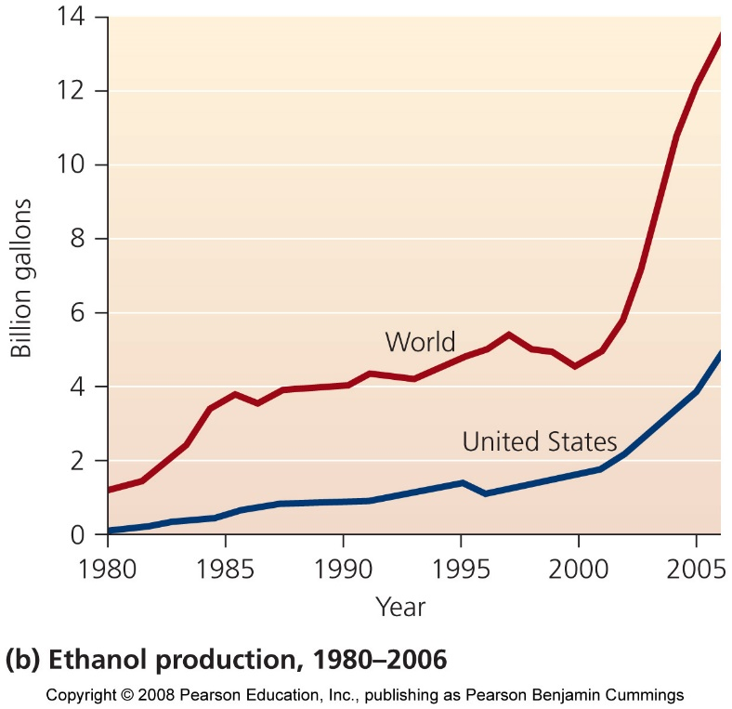
QUESTION: Interpreting Graphs and Data
If ethanol in the U.S. is produced from corn, a drawback suggested from this graph could be:
a) More corn is available
b) More competition between food and fuel
c) Less land planted in corn
d) None of these
Notes:
Answer: b

