Slide 1
ECOLOGY 2

Slide 2
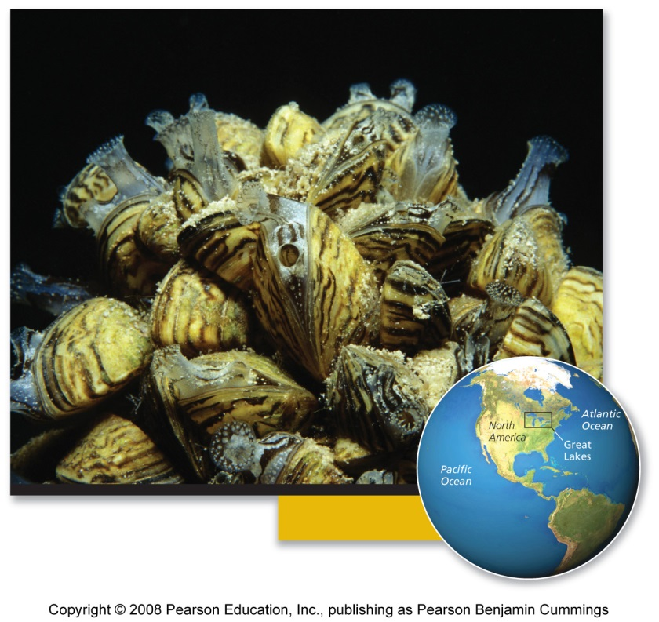
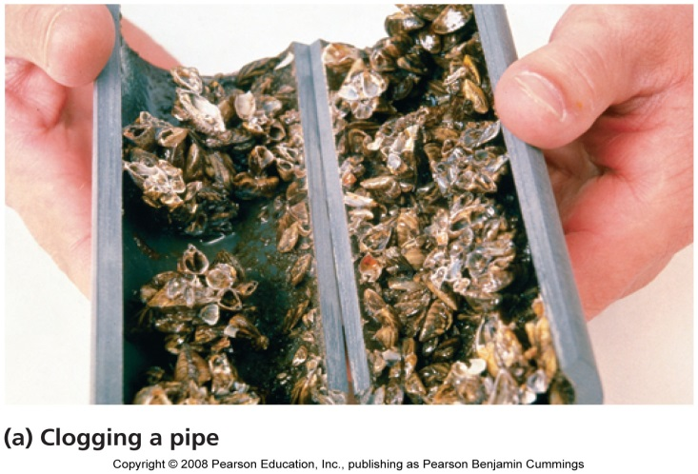
Case Study: Black and white and spread all over
Small, black and white shellfish
Introduced to Lake St. Clair, Canada, in 1988, in discharged ballast water
Within 2 years, the zebra mussels invaded all 5 Great Lakes
Populations grew exponentially
  No natural predators, competitors, or parasites
Hundreds of millions of dollars of damage to property

Slide 3
Species interactions
Species interactions are the backbone of communities
Most important categories
  Competition = both species are harmed
  Predation, parasitism, and herbivory = one species benefits and the other is harmed
  Mutualism = both species benefit

Slide 4
Competition
Competition = relationship where multiple organisms seek the same limited resources they need to survive:
  Food - Water
  Space - Shelter
  Mates - Sunlight
Intraspecific competition = between members of the same species
  High population density = increased competition
Interspecific competition = between members of 2 or more species
  Leads to competitive exclusion or species coexistence

Slide 5
Results of interspecific competition
Competitive exclusion = one species completely excludes another species from using the resource
Species coexistence = neither species fully excludes the other from resources, so both live side by side
  This produces a stable point of equilibrium, with stable population sizes
  Species adjust to minimize competition by using only a part of the available resource

Slide 6
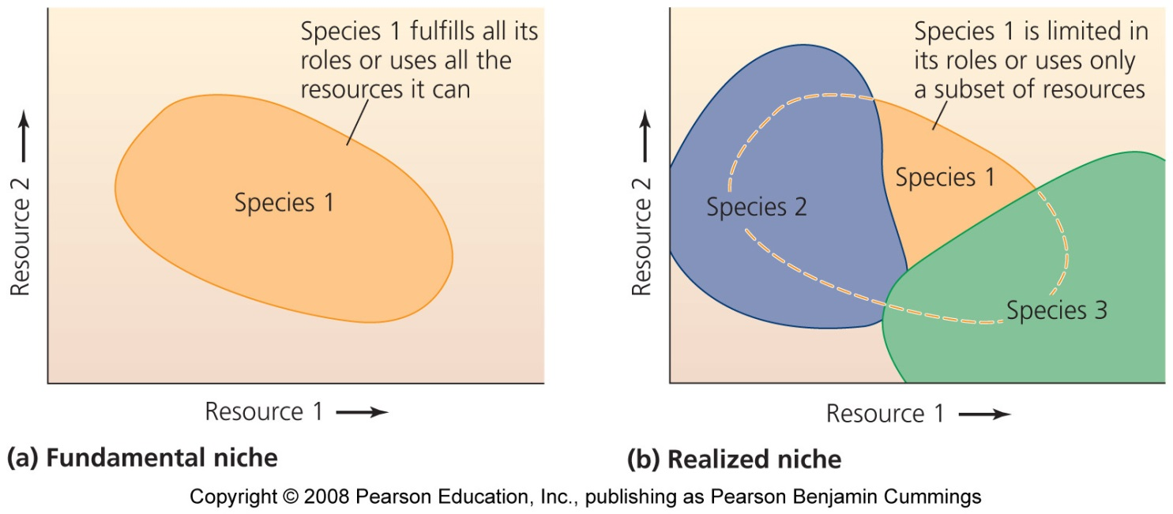
Niche: an individual’s ecological role
Fundamental niche = when an individual fulfills its entire role by using all the available resources
Realized niche = the portion of the fundamental niche that is actually filled
  Due to competition or other species’ interactions

Slide 7
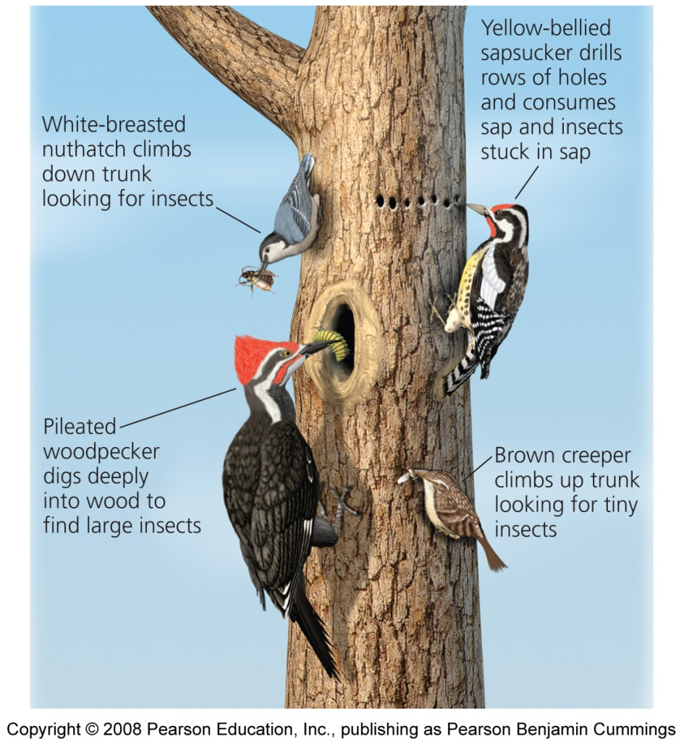
Resource partitioning
Resource partitioning = when species divide shared resources by specializing in different ways
  Ex: one species is active at night, another in the daytime
  Ex: one species eats small seeds, another eats large seeds

Slide 8
Effects of resource partitioning
Character displacement = competing species evolve physical characteristics that reflect their reliance on the portion of the resource they use
  Ex: birds that eat larger seeds evolve larger bills
  Ex: birds that eat smaller seeds evolve smaller bills
Competition is reduced when two species become more different

Slide 9
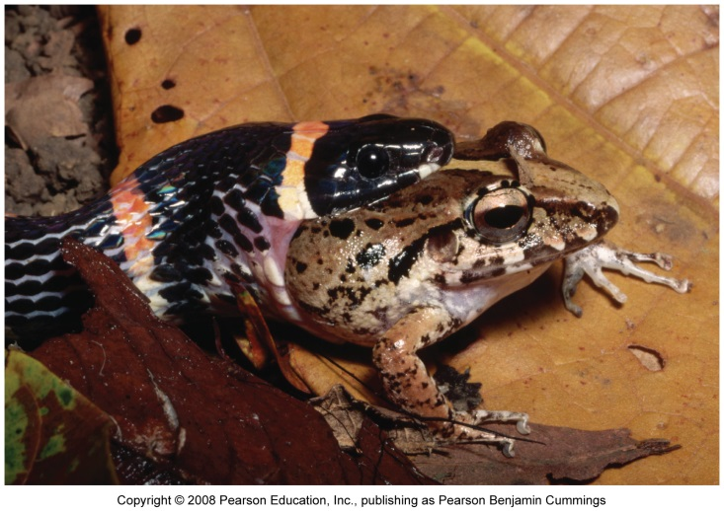
Predation
Exploitation = one member exploits another for its own gain
  Predation, parasitism, herbivory
Predation = process by which individuals of one species (predators) capture, kill, and consume individuals of another species (prey)
  Structures food webs
  Influences community composition through number of predators and prey

Slide 10
Effects of zebra mussels
Zebra mussels eat phytoplankton and zooplankton
  Both populations decrease in lakes with zebra mussels
They don’t eat cyanobacteria
  Population increases in lakes with zebra mussels
Zebra mussels are becoming prey for some North American predators:
  Diving ducks, muskrats, crayfish, flounder, sturgeon, eels, carp, and freshwater drum

Slide 11
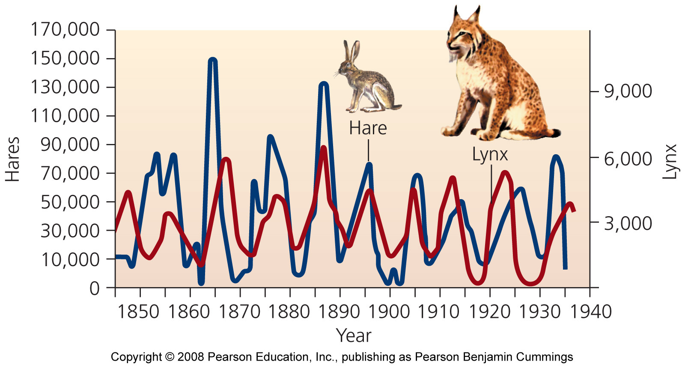
Effects of predation on populations
Increased prey populations increases predators
  Predators survive and reproduce
Increased predator populations decrease prey
Decreased prey population causes starvation of predators
Decreased predator populations increases prey populations

Slide 12
Natural selection
Natural selection leads to evolution of adaptations that make predators better hunters
Individuals who are better at catching prey:
  Live longer, healthier lives
  Take better care of offspring
Predation pressure: prey are at risk of immediate death
  Prey develops elaborate defenses against being eaten

Slide 13
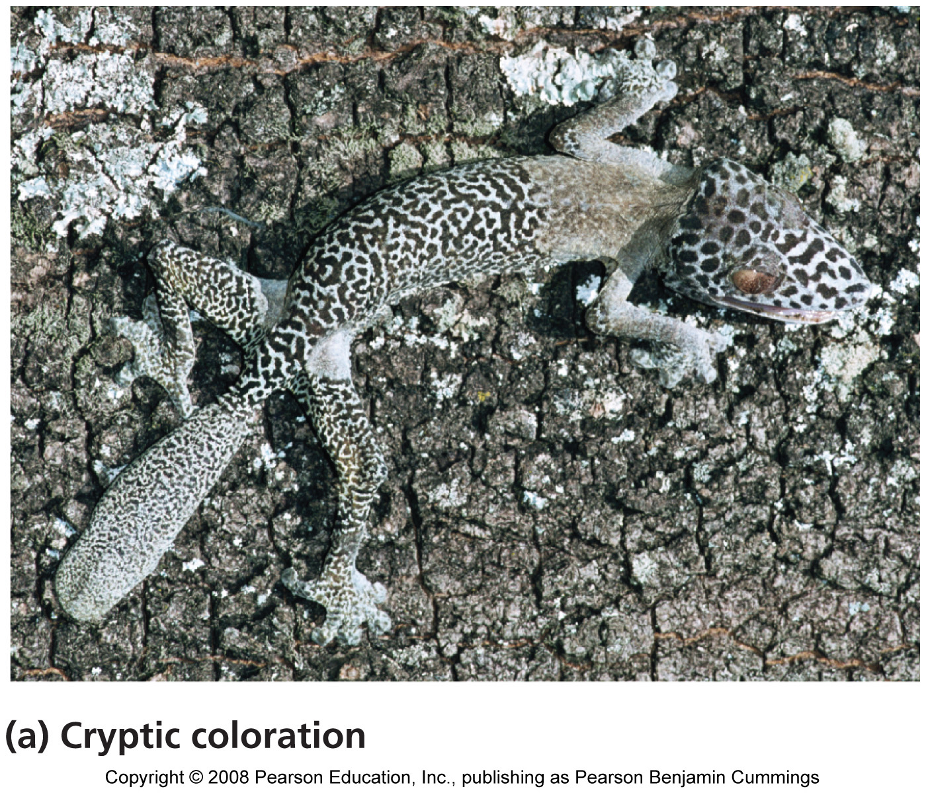
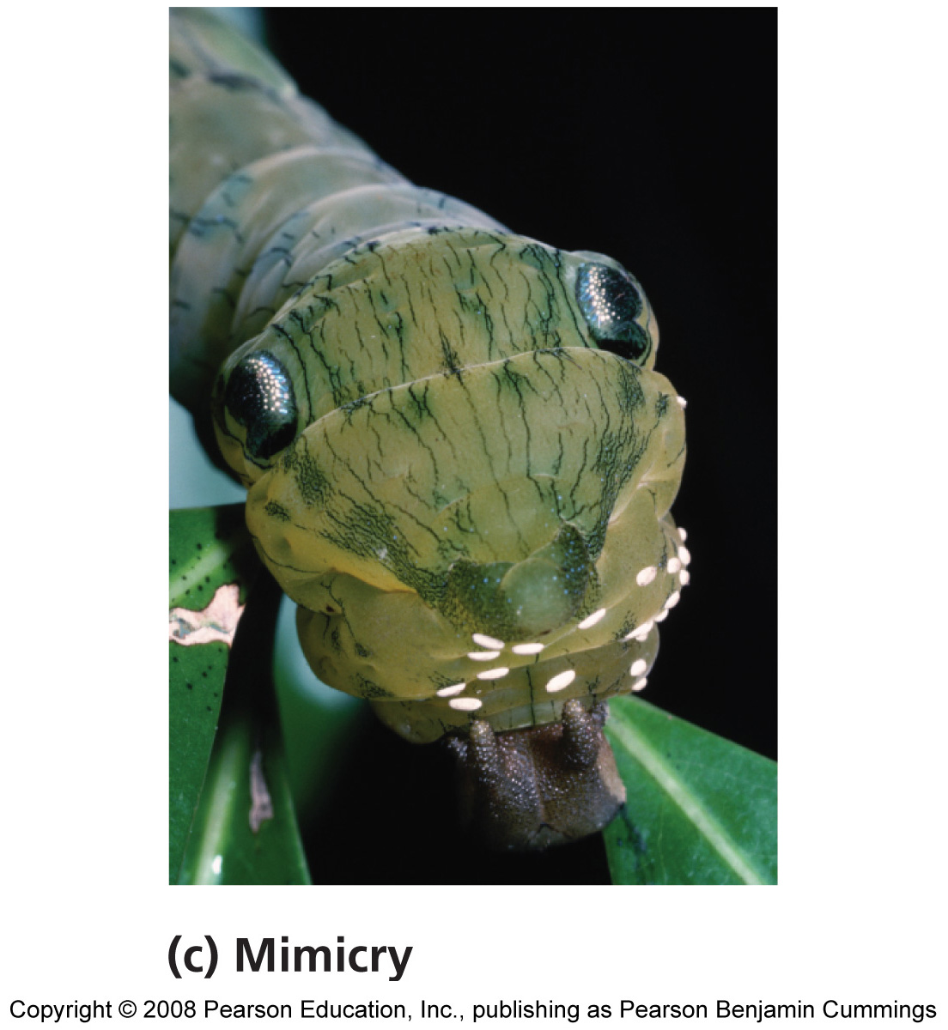
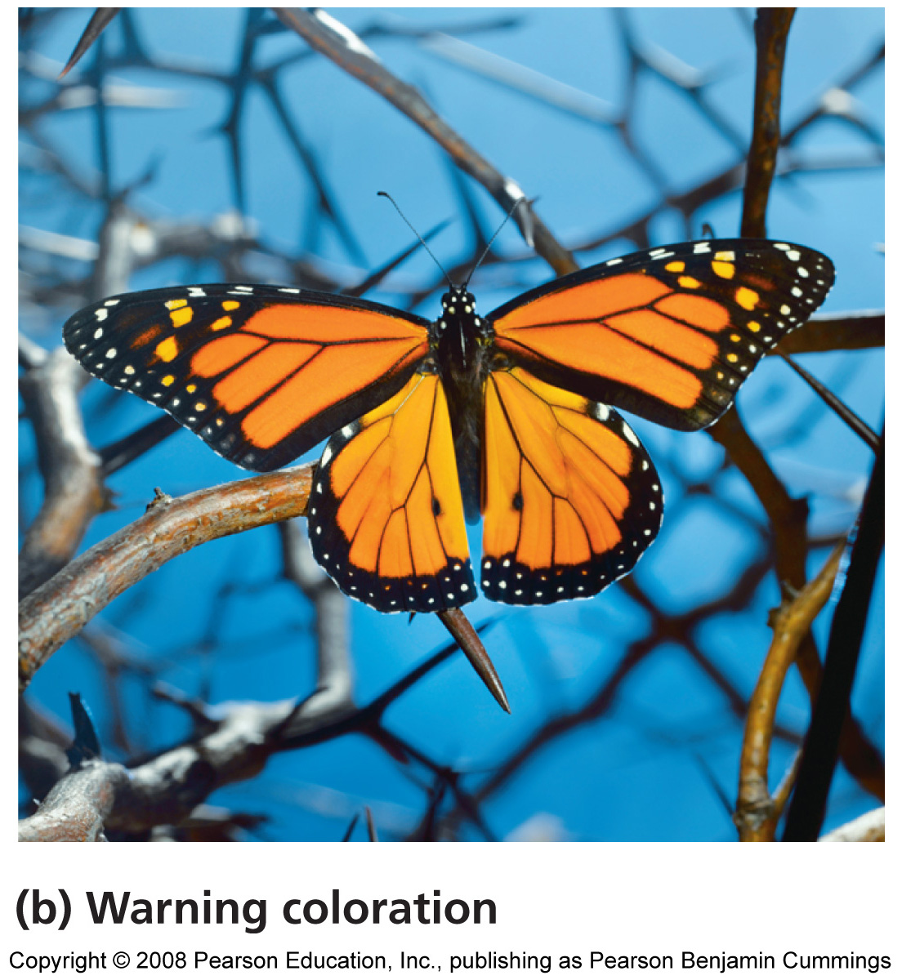
Organisms evolve defenses against being eaten

Slide 14
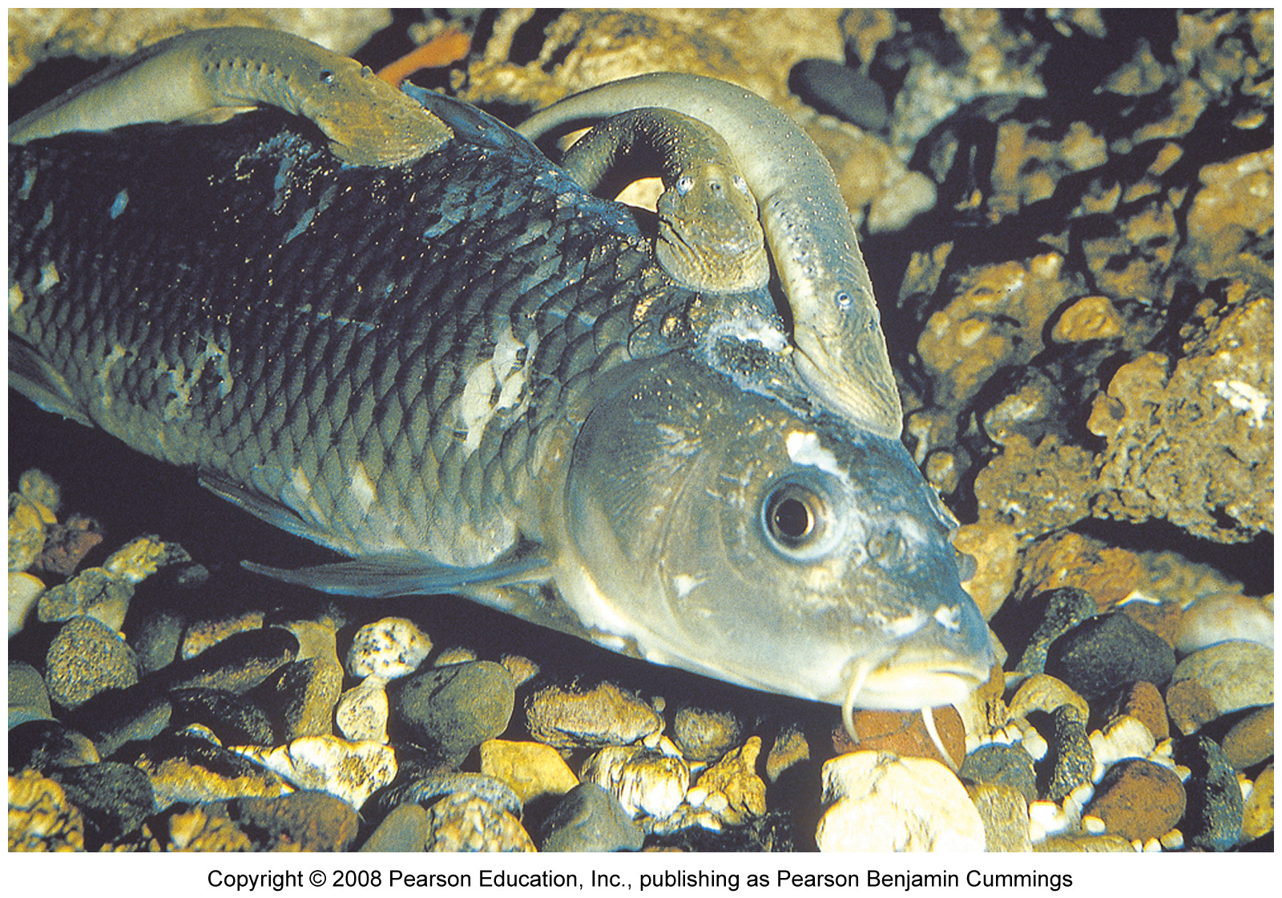
Parasites
Parasitism = a relationship in which one organism (parasite) depends on another (host) for nourishment or other benefit
Some species live within the host
  Disease, tapeworms
Others are free-living, and have infrequent contact with their hosts
  Ticks, sea lampreys
Notes:
14

Slide 15
Coevolution
Coevolution = hosts and parasites become locked in a duel of escalating adaptations
  Has been called an “evolutionary arms race”
  Each evolves new responses to the other
  It may not be beneficial to the parasite to kill its host
Notes:
15

Slide 16
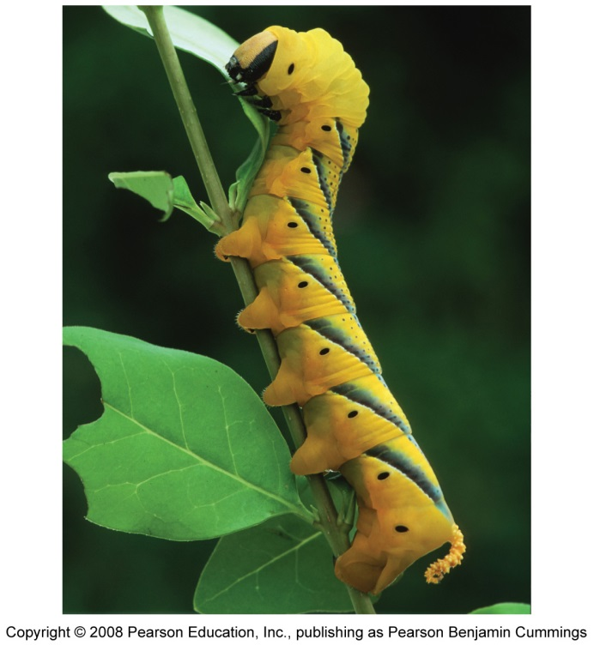
Herbivory
Exploitation in which animals feed on the tissues of plants
  Widely seen in insects
  May not kill the plant, but affects its growth and survival
Defenses against herbivory include
  Chemicals: toxic or distasteful parts
  Physical: thorns, spines, or irritating hairs
  Other animals: protect the plant
Notes:
16

Slide 17
Mutualism
Two or more species benefit from their interactions
Symbiosis = mutualism in which the organisms live in close physical contact
  Microbes within digestive tracts
  Plants and fungi
Pollination = bees, bats, birds and others transfer pollen from one flower to another, fertilizing its eggs
Notes:
17

Slide 18
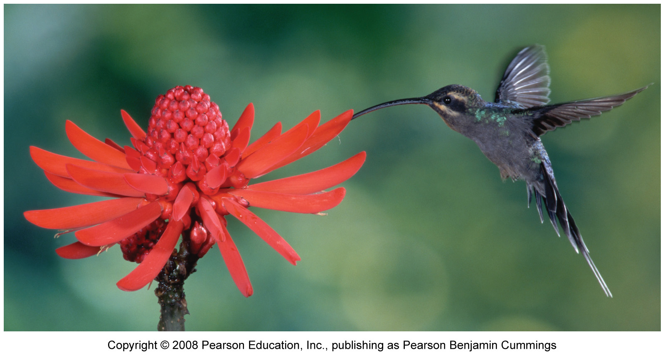
Pollination
In exchange for the plant nectar, the animals pollinate plants, which allows them to reproduce
Notes:
18

Slide 19
Relationships with no effect on one member
Amensalism = a relationship in which one organism is harmed while the other is unaffected
  Difficult to confirm, because usually one organism benefits from harming another
  Allelopathy = certain plants release harmful chemicals
  Or, is this competition?
Commensalism = a relationship in which one organism benefits, while the other remains unaffected
  Facilitation = plants that create shade and leaf litter allow seedlings to grow
Notes:
19

Slide 20
Ecological communities
Community = an assemblage of species living in the same place at the same time
  Members interact with each other
  Interactions determine the structure, function, and species composition of the community
Community ecologists = people interested in how:
  Species coexist and relate to one another
  Communities change, and why patterns exist
Notes:
20

Slide 21
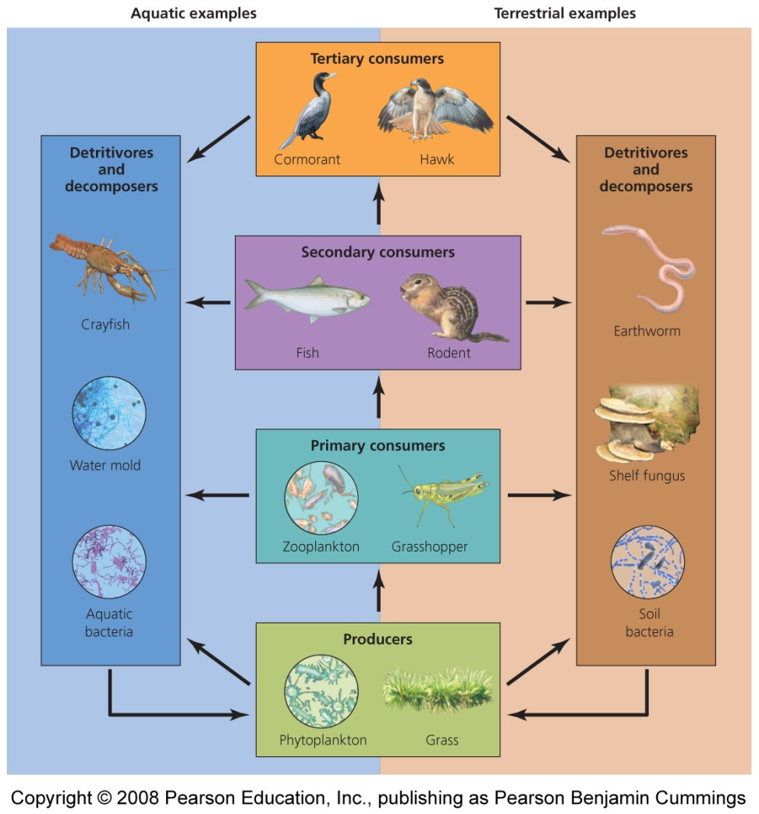
Energy passes through trophic levels
One of the most important species interactions is who eats whom
Matter and energy move through the community
Trophic levels = rank in the feeding hierarchy
  Producers
  Consumers
  Detritivores and Decomposers
Notes:
21

Slide 22
Producers: the first trophic level
Autotrophs (“self-feeders”) = organisms that capture solar energy for photosynthesis to produce sugars
  Green Plants
  Cyanobacteria
  Algae
Chemosynthetic bacteria use the geothermal energy in hot springs or deep-sea vents to produce their food
Notes:
22

Slide 23
Consumers: organisms that consume producers
Primary consumers = second trophic level
  Organisms that consume producers
  Herbivores consume plants
  Deer, grasshoppers
Secondary consumers = third trophic level
  Organisms that prey on primary consumers
  Carnivores consume meat
  Wolves, rodents
Notes:
23

Slide 24
Consumers occur at even higher trophic levels
Tertiary Consumers = fourth trophic level
  Predators at the highest trophic level
  Consume secondary consumers
  Are also carnivores
  Hawks, owls
Omnivores = consumers that eat both plants and animals

Slide 25
Detritivores and decomposers
Organisms that consume nonliving organic matter
  Enrich soils and/or recycle nutrients found in dead organisms
Detritivores = scavenge waste products or dead bodies
  Millipedes
Decomposers = break down leaf litter and other non-living material
  Fungi, bacteria
  Enhance topsoil and recycle nutrients
Notes:
25

Slide 26
Energy, biomass, and numbers decrease
Most energy organisms use is lost as waste heat through respiration
  Less and less energy is available in each successive trophic level
  Each level contains only 10% of the energy of the trophic level below it
There are far fewer organisms at the highest trophic levels, with less energy available
A human vegetarian’s ecological footprint is smaller than a meat-eater’s footprint
Notes:
26

Slide 27
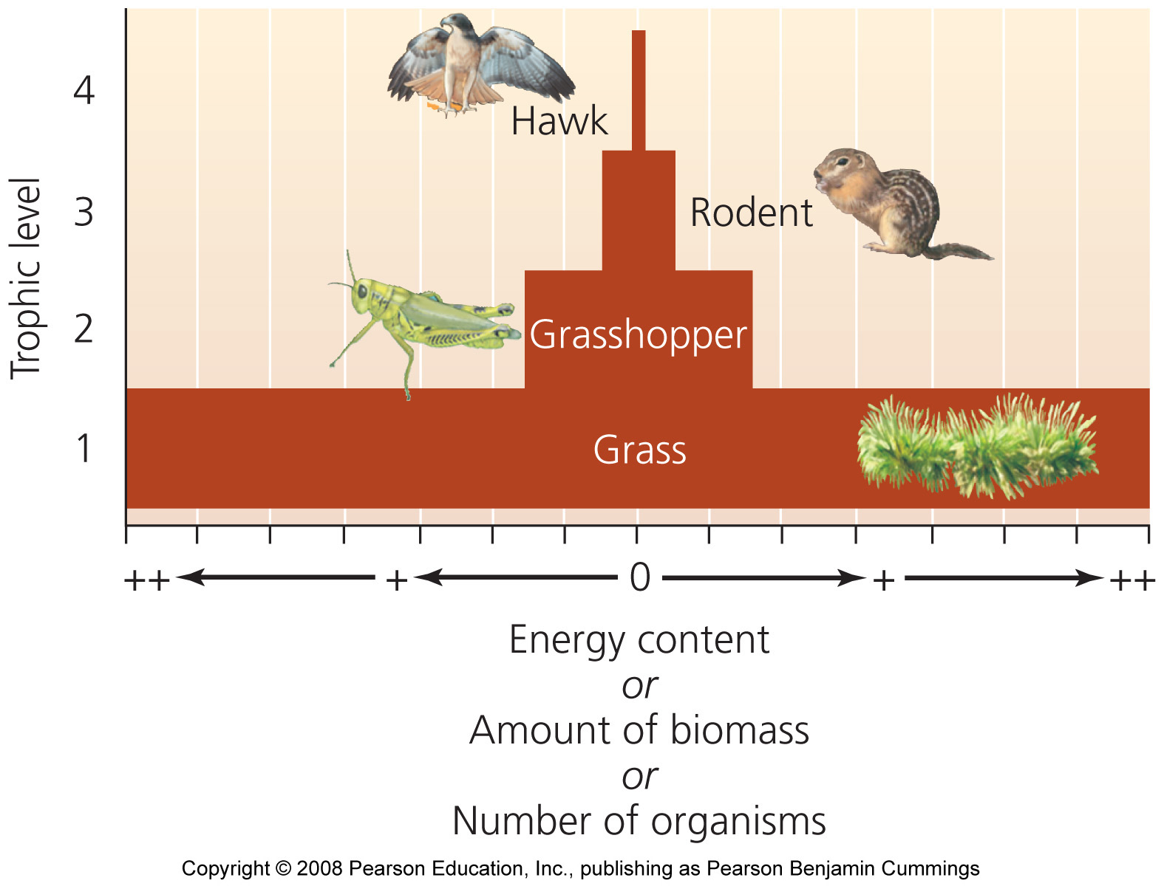
Pyramids of energy, biomass, and numbers

Slide 28
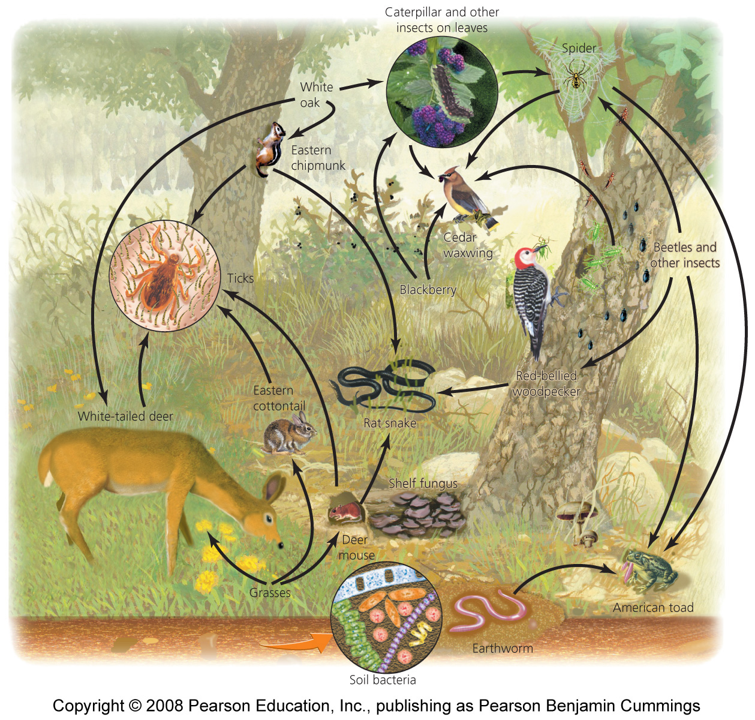
Food webs show relationships and energy flow
Food chain = the relationship of how energy is transferred up the trophic levels
Food web = a visual map of feeding relationships and energy flow
  Includes many different organisms at all the various levels
  Greatly simplified; leaves out the majority of species
Notes:
28

Slide 29
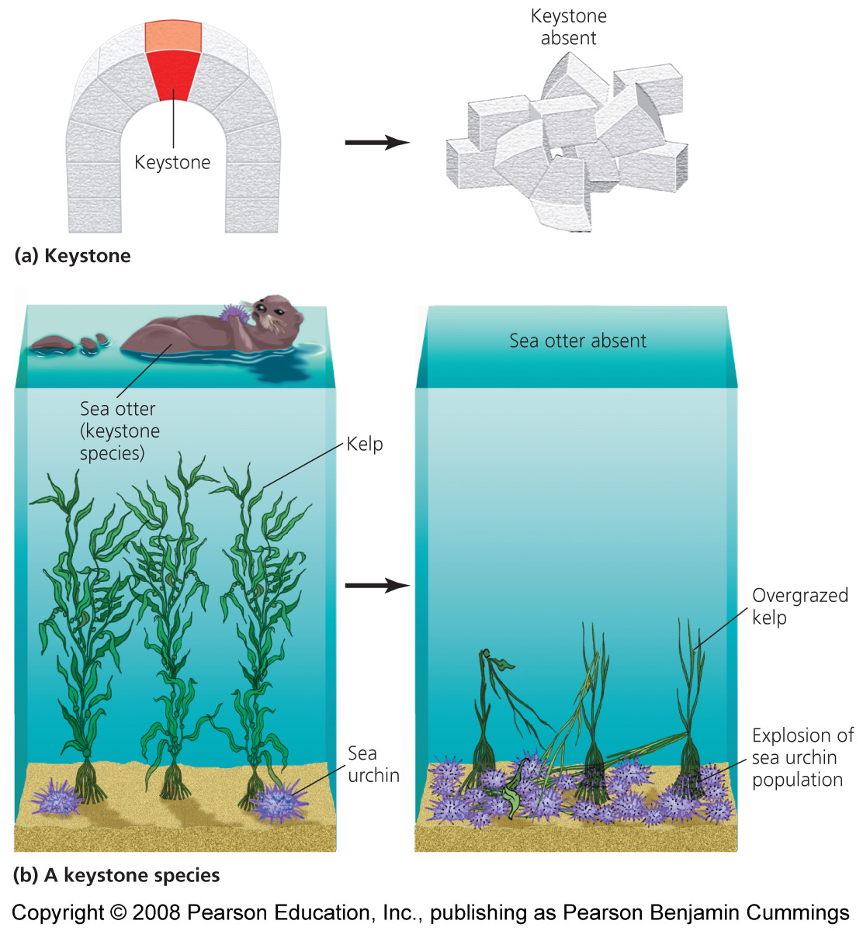
Some organisms play big roles
Keystone Species = has a strong or wide-reaching impact far out of proportion to its abundance
Removal of a keystone species has substantial ripple effects
  Alters the food chain

Slide 30
Species can change communities
Trophic Cascade = predators at high trophic levels can indirectly affect populations of organisms at low trophic levels by keeping species at intermediate trophic levels in check
  Extermination of wolves led to increased deer populations, which led to overgrazed vegetation and changed forest structure
Ecosystem engineers = physically modify the environment
  Beaver dams, prairie dogs, fungi

Slide 31
Communities respond to disturbances
Communities experience many types of disturbance
  Removal of keystone species, spread of invasive species, natural disturbances
  Human impacts cause major changes
Resistance = community of organisms resists change and remains stable despite the disturbance
Resilience = a community changes in response to a disturbance, but later returns to its original state

Slide 32
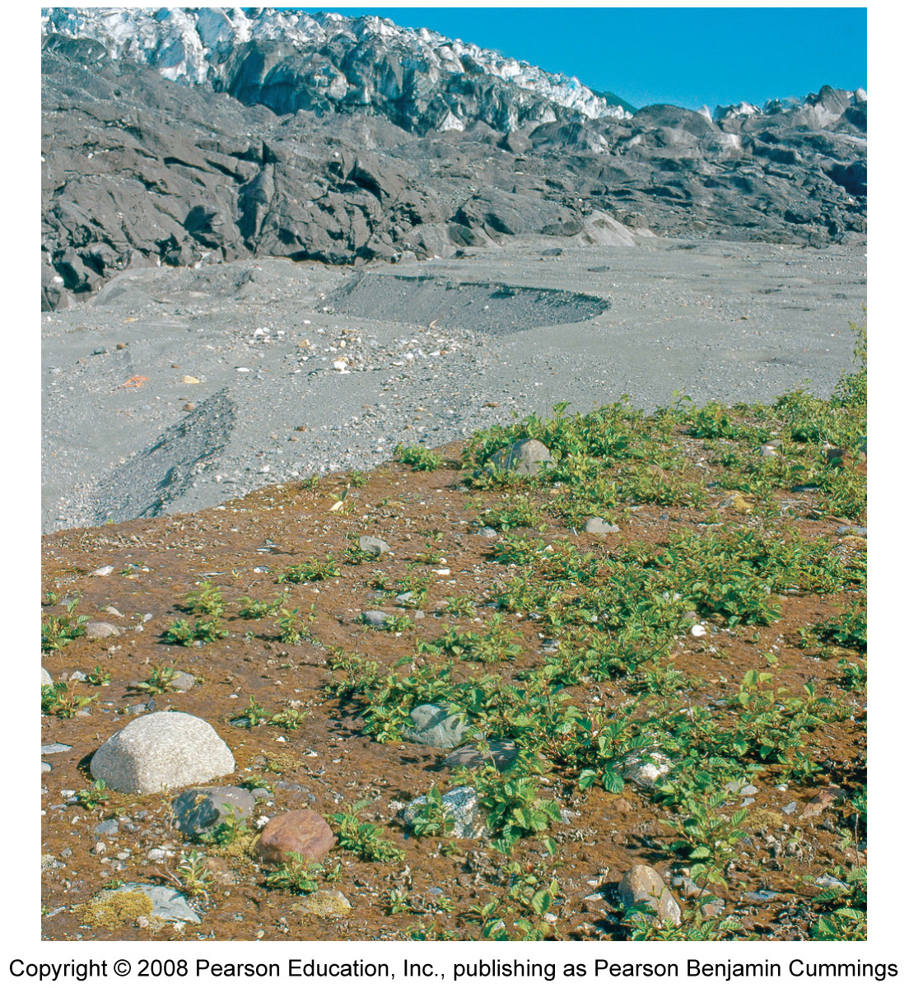
Primary succession
Succession = the predictable series of changes in a community following a disturbance
Primary succession = disturbance eliminates all vegetation and/or soil life
  Glaciers, drying lakes, volcanic lava
Pioneer species = the first species to arrive in a primary succession area (ex, lichens)

Slide 33
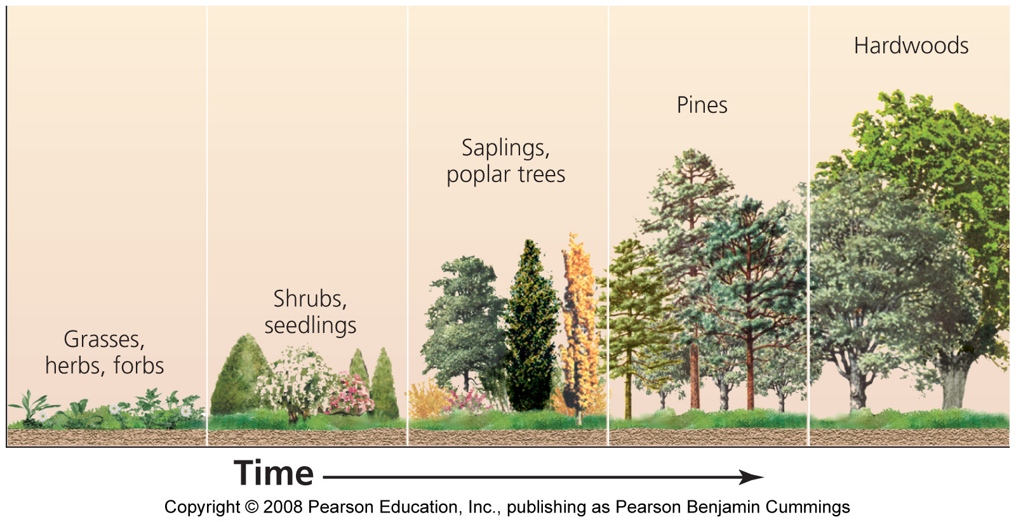
Secondary succession
Secondary succession = a disturbance dramatically alters, but does not destroy, all local organisms
  The remaining organisms form “building blocks” for the next population species
  Fires, hurricanes, farming, logging
Climax community = the community resulting from successful succession
  Remains stable
  until another
  disturbance restarts
  succession

Slide 34
Community cohesion
Frederick Clements = viewed communities as cohesive entities
  Its members remain associated over space and time
  The community shared similar limiting factors and evolutionary histories
Henry Gleason = maintained that each species responds independently to its own limiting factors
  Species can join or leave communities without greatly altering the community’s composition
  The most widely accepted view of ecologists today

Slide 35
Invasive species
Invasive species = non-native (exotic) organisms that spread widely and become dominant in a community
  Growth-limiting factors (predators, disease, etc.) are removed or absent
  They have major ecological effects
  Chestnut blight, from Asia, wiped out American chestnut trees
Some species help people (i.e., European honeybee)

Slide 36
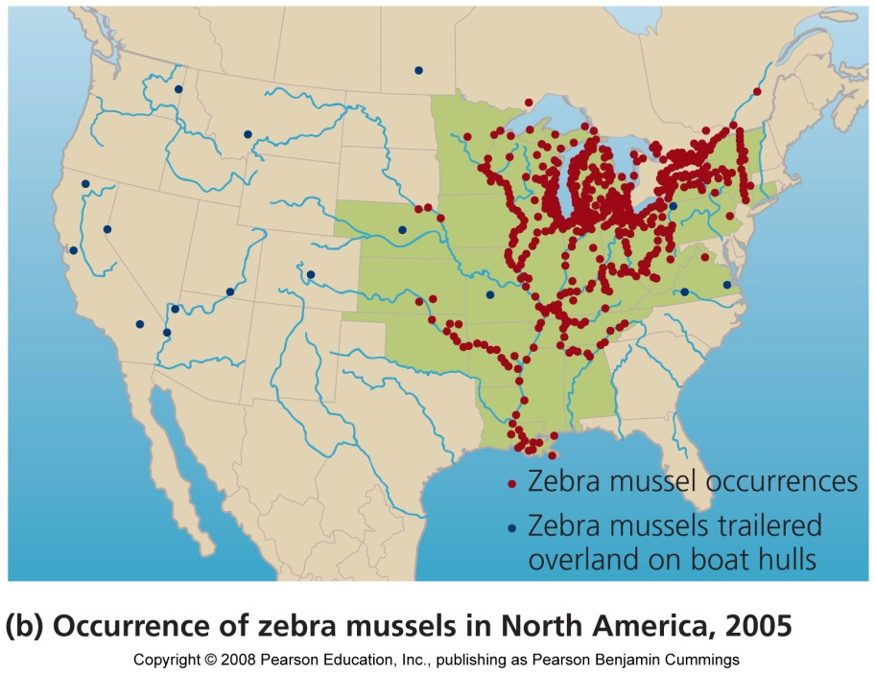
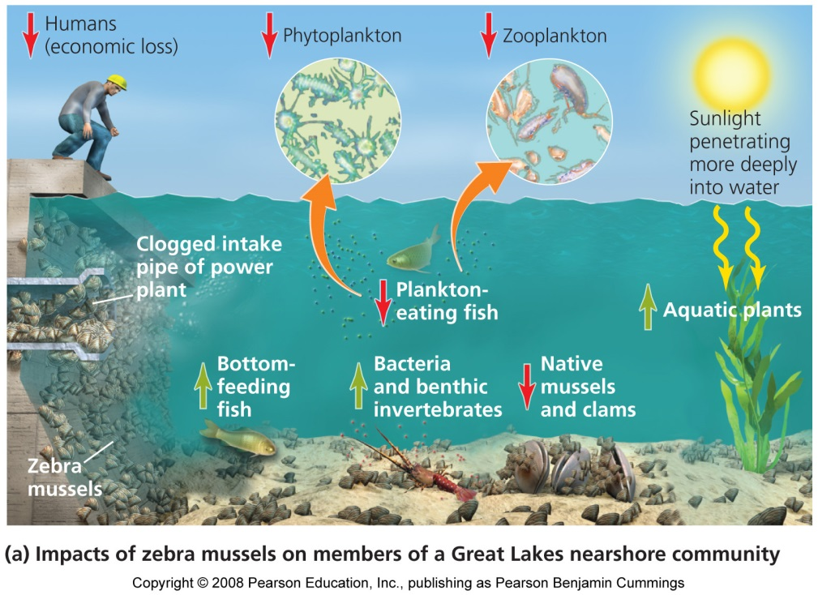
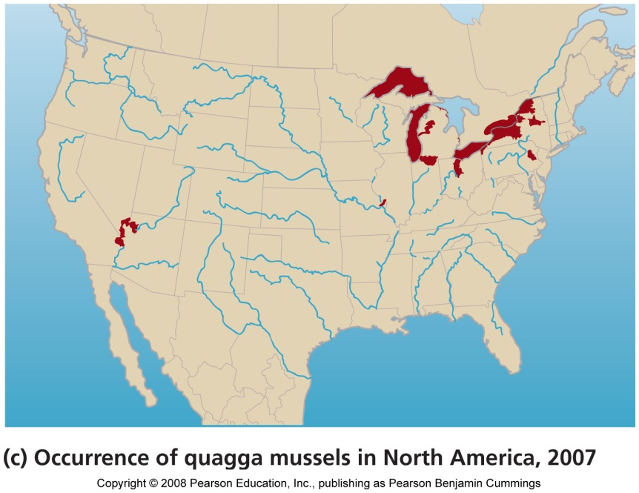
Two invasive mussels

Slide 37
Controlling invasive species
Techniques to control invasive species
  Remove manually
  Toxic chemicals
  Drying them out
  Depriving of oxygen
  Stressing them
    Heat, sound, electricity, carbon dioxide, ultraviolet light
Prevention, rather than control, is the best policy

Slide 38
Changed communities need to be restored
Ecological restoration = returning an area to unchanged conditions
  Informed by restoration ecology = the science of restoring an area to the condition that existed before humans changed it
  It is difficult, time-consuming, expensive
  Best to protect natural systems from degradation in the first place

Slide 39
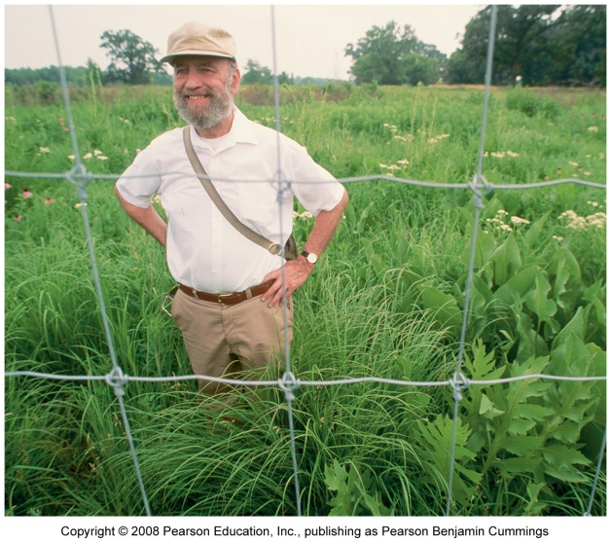
Restoration efforts
Prairie Restoration
  Native species replanted and invasive species controlled
The world’s largest project: Florida Everglades
  Depletion caused by flood control practices and irrigation
  Populations of wading birds dropped 90-95%
  It will take 30 years, and billions of dollars
The U.S. is trying to restore Iraq marshes

Slide 40
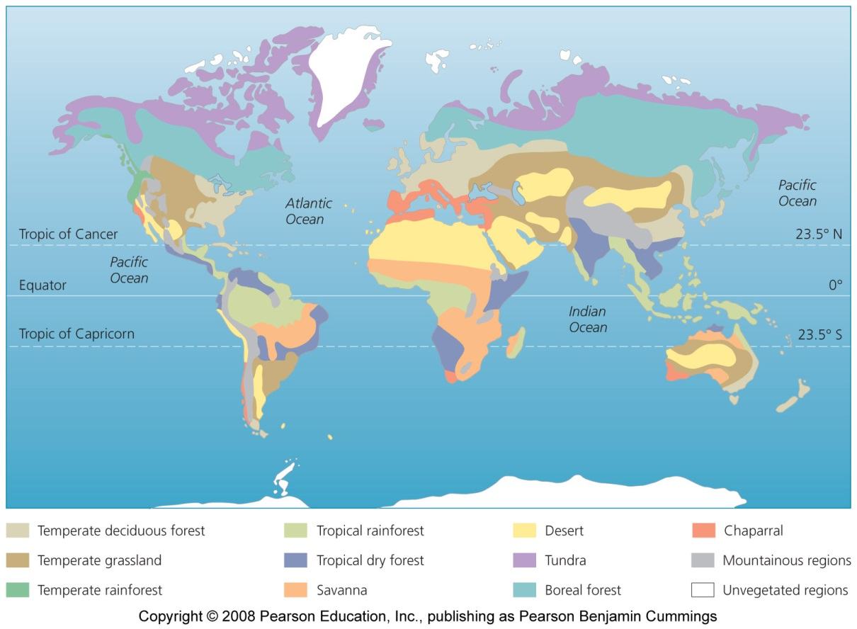
Widely separated regions share similarities
Biome = major regional complex of similar communities recognized by
  Plant type
  Vegetation
  structure

Slide 41
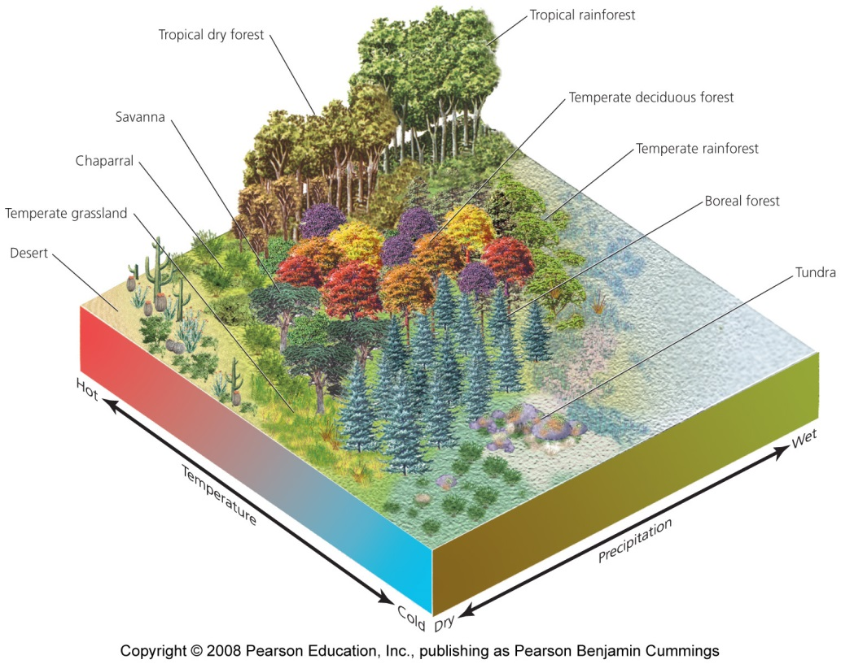
A variety of factors determine the biome
The biome in an area depends on a variety of abiotic factors
  Temperature, precipitation, atmospheric circulation, soil
Climatographs
  A climate diagram showing an area’s mean monthly temperature and precipitation
  Similar biomes occupy similar latitudes

Slide 42
Aquatic systems have biome-like patterns
Various aquatic systems comprise distinct communities
  Coastlines, continental shelves
  Open ocean, deep sea
  Coral reefs, kelp forests
Aquatic systems are shaped by
  Water temperature, salinity, and dissolved nutrients
  Wave action, currents, depth
  Substrate type, and animal and plant life

Slide 43
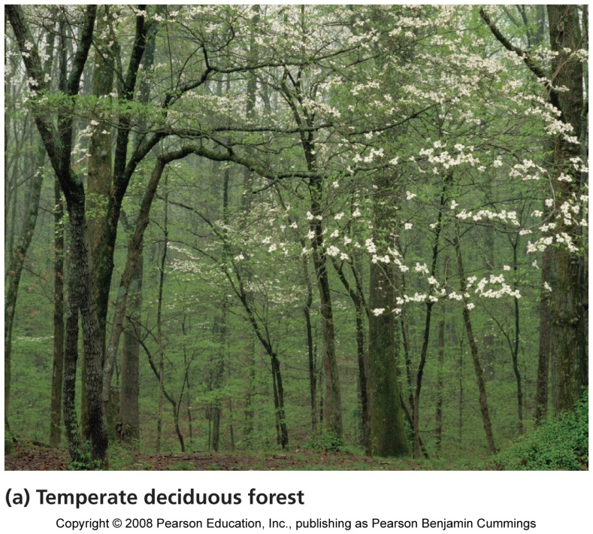
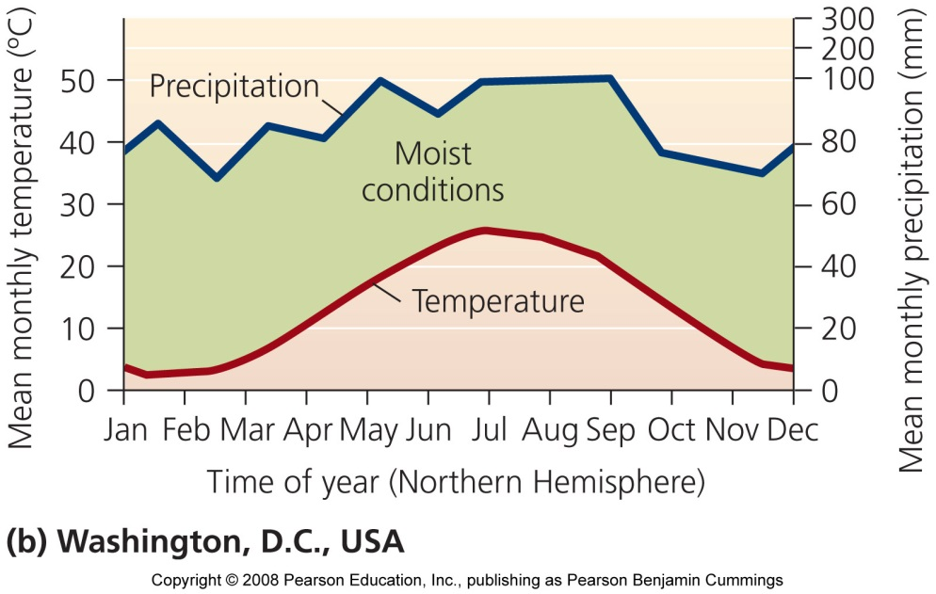
Temperate deciduous forest
Deciduous trees lose their leaves each fall and remain dormant during winter
Mid-latitude forests in Europe, East China, Eastern North America
Fertile soils
Forests = oak, beech, maple

Slide 44
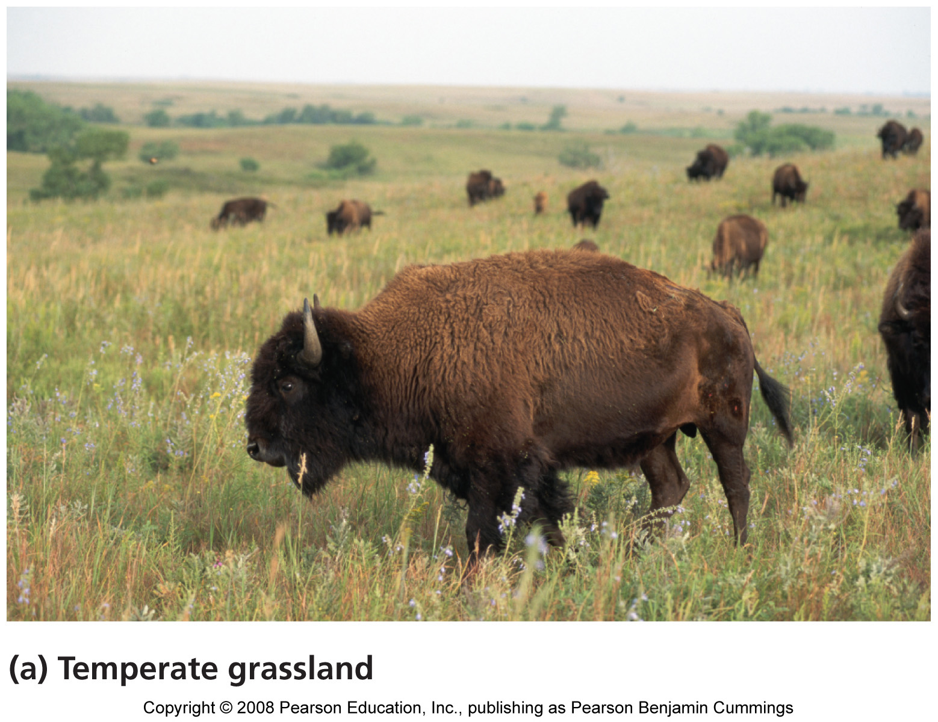
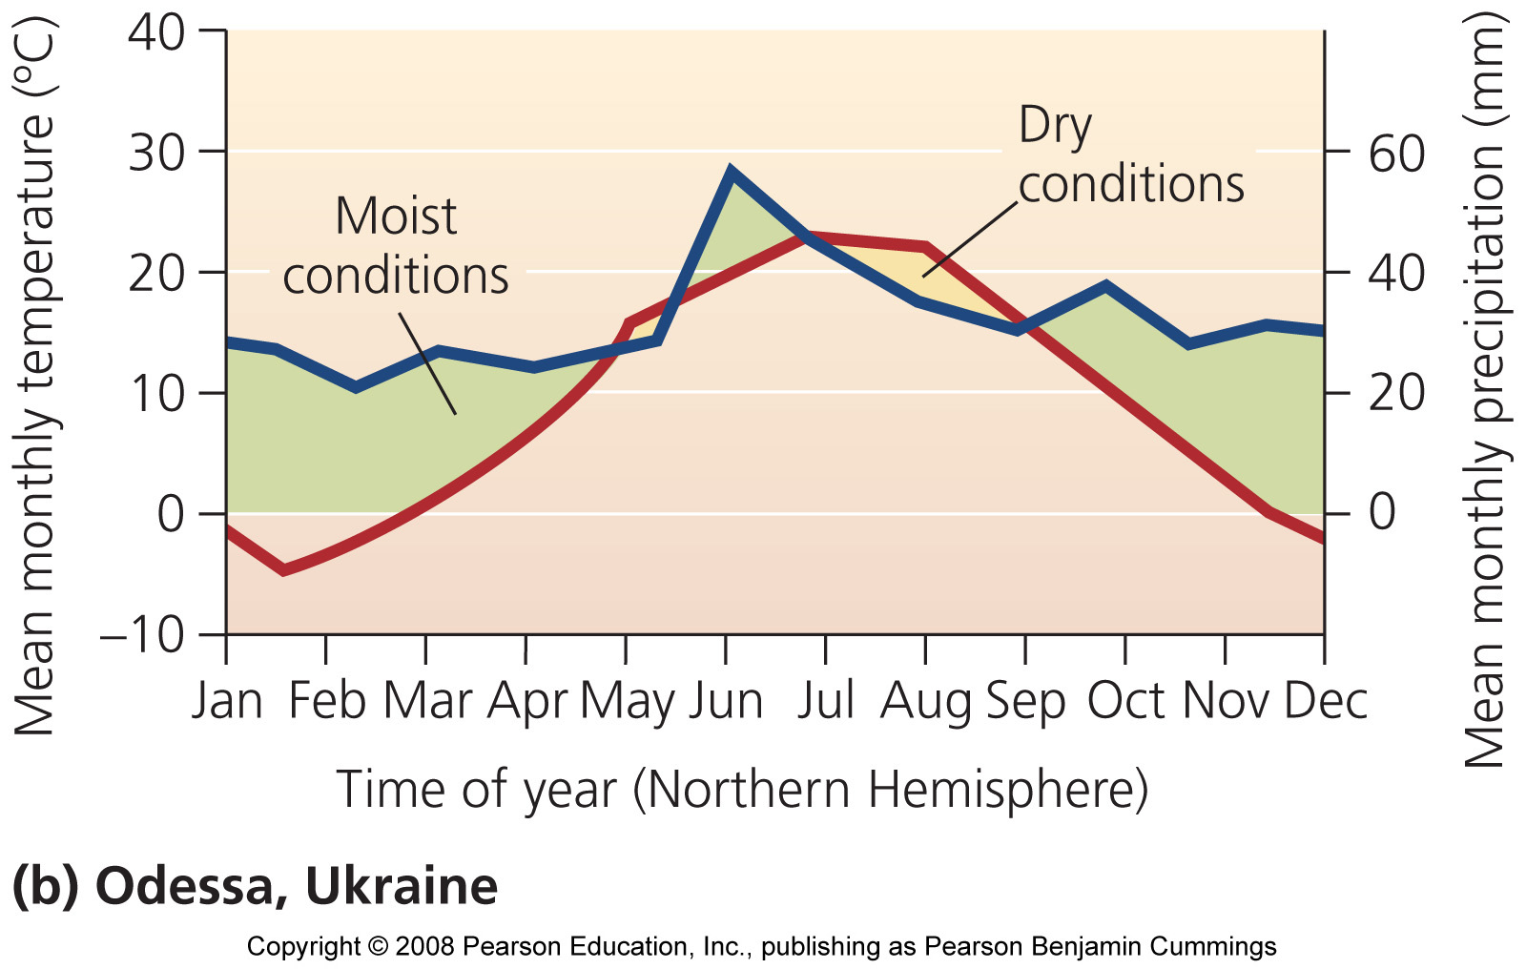
Temperate grasslands
More extreme temperature difference between winter and summer
Less precipitation
Also called steppe or prairie
  Once widespread throughout parts of North and South America and much of central Asia
  Much was converted for agriculture
  Bison, prairie dogs, antelope, and ground-nesting birds

Slide 45
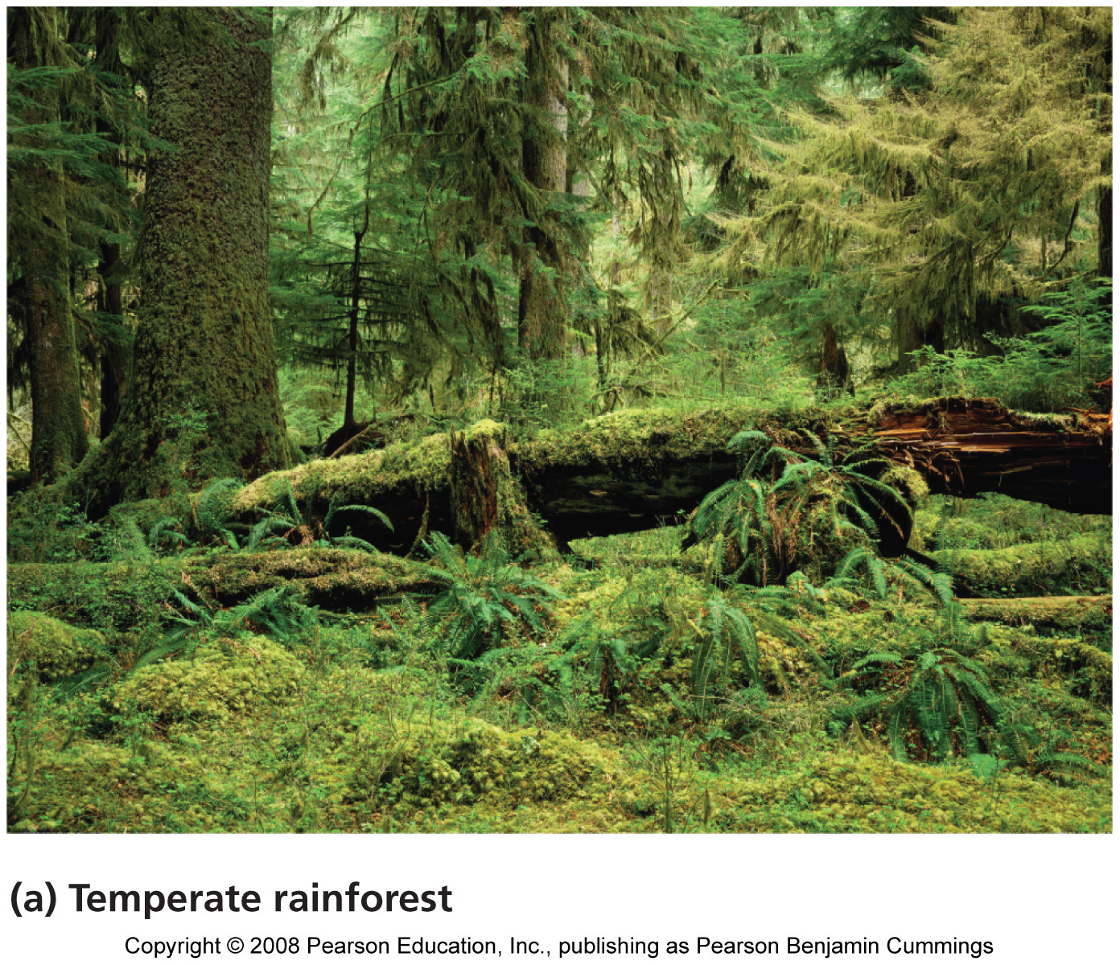
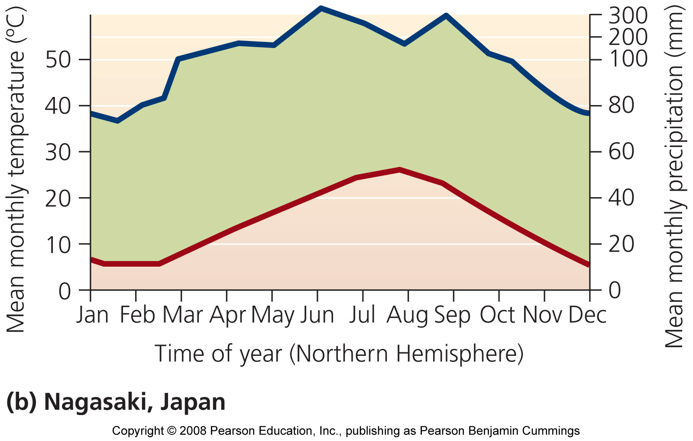
Temperate rainforest
Coastal Pacific Northwest region
Great deal of precipitation
Coniferous trees: cedar, spruce, hemlock, fir
Moisture-loving animals
  Banana slug
The fertile soil is susceptible to erosion and landslides
Provides lumber and paper

Slide 46
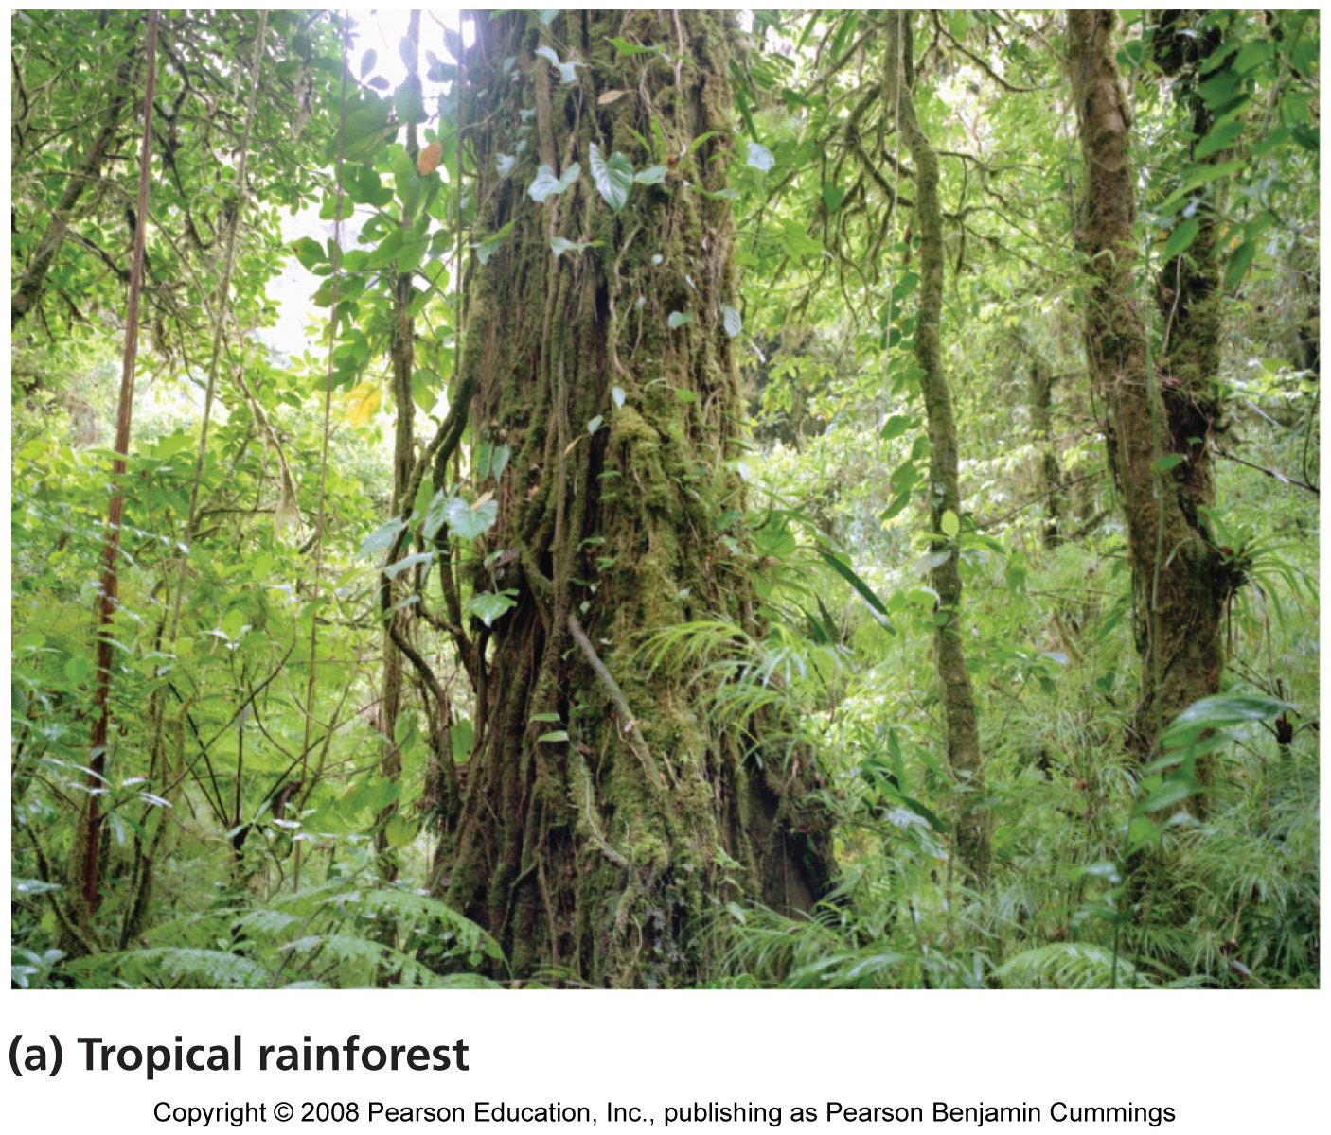
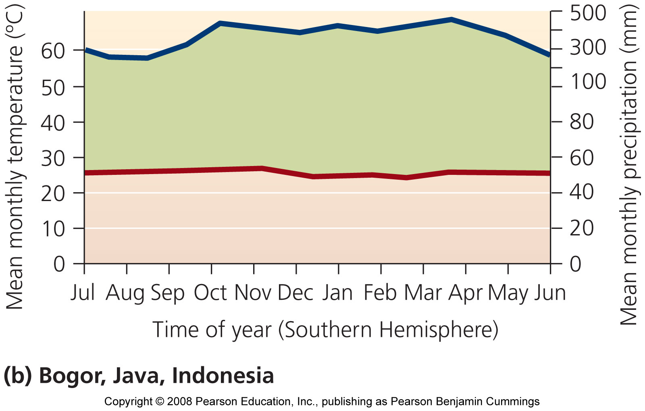
Tropical rainforest
Central America, South America, southeast Asia, and west Africa
Year-round rain and warm temperatures
Dark and damp
Lush vegetation
Variety of animals and tree species, but in low numbers
Very poor, acidic soils

Slide 47
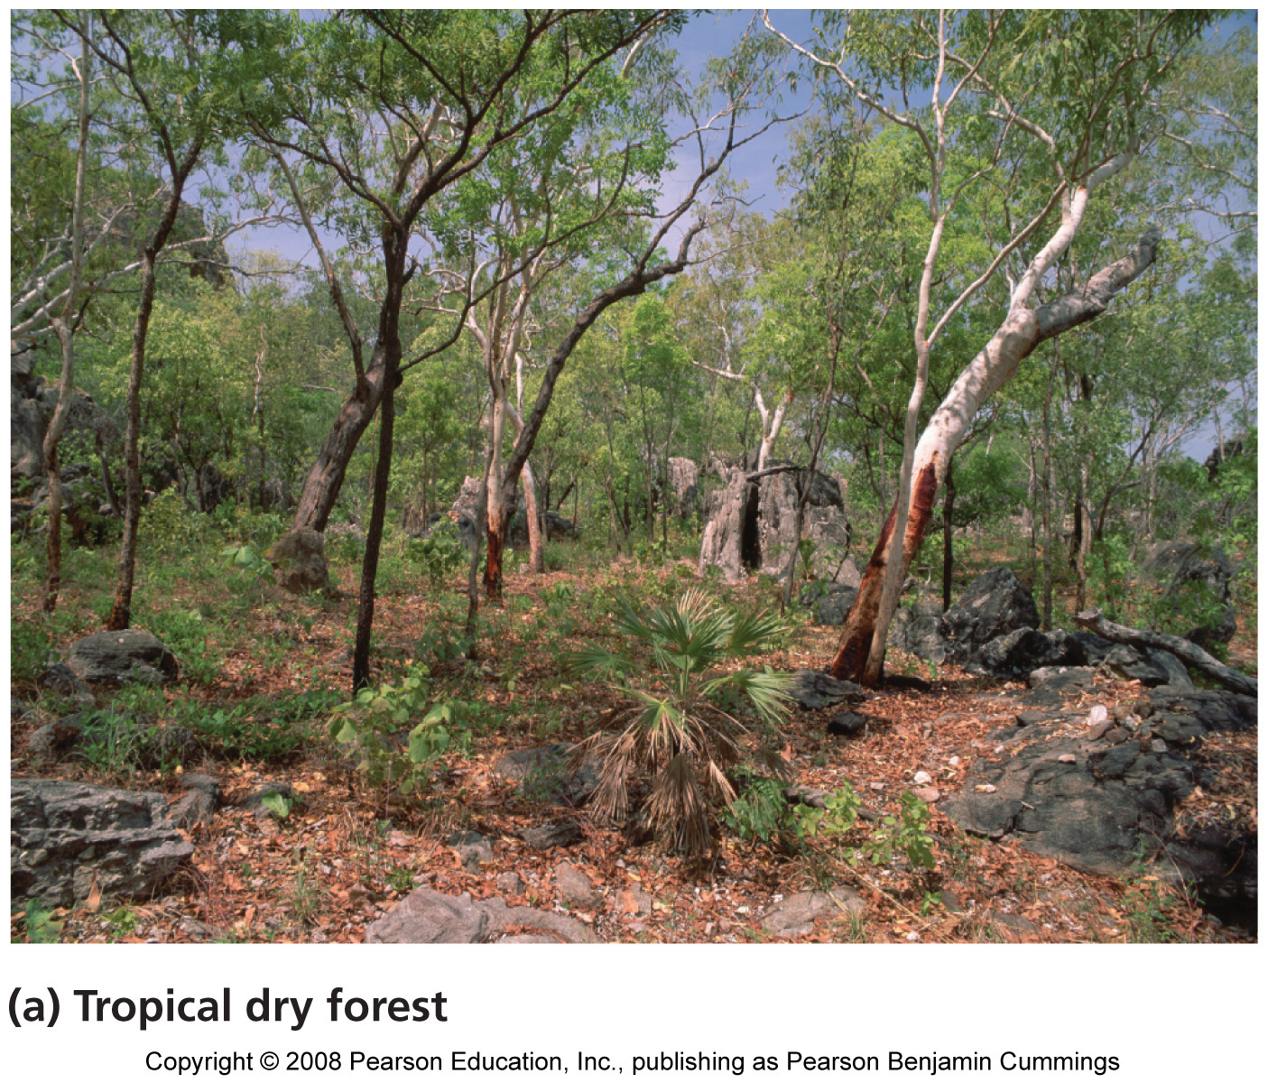
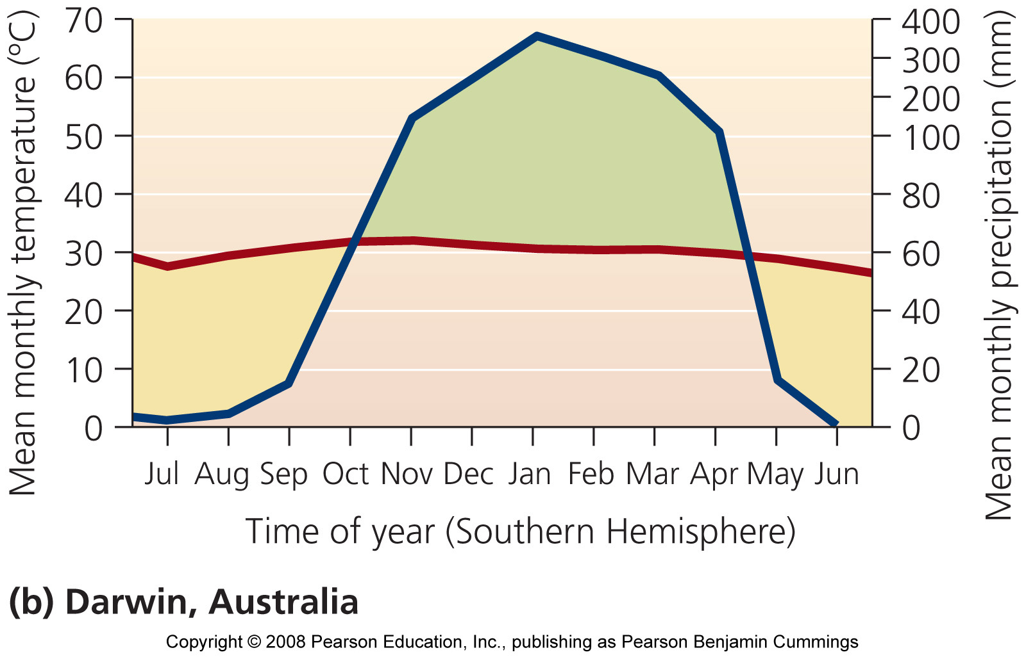
Tropical dry forest
Tropical deciduous forest
India, Africa, South America, northern Australia
Wet and dry seasons
Warm, but less rainfall
Converted to agriculture
Erosion-prone soil

Slide 48
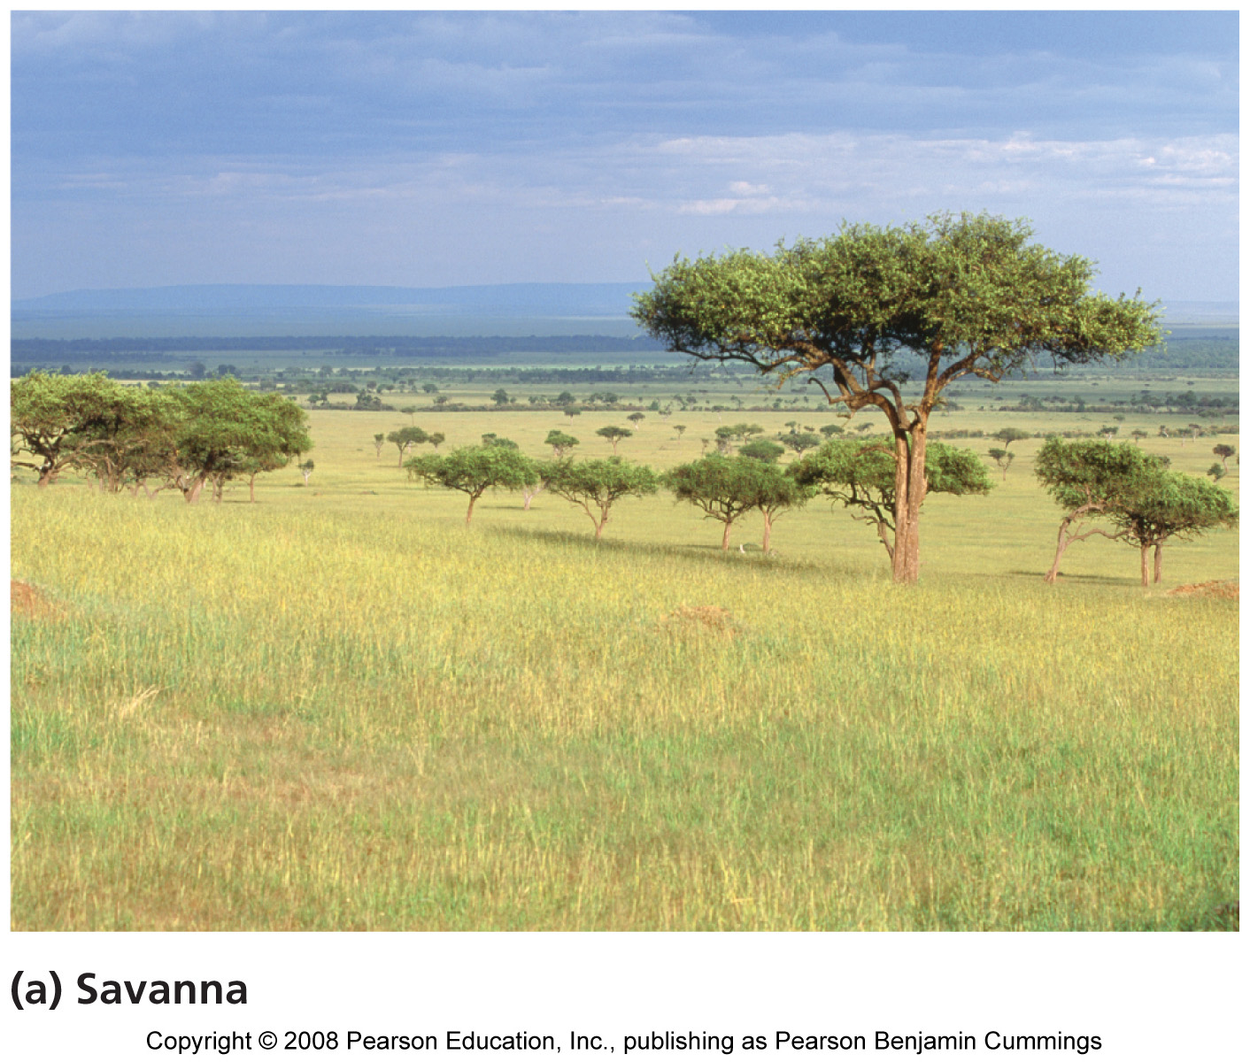
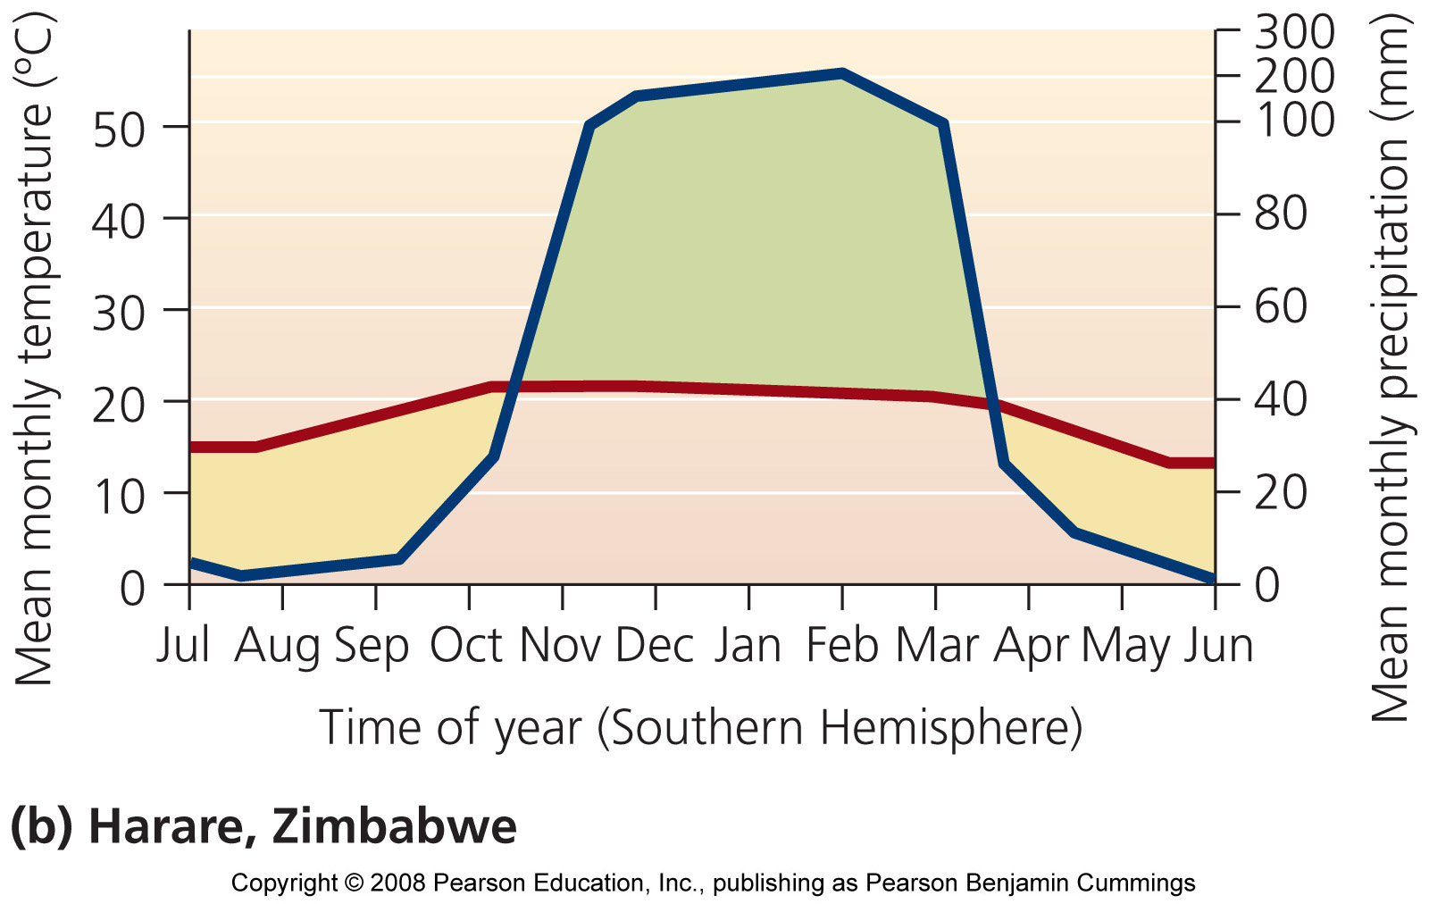
Savanna
Grassland interspersed with trees
Africa, South America, Australia, India
Precipitation only during rainy season
Water holes
Zebras, gazelles, giraffes, lions, hyenas

Slide 49
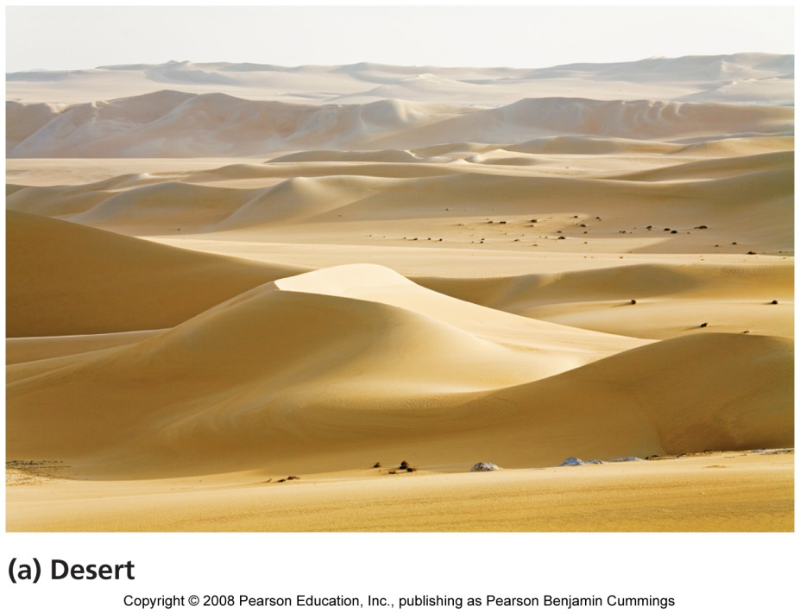
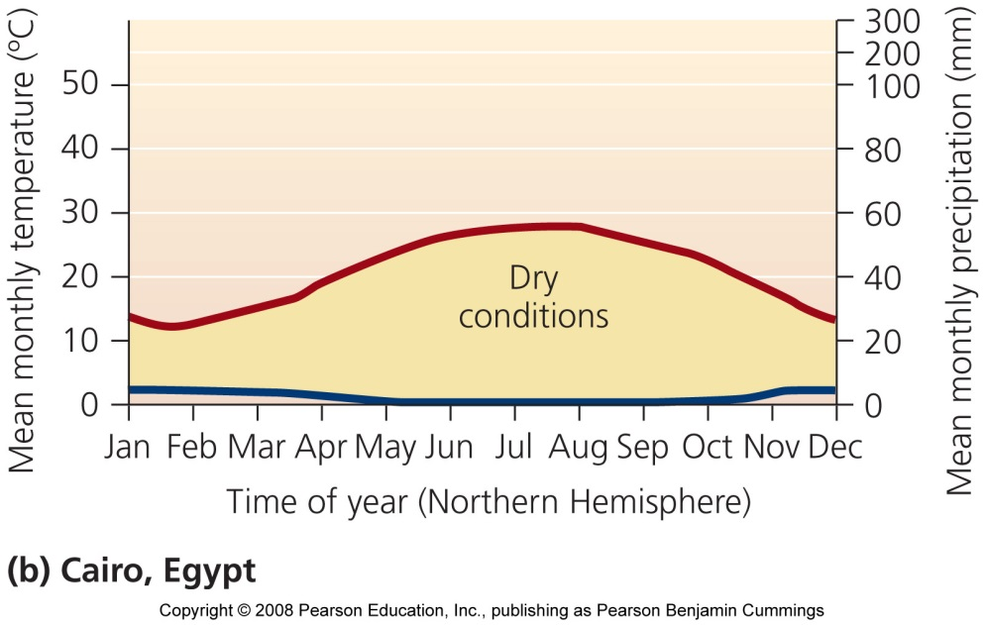
Desert
Minimal precipitation
Some deserts are bare, with sand dunes (Sahara)
Some deserts are heavily vegetated (Sonoran)
They are not always hot
  Temperatures vary widely
Saline soils
Nocturnal or nomadic animals
Plants have thick skins or spines

Slide 50
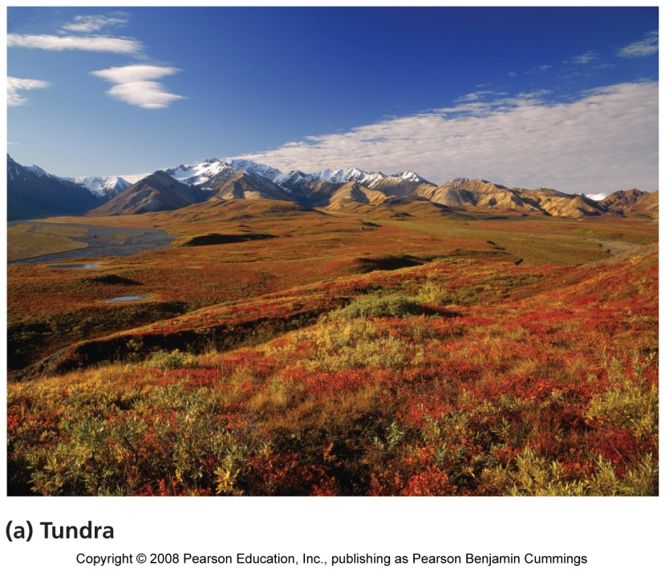
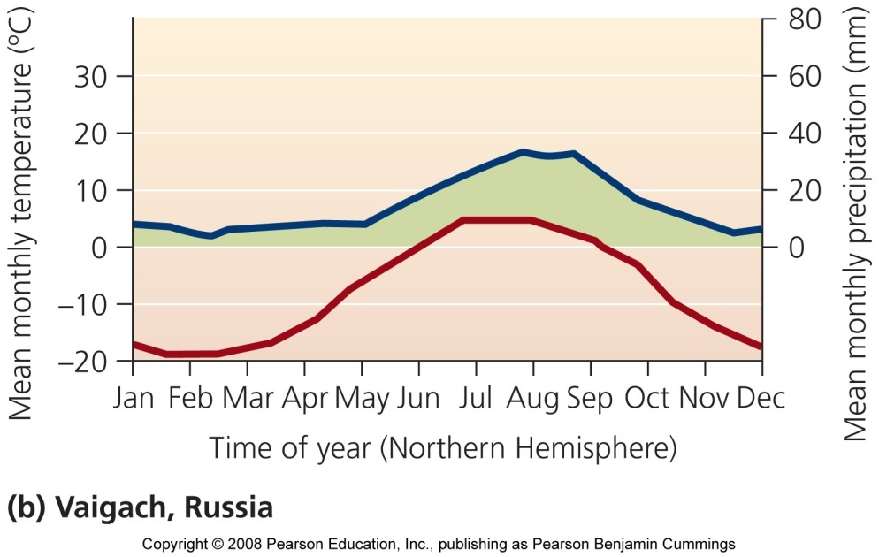
Tundra
Canada, Scandinavia, Russia
Minimal precipitation
  Nearly as dry as a desert
Seasonal variation in temperature
  Extremely cold winters
Permafrost: permanently frozen soil
Few animals: polar bears, musk oxen, caribou
Lichens and low vegetation with few trees

Slide 51
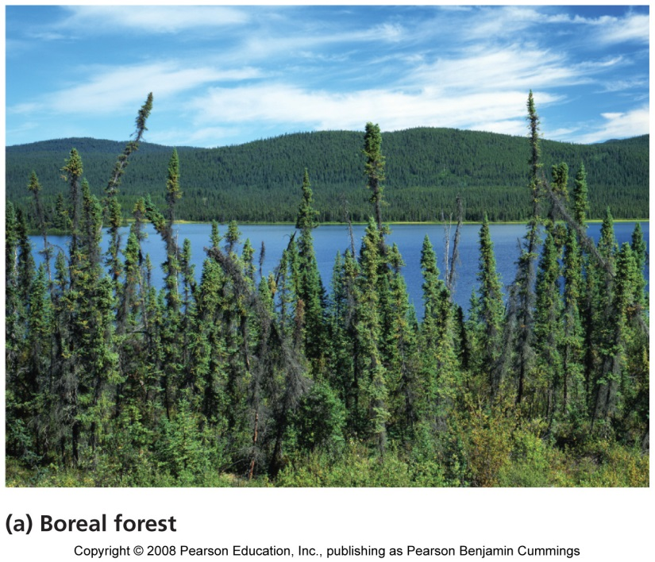
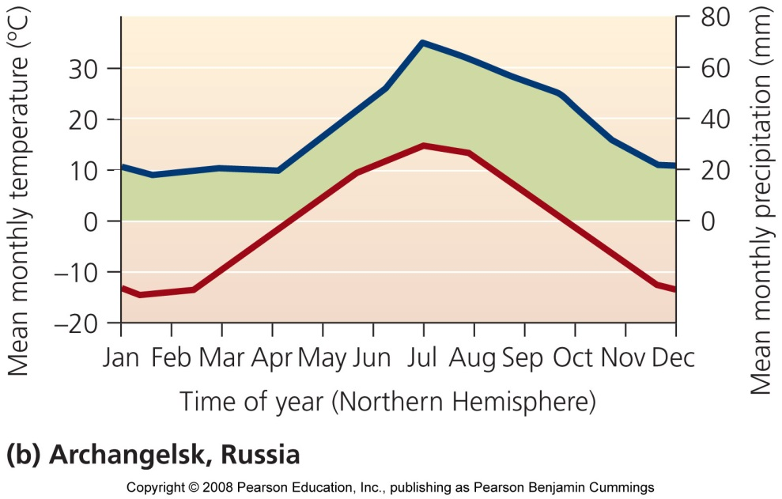
Boreal forest (taiga)
Canada, Alaska, Russia, Scandinavia
Variation in temperature and precipitation
Cool and dry climate
  Long, cold winters
  Short, cool summers
Poor and acidic soil
Few evergreen tree species
Moose, wolves, bears, migratory birds

Slide 52
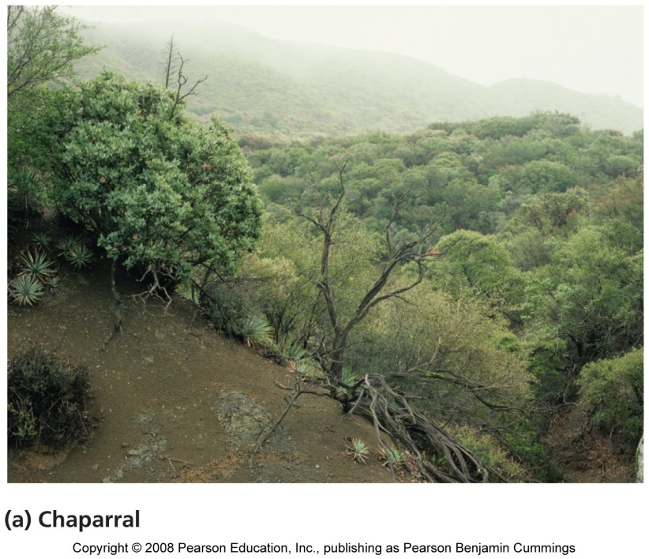
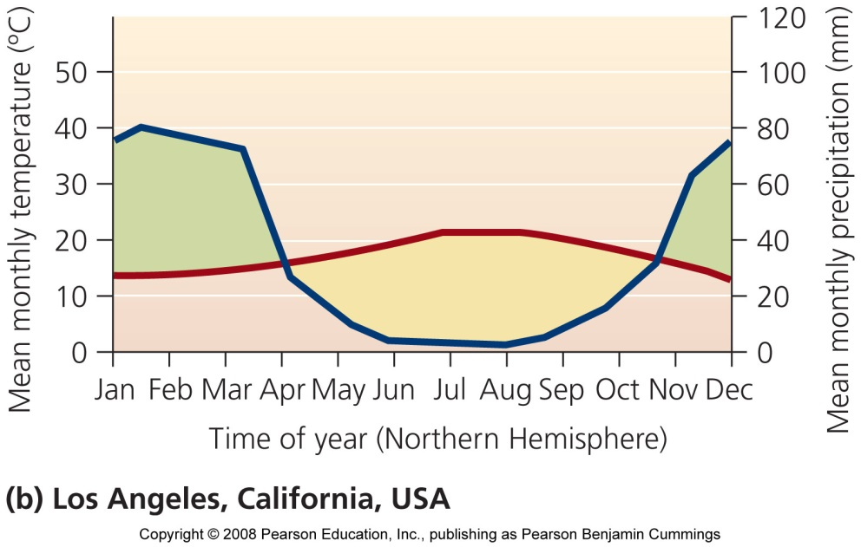
Chaparral
Mediterranean Sea, California, Chile, and southern Australia
High seasonal
  Mild, wet winters
  Warm, dry summers
Frequent fires
Densely thicketed, evergreen shrubs

Slide 53
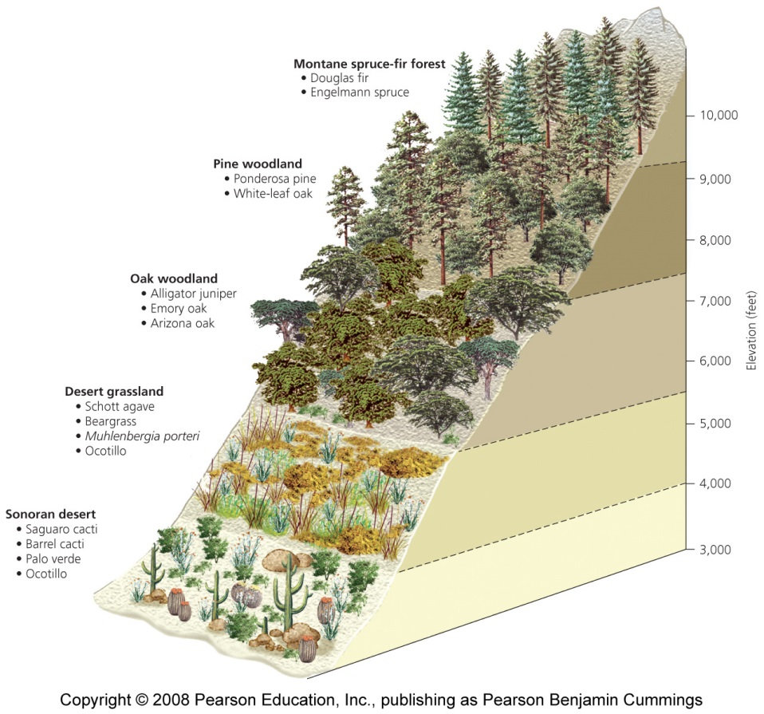
Altitudes create patterns
Vegetative communities change along mountain slopes
  In the Andes, a mountain climber would begin in the tropics and end up in a glacier
  Hiking up a mountain in the southwest U.S. is analogous to walking from Mexico to Canada

