Slide 1
ECOLOGY

Slide 2
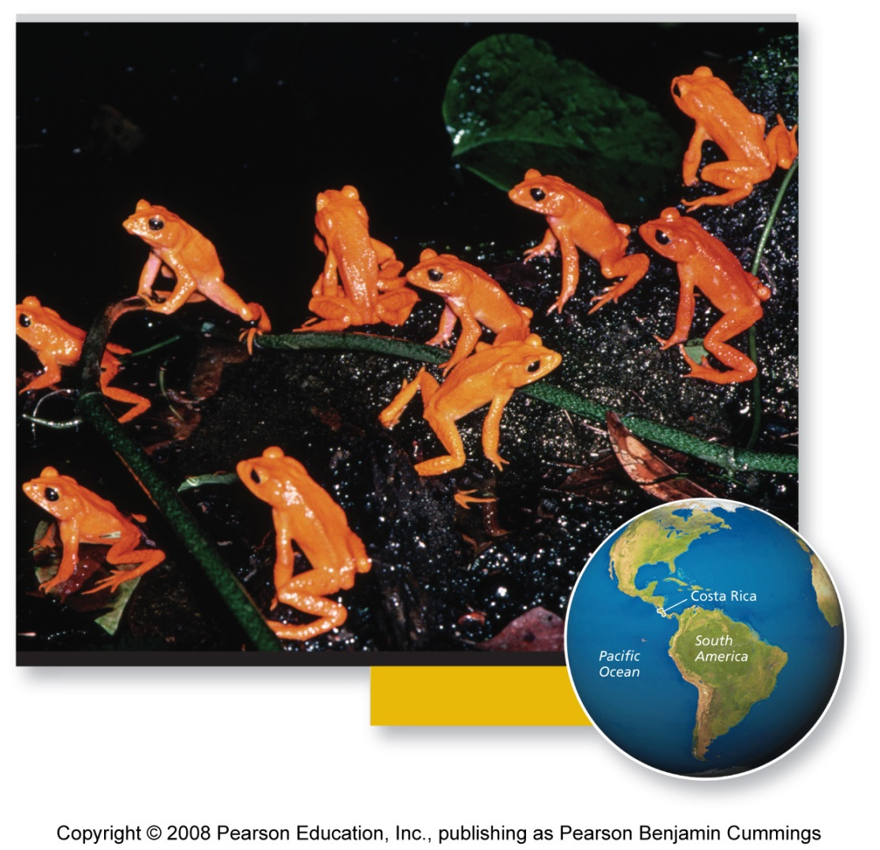
Striking gold in Costa Rica
Golden toads were discovered in 1964, in Monteverde, Chile
The mountainous cloud forest has a perfect climate for amphibians
Unfortunately, they became extinct within 25 years
  Due to global warming’s drying effect on the forest

Slide 3
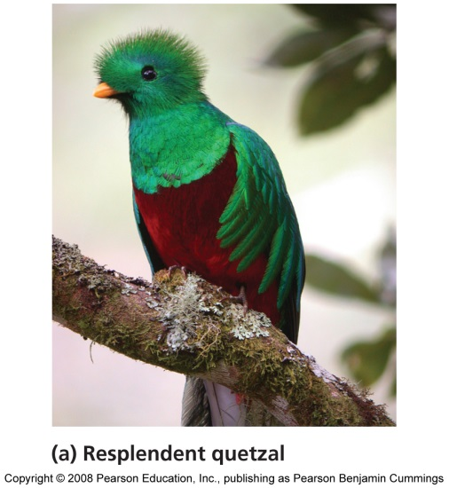
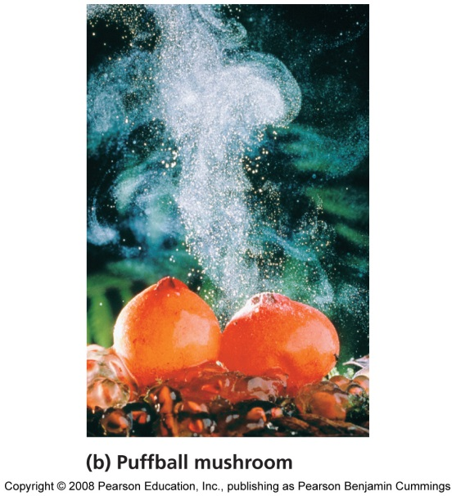
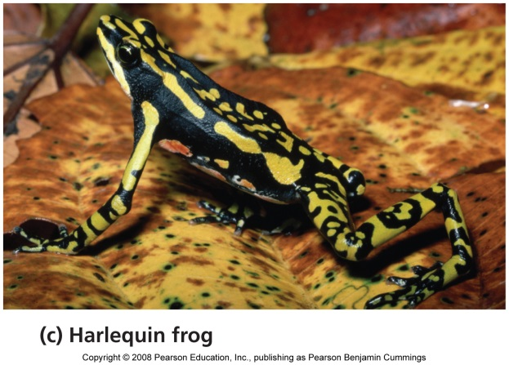
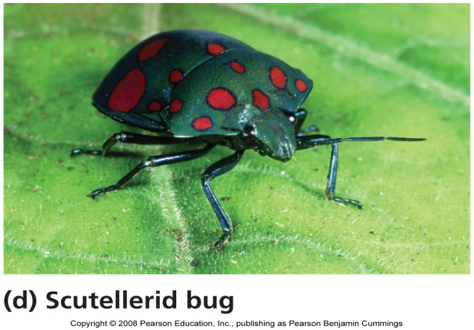
Evolution: the source of Earth’s biodiversity
Biological evolution = genetic change in populations of organisms across generations
May be random or directed by natural selection
  Natural Selection = the process by which traits that enhance survival and reproduction are passed on more frequently to future generations than those that do not

Slide 4
Understanding evolution is vital
It alters the genetic makeup of a population
It is important for understanding antibiotic and pesticide resistance, agricultural issues, production, medicines, etc.
Organisms adapt to their environment and change over time

Slide 5
Natural selection shapes organisms
In 1858, Darwin and Wallace both proposed natural selection as the mechanism of evolution
  Organisms face a constant struggle to survive and reproduce
  Organisms tend to produce more offspring than can survive
  Individuals of a species vary in their characteristics due to genes and the environment
  Some individuals are better suited to their environment and will survive and pass their genes on in their offspring

Slide 6
Genetic variation
Adaptive Trait (Adaptation) = a trait that promotes reproductive success
Mutations = accidental changes in DNA that may be passed on to the next generation
  Non-lethal mutations provide the genetic variation on which natural selection acts
Sexual reproduction also leads to variation

Slide 7
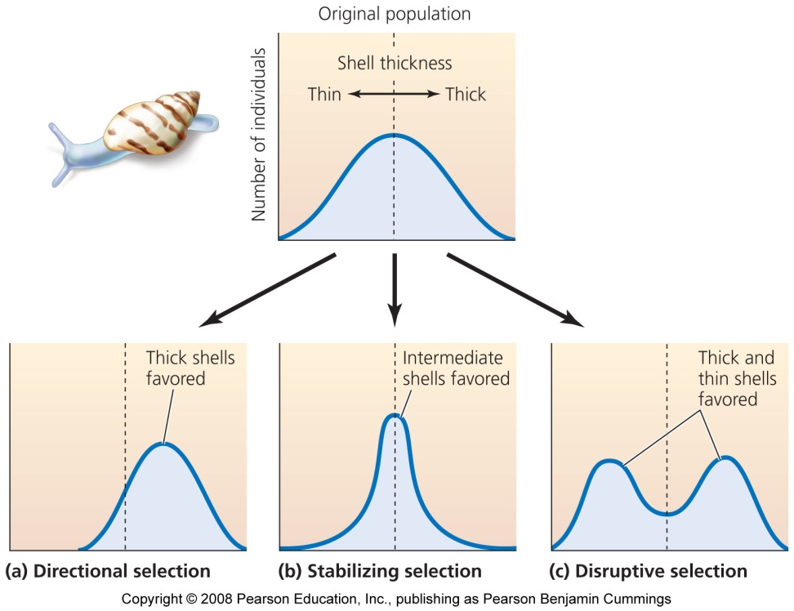
Natural selection acts on genetic variation
Directional selection = drives a feature in one direction
Stabilizing selection = produces intermediate traits, preserving the status quo
Disruptive selection = traits diverge in two or more directions
If the environment changes, a trait may no longer be adaptive

Slide 8
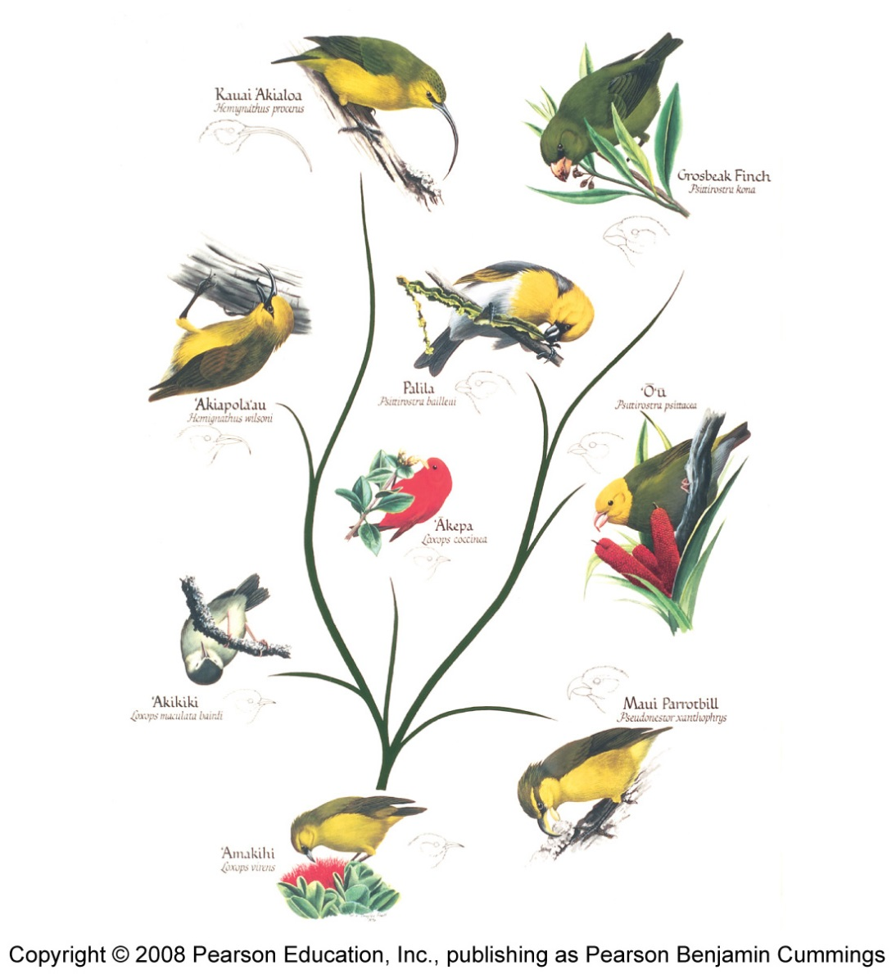
Evidence of natural selection is everywhere
It is evident in every adaptation of every organism
Evident in bacteria and fruit flies in laboratories
Selective breeding of animals

Slide 9
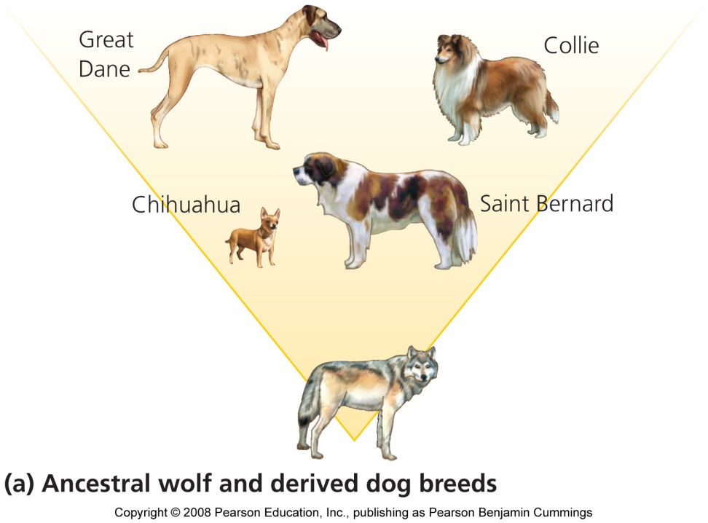
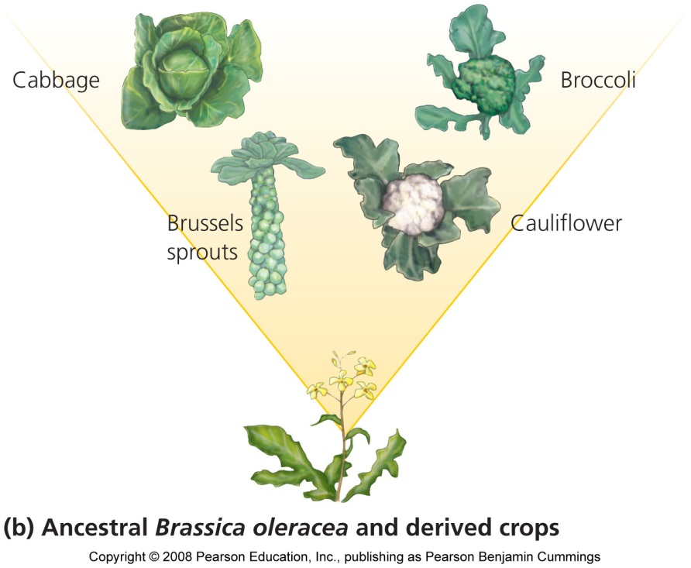
Artificial selection
Artificial Selection = the process of selection conducted under human direction
  For example, artificial selection has led to the great variety of dog breeds

Slide 10
Evolution generates biodiversity
Biological Diversity = An area’s sum total of all organisms
  The diversity of species
  Their genes
  Their populations
  Their communities
Species = a population or group of populations whose members share characteristics and can freely breed with one another and produce fertile offspring
Population = a group of individuals of a species that live in the same area

Slide 11
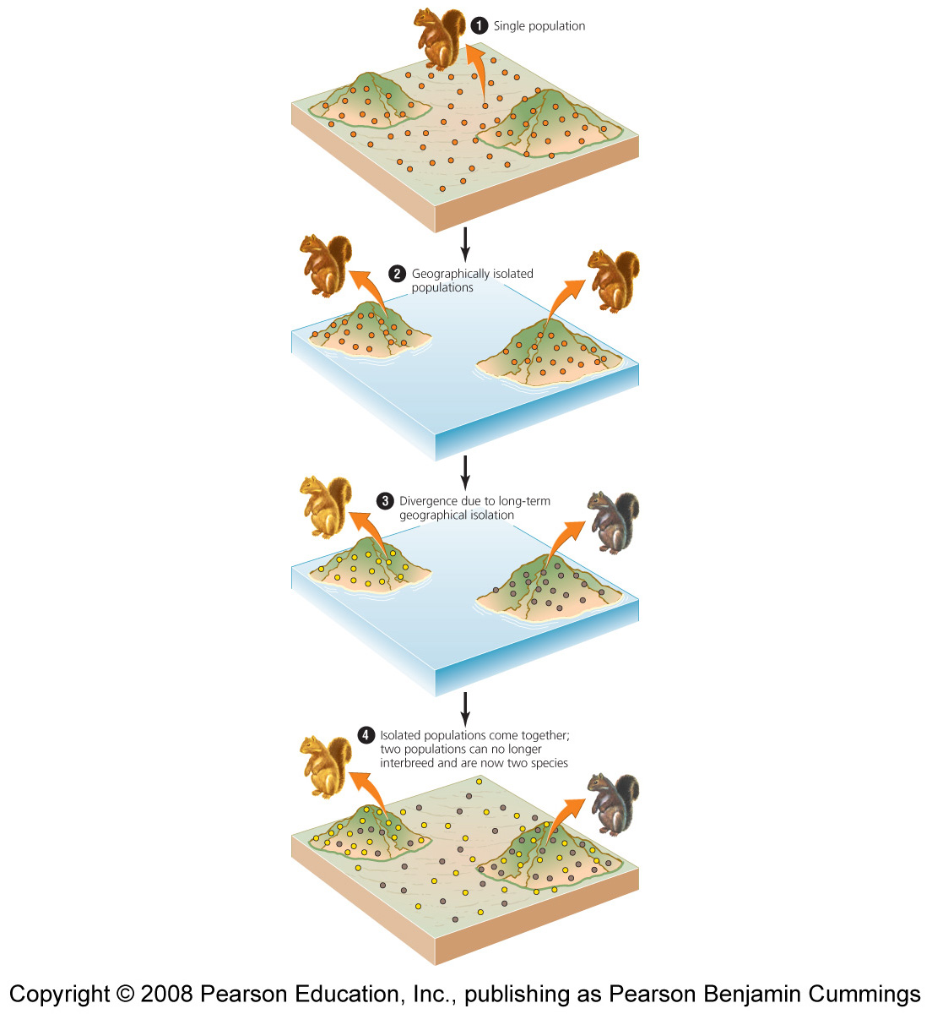
Speciation produces new types of organisms
The process of generating new species
  A single species can generate multiple species
Allopatric speciation = species formation due to physical separation of populations
  Can be separated by glaciers, rivers, mountains
  The main mode of species creation

Slide 12
Another type of speciation
Sympatric speciation = species form from populations that become reproductively isolated within the same area
  Feed in different areas, mate in different seasons
  Hybridization between two species
  Mutations

Slide 13
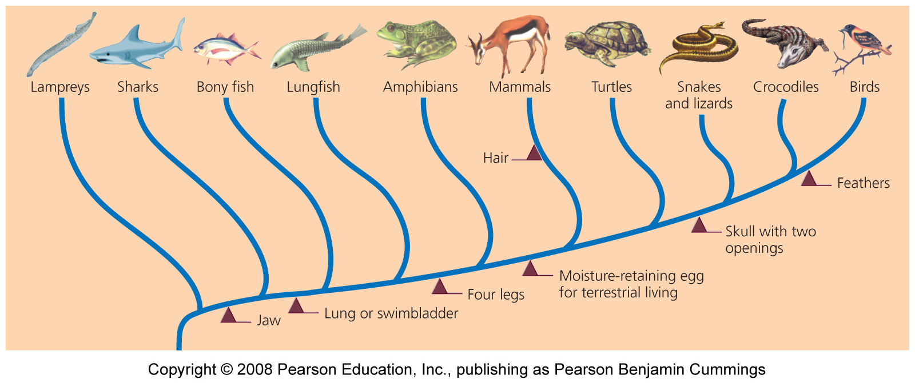
Speciation results in diverse life forms
Speciation generates complex patterns of diversity above the species level
Phylogenetic trees (Cladograms) = Represents the history of species divergence
  Scientists can trace when certain traits evolved
  Show relationships between species

Slide 14
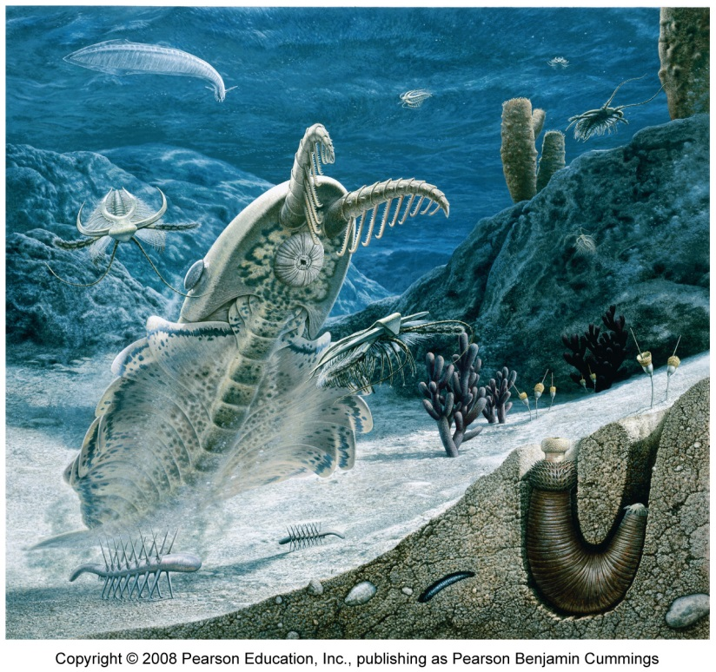
Extinction
Species generally evolve from simple to complex and small to big, but the opposite can occur, and some even disappear
Extinction = the disappearance of a species from Earth
  Occurs when a species cannot adapt quickly enough to a changing environment
  Speciation and extinction affect species numbers

Slide 15
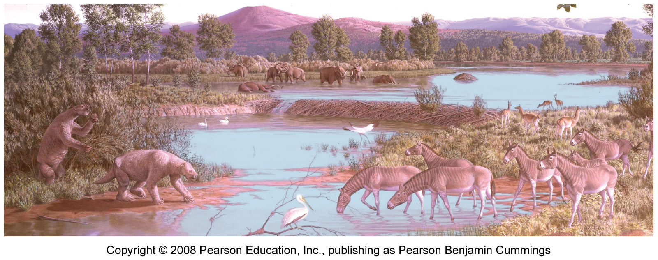
Extinction is a natural process
Extinction is irreversible: once a species is lost, it is lost forever
Humans profoundly affect rates of extinction

Slide 16
Some species are more vulnerable to extinction
Extinction occurs when the environment changes too rapidly for natural selection to keep up
Endemic species = a species only exists in a certain, specialized area
  Very susceptible to extinction
  These species usually have small populations
Many other factors also cause extinction
  Severe weather
  New species
  Specialized species

Slide 17
Earth has had several mass extinctions
Background extinction rate = extinction usually occurs one species at a time
Mass extinction events = five events in Earth’s history that killed off massive numbers of species at once
  50-95% of all species went extinct at one time
Humans are causing the sixth mass extinction event
  Resource depletion
  Population growth
  Development

Slide 18
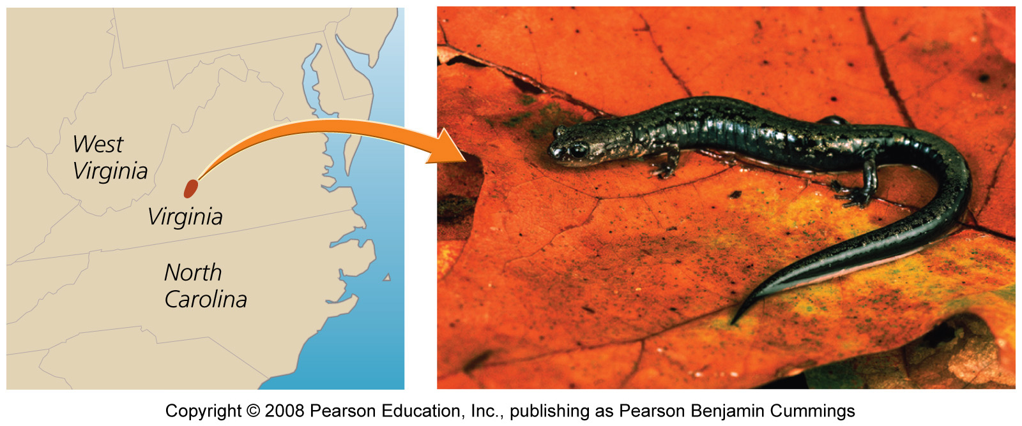
Species’ ranges can be severely restricted
Some U.S. salamander species live on top of single mountains

Slide 19
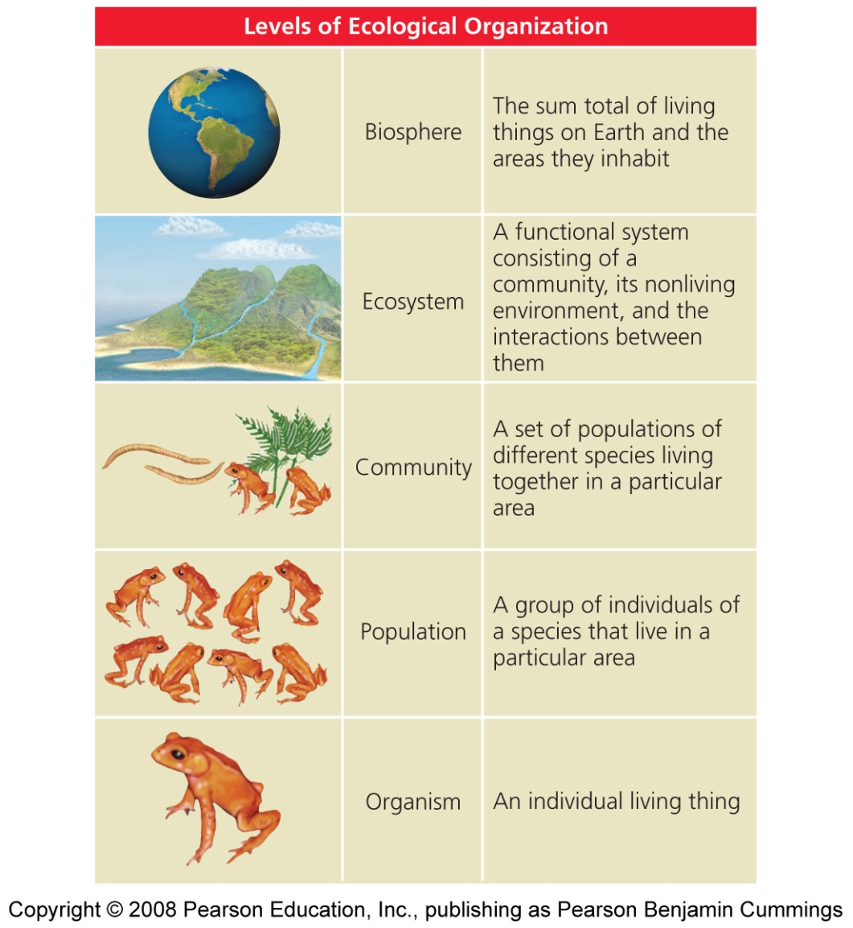
Ecology is studied at several levels
Ecology and evolution are tightly intertwined
Biosphere = the total living things on Earth and the areas they inhabit
Ecosystem = communities and the nonliving material and forces they interact with
Community = interacting species that live in the same area

Slide 20
Levels of ecological organization
Population ecology = investigates the quantitative dynamics of how individuals within a species interact
Community ecology = focuses on interactions among species
Ecosystem ecology = studies living and nonliving components of systems to reveal patterns
  Nutrient and energy flows

Slide 21
Organismal ecology: habitat
Habitat = the environment in which an organism lives
  Includes living and nonliving elements
  Scale-dependent: from square meters to miles
Habitat use = each organism thrives in certain habitats, but not in others
Habitat selection = the process by which organisms actively select habitats in which to live
  Availability and quality of habitat are crucial to an organism’s well-being
  Human developments conflict with this process

Slide 22
Organismal ecology: niche
Niche = an organism’s use of resources and its functional role in a community
  Habitat use, food selection, role in energy and nutrient flow
  Interactions with other individuals
Specialists = species with narrow niches and very specific requirements
  Extremely good at what they do, but vulnerable to change
Generalists = species with broad niches that can use a wide array of habitats and resources
  Able to live in many different places

Slide 23
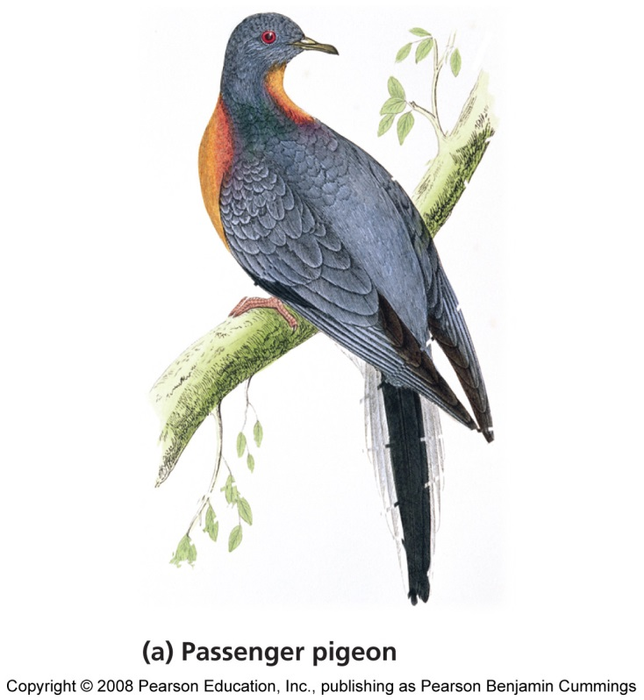
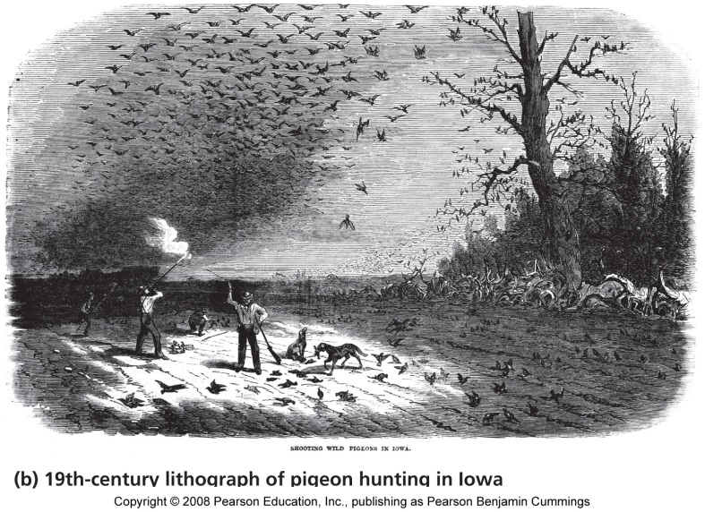
Population characteristics
All populations show characteristics that help scientists predict their future dynamics
Population size = the number of individual organisms present at a given time
  Numbers can increase, decrease, cycle or remain the same

Slide 24
Population characteristics
Population density = the number of individuals within a population per unit area
  High densities make it easier to find mates, but increase competition, and vulnerability to predation
  Low densities make it harder to find mates, but individuals enjoy plentiful resources and space

Slide 25
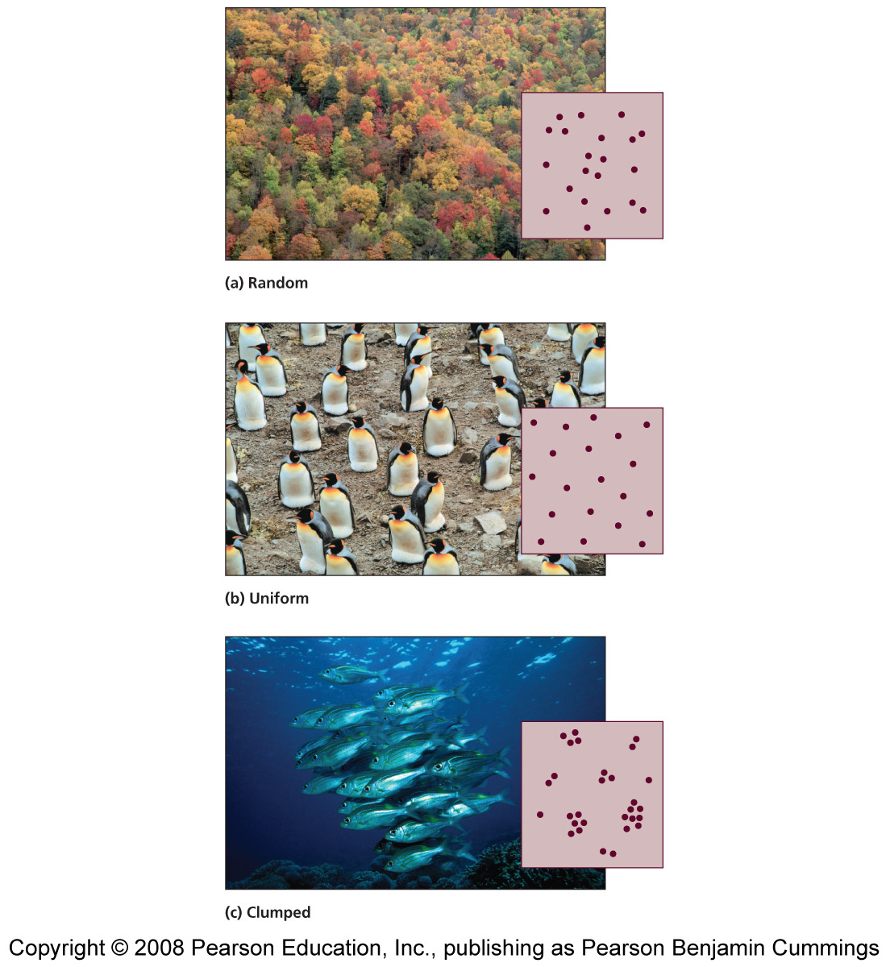
Population characteristics
Population distribution (dispersion) = spatial arrangement of organisms within an area
  Random – haphazardly located individuals, with no pattern
  Uniform – individuals are evenly spaced due to territoriality
  Clumped – arranged according to availability of resources
    Most common in nature

Slide 26
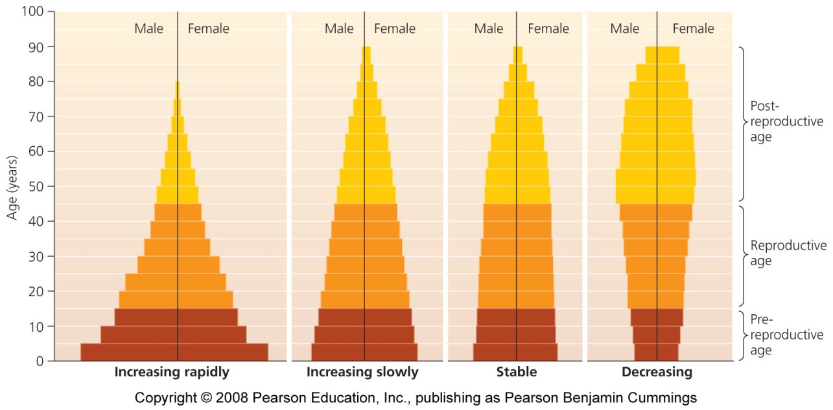
Population characteristics
Sex ratio = proportion of males to females
  In monogamous species, a 50/50 sex ratio maximizes population growth
Age Structure = the relative numbers of organisms of each age within a population
  Age structure diagrams (pyramids) = show the age structure of populations

Slide 27
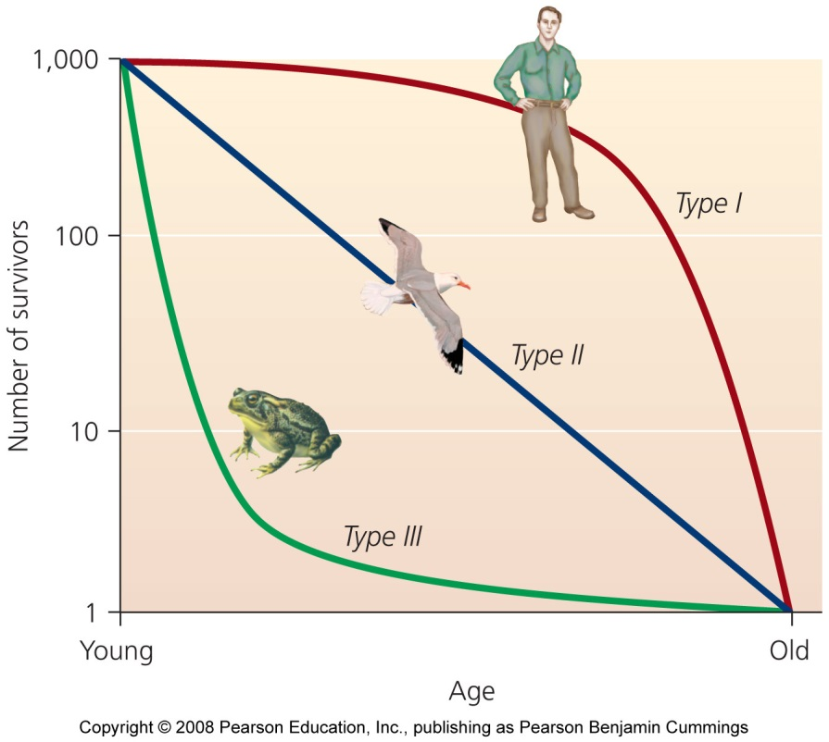
Birth and death rates
Crude birth/death rates = rates per 1000 individuals
Survivorship curves = the likelihood of death varies with age
  Type I: More deaths at older ages
  Type II: Equal number of deaths at all ages
  Type III: More deaths at young ages

Slide 28
Four factors of population change
Natality = births within the population
Mortality = deaths within the population
Immigration = arrival of individuals from outside the population
Emigration = departure of individuals from the population
Growth rate formula =
  (Crude birth rate + immigration rate) - (Crude death rate + emigration rate) = Growth rate

Slide 29
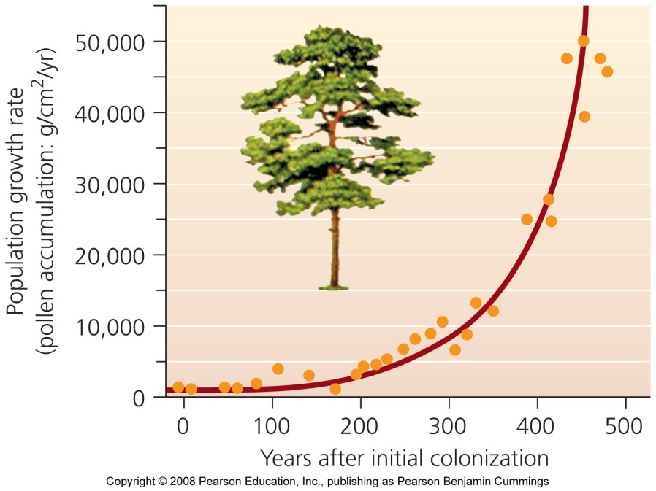
Exponential population growth
Steady growth rates cause exponential population growth
  Something increases by a fixed percent
  Graphed as a J-shaped curve
Exponential growth cannot be sustained indefinitely
  It occurs in nature with a small population and ideal conditions

Slide 30
Limiting factors restrain growth
Limiting factors = physical, chemical and biological characteristics that restrain population growth
  Water, space, food, predators, and disease
Environmental resistance = All limiting factors taken together

Slide 31
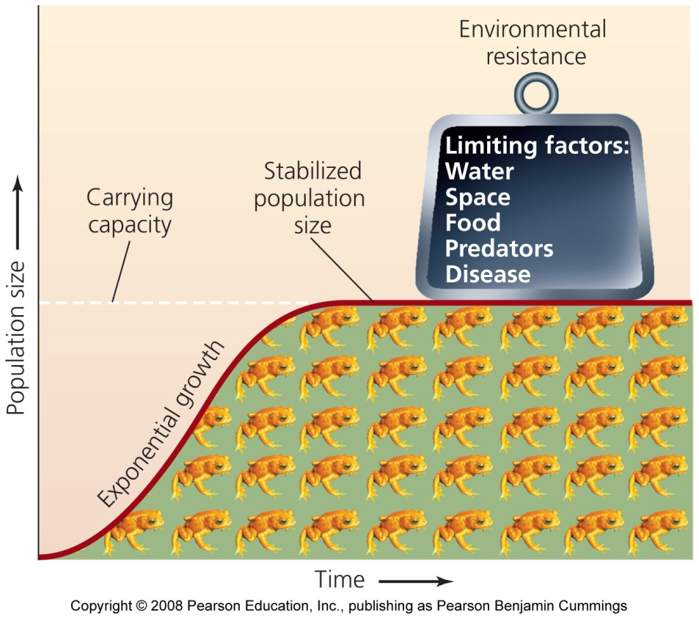
Carrying capacity
Carrying capacity = the maximum population size of a species that its environment can sustain
  An S-shaped logistic growth curve
  Limiting factors slow and stop exponential growth
Carrying capacity changes
Humans have raised their carrying capacity by decreasing the carrying capacity for other species

Slide 32
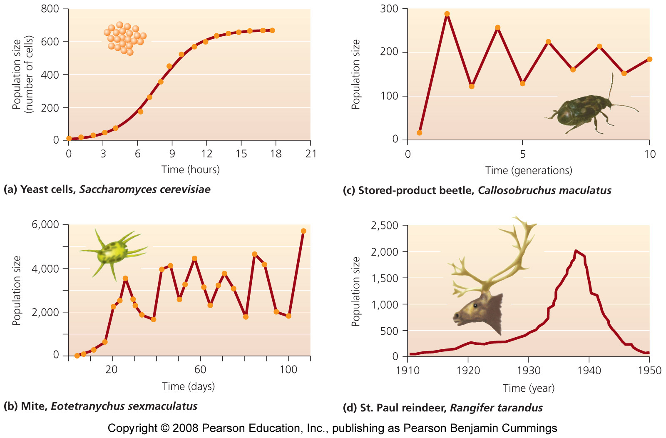
Perfect logistic curves aren’t often found

Slide 33
Population density affects limiting factors
Density-dependent factors = limiting factors whose influence is affected by population density
  Increased risk of predation and competition for mates occurs with increased density
Density-independent factors = limiting factors whose influence is not affected by population density
  Events such as floods, fires, and landslides

Slide 34
Biotic potential and reproductive strategies vary
Biotic potential = the ability of an organism to produce offspring
K-selected species = animals with long gestation periods and few offspring
  Have a low biotic potential
  Stabilize at or near carrying capacity
  Good competitors
r-selected species = animals which reproduce quickly
  Have a high biotic potential
  Little parental care

