Slide 2
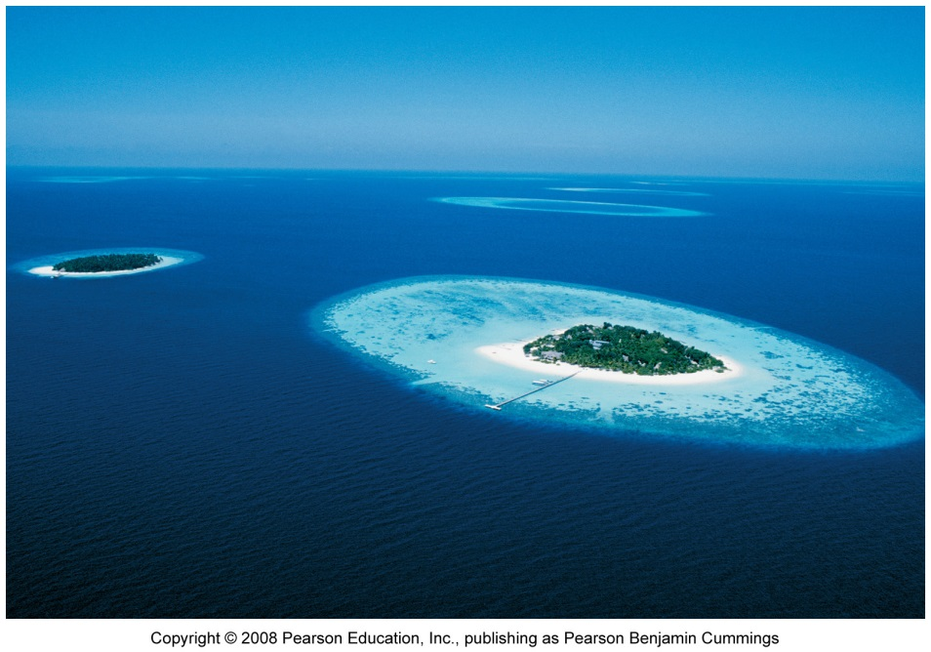
This lecture will help you understand:
The Earth’s climate system
Human influences on the atmosphere and climate
Methods of climate research
Impacts of global climate change
Ways we can respond to climate change

Slide 3
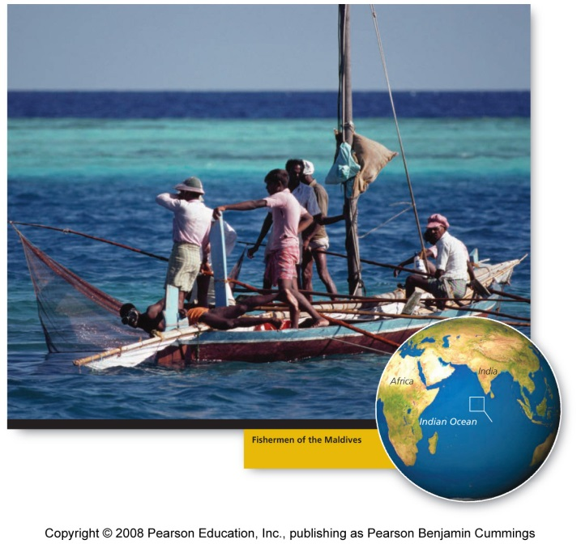
Central Case: Rising seas may flood the Maldives
Visiting tourists think of the Maldives Islands in the Indian Ocean as paradise
The islands could be submerged by rising seas accompanying global climate change
The government has already evacuated residents from of the lowest-lying islands

Slide 4
Our dynamic climate
Climate influences everything around us
The Fourth Assessment Report of the Intergovernmental Panel on Climate Change (IPCC) made it clear that:
  Climate is changing, we are the cause, and this change is already exerting impacts that will become increasingly severe
Al Gore’s movie An Inconvenient Truth has been seen by millions
Climate change is the fastest-moving area of environmental science today

Slide 5
What is climate change?
Climate = an area’s long-term atmospheric conditions
  Temperature, moisture content, wind, precipitation, etc.
Weather = conditions at localized sites over hours or days
Global climate change = describes trends and variations in Earth’s climate
  Temperature, precipitation, storm frequency
Global warming = an increase in Earth’s average temperature
  Earth’s climate has varied naturally through time
  The rapid climatic changes taking place now are due to human activity: fossil fuels, combustion, and deforestation

Slide 6
The Sun and atmosphere keep the Earth warm
Three factors exert more influence on climate than all others
The Sun = without it, the Earth would be dark and frozen
    Also supplies most of our planet’s energy
The atmosphere = without it, the Earth’s temperature would be much colder
    Earth’s atmosphere, clouds, land, ice, and water absorb 70% of incoming solar radiation
The oceans = shape climate by storing and transporting heat and moisture

Slide 7
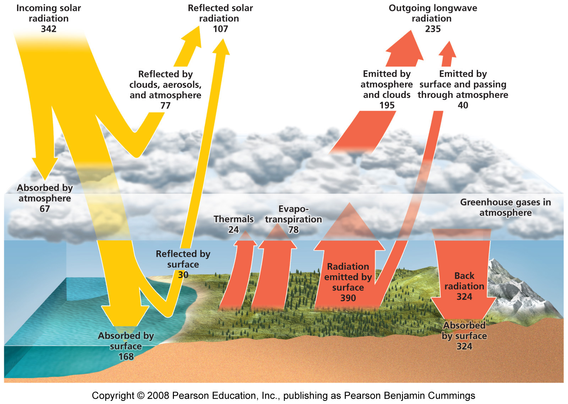
The fate of solar radiation

Slide 8
Greenhouse gases warm the lower atmosphere
As Earth’s surface absorbs solar radiation, the surface increases in temperature and emits infrared radiation
Greenhouse gases = atmospheric gases that absorb infrared radiation
  Water vapor, ozone, carbon dioxide, nitrous oxide, methane, chlorofluorocarbons (CFCs)
  Greenhouse gases differ in their ability to warm the troposphere and surface

Slide 9
The greenhouse effect
After absorbing radiation, greenhouse gases re-emit infrared energy
  Some energy is lost to space
  Greenhouse effect = some energy travels back downward, warming the atmosphere and planet’s surface
Global potential = the relative ability of one molecule of a given greenhouse gas to contribute to warming
  Expressed in relation to carbon dioxide (potential = 1)
  Hydrochlorofluorocarbons are 12,000 times as potent as carbon dioxide

Slide 10
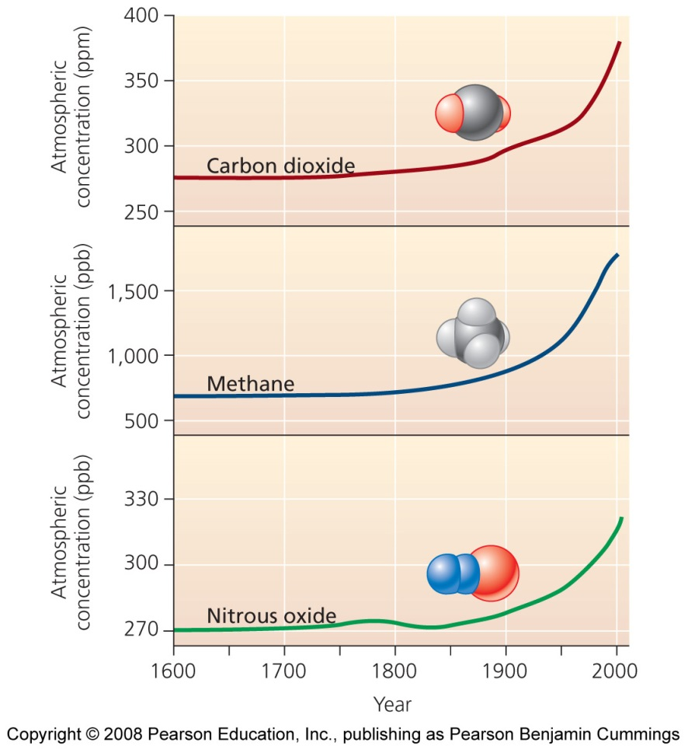
Carbon dioxide is of primary concern
Not the most potent greenhouse gas, but it is extremely abundant
  The major contributor to global warming
Human activities have boosted atmospheric concentrations from 280 parts per million (ppm) to 383 ppm
  To their highest levels in more than 650,000 years

Slide 11
What caused levels of CO₂ to increase?
Burned fossil fuels in our homes, factories, and automobiles
  Transferred large amounts of carbon dioxide from lithospheric reservoirs into the atmosphere
  The main reason atmospheric carbon dioxide concentrations have increased so dramatically
Deforestation has contributed to rising atmospheric CO₂ concentration
  Forests serve as sinks for recently active carbon
  Their removal reduces the biosphere’s ability to absorb carbon dioxide from the atmosphere

Slide 12
Other greenhouse gases add to warming
Methane = fossil fuel deposits, livestock, landfills, and crops such as rice
Nitrous oxide = feedlots, chemical manufacturing plants, auto emissions, and synthetic nitrogen fertilizers
Ozone = risen due to photochemical smog
Halocarbon gases (CFCs) = are declining due to the Montreal Protocol
Water vapor = the most abundant greenhouse gas and contributes most to the greenhouse effect
  Could increase cloudiness, which might slow global warming by reflecting more solar radiation back into space

Slide 13
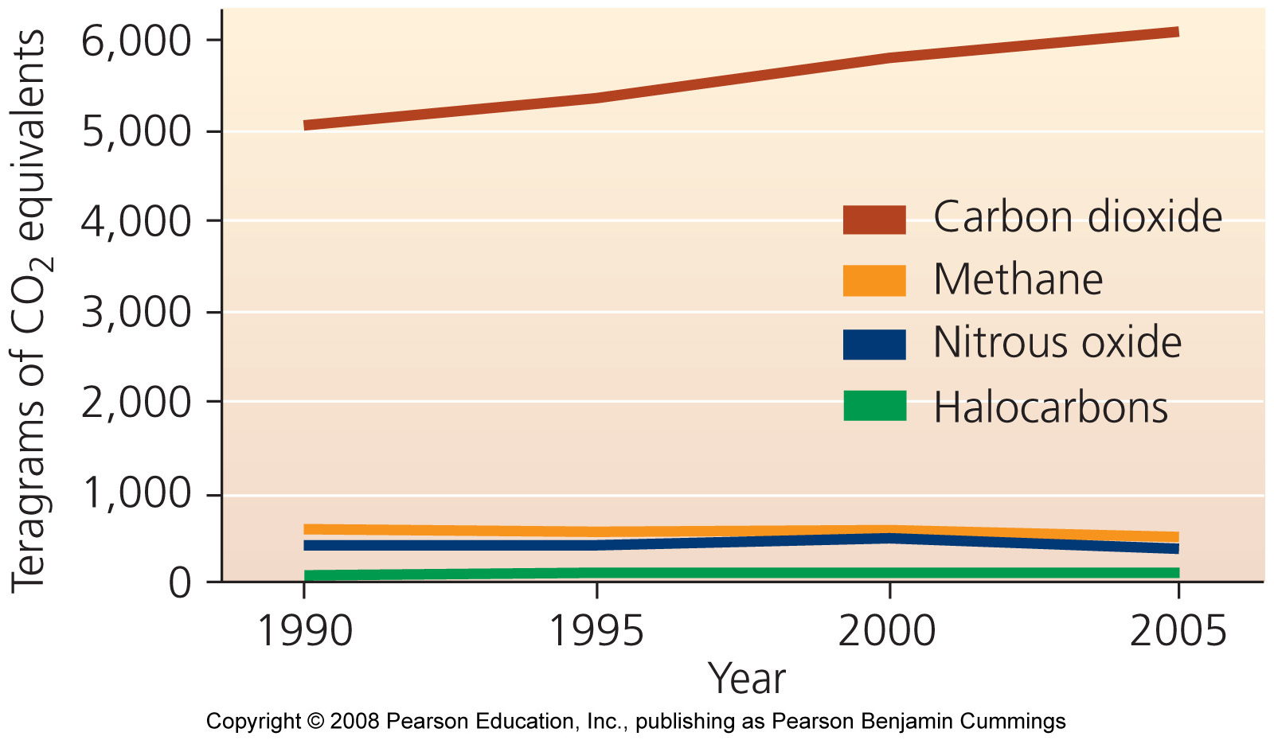
U.S. emissions of major greenhouse gases

Slide 14
Aerosols may exert a cooling effect
Aerosols = microscopic droplets and particles that have either a warming or cooling effect
Soot, or black carbon aerosols, cause warming by absorbing solar energy
  But, most tropospheric aerosols cool the atmosphere by reflecting the Sun’s rays
Sulfate aerosols produced by fossil fuel combustion may slow global warming, at least in the short term
  Volcanic eruptions reduce sunlight reaching the earth and cool the Earth

Slide 15
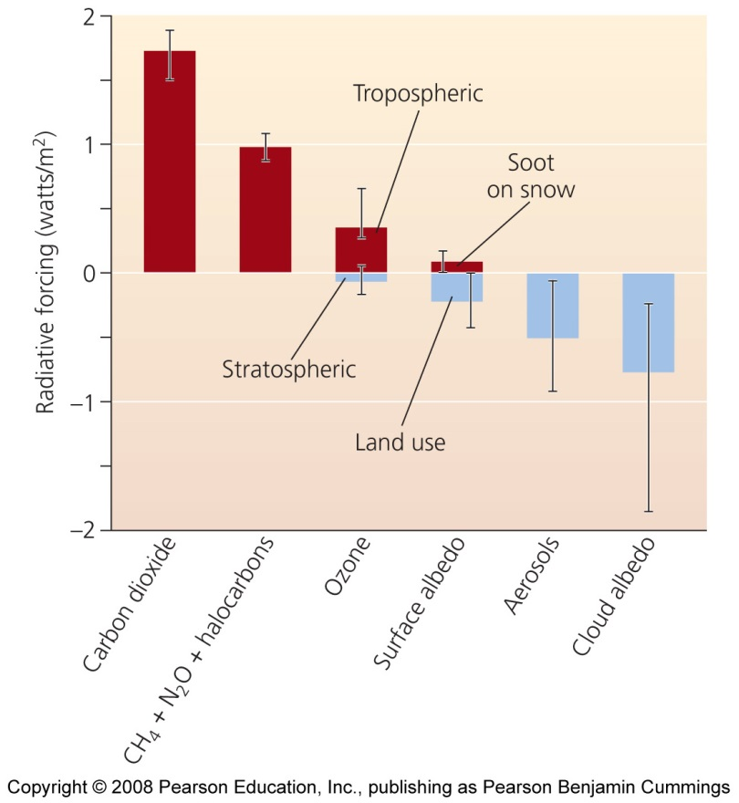
Radiative forcing expresses change in energy
Scientists estimate the influence of factors over Earth’s energy balance
Radiative forcing = the amount of change in energy that a given factor causes
  Positive forcing warms the surface; negative forcing cools it
Compared with the pre-industrial Earth, Earth is experiencing radiative forcing of 1.6 watts/m²
  Enough to alter the climate

Slide 16
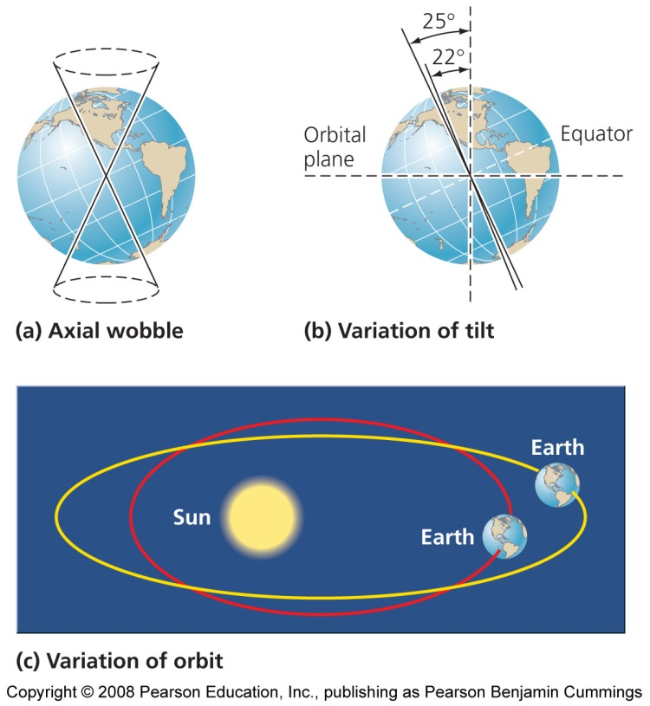
Milankovitch cycles influence climate
Milankovitch cycles = periodic changes in Earth’s rotation and orbit around the Sun
  Alter the way solar radiation is distributed over Earth’s surface
  By modifying patterns of atmospheric heating, these cycles trigger long-term climate variation such as periodic glaciation

Slide 17
Solar output and ocean absorption influence climate
Solar output = drives temperature change on Earth’s surface
  The Sun varies in the radiation it emits
  Variation in solar energy (i.e., solar flares) has not been great enough to change Earth’s temperature
Ocean absorption = the ocean holds 50 times more carbon than the atmosphere and absorbs it from the atmosphere
  Carbon absorption by the oceans is slowing global warming but not preventing it
  Warmer oceans absorb less CO₂ because gases are less soluble in warmer water – a positive feedback effect that accelerates warming

Slide 18
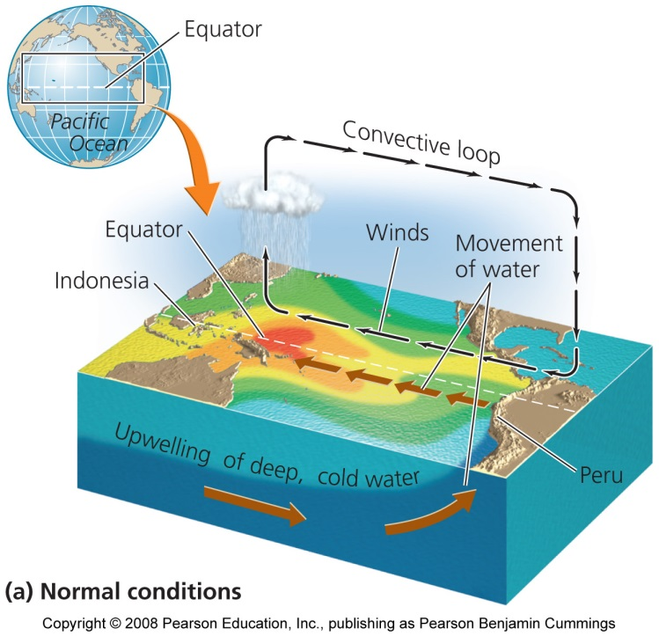
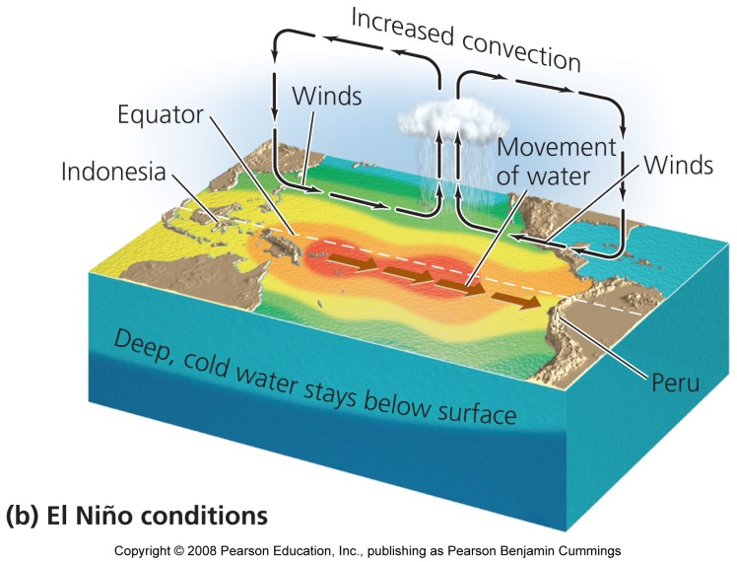
Ocean circulation and ENSO influence climate
Ocean circulation = ocean water exchanges tremendous amounts of heat with the atmosphere, and ocean currents move energy from place to place
El Niño-southern oscillation (ENSO) = a systematic shift in atmospheric pressure, sea surface temperature, and ocean circulation in the tropical Pacific

Slide 19
El Niño
Normally, winds blow from east to west along the equator, from high to low pressure
Westward-moving surface waters allow nutrient-rich upwelling along the coast of Peru
ENSO occurs when air pressure increases in the western Pacific and decreases in the eastern Pacific, causing the equatorial winds to weaken
Water flows eastward, suppressing upwellings, shutting down delivery of nutrients that support aquatic life
Coastal industries are devastated, global weather is changed

Slide 20
La Niña events
The opposite of El Niño events
  Cold surface waters extend far westward in the equatorial Pacific and weather patterns are affected in opposite ways
ENSO cycles are periodic, occurring every 2-8 years
  Globally warming air and sea temperatures may be increasing their frequency and strength

Slide 21
Thermohaline circulation
Thermohaline circulation = a worldwide current system in which warmer, fresher water moves along the surface; and colder, saltier water moves deep beneath the surface
  Warm surface water carries heat to Europe
  North American Deep Water (NADW) = the deep portion of the thermohaline circulation, consisting of dense, cool water that sinks
  Interrupting the thermohaline circulation could trigger rapid climate change

Slide 22
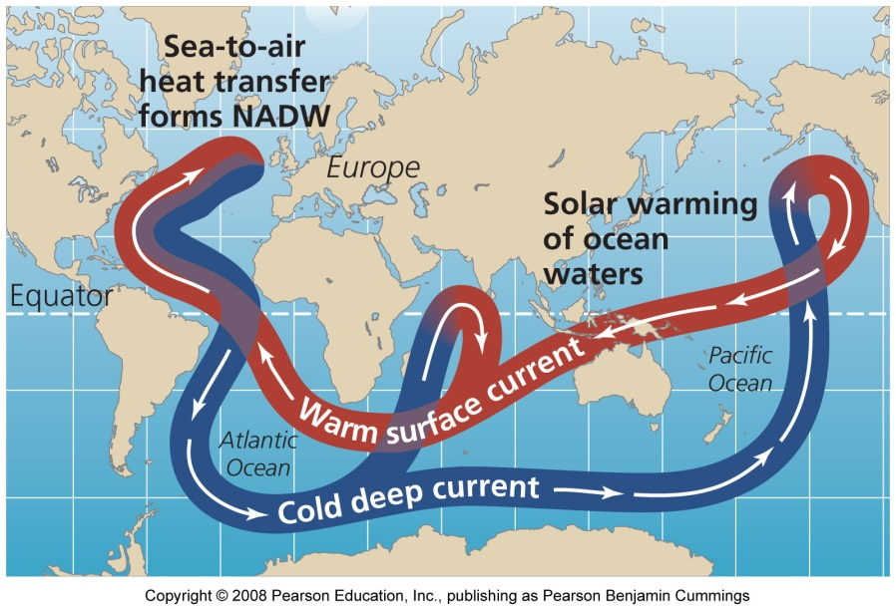
NADW is vulnerable
If Greenland’s ice melts, freshwater runoff would dilute ocean waters, making them less dense, and stopping NADW
  Some data suggest thermohaline circulation is slowing
Europe would rapidly cool, as shown in The Day After Tomorrow, a movie which exaggerated the impacts

Slide 23
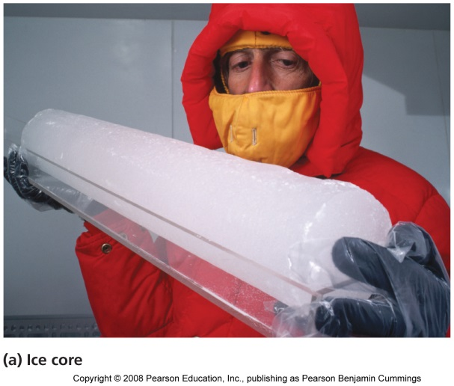
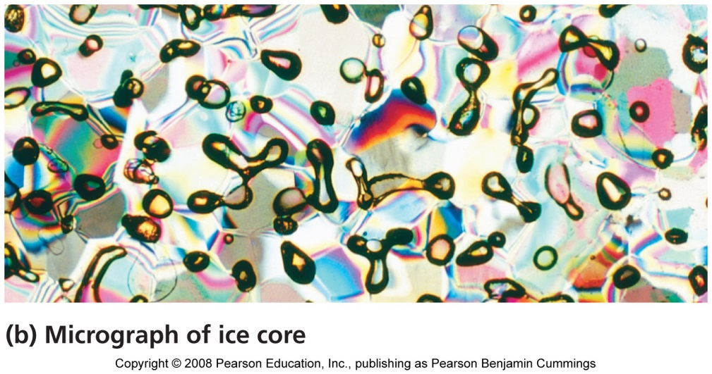
Proxy indicators tell us about the past
Proxy indicators = types of indirect evidence that serve as substitutes for direct measurements
  Shed light on past climate
  Ice caps, ice sheets, and glaciers hold clues to Earth’s climate
  Trapped bubbles in ice cores show atmospheric composition, greenhouse gas concentration, temperature trends, snowfall, solar activity, and frequency of fires

Slide 24
More proxy indicators
Cores in sediment beds preserve pollen grains and other plant remnants
Tree rings indicate age, wetness of the season, droughts, and seasonal growth
Researchers also gather data on past ocean conditions from coral reefs
Scientists need to combine multiple records to get a global perspective

Slide 25
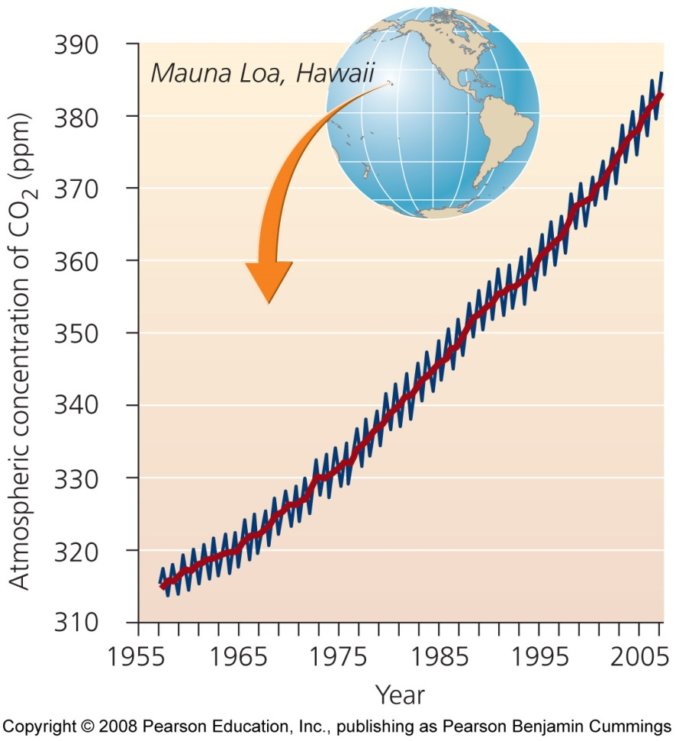
Direct atmospheric sampling tells us about the present
Trends in atmospheric concentrations of carbon dioxide show that concentrations have increased from 315 ppm to 383 ppm

Slide 26
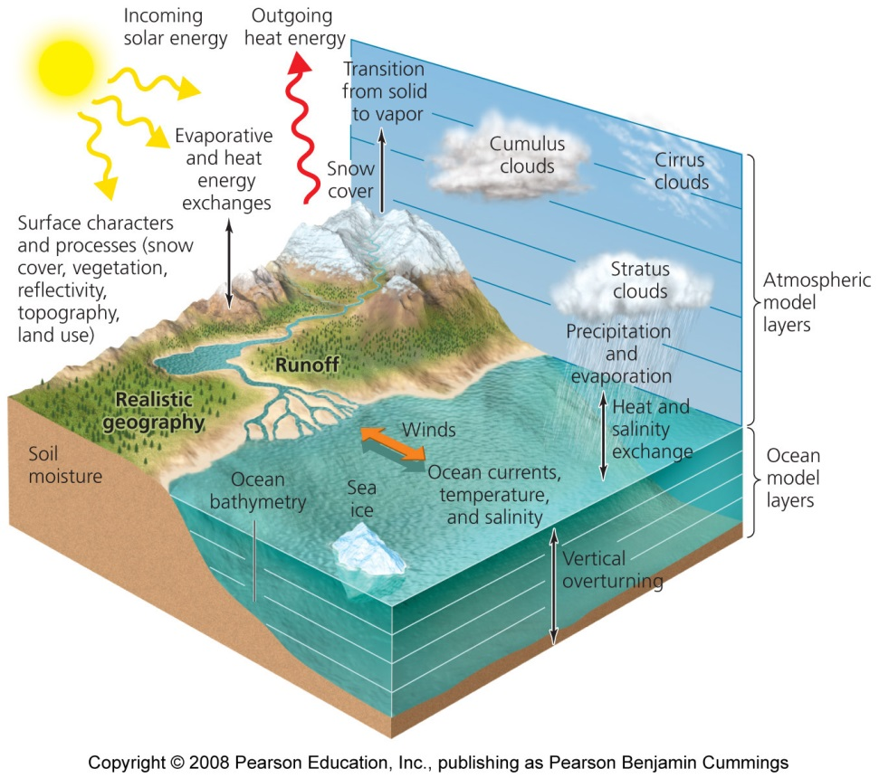
Models help us understand climate
Coupled general circulation model (climate models) = programs that combine what is known about atmospheric circulation, ocean circulation, atmosphere-ocean interactions, and feedback mechanisms to simulate climate processes
  These models are becoming more reliable in predicting climate change

Slide 27
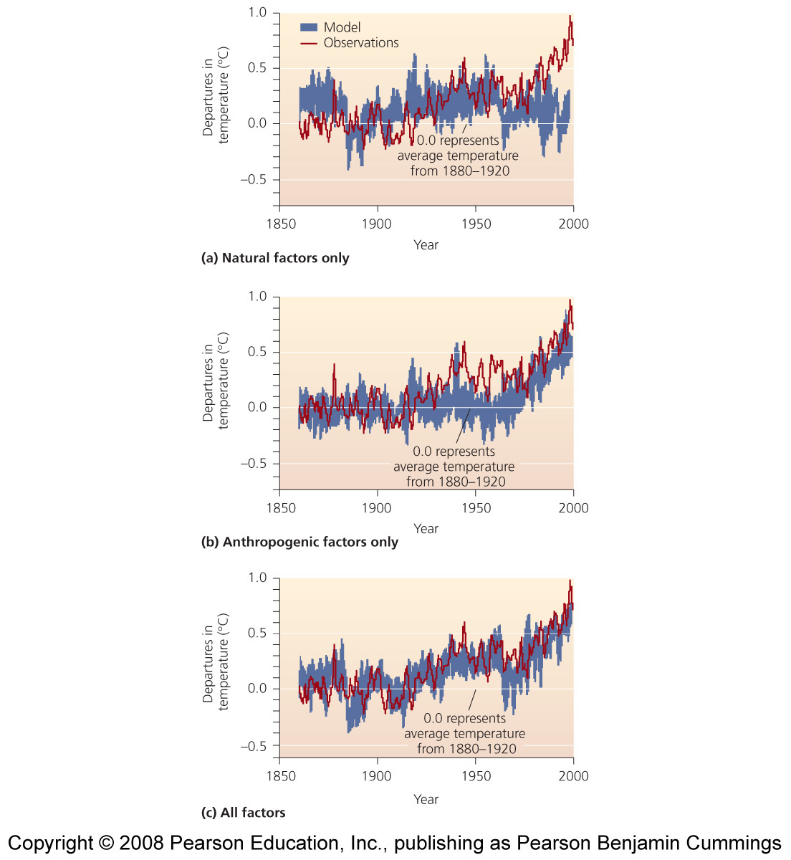
Results from three simulations
Figure (a) shows natural climate factors only
  Volcanoes
Figure (b) shows only human factors
  Emissions of greenhouse gases
Figure (c) shows both factors

Slide 28
Current and future trends and impacts
Evidence that climate conditions have changed since industrialization has increased
Intergovernmental Panel on Climate Change (IPCC)
  An international panel of scientists and government officials established in 1988
  Has presented a series of reports on the synthesis of scientific information concerning climate change

Slide 29
The fourth assessment report
Fourth Assessment Report (2007)
  Consensus of scientific climate research from around the world
  Summarizes thousands of studies
  It documents observed trends in surface temperature, precipitation patterns, snow and ice cover, sea levels, storm intensity, etc.
  Predicts future changes, addressing impacts of current and future climate change on wildlife, ecosystems, and human societies
  Discusses possible strategies to pursue in response to climate change

Slide 30
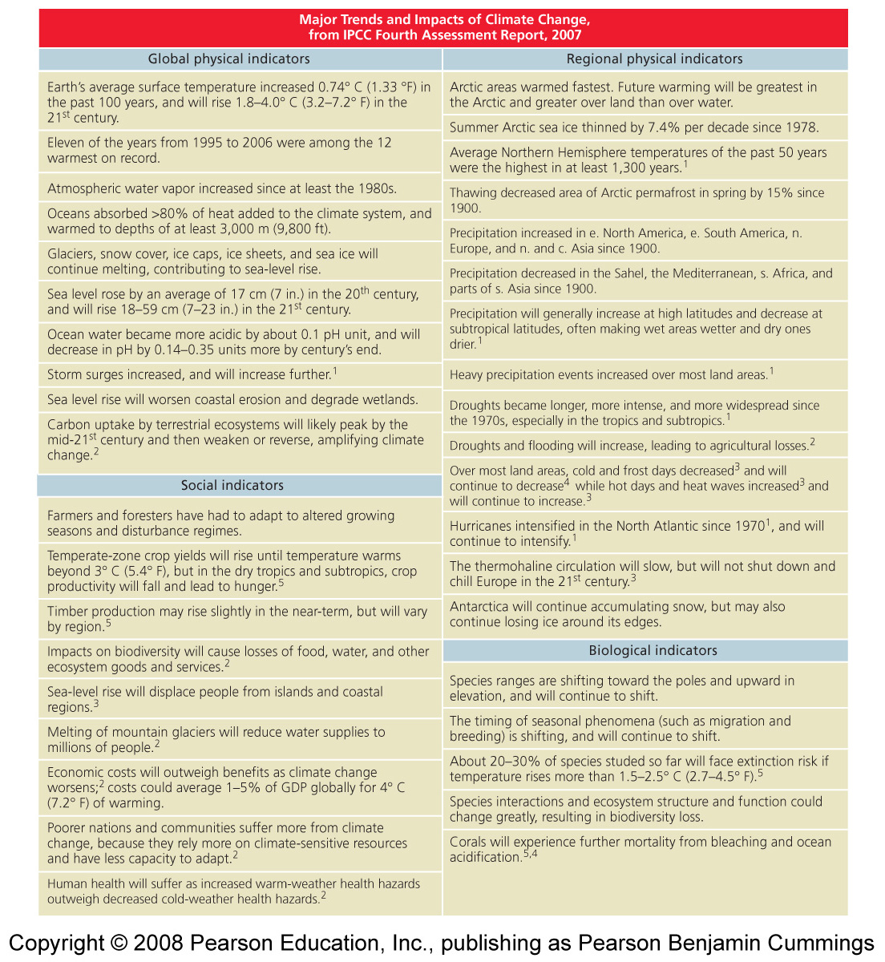

Slide 31
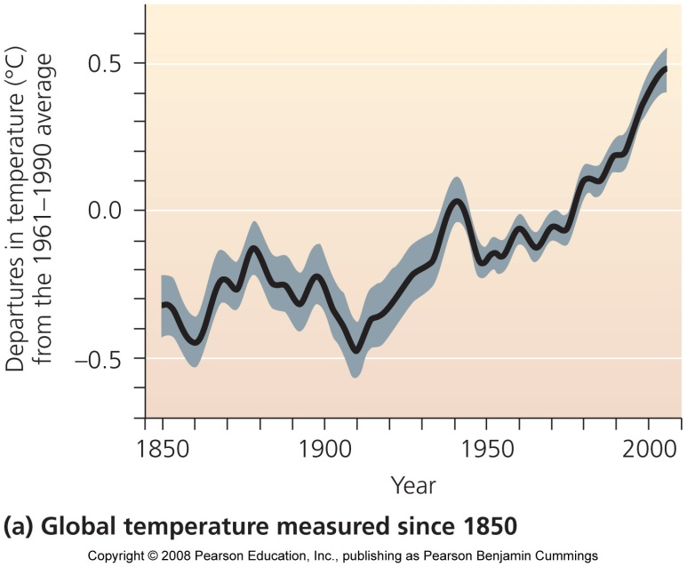
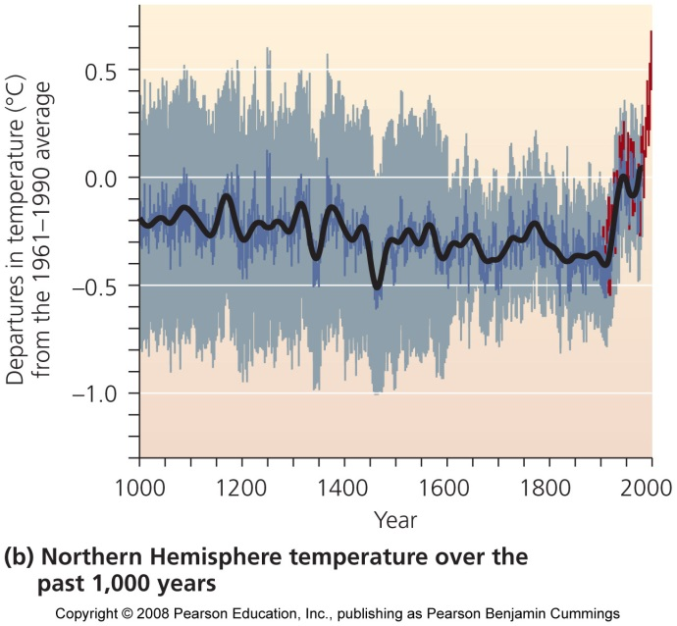
Temperature increases will continue
The IPCC report concludes that average surface temperatures on earth have been rising since 1906, with most of the increase occurring in the last few decades

Slide 32
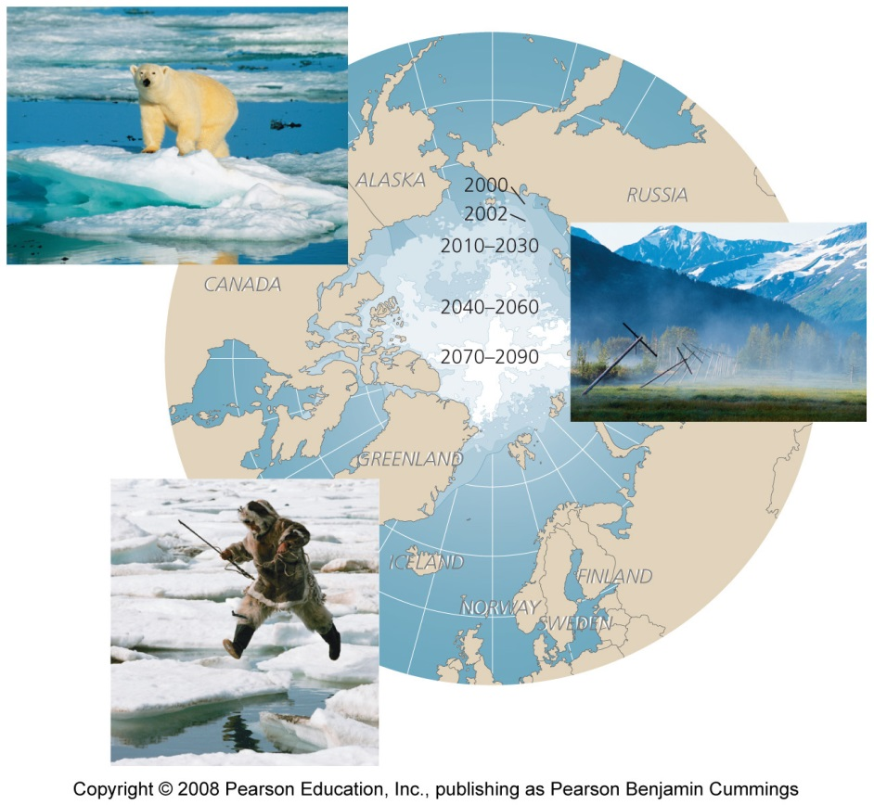
Temperature changes are greatest in the Arctic
Ice caps are melting
Polar bears are starving
Storms are increasing
Sea ice is thinning

Slide 33
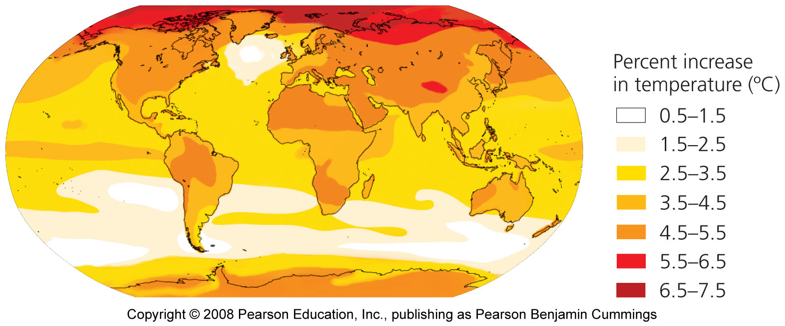
Temperatures will rise 0.2 degree Celsius per decade
More frequent heat waves
Temperature change will vary by region
Stronger storms

Slide 34
Changes in precipitation vary by region
Some regions are receiving more precipitation than usual, and others are receiving less
Droughts have become more frequent and severe
  Harming agriculture, promoting soil erosion, reducing drinking water supplies, and encouraging forest fires
Heavy rains have contributed to flooding
  Killing people, destroying homes, and inflicting billions of dollars in damage

Slide 35
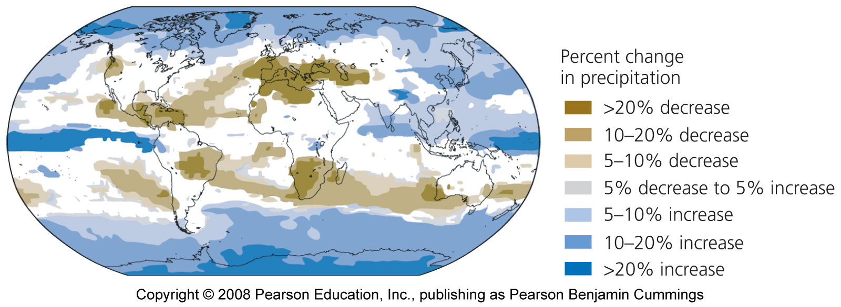
Projected changes in precipitation

Slide 36
Melting snow and ice
Mountaintop glaciers are disappearing
  In Glacier National Park, only 27 of 150 glaciers remain
  Risks of sudden floods as ice dams burst
  Reducing summertime water supplies
Melting of the Greenland ice sheet is accelerating
As ice melts, darker, less-reflective surfaces are exposed and absorb more sunlight, causing more melting

Slide 37
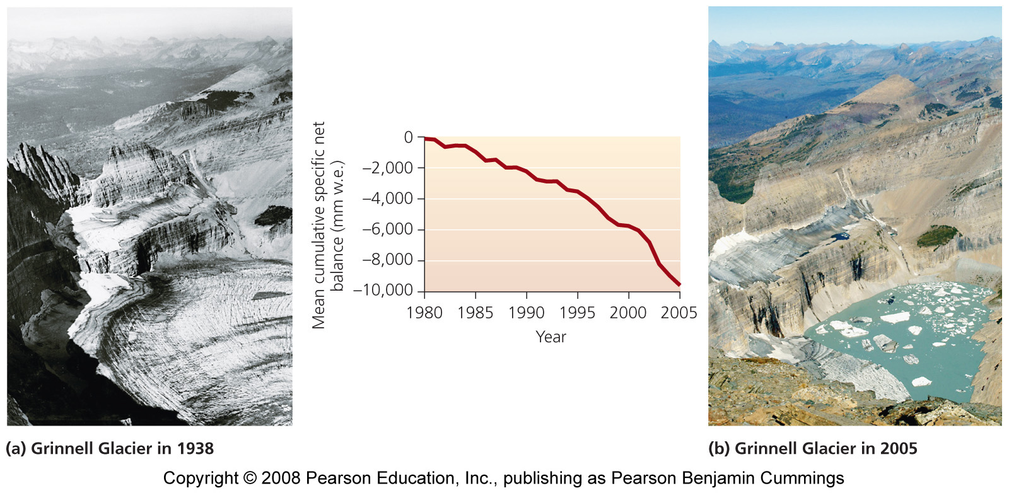
Worldwide, glaciers are melting rapidly

Slide 38
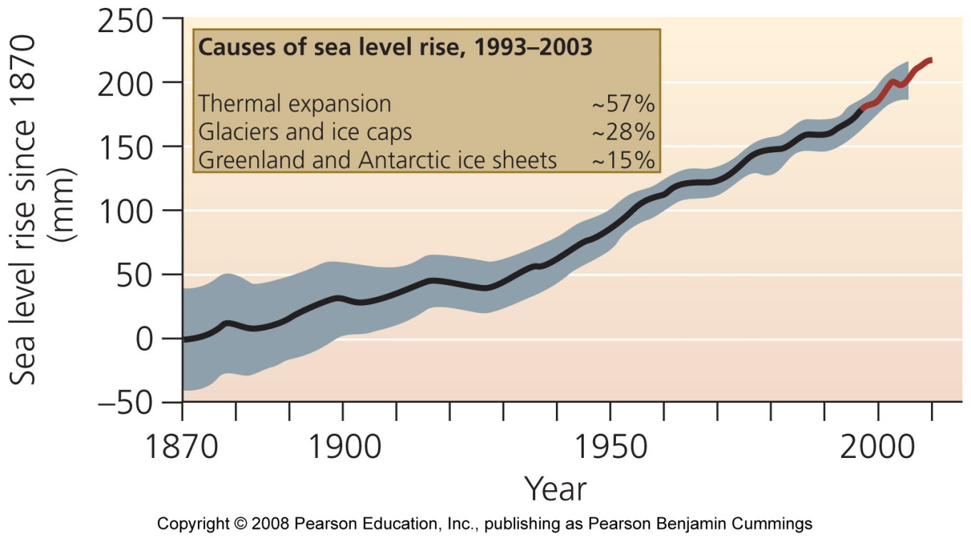
Rising sea levels
As glaciers and ice melt, increased water will flow into the oceans
As oceans warm, they expand
Leads to beach erosion, coastal floods, and intrusion of salt water into aquifers

Slide 39
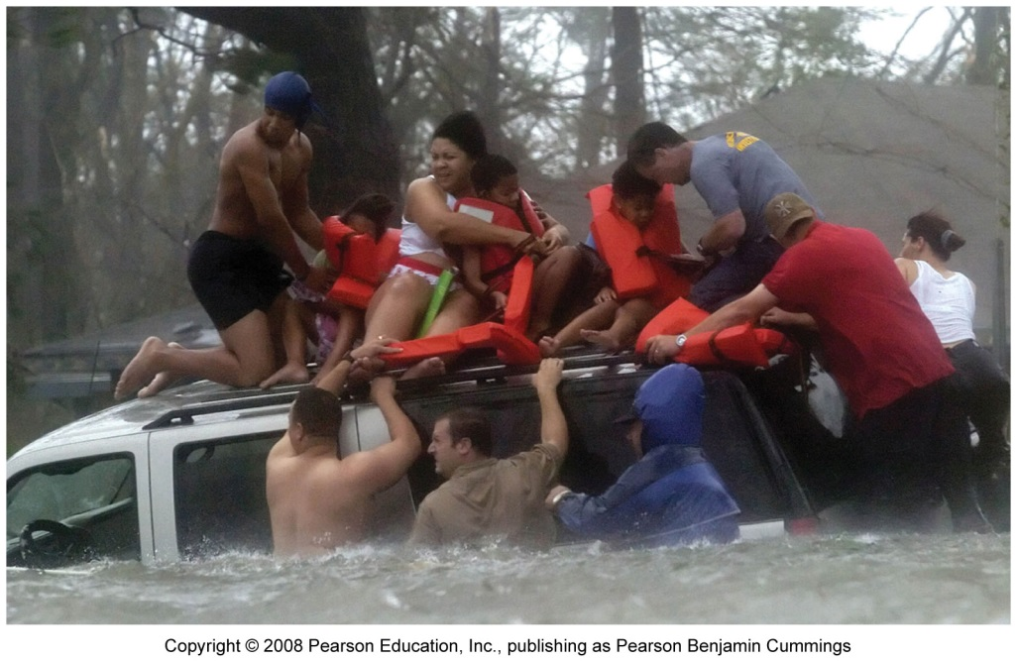
Coastal areas will flood
Storm surge = temporary and localized rise in sea level brought on by the high tides and winds associated with storms
Cities will be flooded
Millions of people will be displaced from coastal areas
IPCC predicts mean sea level to be 18-59 cm (7-23 in) higher than today’s at the end of the 21st century

Slide 40
Climate change affects organisms and ecosystems
Organisms are adapted to their environments, so they are affected when those environments change
Global warming modifies temperature-dependent phenomena
  Timing of migration, breeding
Spatial shifts in the range of organisms
  Animals and plants will move towards the poles or upward in elevation
  20-30% of all species will be threatened with extinction
Plants act as carbon sinks; fewer plants means more CO₂ in the atmosphere

Slide 41
Climate change exerts societal impacts
Human society is beginning to feel the impacts of climate change
Agriculture: growing seasons shortened, crops more susceptible to droughts and failure; crop production will decrease, worsening hunger
Forestry: increased insect and disease outbreaks, increased chance of forest fires (especially in rainforests)
Health: heat waves and stress can cause death, respiratory ailments, expansion of tropical diseases, increased chance of drowning if storms become intense, hunger-related ailments

Slide 42
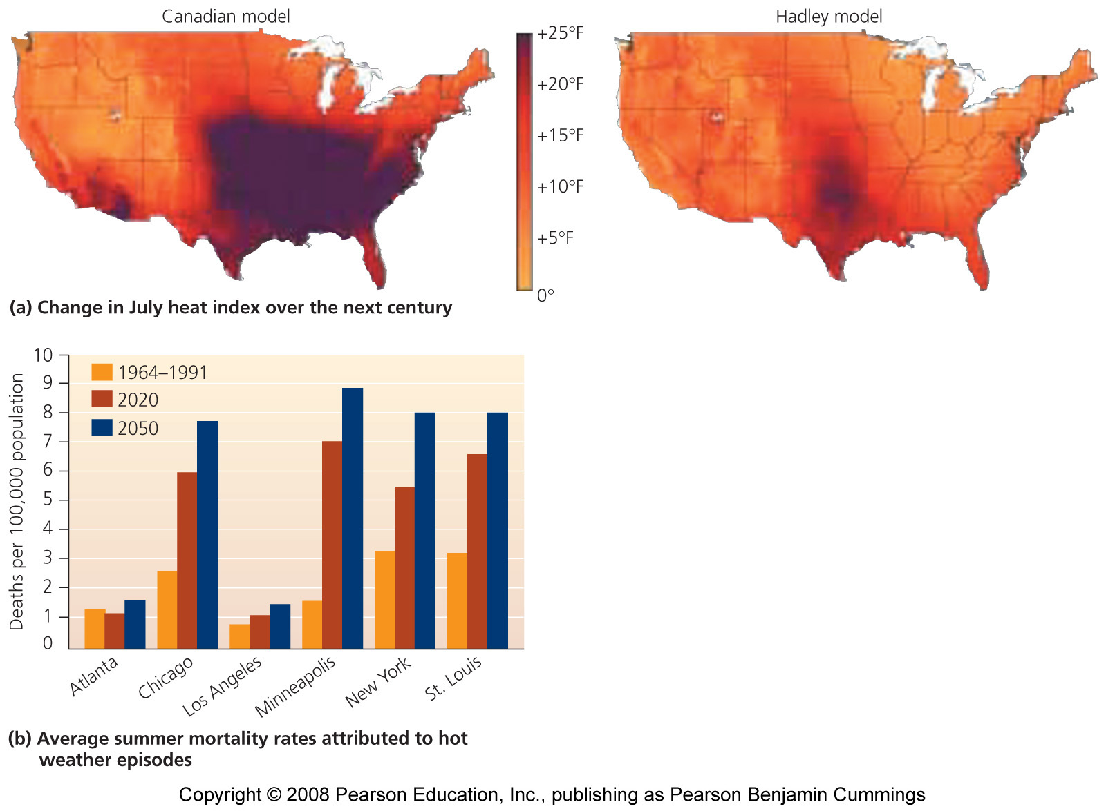
Heat waves will increase

Slide 43
Climate change affects economics
Costs will outweigh benefits
Widen the gap between rich and poor
Will cost 1-5% GDP on average globally
  Poor nations will lose more than rich ones
  Climate change could cost 5-20% of GDP by 2200

Slide 44
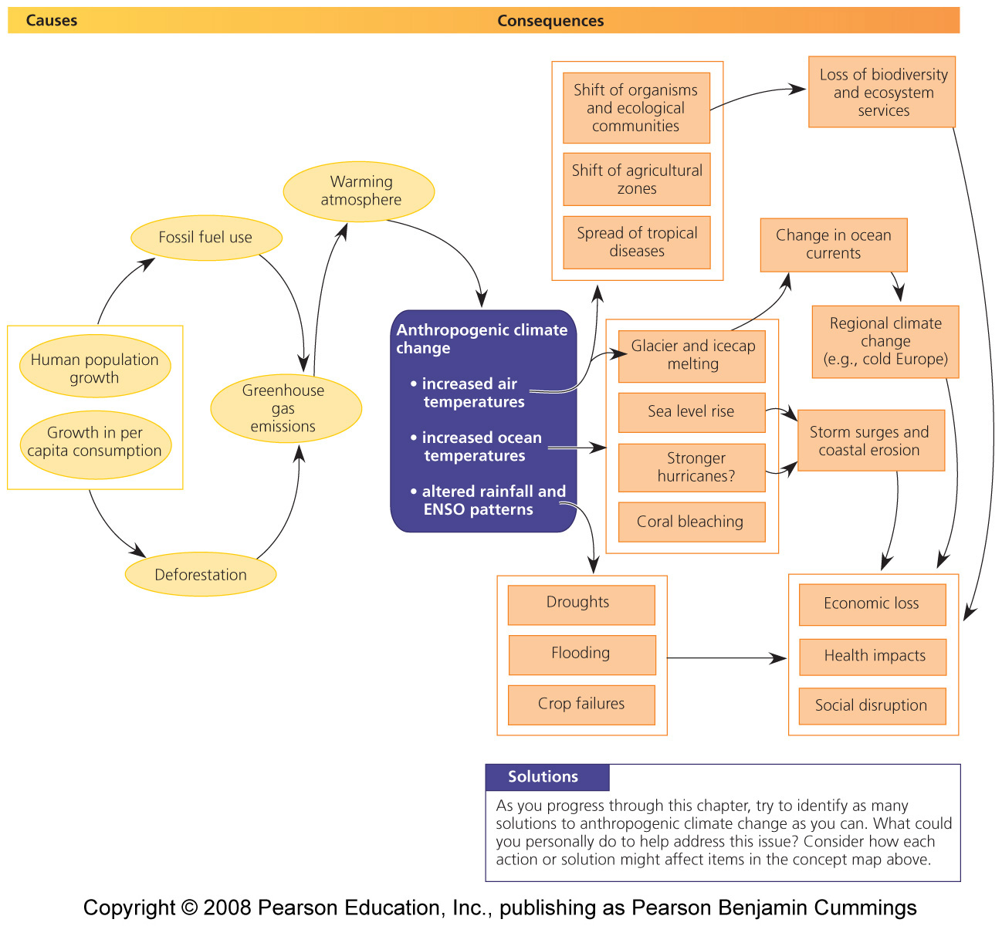
Causes and consequences of climate change

Slide 45
U.S. Global Change Research Program (1990)
Predicted:
  Temperature increases
  Worse droughts and flooding
  Decreased crop yields and water shortages
  Health problems and mortality
  Altered forest ecosystems
  Lost coastal areas
  Undermined Alaskan buildings and roads

Slide 46
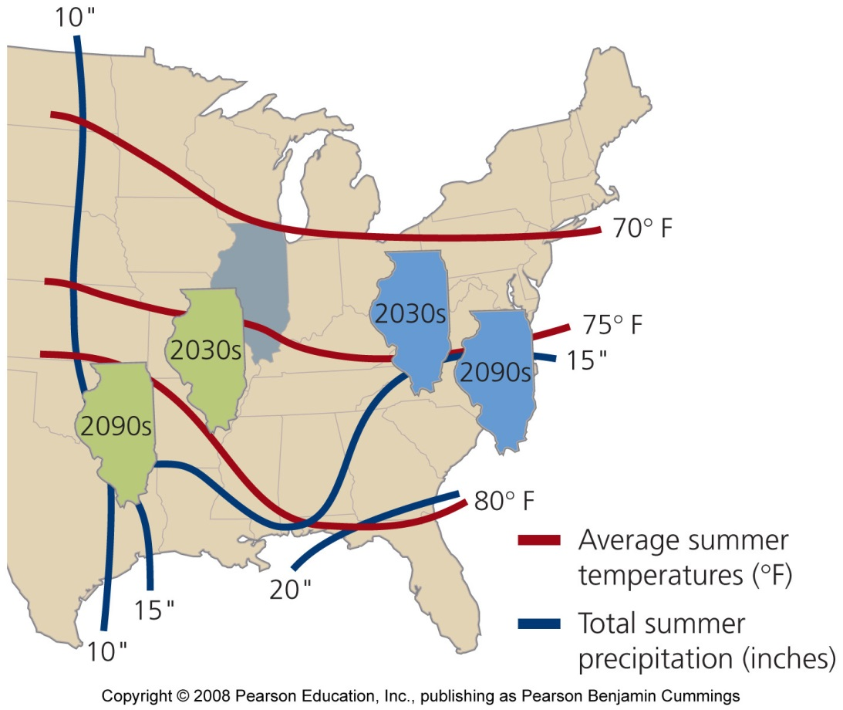
Predictions from two models
By 2030, Illinois will have a climate like Missouri’s.
By 2090, it will have a climate like Oklahoma’s.
Green = Canadian model
Blue = Hadley model

Slide 47
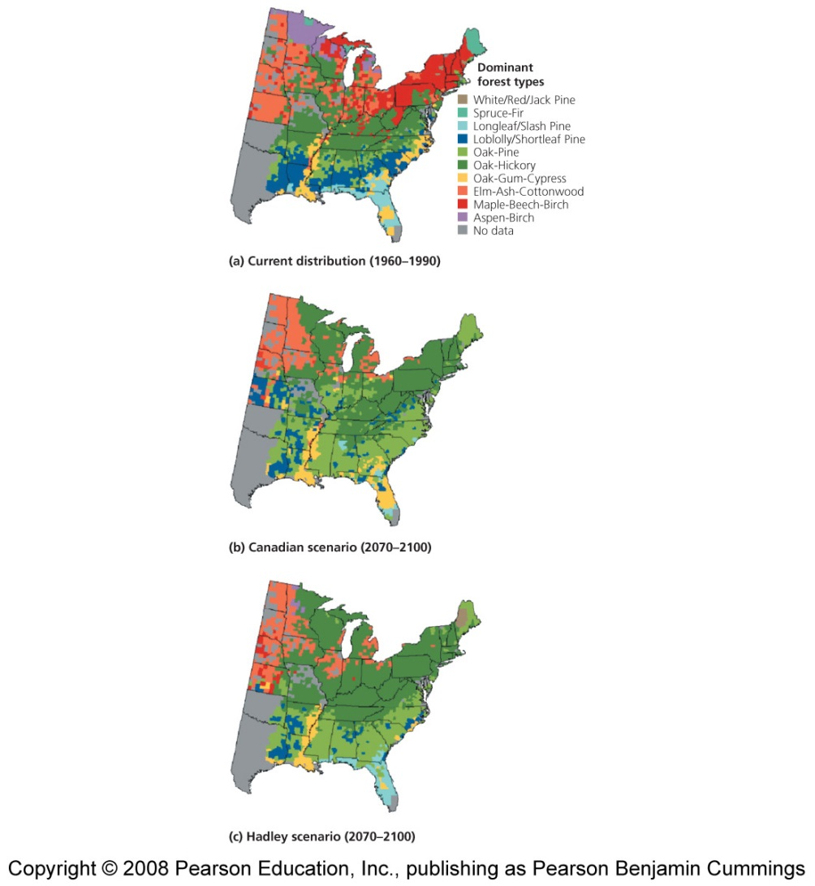
The USGCRP was suppressed
Once President G.W. Bush came to power
Climate change is politically divisive:
  It challenges entrenched and powerful interests

Slide 48
Are we responsible for climate change?
The IPCC concluded that it is more than 90% likely that most global warming is due to humans
At the “G8” summit in 2005, national academies of 11 nations issued a joint statement urging political leaders to take action
Despite broad scientific consensus that climate change is a pressing issue, it remains mired in an outdated debate
  Is global warming real? Are humans to blame?
The debate was fanned by skeptics-funded industry
  Aimed to cast doubt on the scientific consensus
  Today, the debate is largely over

Slide 49
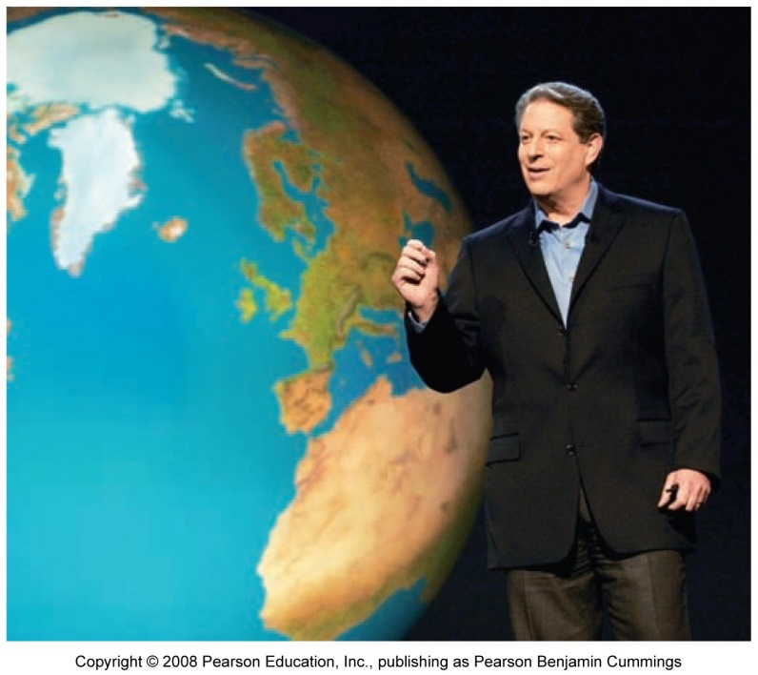
The debate over climate change is over
Most Americans accept that fossil fuel consumption is changing the planet
An Inconvenient Truth helped turn the tide
  84% of people surveyed thought that humans contribute to global warming
  Many corporations offer support for greenhouse gas reductions

Slide 50
Shall we pursue mitigation or adaptation?
Mitigation = pursue actions that reduce greenhouse gas emissions, in order to lessen severity of future climate change
  Renewable energy sources, farm practices to protect soil integrity, preventing deforestation
Adaptation = accept climate change is happening and pursue strategies to minimize its impacts on us
  Criticized as sidestepping
Both are necessary

Slide 51
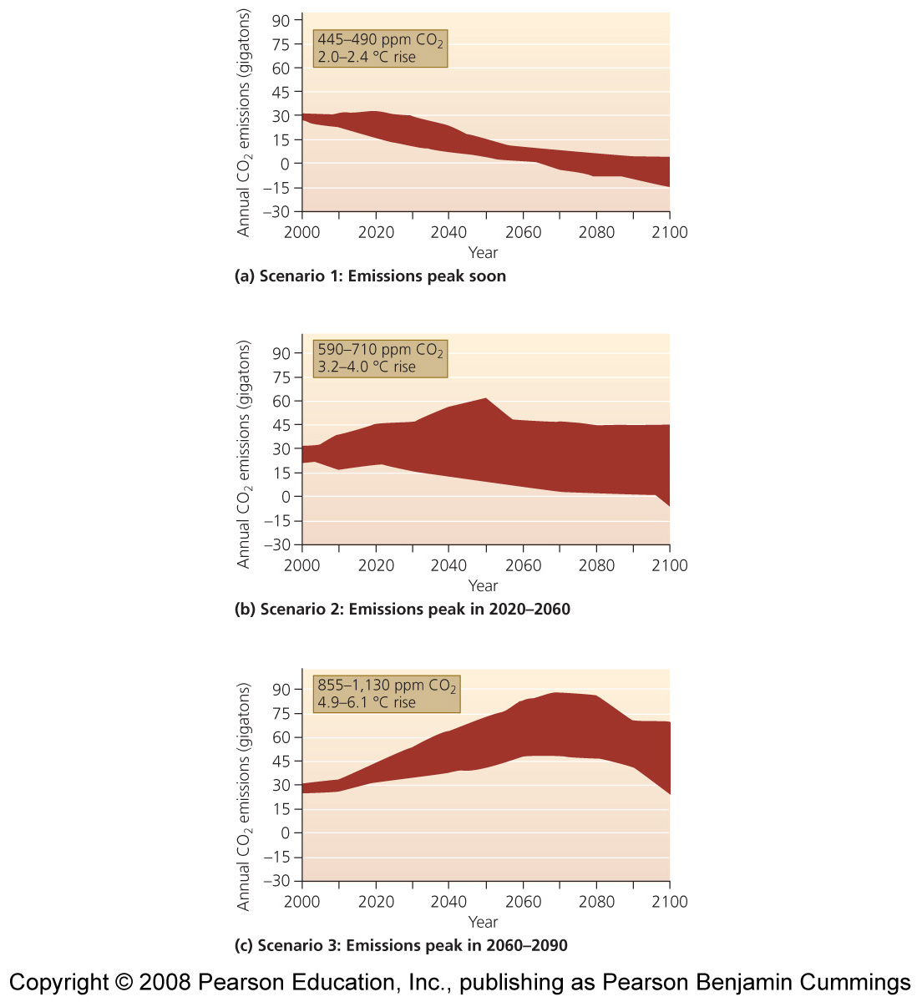
We need to act fast
The faster we reduce our emissions, the less we will alter climate

Slide 52
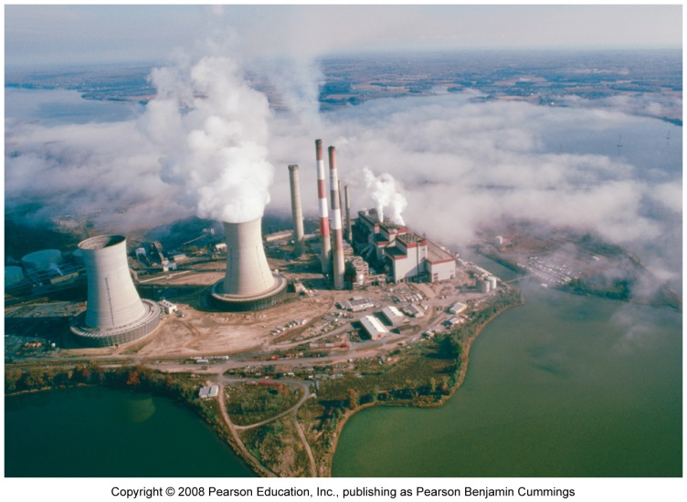
Electricity generation
A coal-fired, electricity-generating power plant
Largest source of U.S. CO₂ emissions
Two ways to reduce fossil fuel use: conservation and efficiency
  Arise from technology and individual choices
  Replacing worn-down appliances with newer models, lifestyle choices
  Use fewer greenhouse-gas-producing products

Slide 53
Sources of electricity
We can change the energy we use
  Natural gas
  Carbon-capture = technologies or approaches that remove CO₂ from power plant emissions
  Carbon sequestration (storage) = storing carbon somewhere (underground?) where it will not seep out
  Use technologies and energy sources without using fossil fuels (nuclear, hydroelectric, solar power, etc.)

Slide 54
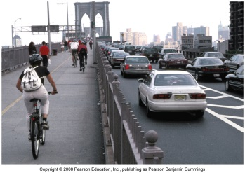
Transportation
2nd largest U.S. greenhouse gas
The typical automobile is highly inefficient
Ways to help:
  Technology: make vehicles more fuel-efficient, hybrid cars
  Drive less and use public transportation
  Public transportation is the most effective way to conserve energy, reduce pollution
  Live nearer your workplace, so you can bike or walk

Slide 55
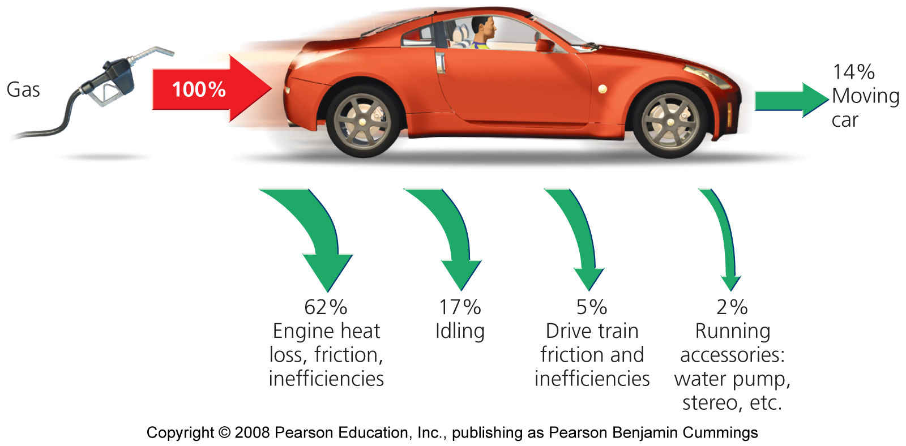
Conventional cars are inefficient

Slide 56
We can reduce emissions in other ways, too
Use advances in agriculture, forestry, and waste management
  Grow renewable biofuels
  Rapid reforestation of deforested areas
  Recovering methane from landfills
  Recycling, composting, and reduction or reuse of materials

Slide 57
We need to follow multiple strategies
There is no single magic bullet for mitigating climate change
Most reductions can be achieved using current technology
Stabilization triangle = a portfolio of strategies, each one feasible in itself, that could stabilize CO₂ emissions
  Not enough, we need to reduce, not merely stabilize, emissions

Slide 58
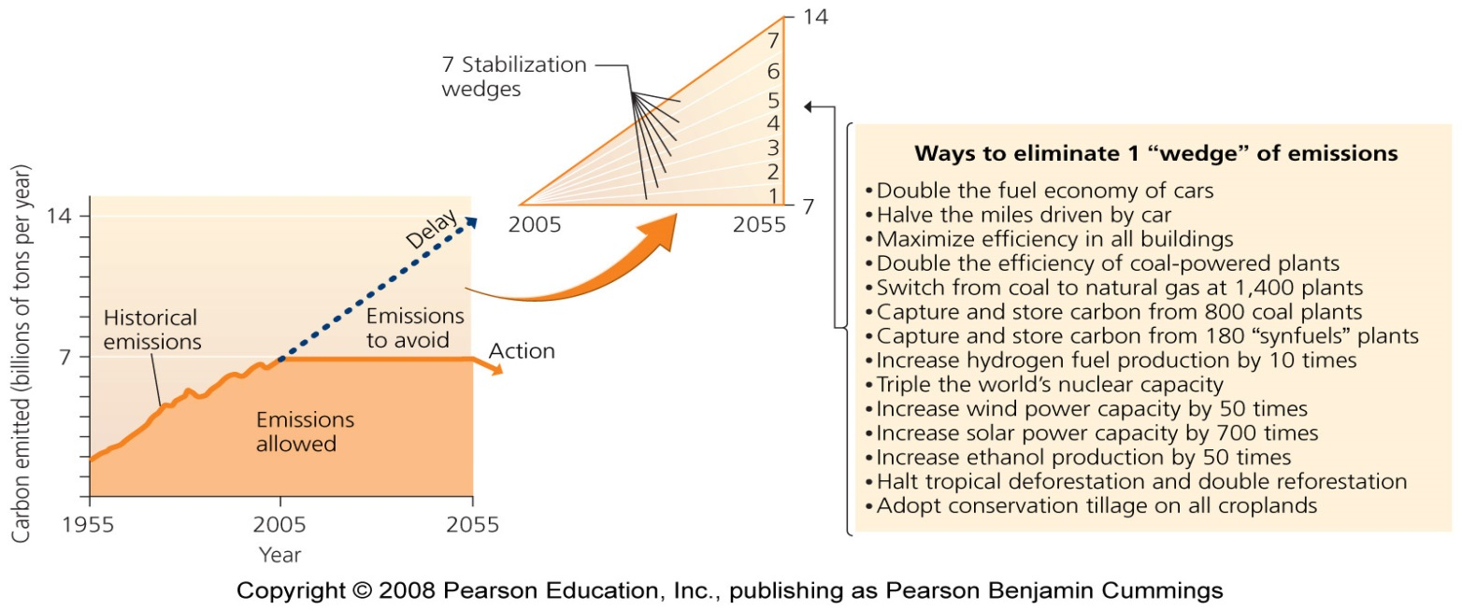
Halting emissions

Slide 59
Government mandates or market incentives?
Governmental command-and-control policy has been vital in safeguarding environmental quality and promoting human well-being
  However, mandates are resisted by industry
  Market incentives can sometimes be more effective in driving change
Policymakers, industry, commerce, and citizens are searching for ways to employ government and the market to reduce emissions in ways that are fair, economically palatable, effective, and enforceable

Slide 60
The FCCC
UN Framework Convention on Climate Change (FCCC) = outlines a plan for reducing greenhouse gas emissions to 1990 levels by the year 2000 through a voluntary, nation-by-nation approach
  By the late 1990s, it was clear that the voluntary approach would not succeed
  U.S. emissions increased by 17.9% from 1990 to 2006
  Germany, with the third most technologically advanced economy in the world, reduced emissions by 17.2% between 1990 and 2004
Developing nations created a binding international treaty that would require all signatory nations to reduce their emissions

Slide 61
The Kyoto Protocol seeks to limit emissions
The Kyoto Protocol mandates that, between 2008-2012, signatory nations must reduce emissions of six greenhouse gases to levels below those of 1990
  This treaty took effect in 2005, after Russia became the 127th nation to ratify it
The United States will not ratify the Kyoto Protocol because it requires industrialized nations to reduce emissions, but it does not require the same of rapidly industrializing nations such as China and India
Businesses in industrialized nations feel they have more to lose economically from restrictions

Slide 62
Advancing climate change policy
George W. Bush and Congress will not address climate change
  State and local governments across the U.S. are responding and advancing policies to limit greenhouse emissions
  Mayors from all 50 states signed the U.S. Mayors Climate Protection Agreement, where the mayors commit their cities to pursue policies to “meet or beat” Kyoto Protocol guidelines
California’s legislature passed the Global Warming Solutions Act, which aims to cut the state’s greenhouse gas emissions 25% by the year 2020
10 northeastern states launched the Regional Greenhouse Gas Initiative (RGGI) in 2007, which set up a cap-and-trade program for carbon emissions from power plants

Slide 63
Market mechanisms address climate change
Permit trading programs can harness the economic efficiency of the free market to achieve policy goals while allowing business
The price of a permit fluctuates freely in the market, creating the same kinds of financial incentives as any other commodity that is bought and sold in our capitalist system
The Chicago Climate Change is the world’s first emissions trading program for greenhouse gas reduction
The world’s largest cap-and-trade program is the European Union Emission Trading Scheme

Slide 64
Carbon offsets are in vogue
Emissions trading programs allow participants who cannot or will not reduce their emissions to use carbon offsets instead
Carbon offset = a voluntary payment to another entity intended to enable that entity to reduce the greenhouse emissions that one is unable or unwilling to reduce oneself
  Becoming popular among utilities, businesses, universities, governments, and individuals trying to achieve carbon-neutrality, where no net carbon is emitted
Carbon offsets fall short
  A lack of oversight to make sure that the offset money accomplishes what it is intended for

