Slide 1
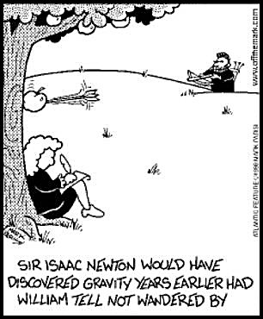
Gravity

Slide 2
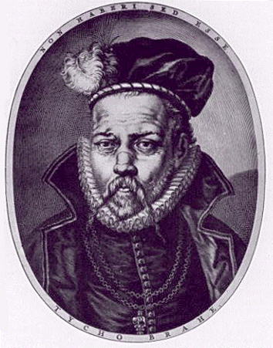
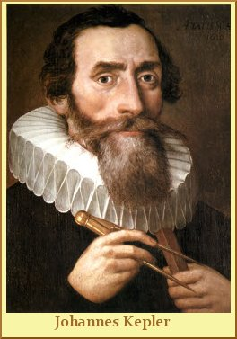
Gravity Before Newton
1575 -1596 Tycho Brahe
-Danish Astronomer who made careful
observations of planetary motion.
1609 & 1619– Johannes Kepler
- After studying Brahe’s data Kepler
developed three laws of planetary motion
-The paths of planets around the sun are elliptical in shape, with the center of the sun being located at one focus
- An imaginary line drawn from the center of the sun to the center of a planet will sweep out equal areas in equal times
- The ratio of the squares of the periods of any two planets is equal to the
ratio of the cubes of their average distance from the sun
1634 – Galileo determines that objects in a free fall accelerate
at 9.8 m/s²
Notes:
Brahe – most accurate observations without a telescope. Died of uremia – kidney failure, thought at the time to have been brought on by holding his pee so as not to seem rude. Recently exhumed to check theory that he died of mercury poisoning. The results were inconclusive

Slide 3
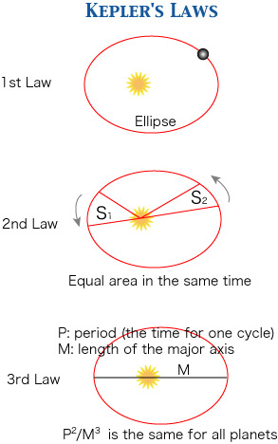
Kepler’s Laws provided a framework
For describing the paths and motion
of planets around the sun
Kepler could not explain why such
Motion existed
His best explanation was that the
planets were magnetically driven
by the sun

Slide 4
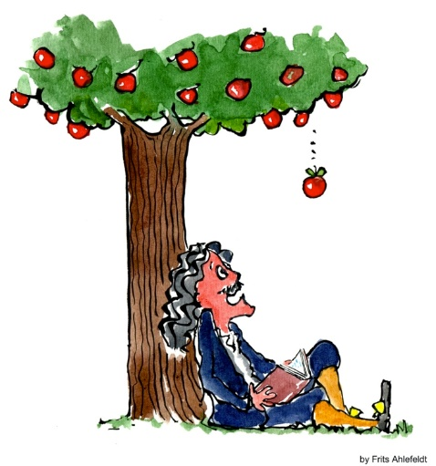
Newton’s Big Idea
Newton understood there had to be a cause for the elliptical motion of the planets – in the absence of an unbalanced force, the planets would continue in a straight line. Newton’s First Law
The Legend - Newton, sitting under an apple tree, realizes that the Earth’s pull on an apple extends also to pull on the Moon.
The reality is that Newton realized that the
same force that caused objects to fall to
Earth was the same force that caused planets to orbit the sun and
the moon to orbit the Earth
So Newton’s Big Idea is that the same set of laws that govern the
actions of things on Earth govern the actions of everything in the
Universe
Known as the Newtonian Synthesis

Slide 5
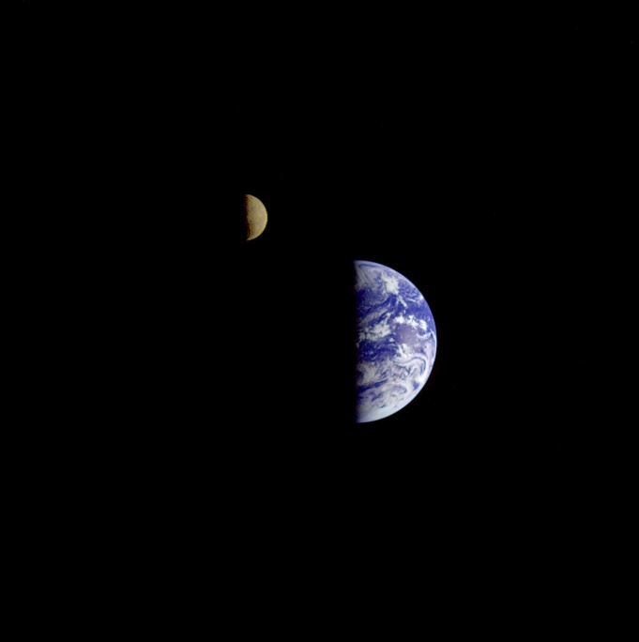
Newton’s Big Idea –
The Universal Law of Gravity
Law of universal gravitation:
Everything pulls on everything else.
Every body attracts every other body with a force that is directly proportional to the product of their masses and inversely proportional to the square of the distance separating them.

Slide 6
The Universal Law of Gravity
In equation form:
where m is the mass of the objects and d is the distance between their centers.
Examples:
    The greater the masses m₁ and m₂ of two bodies, the greater the force of attraction between them.
    The greater the distance of separation d, the weaker the force of attraction.
mass
×
mass
m
m
Force
~
₁
₂
or
F
~
₁
₂
distance
d
²
²

Slide 7
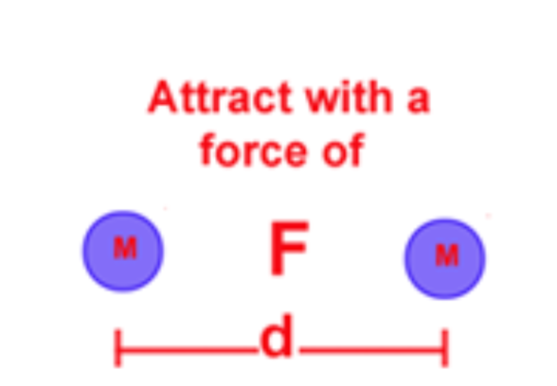
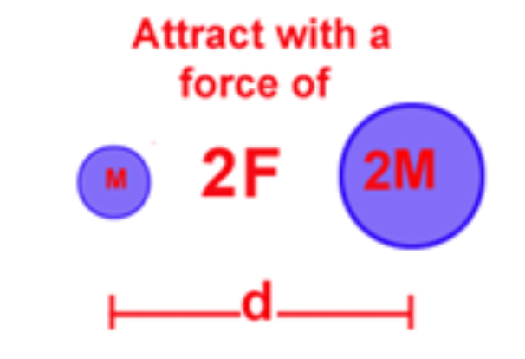
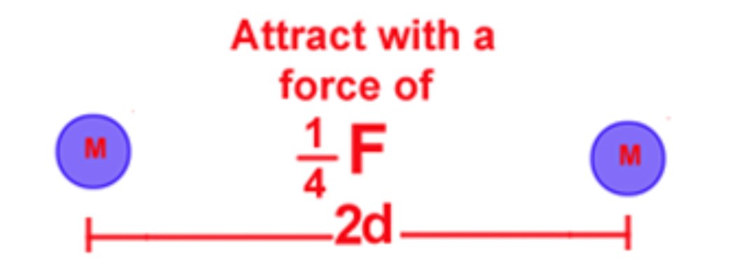
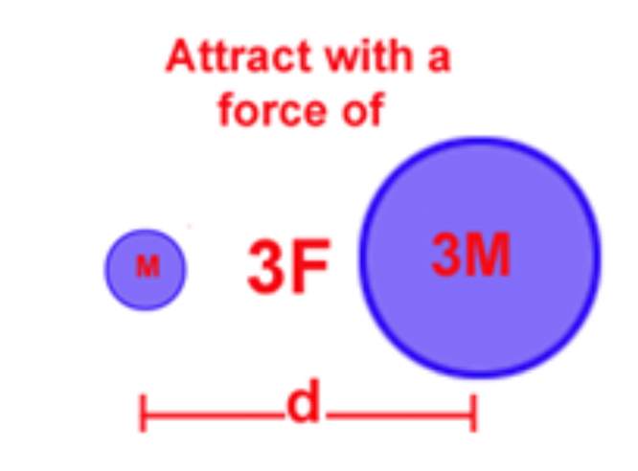
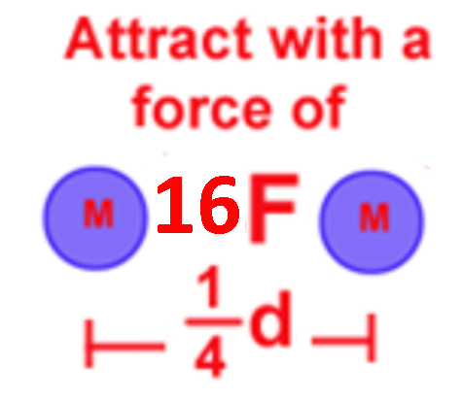
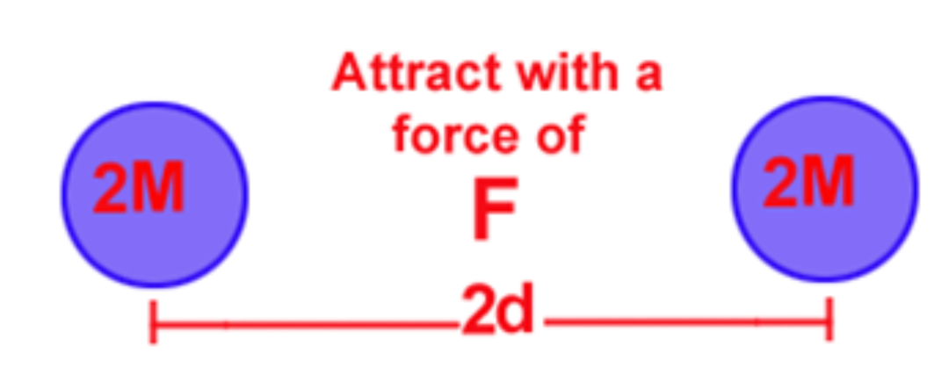
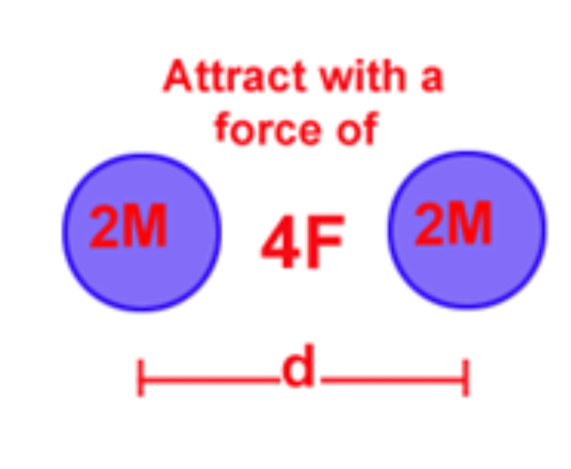
Law of Gravitation Examples
Let the equation
be your guide
m₁
m₂
F
~
d
²
Which has a greater
impact on F_{grav} a
change in mass or a
change in distance?

Slide 8
Gravity and Distance: The Inverse-Square Law
Inverse-square law:
relates the intensity of an effect to the inverse- square of the distance from the cause.
- in equation form: intensity = 1/distance².
- for increases in distance, there are decreases in force.
- even at great distances, force approaches but never reaches zero.
- Everything in the Universe has a gravitational interaction with everything else
Notes:
Any effect which has a point source acts equally in all directions and has no limit to its range follows the inverse square law. Light, Electromagnetism, sound radiation

Slide 9
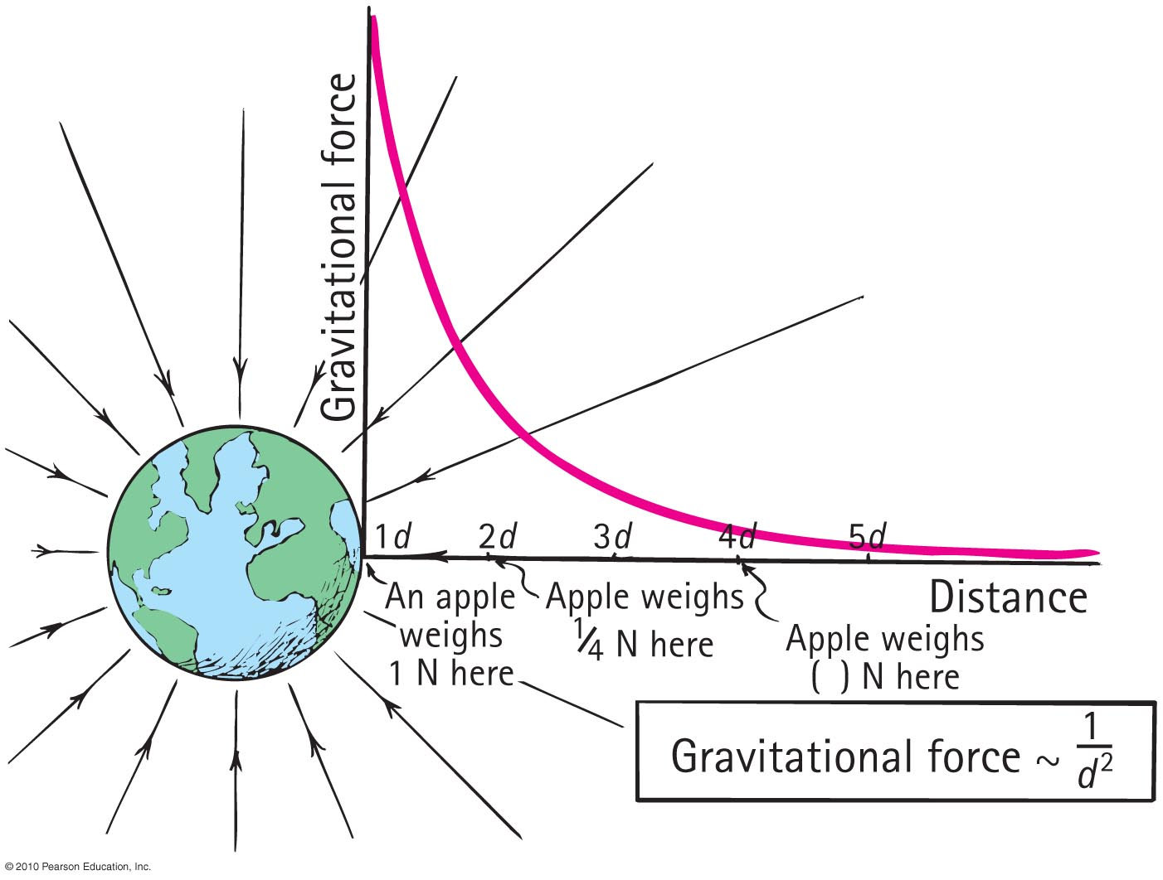
Inverse-Square Law

Slide 10
The Gravitational Constant ( G )
Newton realized that in order to precisely calculate the force of gravity between any two objects, a constant of proportionality was required.
This constant called the Universal Gravitational Constant is represented with G
With the addition of G becomes
m₁
m₂
F
~
d
²

Slide 11
Calculations of Gravity using G
Universal gravitational constant:G = 6.67 × 10⁻¹¹ N m²/kg²
- the unit N m²/kg² allows F to be in Newtons
Example: A 3kg mass and a 2 kg mass are separated by a distance of 5m
Example: Mr. Kirwan has a mass of 98kg. Fluffy the Wonder Hamster has
a mass of 0.1kg. If they stand 2m apart, what is the gravitational
force of attraction between them?
grav
F = 6.67 x 10⁻¹¹ N m² (3 kg) (2 kg)
kg² (5 m)²
6.67 x 10⁻¹¹ N m² (6 kg²)
kg² 25 m²
=
grav
Fgrav = 1.60 x 10⁻¹¹ N
F = 6.67 x 10⁻¹¹ N m² (98 kg) (0.1 kg)
kg² (2 m)²
6.67 x 10⁻¹¹ N m² (9.8 kg²)
kg² 4 m²
=
grav
Fgrav = 1.63 x 10⁻¹⁰ N

Slide 12
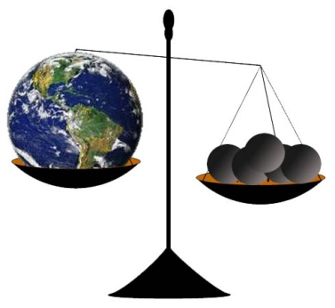

Determining the Mass of the Earth
Use Newton’s Universal Law of
Gravitation
becomes
In this case,d is the radius of the Earth which = 6.4 x 10⁶ m
In this case, F_{grav} is the gravitational force that the earth exerts on a mass of 1 kg at its surface = 9.8 N
(9.8 N) (6.4 x 10⁶ m)²
= 6 x 10²⁴ kg
(6.67 x 10⁻¹¹ N m²/kg²) (1kg)

Slide 13
Gravitational Fields-A Real Life Force Field
Earth and Moon interact at a distance – That is they interact without touching – action at a distance
One way to think of this:
  Earth is surrounded by a gravitational field.
  Moon interacts with this gravitational field.
Gravitational field is an alteration of space around Earth (or any object with mass).
  Gravitational field is an example of a force field (another example: magnetic field).
Notes:
Ask if students can think of any other examples of gravity at a distance

Slide 14
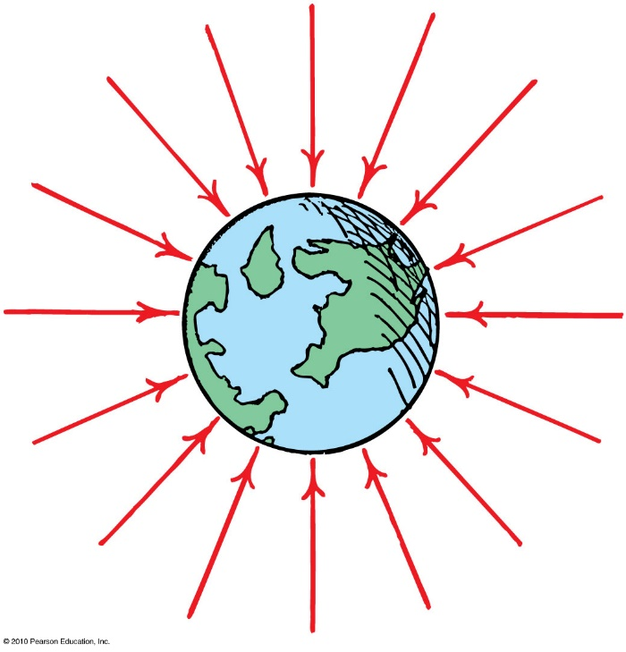
Gravitational Fields
Fields are represented by field lines radiating into the object (Earth).
The inward direction of arrows indicates that the force is always attractive to Earth.
The crowding of arrows closer to Earth indicates that the magnitude of the force is larger closer to Earth.

Slide 15
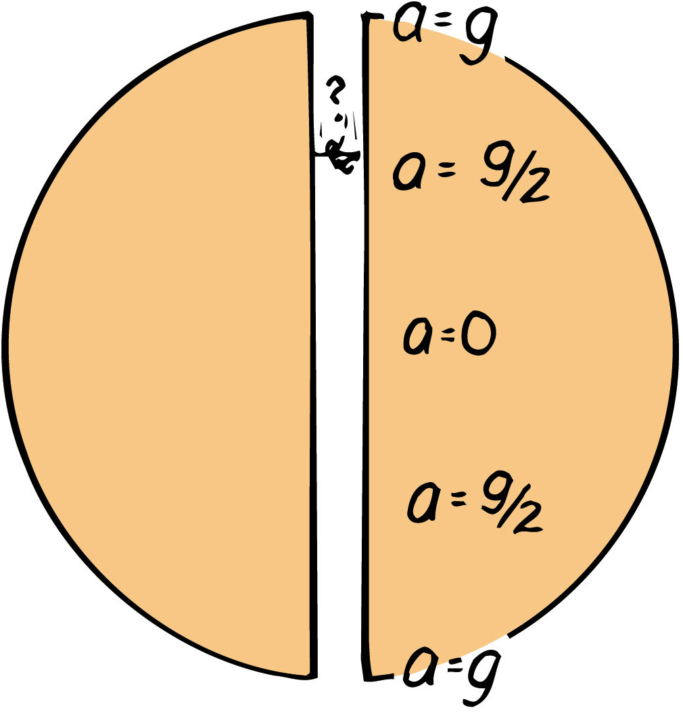
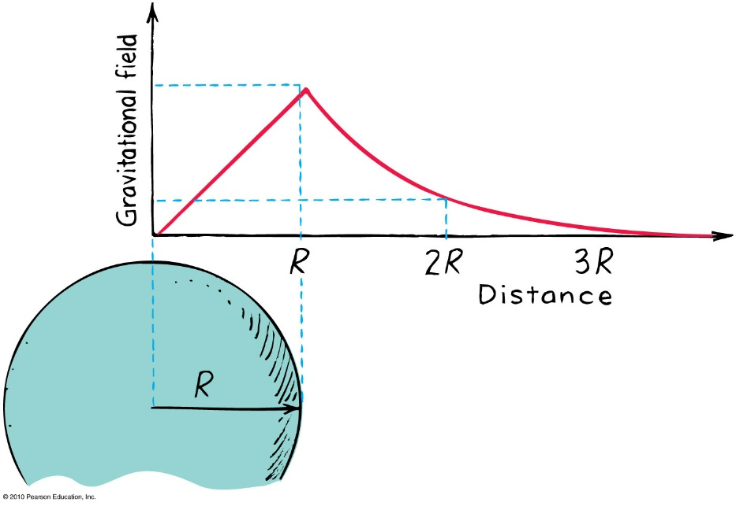
Gravitational Fields
Inside a planet, it decreases to zero at the center
  because pull from the mass of Earth below you is partly balanced by what is above you.
  At the center, F_{grav} = 0 so g = 0
  - Someone falling through the earth
  would have 0 acceleration but
  maximum velocity at the center
  Falling Through The Earth: Ask a Physicist
So if F_{grav} decreases as one moves away from a planet, and it also decreases as you move into a planet, where is it the strongest?
F_{grav} is strongest on a
planet’s surface
Notes:
Start video at 1:20
At the core you would have max v and 0 a If air resistance etc… is neglected v at the center would be 7900 m/s 17,671.8 mph Trip from one side to the other would take 42 min

Slide 16
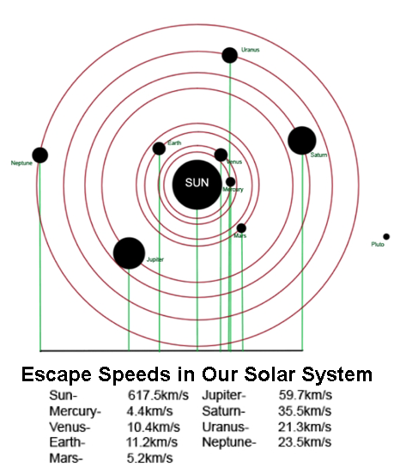
Escape Speed
One way to measure the gravitational force of a planet is to refer to the speed that something needs to go to escape the gravitational force of a planet’s surface.
- This is speed is called the Escape Speed
-Earth’s escape speed is 11,200 m/s meaning any projectile travelling at least 11,200 m/s will be able to leave earth
Notes:
If an object is powered, it does not have to go 11,200 m/s since it can continually do work against gravity

Slide 17
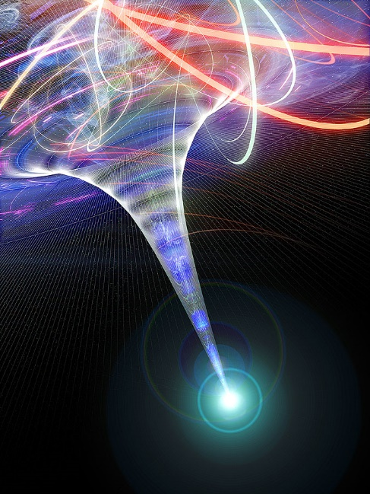
Black Holes
Black Holes are formed when a star collapses in on itself.
- none of the mass of the star is lost, but the radius is reduced to almost nothing
- According to Newton this would create a tremendous gravitational force
- The black in the term Black Hole refers to the fact that light can’t escape its gravitational pull
Why are they called holes?
To understand that, you need to
understand Einstein’s explanation of
gravity

Slide 18
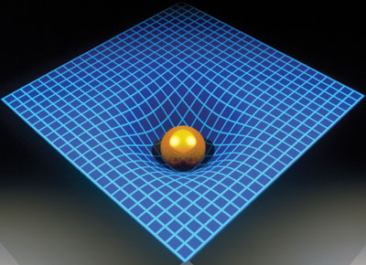
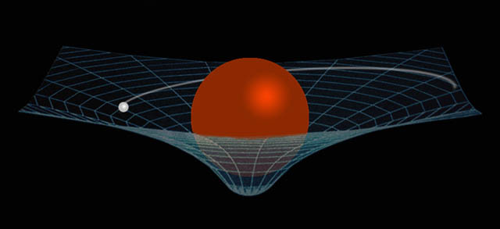
Einstein’s Theory of Gravitation
Einsteins General Theory of Relativity proposed that space and time were a single four dimensional entity he referred to as space-time and an object with mass deforms space-time
- the greater the mass of an object, the greater the deformation of space-time around the object.
The warped space-time affects the motion of other objects
-according to Einstein, objects like the planets in our solar system orbit a more
massive object like the sun because the
distortion of space-time by the sun causes
their paths to curve

Slide 19
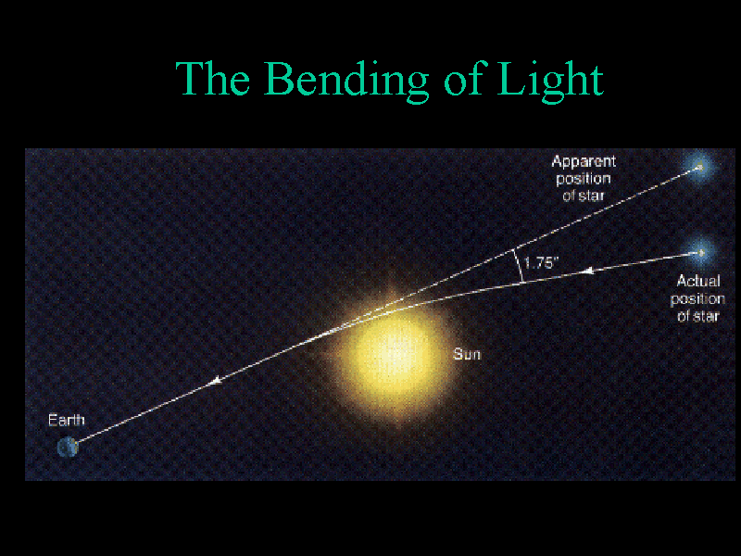
Notes:
Experiment conducted by Arthur Eddington proved relativity. During an eclipse in 1919 he

Slide 20
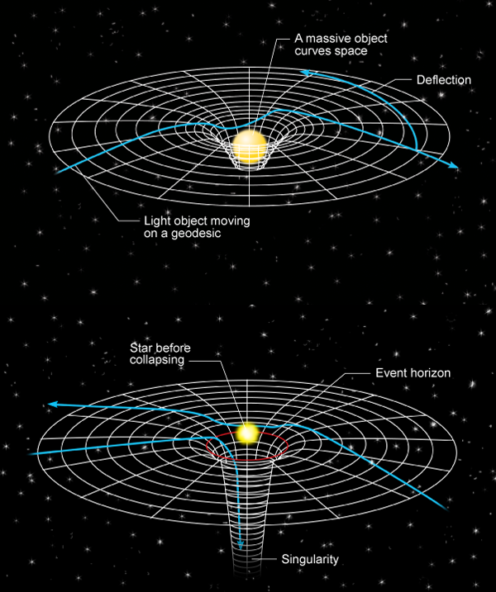
Relativity and Black Holes
The distortion of space-time created by
black holes is massive
The closer one gets to a black hole the
greater the curvature of space and the
black hole is basically a bottomless pit in
space-time
The boundary between the inside of a
black hole and the rest of the universe
is called the event horizon
Anything crossing the event horizon
can never return to the universe
More importantly, the tidal forces
of a black hole would tear you apart
M

Slide 21
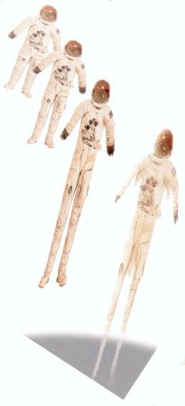
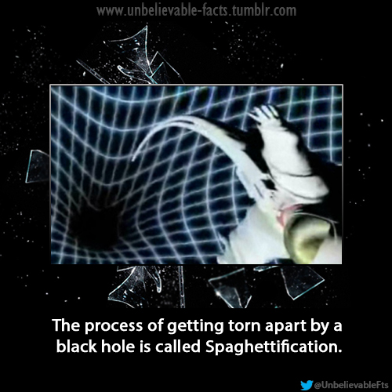
Tidal Forces
Are created when the force of gravity acting on an object isn’t equal across the entire object
-The gravitational forces at the event horizon are so extreme that they would create exceptionally strong tidal forces in anything that approaches it.
- Tidal forces acting on an astronaut falling feet-first toward a black hole. The pull of the black hole would be much stronger on his feet than on his head. This would cause his feet to accelerate faster than his head stretching and ultimately tear him apart.
M

Slide 22
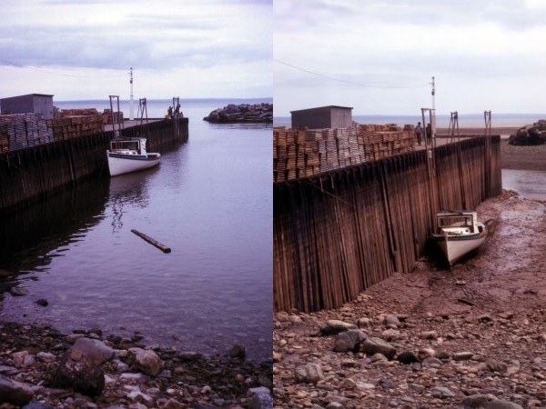
Tidal Forces Closer to Home
Tidal forces created by the gravitational attraction between the moon and the earth create tides on earth
High Tide
Low Tide
Bay of Fundy Nova Scotia where tides
can vary by as much as 16m (54 ft) daily
M

Slide 23
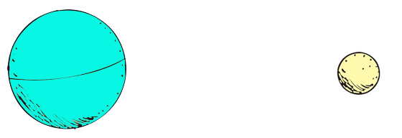
Newton’s Law of Gravitation and Tidal Forces
According to Newton’s Universal Law of Gravitation, the gravitational
attraction between the moon and the earth isn’t uniformly distributed
across either body
Remember the inverse nature of gravity
1
d²
The sides of the bodies closest to each other experience a greater gravitational
pull than the sides that are farthest apart
M

Slide 24
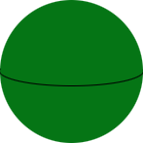
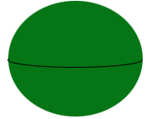

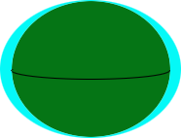
A Simplified Model of Tides
The unequal gravitational pull between the moon and the Earth causes the Earth to elongate and bulge outward
The diameter of the earth at the poles is 43 km less than at the equator
This unequal gravitational pull has a greater effect on the oceans causing
them to elongate farther than the earth
The tides in the earth are measured in cm, the tides in the ocean are
measured in meters
M

Slide 25
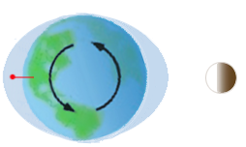
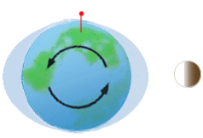
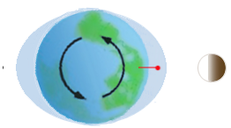
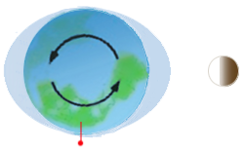
Daily Tidal Fluctuations
We experience daily tides as the earth rotates into and out of the bulge of the
oceans
This causes 2 high tides and 2 low tides daily alternating every 6 hours
High Tides
Low Tides
M

Slide 26
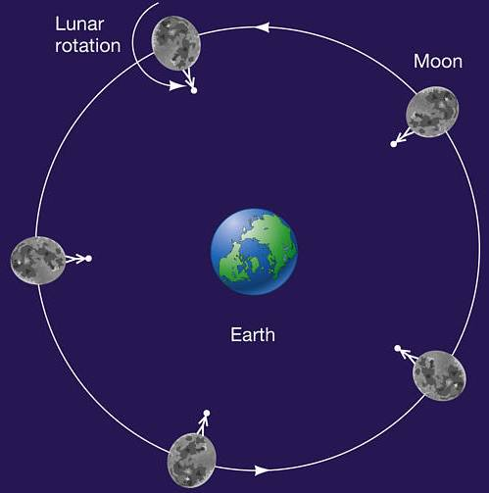
Tidal Locking aka Captured Rotation
Occurs when the difference in gravitational pull across an astronomical body causes it to always face another astronomical body
In the same way that the gravitational attraction of the moon and earth cause the earth to elongate, it causes the moon to elongate
The moon initially rotated like the earth, as it did, it experienced tides
The tides in the moon caused mechanical friction within the moon and torque which absorbed the rotational energy of the moon
Over time, the moon’s rate of rotation slowed down until its rate of rotation matches its orbital period
As a result we always see the same face of the moon
M

Slide 27
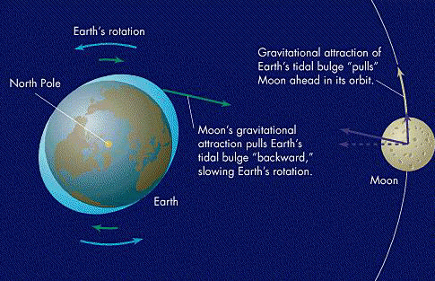
Gravitational Locking and the Earth
The tidal effect of the moon on the earth and its oceans are gradually slowing the earth’s rotation
The slowing is causing days to become longer at a rate of 0.002 s / century
Evidence shows that during the Cambrian period 600 million years ago, day length was 21 hours – 418 days in a year
Eventually, the earth’s rate of
rotation will be slowed down
enough that it matches the moon’s
Both bodies will then perpetually
show the same face to each other
M

