Slide 1
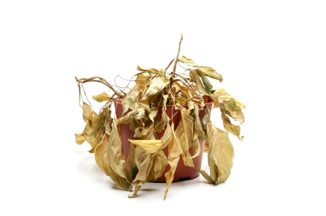
Herbicides!!!

Slide 2
General Safety Rules
Use only approved pesticides
Read the label before application
Use the pesticide with the lowest toxicity
Use only when needed
Apply in good weather

Slide 3
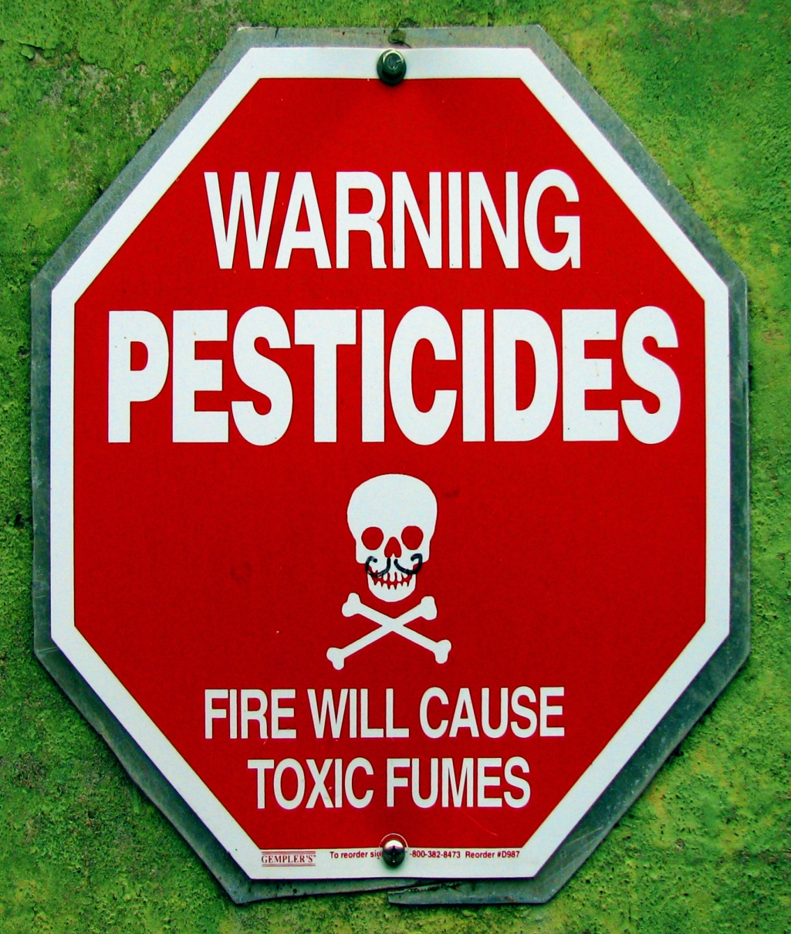
Types of Pesticides
Systemic poisons
Contact poisons
Fumigants
Stomach poisons
Suffocation agents
Repellents
Fatal Attraction action

Slide 4
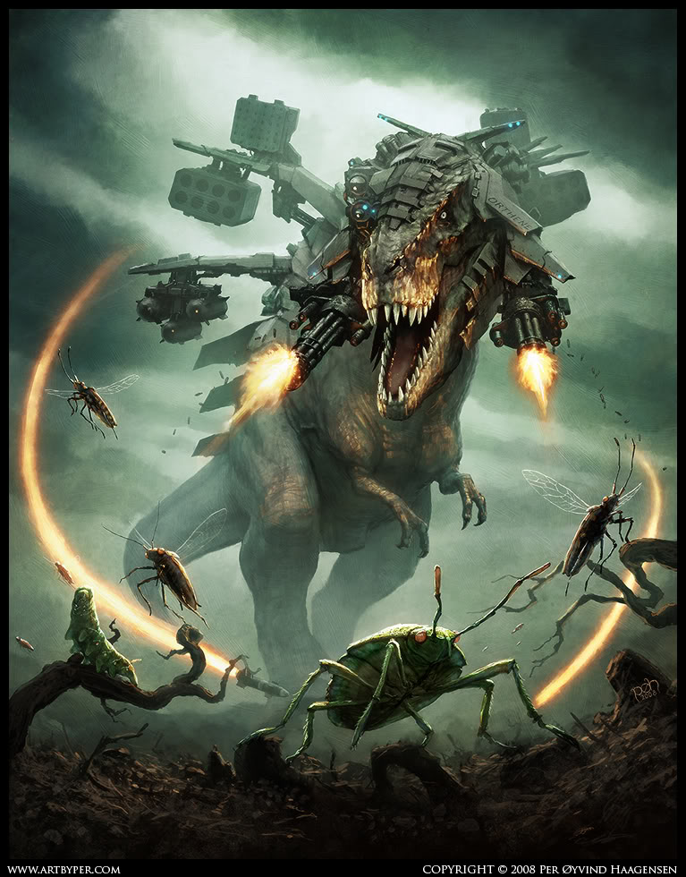

Slide 5
Which do herbicides fall in to?

Slide 6
Systemics
Foliar spray or soil drench
Insects eat it, destroys digestive and CNS
Ex: orthene, last girlfriend’s cooking, and glyphosate (NOT FOR USE ON FOOD CROPS)

Slide 7
Contact
Absorbed through the exoskeleton.
Attacks respiratory and nervous systems
Ex. Malathion

Slide 8
Fumigants
Enter through respiratory system
Effective in greenhouses
Dispersed over a large area
        Ex. phosphene, High school girlfriend

Slide 9
Stomach poisons
Must be ingested by insect
Ex. rotenone

Slide 10
Repellents
Designed to dissuade not kill
Ex. Bordeaux mix

Slide 11
Fatal attraction
Utilizes pheromones
Catch and kill usually male insects such as Japanese beetle
Ex. Ladybird pheromone, my ex. All of them.

Slide 12
Herbicides
Are mostly systemic or contact
They are classified by
  Selectivity
  Timing
  Method
  Chemistry
  Formulation

Slide 13
Selectivity
Selective herbicides are effective in controlling a limited number of plant species.
  For example, 2,4-dichlorophenoxyacetic acid (2,4-D) kills broadleaf weeds and does not affect grasses.
Nonselective herbicides kill literally. Everything.

Slide 14
Timing
There are three stages of life cycle when herbicide can be applied
  Preplant
  Preemergence
  Postemergence

Slide 15
Method
Broadcast –cover all area uniformly.
        Ex: The Korean ex’s parents. Always around. Always.
Band – apply in a …band… like a line …not like… full of brass and… percussion
Spot –apply in a small area.

Slide 16
Chemistry
Organic – made of carbon.
        Ex. Phenoxy dipehenyl ethers, Fusilade, most of the things I’ve dated.
Inorganic – not organic
        Ex. All hebicides that are not organic. You just wrote that didn’t you.

Slide 17
Formulations
Liquids- Most common type of herbicide (sprays)
        Ex. Mace, Malathion
Granuals – small balls or compacted powders

