Slide 2
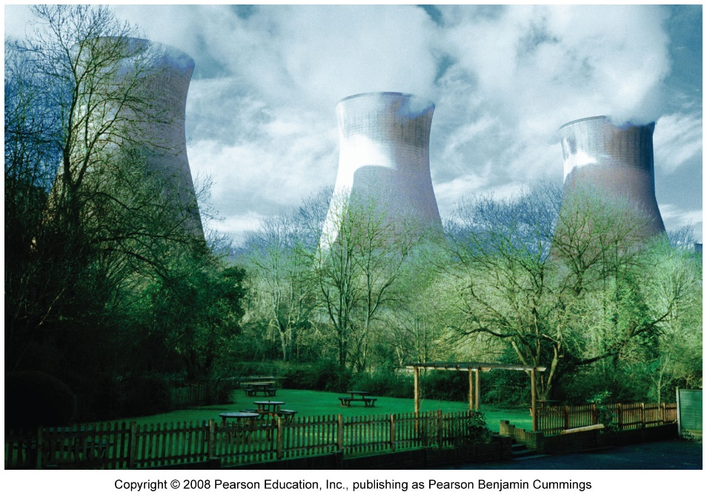
This lecture will help you understand:
Reasons for seeking alternative fuels
Contributions to world energy by alternative fuels
Nuclear energy
The social debate over nuclear energy
Biomass energy
Hydroelectric power

Slide 3
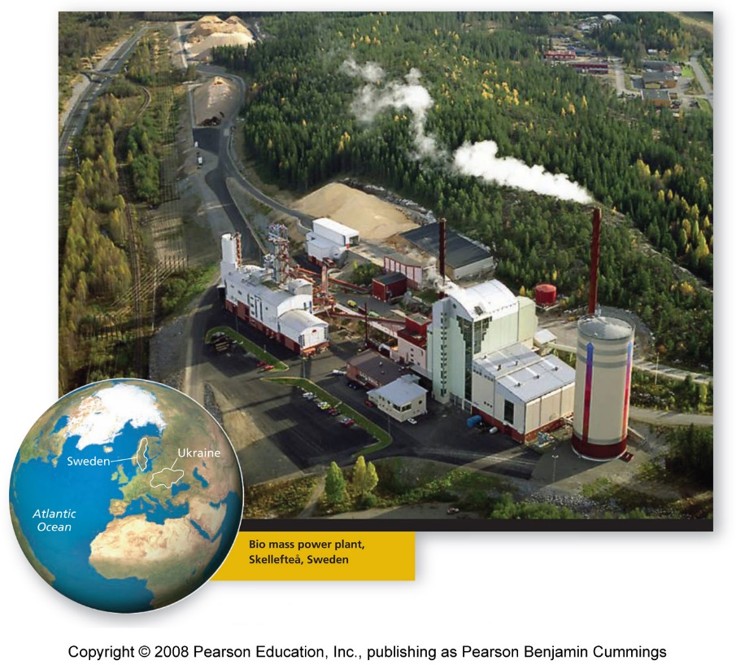
Central Case: Sweden’s search for alternative energy
In 1980, Sweden’s electorate voted to phase out nuclear energy, but it’s been difficult
The government has promoted the development of hydroelectric, biomass, and wind power
Sweden is an international leader in renewable energy alternatives, but it still relies on nuclear power

Slide 4
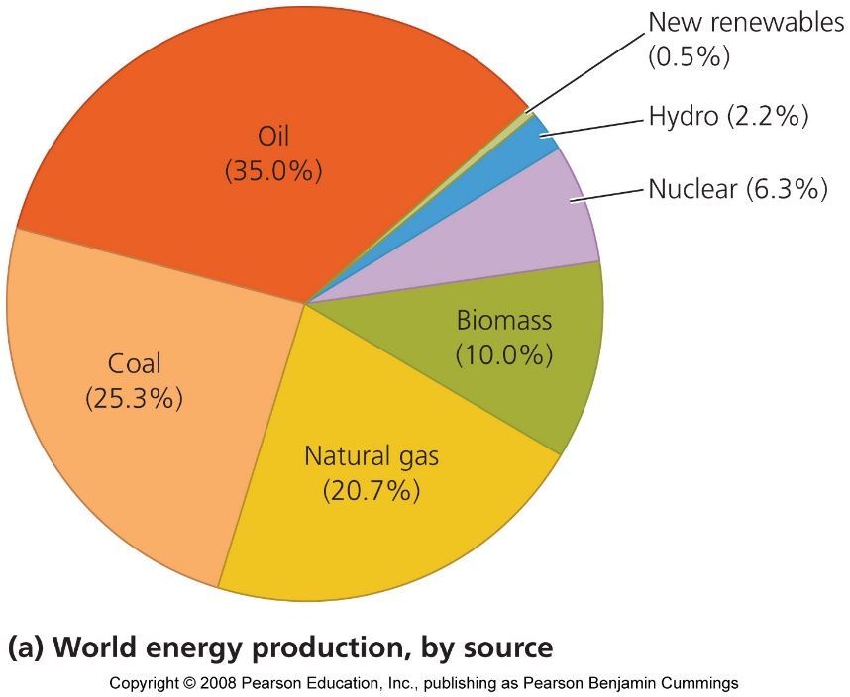
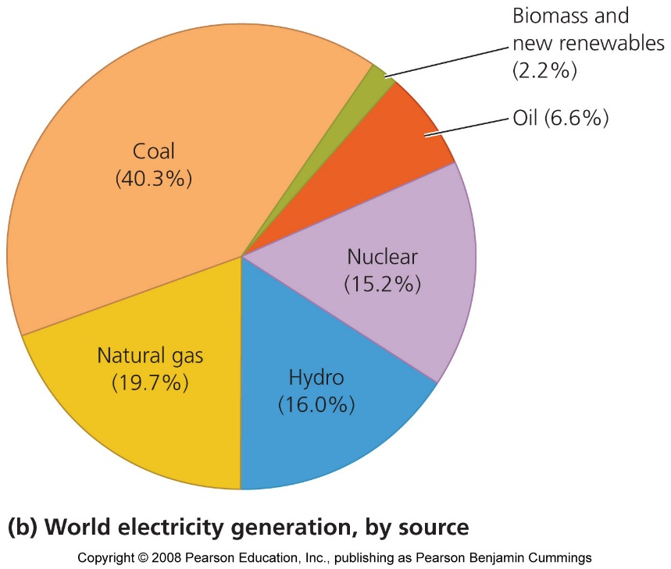
Alternatives to Fossil Fuels
80% of our energy comes from oil, coal, and natural gas
  These three fuels also power two-thirds of the world’s electricity generation
Given fossil fuel’s substantial drawbacks, many people believe we need to shift to using less easily depleted and environmentally gentler fuels

Slide 5
Conventional alternatives
Three alternative energy sources are currently the most developed and most widely used: nuclear energy, hydroelectric power, and energy from biomass
These are all “conventional alternatives” to fossil fuels
  They exert less environmental impact
  Each has benefits and drawbacks
  These are best viewed as intermediates along a continuum of renewability

Slide 6
Conventional alternatives provide energy
Fuelwood and other biomass sources provide 10% of the world’s energy, nuclear power provides 6.3%, and hydropower provides 2.2%
Nuclear energy and hydropower each account for nearly one-sixth of the world’s electricity generation

Slide 7
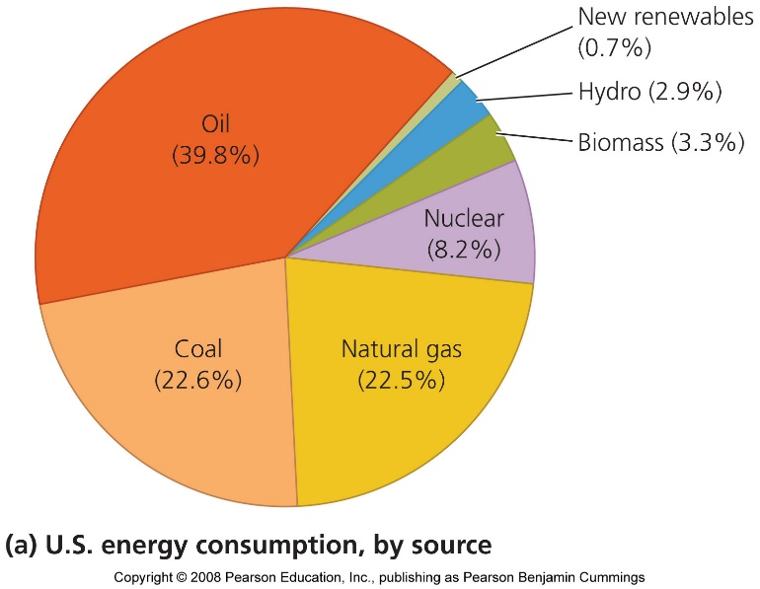
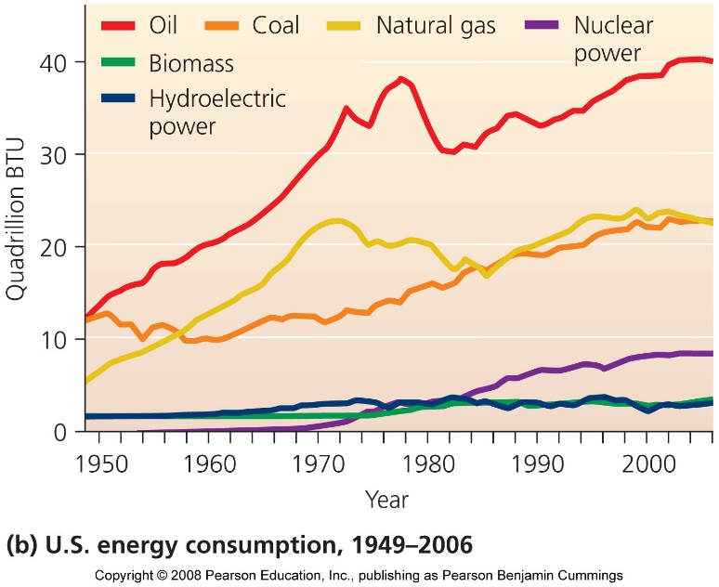
The U.S. relies on fossil fuels
The U.S. relies more on fossil fuels and nuclear power than other countries
  Conventional alternatives play minor, yet substantial roles, in energy use
  The use of conventional alternatives has been growing more slowly than fossil fuels

Slide 8
Nuclear Power
Public safety concerns and the costs of addressing them have constrained the development and spread of nuclear power in the United States, Sweden, and many other nations
The U.S. generates the most electricity from nuclear power
  20% of U.S. electricity comes from nuclear sources
France receives 78% of its electricity from nuclear power

Slide 9
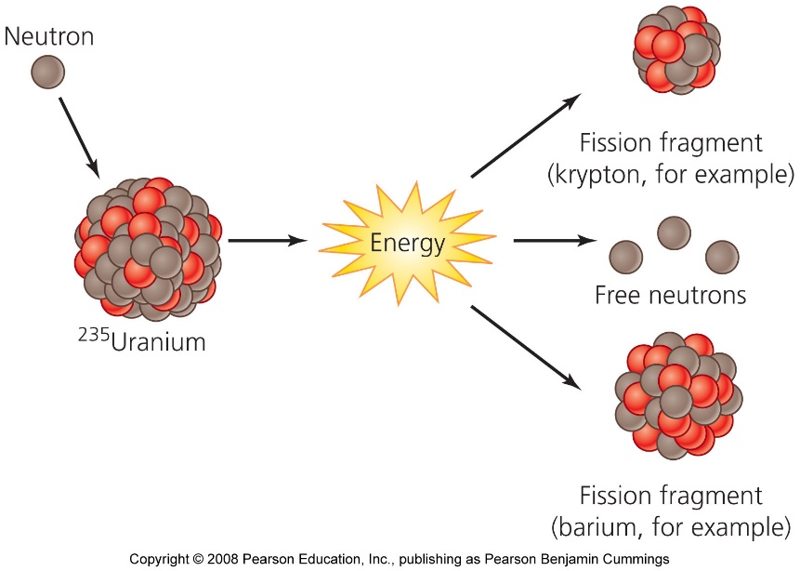
Fission releases nuclear energy
Nuclear energy = the energy that holds together protons and neutrons within the nucleus of an atom
  The reaction that drives the release of nuclear energy in power plants is nuclear fission = the splitting apart of atomic nuclei

Slide 10
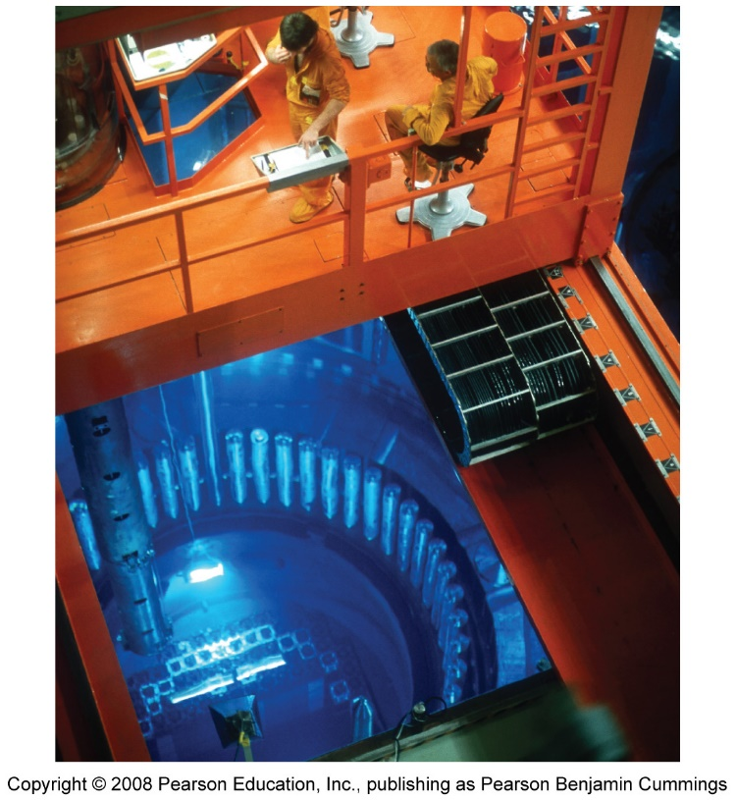
Nuclear energy comes from uranium
Nuclear reactors = facilities within nuclear power plants
Nuclear fuel cycle = the process when naturally occurring uranium is mined from underground deposits
Radioisotopes = emit subatomic particles and high-energy radiation as they decay into lighter radioisotopes, ultimately becoming stable isotopes
Most spent fuel is disposed of as radioactive waste

Slide 11
Fission in reactors generates electricity
For fission to begin in a nuclear reactor, the neutrons bombarding uranium are slowed down with a substance called a moderator
Control rods = made of a metallic alloy that absorbs neutrons, and are placed into the reactor among the water-bathed fuel rods
Containment buildings are constructed to prevent leaks of radioactivity due to accidents or natural catastrophes such as earthquakes

Slide 12
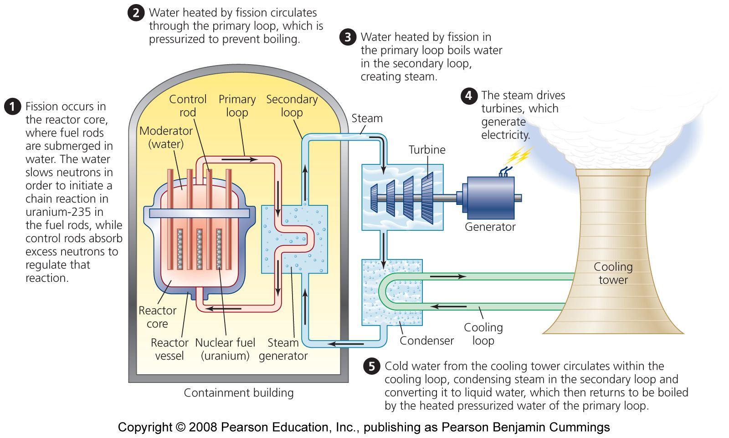
A typical light water reactor

Slide 13
Breeder reactors make better use of fuel
Breeder reactors make use of U-238, which in conventional fission goes unused as a waste product
Breeder reactors are more dangerous than conventional reactors because highly reactive liquid sodium is used as a coolant, raising the risk of explosive accidents
They also are more expensive than conventional reactors
  Highly reactive sodium, instead of water, is used as a coolant, raising the risk of explosive accidents
All but a handful of the world’s breeder reactors have now been shut down

Slide 14
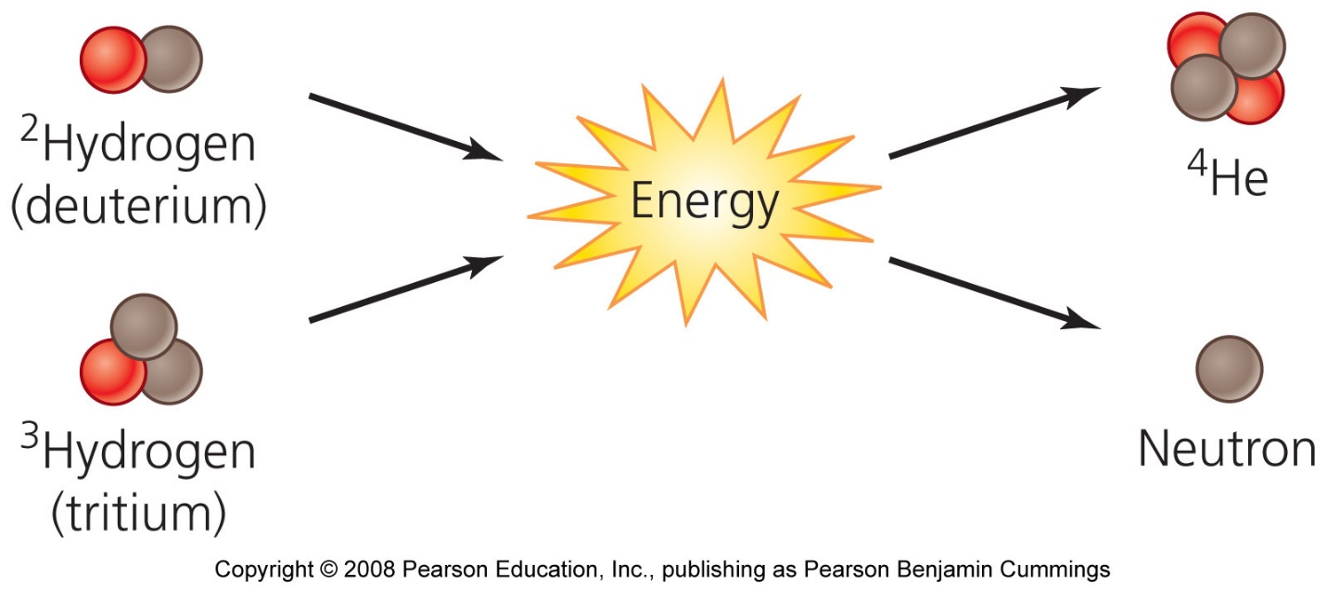
Fusion remains a dream
Nuclear fusion = the process that drives our Sun’s vast output of energy
  The force behind hydrogen (thermonuclear) bombs
  Involves forcing together the small nuclei of lightweight elements under extremely high temperature and pressure
  If we could control fusion, we could produce vast amounts of energy from water

Slide 15
Nuclear power delivers energy cleanly
Nuclear power helps us avoid emitting 600 million metric tons of carbon each year
  Equivalent to 8% of global greenhouse gas emissions
Nuclear power plants are safer for workers than coal-fired plants
Drawbacks of nuclear power:
  Nuclear waste is radioactive
  If an accident occurs at a power plant, the consequences can potentially be catastrophic
Today, the world has 436 operating nuclear plants in 30 nations

Slide 16
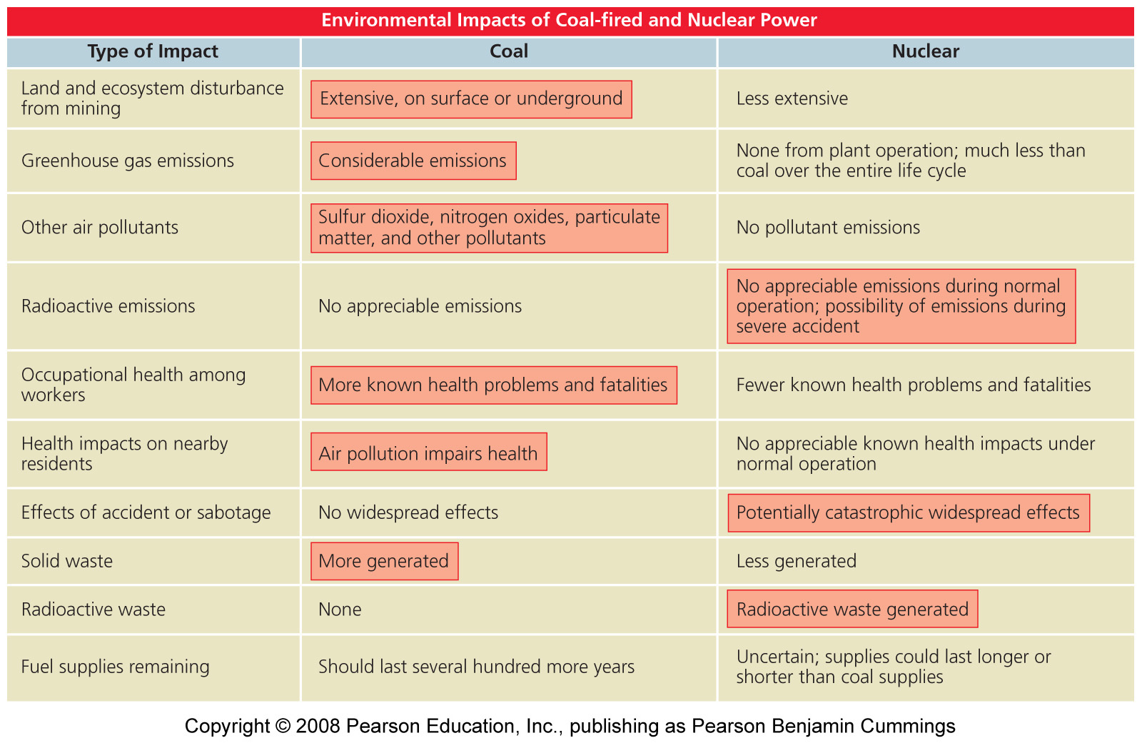
Coal versus nuclear power

Slide 17
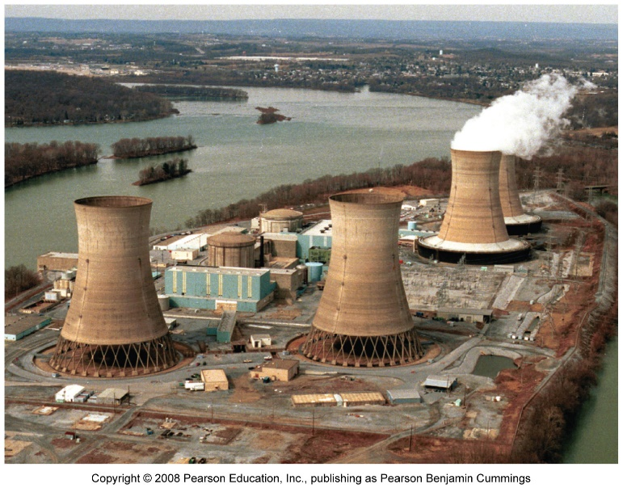
Nuclear power poses small risks
Nuclear power poses the possibility of catastrophic accidents
  Spawning public anxiety over nuclear power
Three Mile Island was the most serious accident in the U.S.

Slide 18
Meltdown at Three Mile Island
Meltdown = coolant water drained from the reactor vessel, temperatures rose inside the reactor core, and metal surrounding the uranium fuel rods began to melt, releasing radiation
  Three Mile Island is regarded as a near-miss: the emergency could have been far worse
The event raised safety concerns for U.S. citizens and policymakers

Slide 19
Chernobyl was the worst accident yet
The 1986 explosion at the Chernobyl plant in Ukraine caused the most severe nuclear power plant accident the world has ever seen
  For 10 days, radiation escaped from the plant while crews tried to put out the fire
  The Soviet Union evacuated more than 100,000 residents
  The landscape around the plant for 19 miles remains contaminated
  The accident killed 31 people directly and many became sick or developed cancer

Slide 20
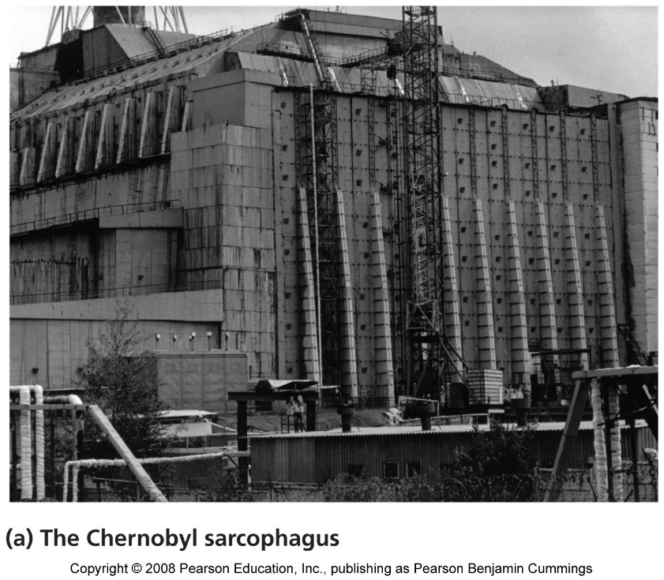
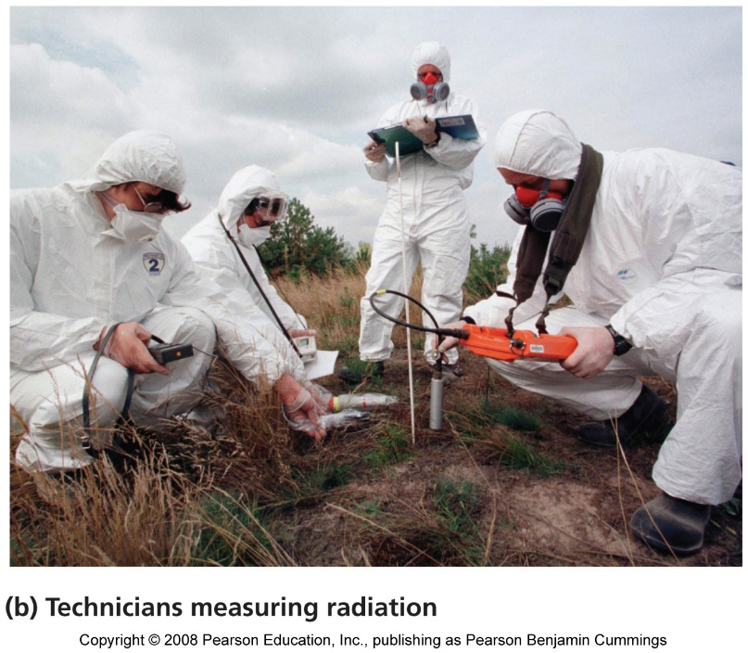
The Chernobyl accident
The destroyed reactor was encased in a massive concrete sarcophagus to contain further leakage

Slide 21
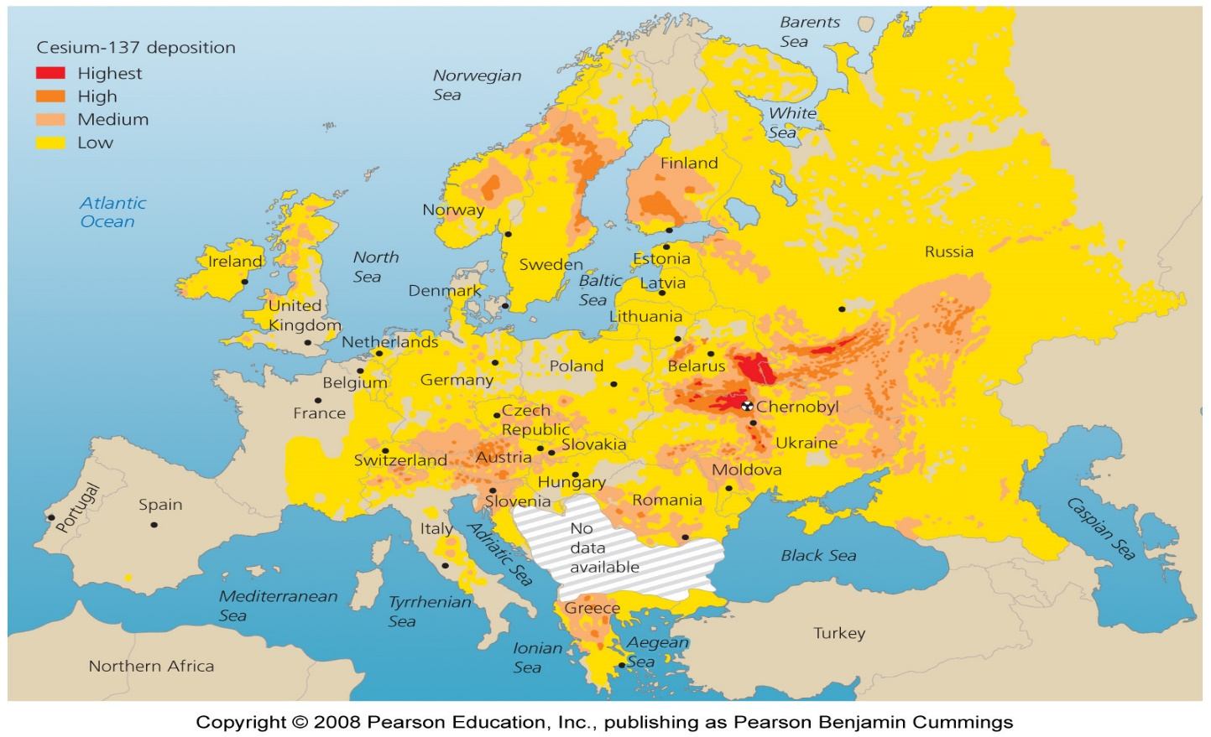
Atmospheric currents carried radioactive fallout from Chernobyl across much of the Northern Hemisphere

Slide 22
Smaller-scale accidents have occurred
Although western reactors are far safer than Chernobyl, smaller accidents have occurred
  A 1999 accident in Japan killed two workers and exposed 400 others to leaked radiation
As plants around the world age, they require more maintenance and are less safe
  Recent terrorist attacks raised fears that similar attacks could be carried out against nuclear plants
  Or stolen radioactive material could be used in attacks
The U.S. government’s “megatons to megawatts” program has been buying up radioactive material and using it in power plants

Slide 23
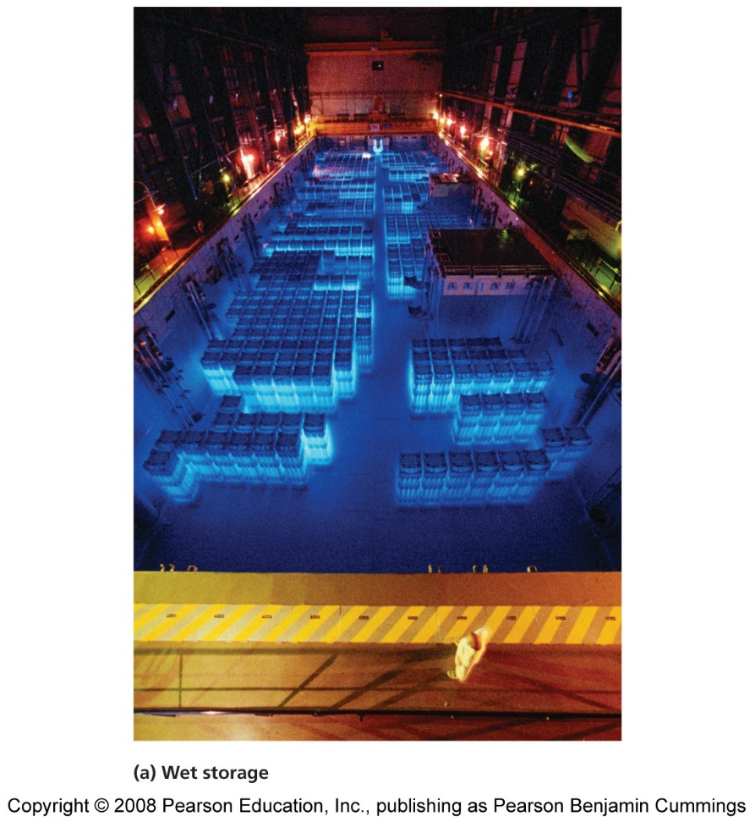
Waste disposal remains a problem
The long half-lives of uranium, plutonium, and other radioisotopes will cause them to continue emitting radiation for thousands of years
Radioactive waste must be placed in unusually stable and secure locations where radioactivity will not harm future generations
Nuclear waste from power generation is being held in temporary storage at nuclear power plants across the U.S. and the world

Slide 24
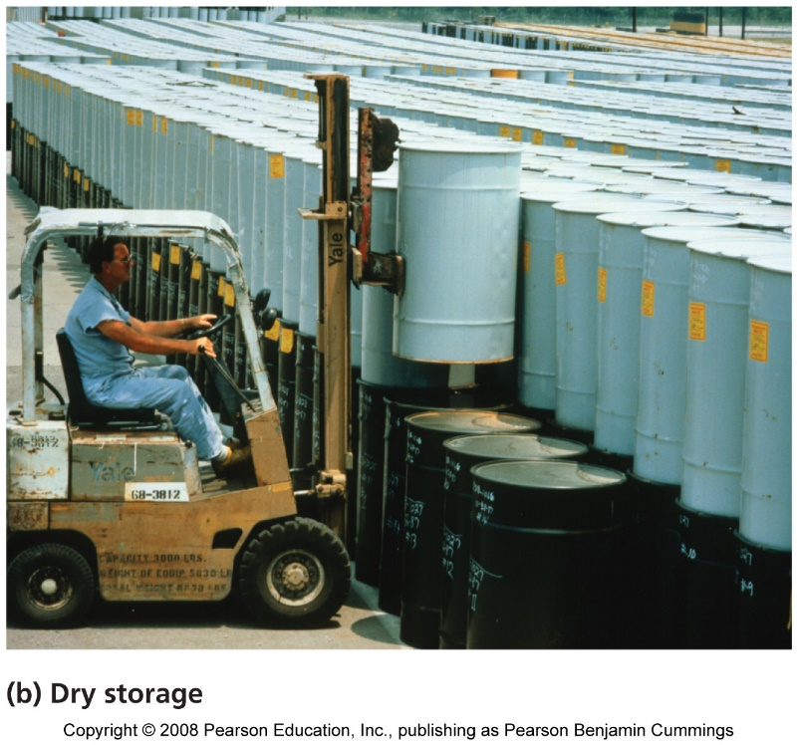
Spent fuel rods must be stored
Spent fuel rods are sunk in pools of cooling water to minimize radiation leakage
By 2010, 75% of U.S. plants will have no room left for this type of storage
  They are now expanding their storage capacity by storing waste in thick casks of steel, lead, and concrete

Slide 25
U.S. power plants store tons of waste
U.S. power plants store 56,000 metric tons of high-level radioactive waste, as well as much more low-level radioactive waste
Waste is held at 125 sites in over 39 states
  Most of these sites are vulnerable to terrorist attacks
Over 161 million U.S. citizens live within 75 miles of temporarily stored waste

Slide 26
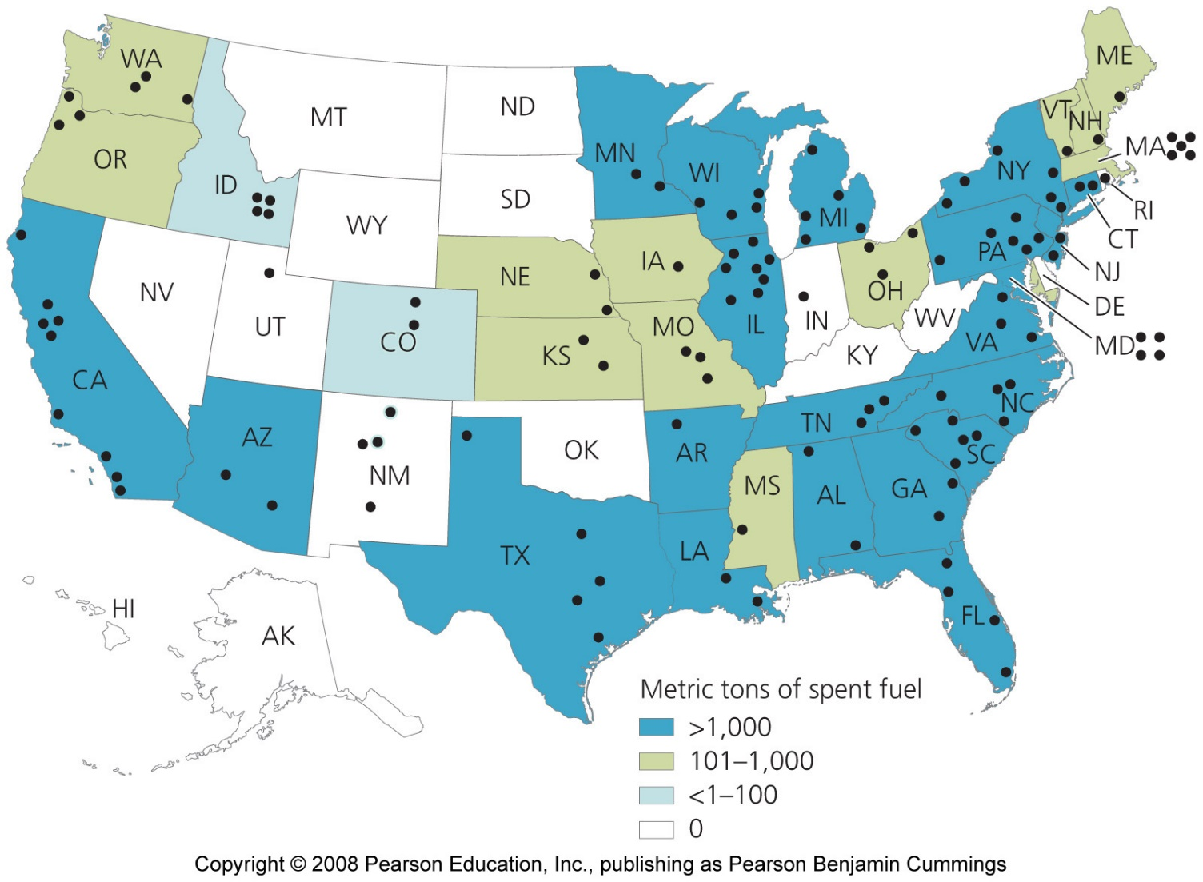
Storage of high-level radioactive waste

Slide 27
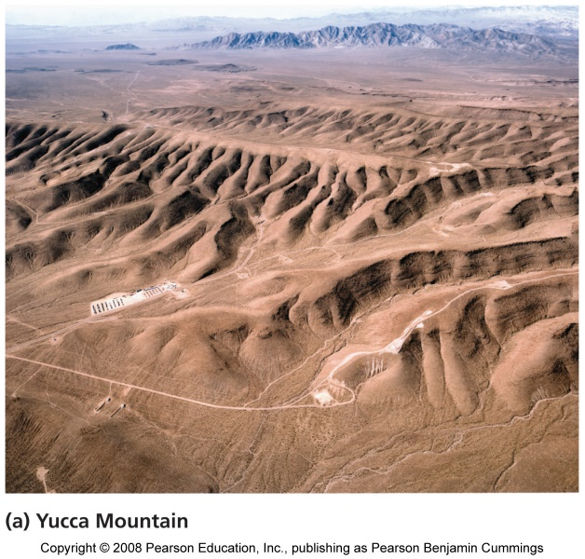
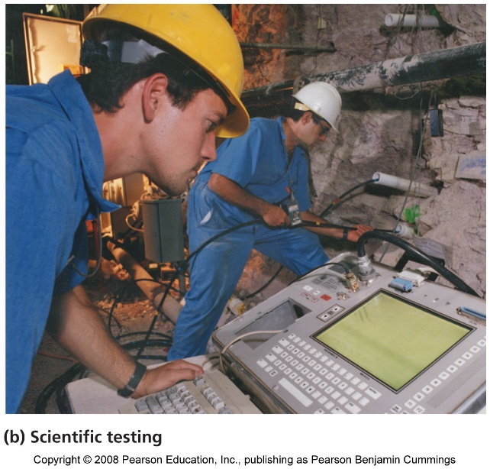
Waste storage at Yucca Mountain, Nevada
Nuclear waste managers want to send all waste to a central repository that can be heavily guarded
  Yucca Mountain, Nevada, was recommended by the president and approved by Congress
  It’s waiting approval from the Nuclear Regulatory Commission to become the site that receives waste from nuclear reactors and military installations

Slide 28
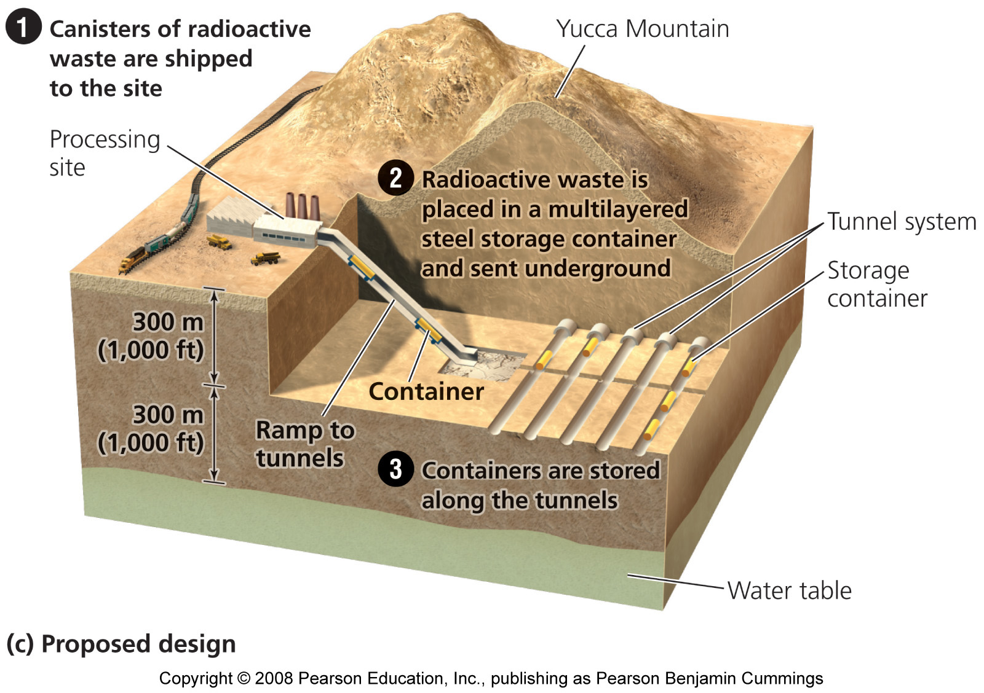
Yucca Mountain, Nevada

Slide 29
Scientists and policymakers chose Yucca Mountain
It is 14 miles to the nearest year-round residences
It has stable geology, with minimal risk of earthquakes that could damage the tunnels and release radioactivity
Its dry climate should minimize water infiltration, reducing chances of groundwater contamination
The water table is deep underground, making groundwater contamination less likely
The pool of groundwater does not connect with groundwater elsewhere, so any contamination would be contained
The location on federal land can be protected from sabotage

Slide 30
Concerns with Yucca Mountain as a site
Some argue that earthquakes and volcanic activity could destabilize the site’s geology
They also fear that fissures in the mountain’s rock could allow rainwater to seep into the caverns
Nuclear waste will need to be transported to Yucca Mountain from the 120-some current storage areas and from current and future nuclear plants and military installations
  Shipments by rail and truck across thousands of public highways through all the states in the union cause a high risk of accident or sabotage

Slide 31
Dilemmas have slowed nuclear power’s growth
It is enormously expensive to build, maintain, operate, and ensure the safety of nuclear facilities
  Shutting down (decommissioning) plants can be more expensive than construction
Electricity is more expensive than from coal and other sources
Nuclear power plants in Western Europe will be retired by 2030
  Asian nations are increasing nuclear capacity; 15 to 26 plants are under construction

Slide 32
The future of U.S. nuclear energy
The U.S. nuclear industry has stopped building plants
  Expanding nuclear capacity would decrease reliance on fossil fuels
  Engineers are planning ways to make nuclear power plants safer and less expensive

