Slide 1
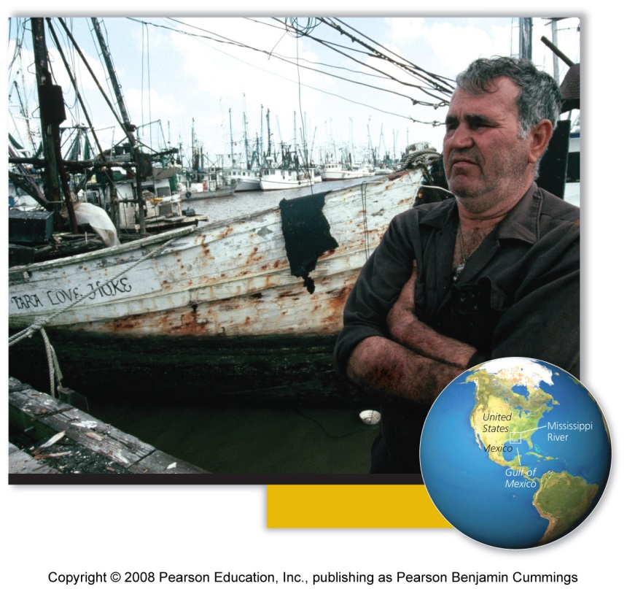
Central Case: The Gulf of Mexico’s “Dead Zone”
Gulf of Mexico brings in 600 million kg/year shrimp, fish, and shellfish
Gulf “dead zone” = a region of water so depleted of oxygen that kills or drives away marine organisms
Hypoxia = low concentrations of dissolved oxygen water
Caused by fertilizer, runoff, sewage

Slide 2
The Earth’s systems
System = a network of relationships among parts elements or components that interact with and influence one another
  Exchange of energy, matter, or information
  Receives inputs of energy, matter, or information; processes these inputs; and produces outputs
Systems often show behavior that is hard to understand and predict
Feedback loop = a system’s output serves as input to that same system
  A circular process

Slide 3
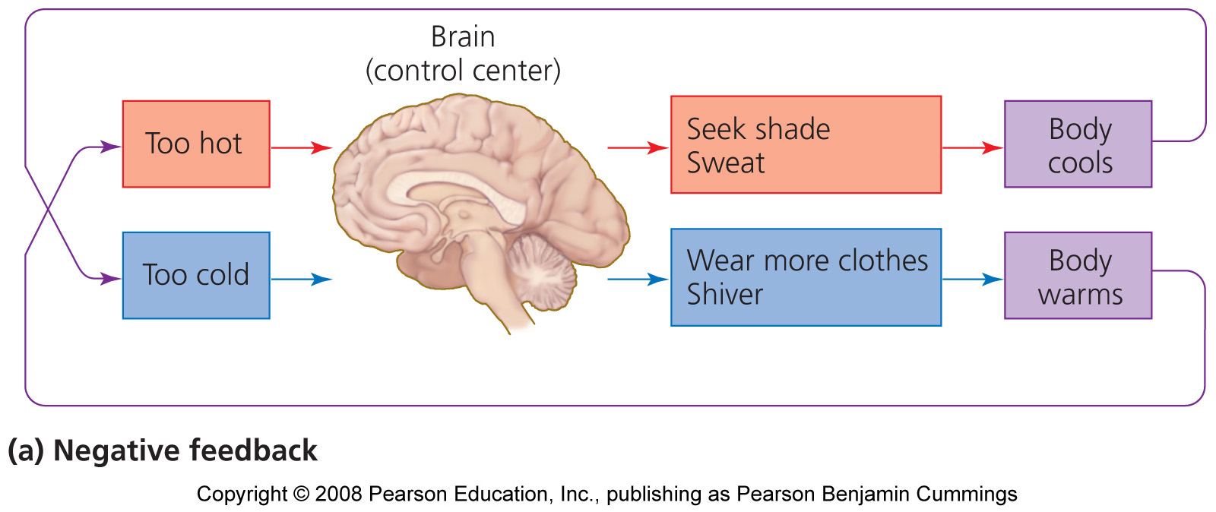
Negative feedback loop
Negative feedback loop = output that results from a system moving in one direction acts as input that moves the system in the other direction.
- Input and output essentially neutralize one another
  Stabilizes the system
  Example: body temperature
  Most systems in nature

Slide 4
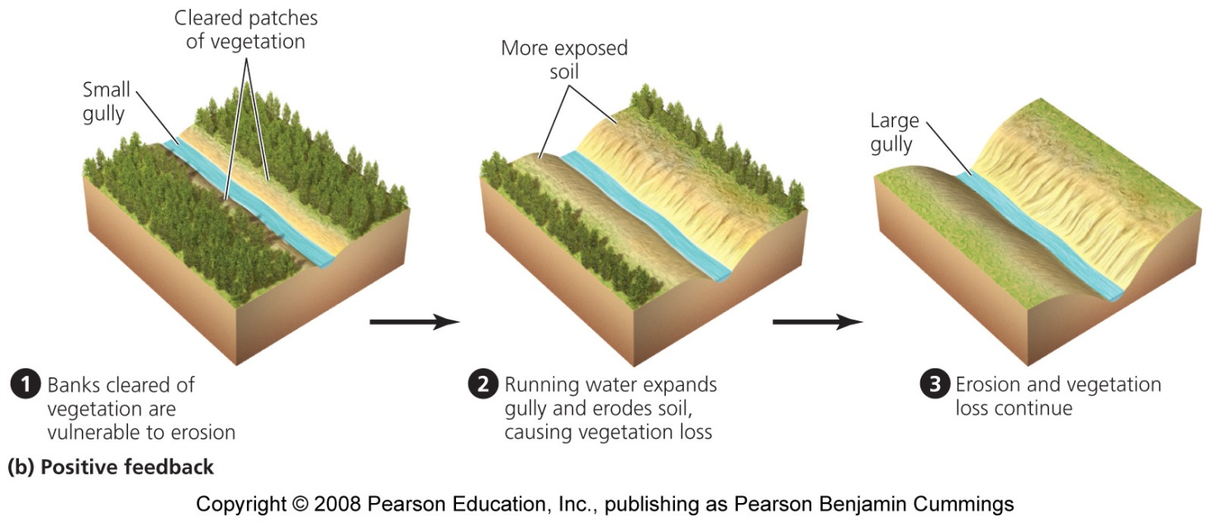
Positive feedback loop
Positive feedback loop = instead of stabilizing a system, it drives it further toward one extreme or another
Examples: exponential growth in human population, spread of cancer, erosion
Rare in nature
  But are common in natural systems altered by human impact

Slide 5
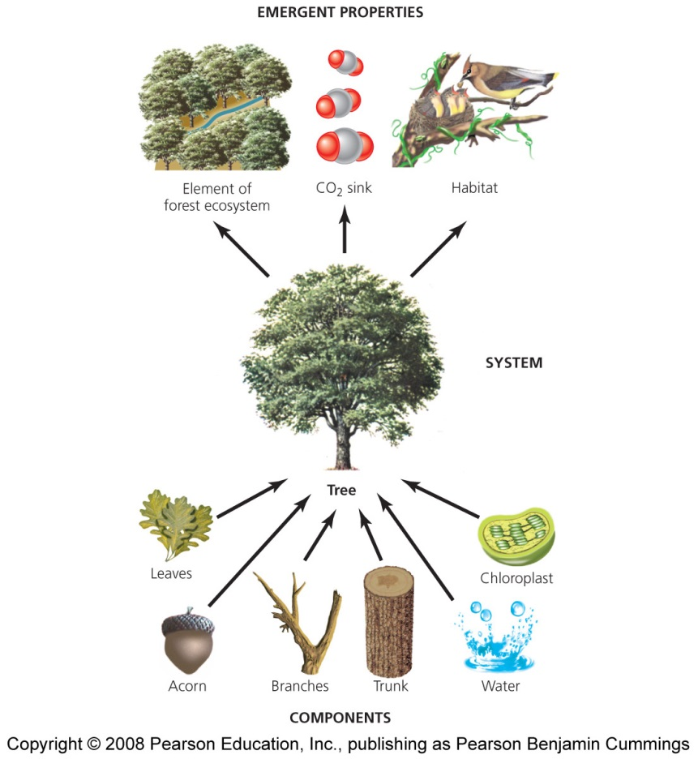
Systems are active
Dynamic equilibrium = system processes move in opposing directions at equivalent rates, balancing their effects
Homeostasis = a system maintains constant or stable internal conditions
Emergent properties = system characteristics not evident in the components alone
  “The whole is more than the sum of the parts”
It is hard to fully understand systems; they connect to other systems and do not have sharp boundaries

Slide 6
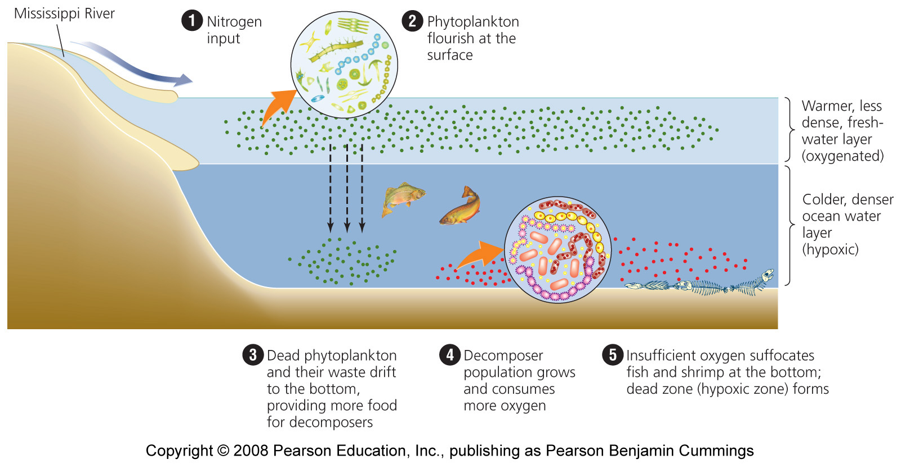
Eutrophication
The process of nutrient overenrichment, blooms of algae, increased production of organic matter, and ecosystem degradation

Slide 7
Nutrients circulate through ecosystems
Physical matter is circulated continually in an ecosystem
Nutrient (biogeochemical) cycle = the movement of nutrients through ecosystems
  Atmosphere, hydrosphere, lithosphere, and biosphere
Pools (reservoirs) = where nutrients reside for varying amounts of time
Flux = movement of nutrients among pools, which change over time and are influenced by human activities
Sources = pools that release more nutrients than they accept
Sinks = accept more nutrients than they release
Notes:
7

Slide 8
The carbon cycle
Carbon is found in carbohydrates, fats, proteins, bones
Carbon cycle = describes the routes that carbon atoms take through the environment
Photosynthesis moves carbon from the air to organisms
Respiration returns carbon to the air and oceans
Decomposition returns carbon to the sediment, the largest reservoir of carbon
  Ultimately, it may be converted into fossil fuels
The world’s oceans are the second largest reservoir of carbon
Notes:
8

Slide 9
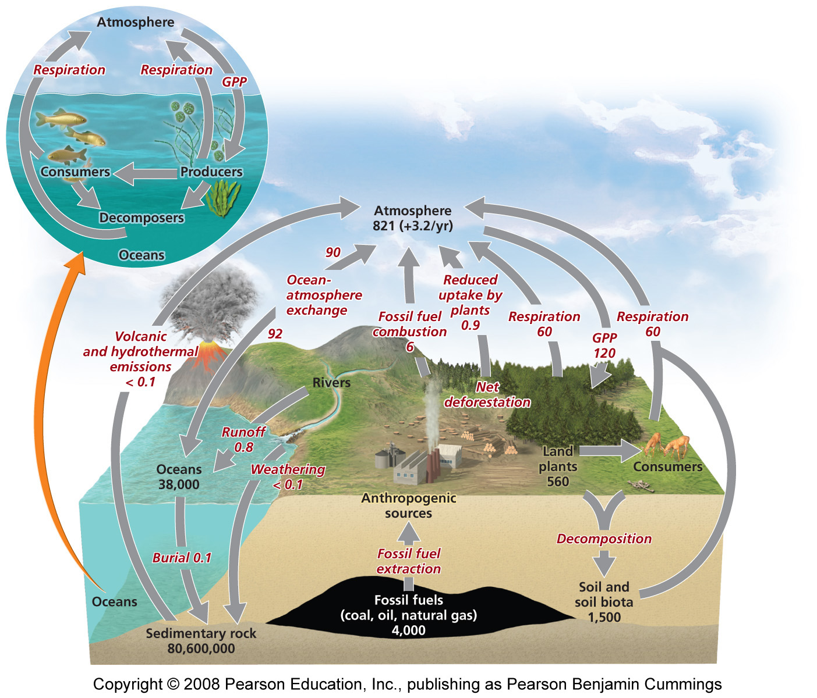
The carbon cycle

Slide 10
Humans affect the carbon cycle
Burning fossil fuels moves carbon from the ground to the air
Cutting forests and burning fields moves carbon from organisms to the air
Today’s atmospheric carbon dioxide reservoir is the largest in the past 650,000 years
  The driving force behind climate change
The missing carbon sink: 1-2 billion metric tons of carbon are unaccounted for
  It may be the plants or soils of northern temperate and boreal forests

Slide 11
The phosphorus cycle
Phosphorus is a key component of cell membranes, DNA, RNA, ATP and ADP
Phosphorus cycle = describes the routes that phosphorus atoms take through the environment
  No significant atmospheric component
  Most phosphorus is within rocks and is released by weathering
With naturally low environmental concentrations, phosphorus is a limiting factor for plant growth

Slide 12
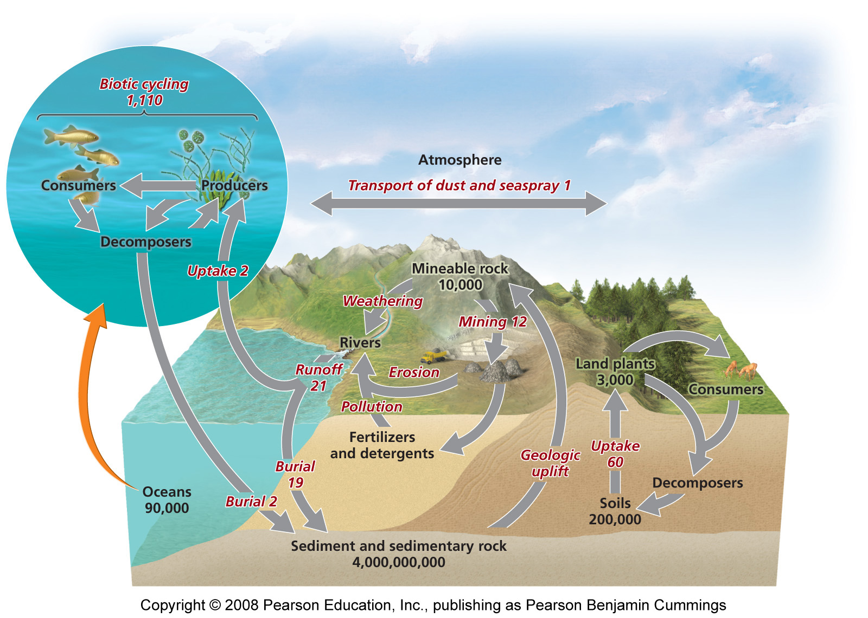
The phosphorus cycle

Slide 13
Humans affect the phosphorus cycle
Mining rocks for fertilizer moves phosphorus from the soil to water systems
  Wastewater discharge also releases phosphorus
Runoff containing phosphorus causes eutrophication of aquatic systems

Slide 14
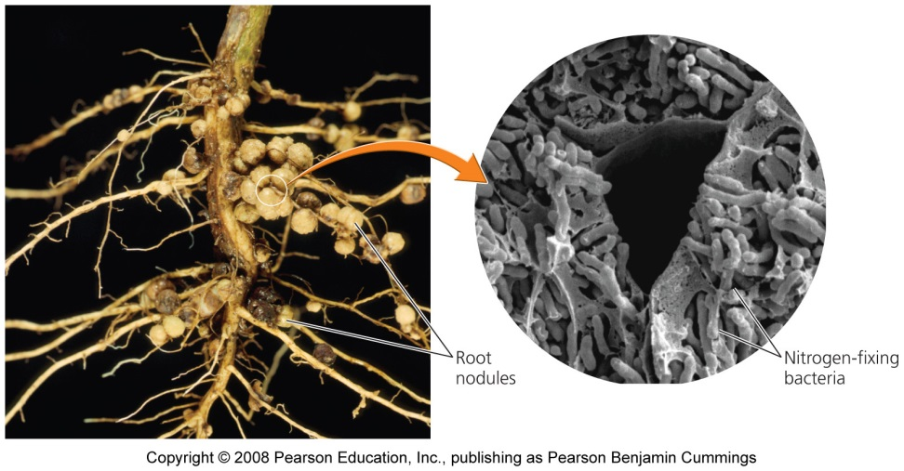
The nitrogen cycle
Nitrogen comprises 78% of our atmosphere, and is contained in proteins, DNA and RNA
Nitrogen cycle = describes the routes that nitrogen atoms take through the environment
  Nitrogen gas is inert and cannot be used by organisms
Nitrogen fixation = Nitrogen gas is combined (fixed) with hydrogen by nitrogen-fixing bacteria to become ammonium
  Which can be used
  by plants

Slide 15
Nitrification and denitrification
Nitrification = bacteria that convert ammonium ions first into nitrite ions then into nitrate ions
  Plants can take up these ions
Animals obtain nitrogen by eating plants or other animals
Denitrifying bacteria = convert nitrates in soil or water to gaseous nitrogen, releasing it back into the atmosphere

Slide 16
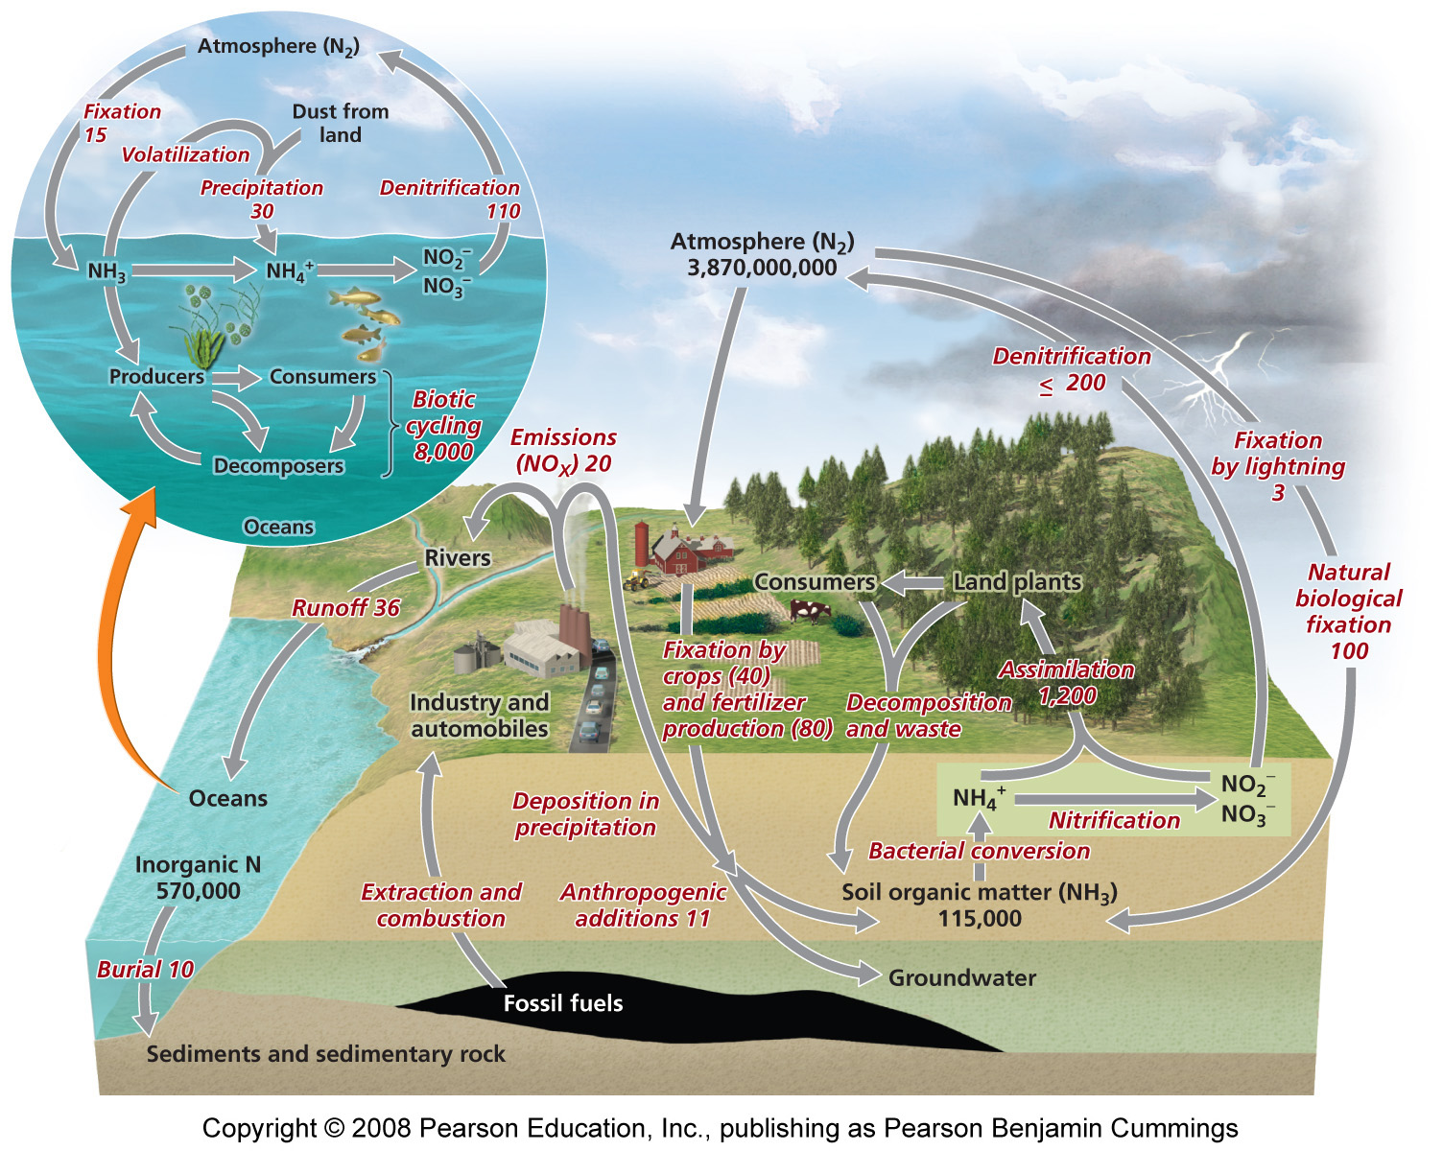
The nitrogen cycle

Slide 17
Humans affect the nitrogen cycle
Haber-Bosch process = synthetic production of fertilizers by combining nitrogen and hydrogen to synthesize ammonia
  Dramatically changed the nitrogen cycle
  Humans are fixing as much nitrogen as nature does
Increased emissions of nitrogen-containing greenhouse gases
Calcium and potassium in soil washed out by fertilizers
Acidified water and soils
Moved more nitrogen into plants and terrestrial systems
Reduced biodiversity of plants adapted to low-nitrogen soils
Changed estuaries and coastal ecosystems and fisheries

Slide 18
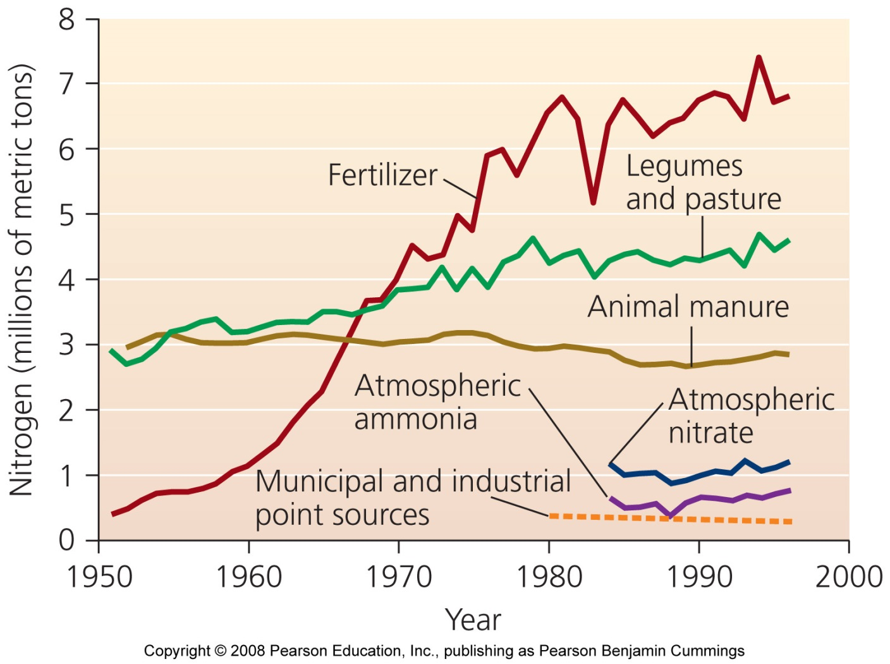
Human inputs of nitrogen into the environment
Fully half of nitrogen entering the environment is of human origin

Slide 19
A law addressing hypoxia in the Gulf
The Harmful Algal Bloom and Hypoxia Research and Control Act (1998) called for an assessment of hypoxia in the Gulf
Solutions outlined included:
  Reduce nitrogen fertilizer use in Midwestern farms
  Change timing of fertilizer applications to minimize runoff
  Use alternative crops
  Restore wetlands and create artificial ones
  Improve sewage = treatment technologies
  Evaluate these approaches

Slide 20
The hydrologic cycle
Water is essential for biochemical reactions and is involved in nearly every environmental system
Hydrologic cycle = summarizes how liquid, gaseous and solid water flows through the environment
  Oceans are the main reservoir
Evaporation = water moves from aquatic and land systems to air
Transpiration = release of water vapor by plants
Precipitation = condensation of water vapor as rain or snow

Slide 21
Groundwater
Aquifers = underground reservoirs of sponge-like regions of rock and soil that hold …
  Groundwater = water found underground beneath layers of soil
  Water table = the upper limit of groundwater held in an aquifer
  Water may be ancient (thousands of years old)
Groundwater becomes exposed to the air where the water table reaches the surface

Slide 22
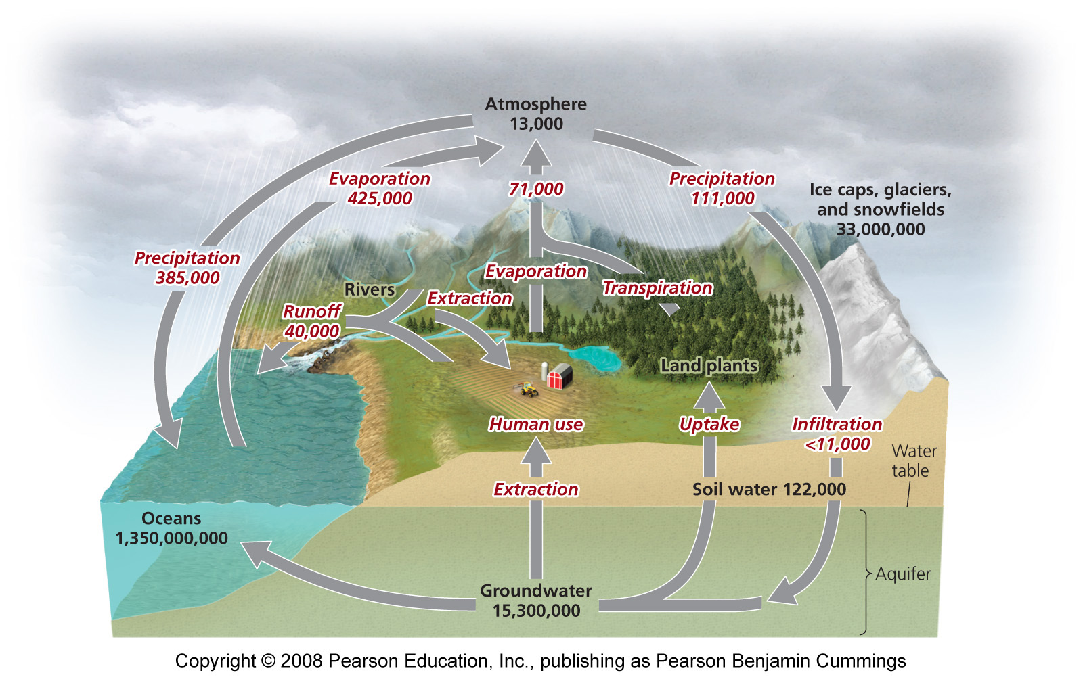
The hydrologic cycle

Slide 23
Human impacts on hydrologic cycle
Damming rivers increases evaporation and infiltration
Altering the surface and vegetation increases runoff and erosion
Spreading water on agricultural fields depletes rivers, lakes and streams
Removing forests and vegetation reduces transpiration and lowers water tables
Emitting pollutants changes the nature of precipitation
The most threatening impact is overdrawing groundwater for drinking, irrigation, and industrial use
Notes:
23

Slide 24
Species interactions
Species interactions are the backbone of communities
Most important categories
  Competition = both species are harmed
  Predation, parasitism, and herbivory = one species benefits and the other is harmed
  Mutualism = both species benefit

Slide 25
Competition
Competition = relationship where multiple organisms seek the same limited resources they need to survive:
  Food - Water
  Space - Shelter
  Mates - Sunlight
Intraspecific competition = between members of the same species
  High population density = increased competition
Interspecific competition = between members of 2 or more species
  Leads to competitive exclusion or species coexistence

Slide 26
Results of interspecific competition
Competitive exclusion = one species completely excludes another species from using the resource
Species coexistence = neither species fully excludes the other from resources, so both live side by side
  This produces a stable point of equilibrium, with stable population sizes
  Species adjust to minimize competition by using only a part of the available resource

Slide 27
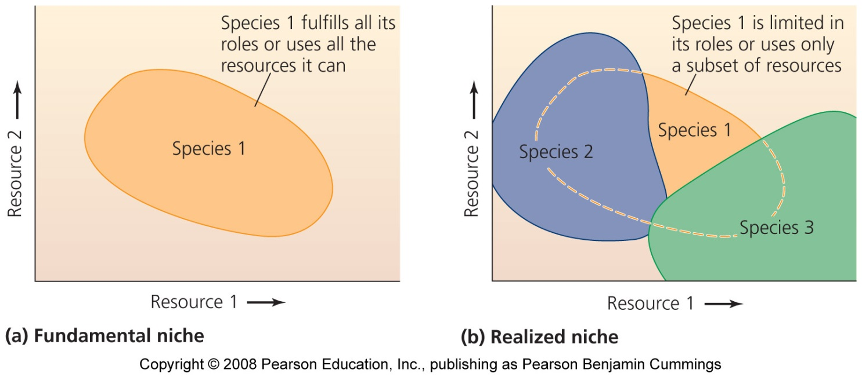
Niche: an individual’s ecological role
Fundamental niche = when an individual fulfills its entire role by using all the available resources
Realized niche = the portion of the fundamental niche that is actually filled
  Due to competition or other species’ interactions

Slide 28
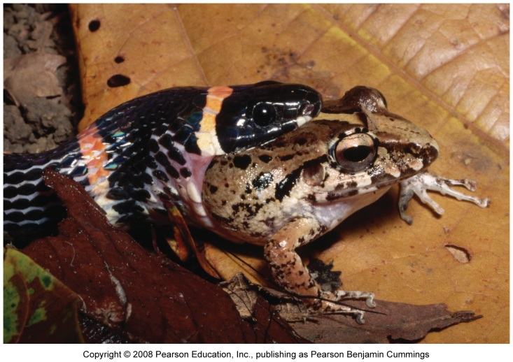
Predation
Exploitation = one member exploits another for its own gain
  Predation, parasitism, herbivory
Predation = process by which individuals of one species (predators) capture, kill, and consume individuals of another species (prey)
  Structures food webs
  Influences community composition through number of predators and prey

Slide 29
Effects of zebra mussels
Zebra mussels eat phytoplankton and zooplankton
  Both populations decrease in lakes with zebra mussels
They don’t eat cyanobacteria
  Population increases in lakes with zebra mussels
Zebra mussels are becoming prey for some North American predators:
  Diving ducks, muskrats, crayfish, flounder, sturgeon, eels, carp, and freshwater drum

Slide 30
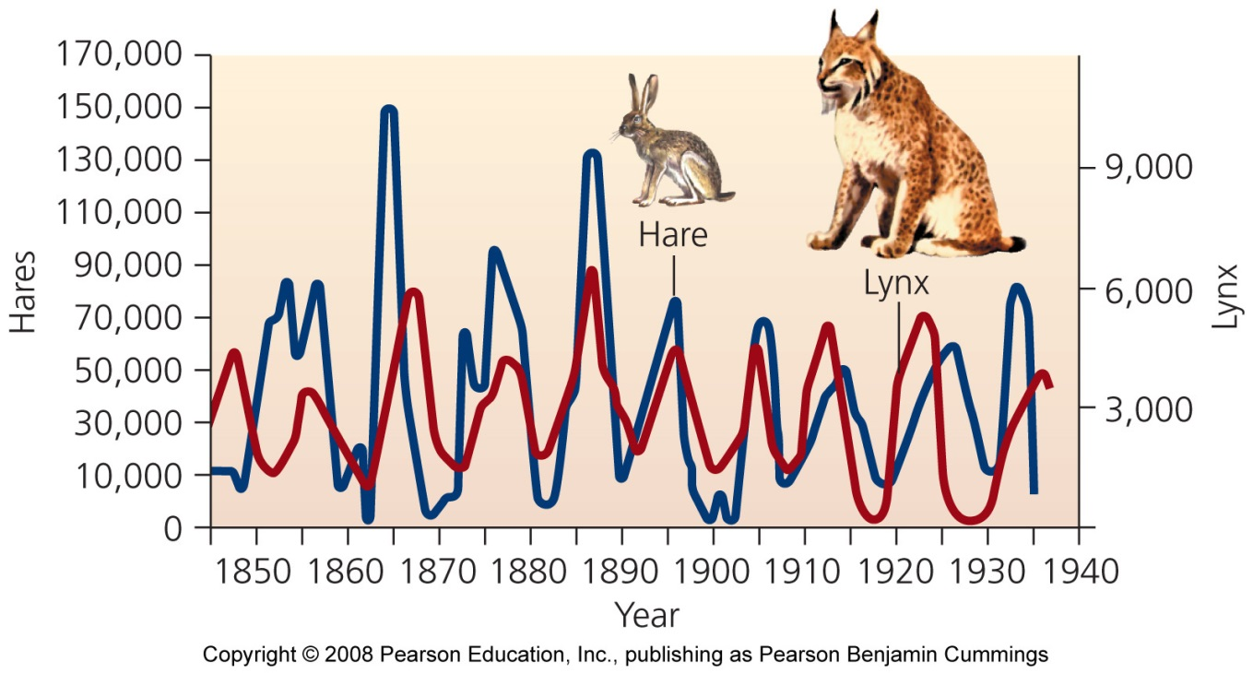
Effects of predation on populations
Increased prey populations increases predators
  Predators survive and reproduce
Increased predator populations decrease prey
Decreased prey population causes starvation of predators
Decreased predator populations increases prey populations

Slide 31
Natural selection
Natural selection leads to evolution of adaptations that make predators better hunters
Individuals who are better at catching prey:
  Live longer, healthier lives
  Take better care of offspring
Predation pressure: prey are at risk of immediate death
  Prey develops elaborate defenses against being eaten

Slide 32
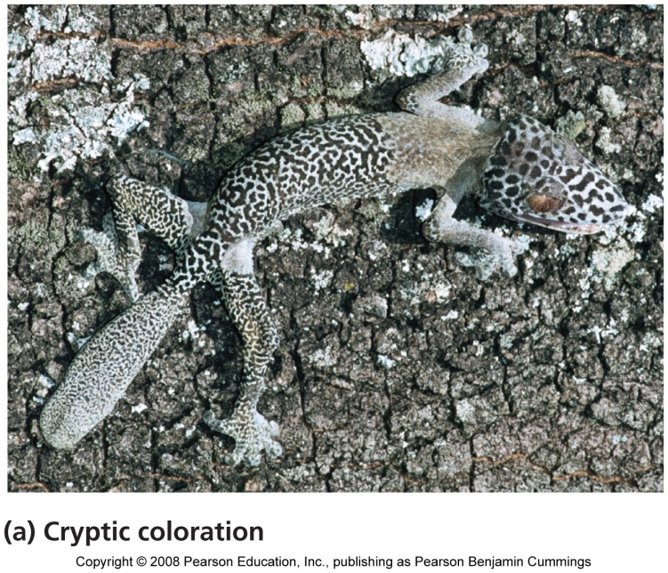
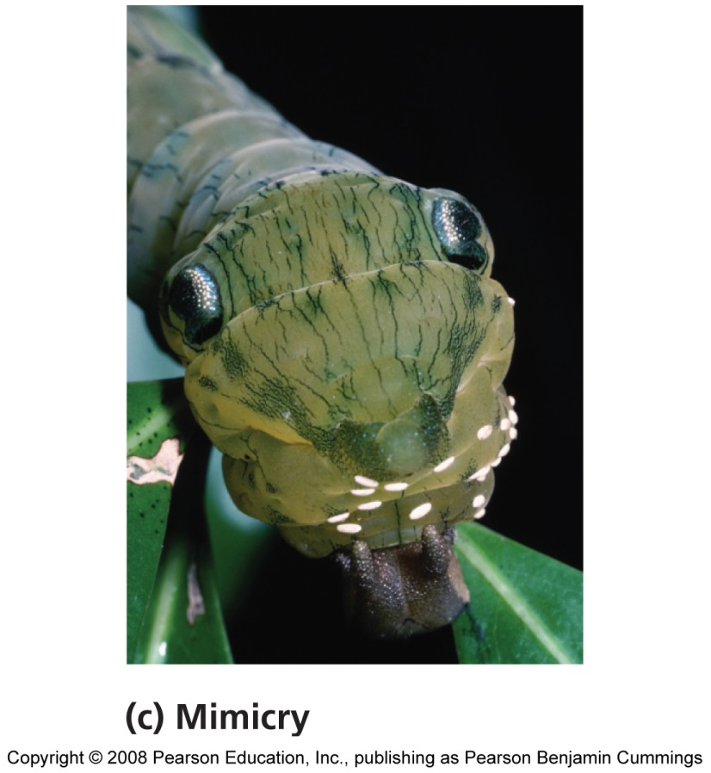
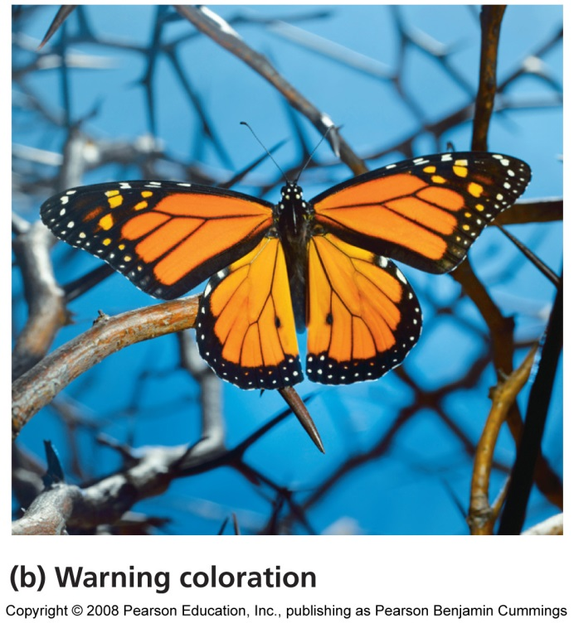
Organisms evolve defenses against being eaten

Slide 33
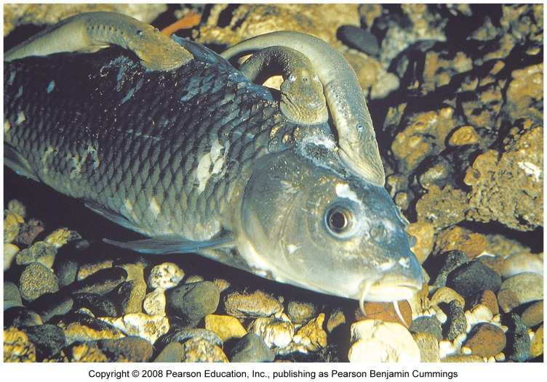
Parasites
Parasitism = a relationship in which one organism (parasite) depends on another (host) for nourishment or other benefit
Some species live within the host
  Disease, tapeworms
Others are free-living, and have infrequent contact with their hosts
  Ticks, sea lampreys
Notes:
33

Slide 34
Coevolution
Coevolution = hosts and parasites become locked in a duel of escalating adaptations
  Has been called an “evolutionary arms race”
  Each evolves new responses to the other
  It may not be beneficial to the parasite to kill its host
Notes:
34

Slide 35
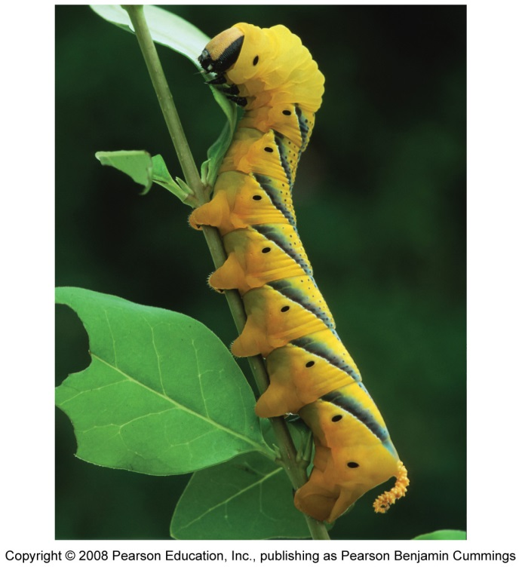
Herbivory
Exploitation in which animals feed on the tissues of plants
  Widely seen in insects
  May not kill the plant, but affects its growth and survival
Defenses against herbivory include
  Chemicals: toxic or distasteful parts
  Physical: thorns, spines, or irritating hairs
  Other animals: protect the plant
Notes:
35

Slide 36
Mutualism
Two or more species benefit from their interactions
Symbiosis = mutualism in which the organisms live in close physical contact
  Microbes within digestive tracts
  Plants and fungi
Pollination = bees, bats, birds and others transfer pollen from one flower to another, fertilizing its eggs
Notes:
36

Slide 37
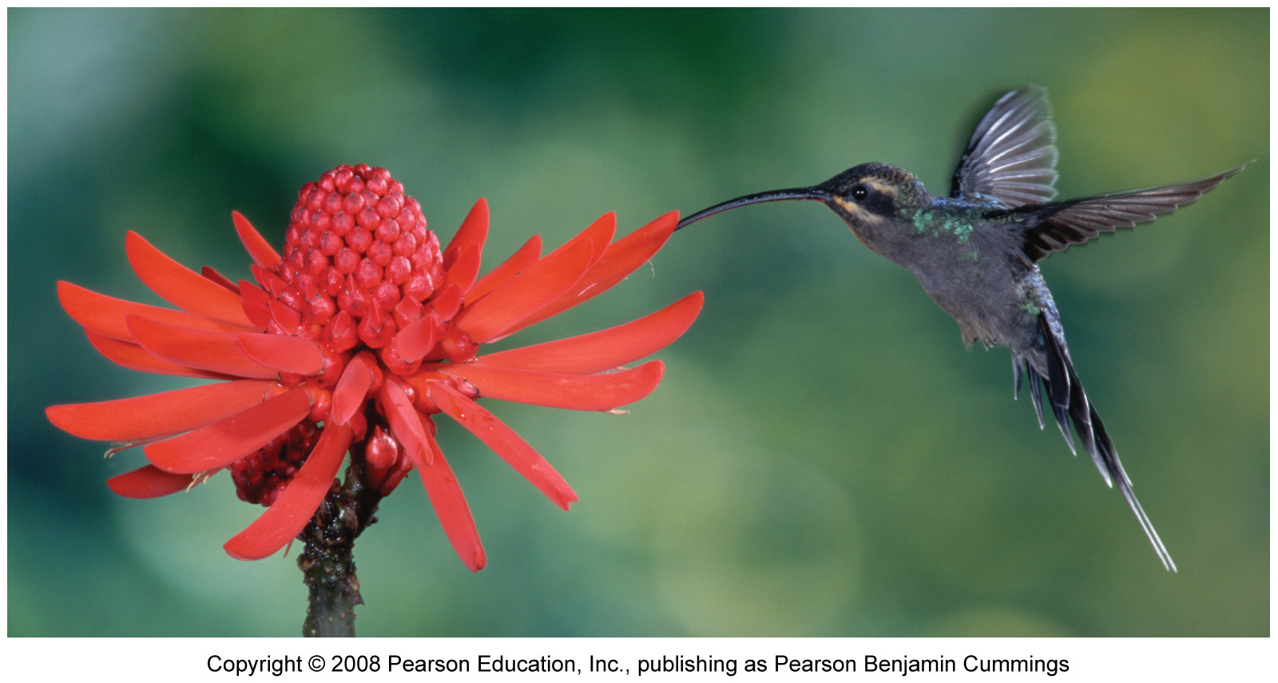
Pollination
In exchange for the plant nectar, the animals pollinate plants, which allows them to reproduce
Notes:
37

Slide 38
Relationships with no effect on one member
Amensalism = a relationship in which one organism is harmed while the other is unaffected
  Difficult to confirm, because usually one organism benefits from harming another
  Allelopathy = certain plants release harmful chemicals
  Or, is this competition?
Commensalism = a relationship in which one organism benefits, while the other remains unaffected
  Facilitation = plants that create shade and leaf litter allow seedlings to grow
Notes:
38

Slide 39
Ecological communities
Community = an assemblage of species living in the same place at the same time
  Members interact with each other
  Interactions determine the structure, function, and species composition of the community
Community ecologists = people interested in how:
  Species coexist and relate to one another
  Communities change, and why patterns exist
Notes:
39

Slide 40
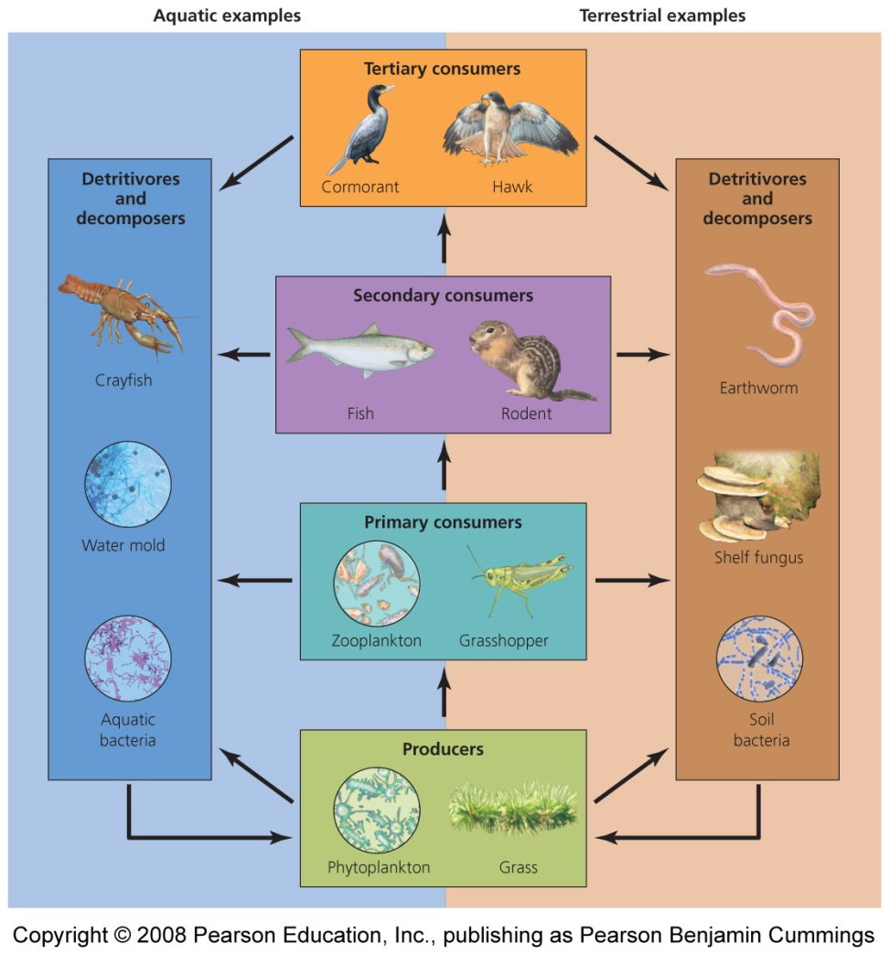
Energy passes through trophic levels
One of the most important species interactions is who eats whom
Matter and energy move through the community
Trophic levels = rank in the feeding hierarchy
  Producers
  Consumers
  Detritivores and Decomposers
Notes:
40

Slide 41
Producers: the first trophic level
Autotrophs (“self-feeders”) = organisms that capture solar energy for photosynthesis to produce sugars
  Green Plants
  Cyanobacteria
  Algae
Chemosynthetic bacteria use the geothermal energy in hot springs or deep-sea vents to produce their food
Notes:
41

Slide 42
Consumers: organisms that consume producers
Primary consumers = second trophic level
  Organisms that consume producers
  Herbivores consume plants
  Deer, grasshoppers
Secondary consumers = third trophic level
  Organisms that prey on primary consumers
  Carnivores consume meat
  Wolves, rodents
Notes:
42

Slide 43
Consumers occur at even higher trophic levels
Tertiary Consumers = fourth trophic level
  Predators at the highest trophic level
  Consume secondary consumers
  Are also carnivores
  Hawks, owls
Omnivores = consumers that eat both plants and animals

Slide 44
Detritivores and decomposers
Organisms that consume nonliving organic matter
  Enrich soils and/or recycle nutrients found in dead organisms
Detritivores = scavenge waste products or dead bodies
  Millipedes
Decomposers = break down leaf litter and other non-living material
  Fungi, bacteria
  Enhance topsoil and recycle nutrients
Notes:
44

Slide 45
Energy, biomass, and numbers decrease
Most energy organisms use is lost as waste heat through respiration
  Less and less energy is available in each successive trophic level
  Each level contains only 10% of the energy of the trophic level below it
There are far fewer organisms at the highest trophic levels, with less energy available
A human vegetarian’s ecological footprint is smaller than a meat-eater’s footprint
Notes:
45

Slide 46
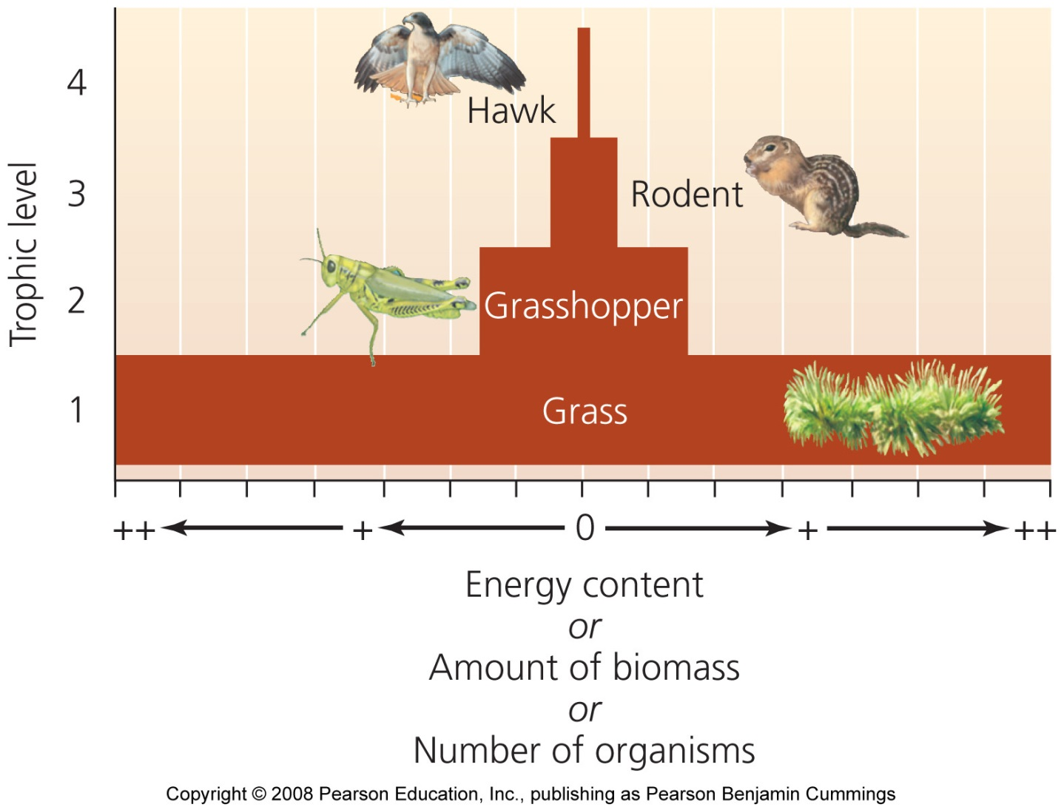
Pyramids of energy, biomass, and numbers

Slide 47
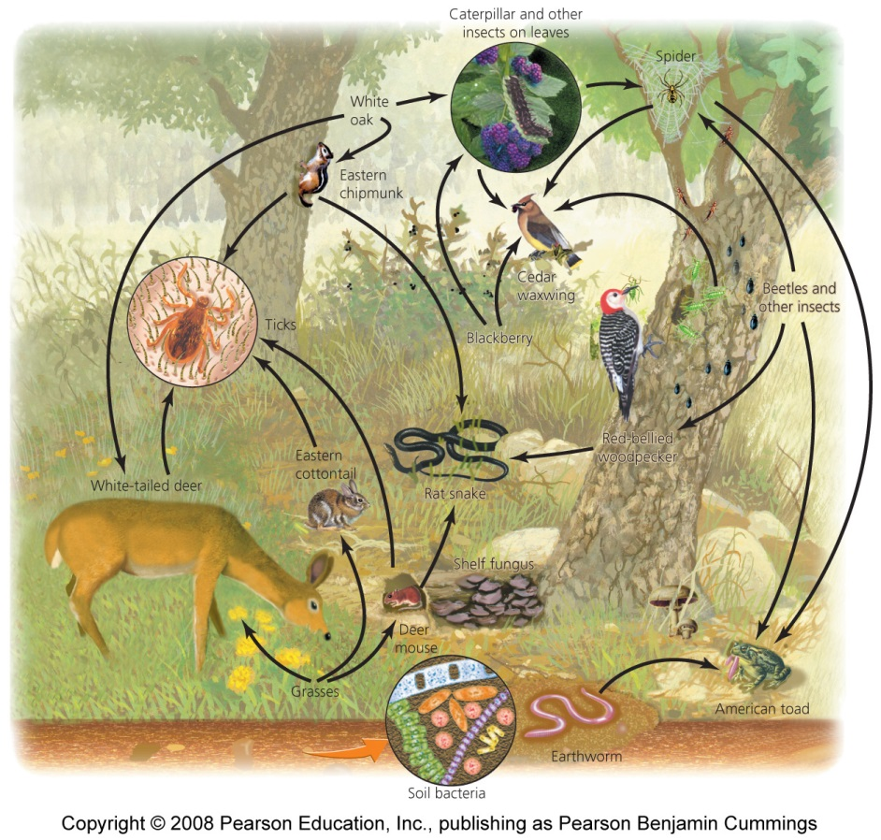
Food webs show relationships and energy flow
Food chain = the relationship of how energy is transferred up the trophic levels
Food web = a visual map of feeding relationships and energy flow
  Includes many different organisms at all the various levels
  Greatly simplified; leaves out the majority of species
Notes:
47

Slide 48
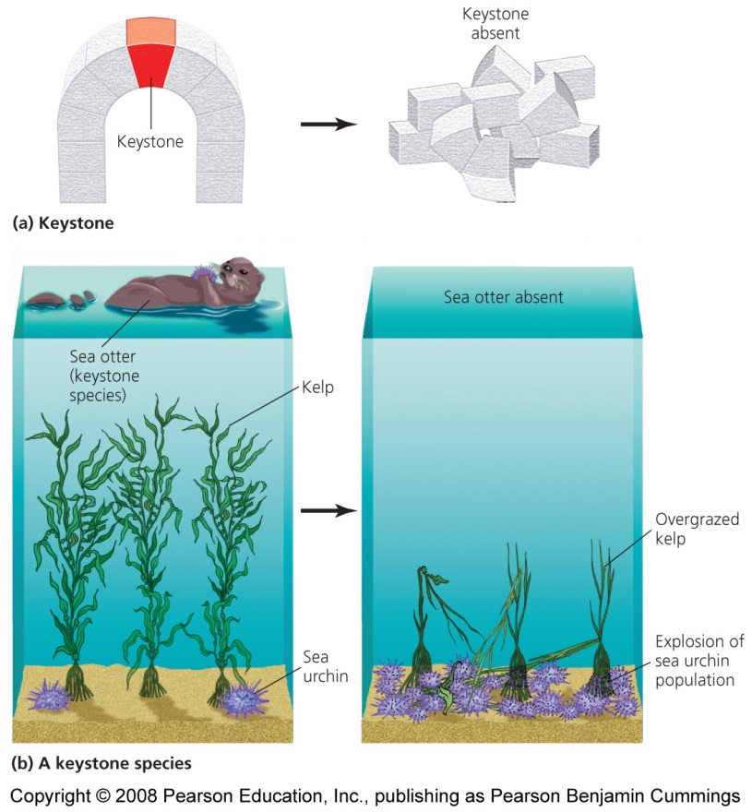
Some organisms play big roles
Keystone Species = has a strong or wide-reaching impact far out of proportion to its abundance
Removal of a keystone species has substantial ripple effects
  Alters the food chain

Slide 49
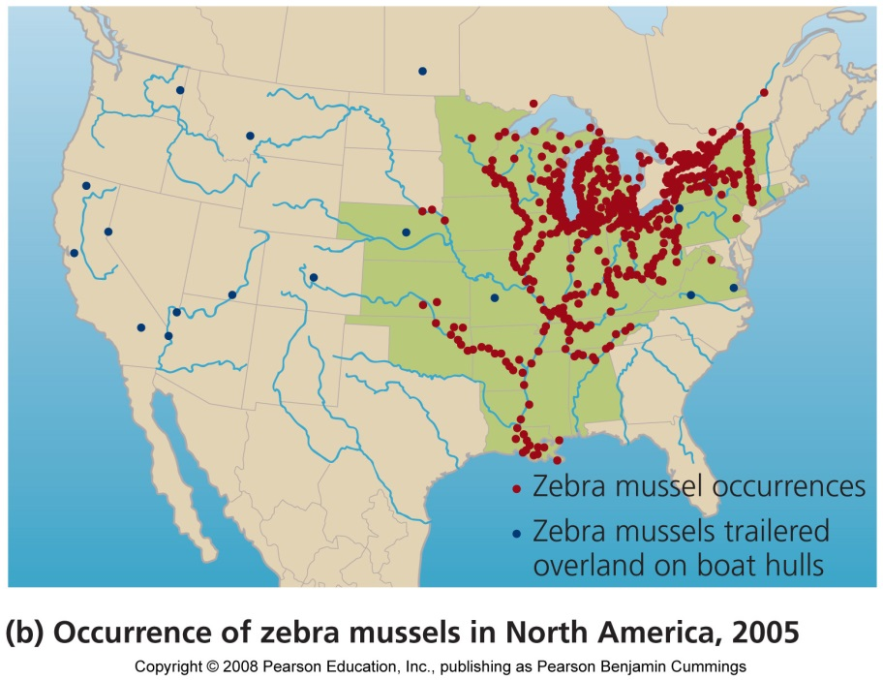
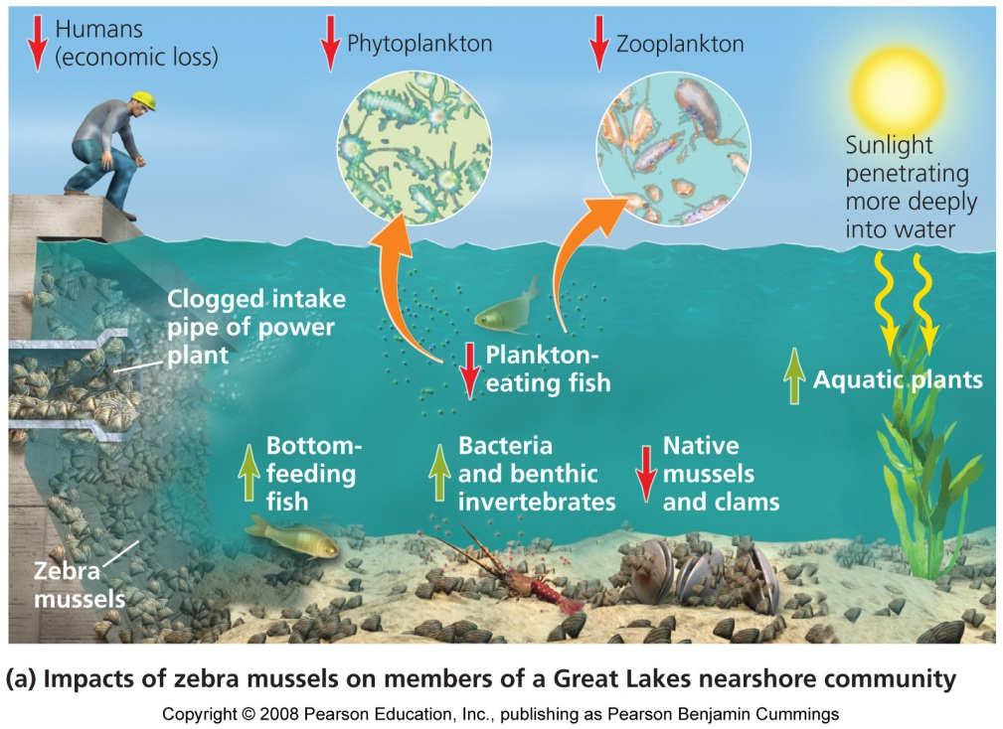
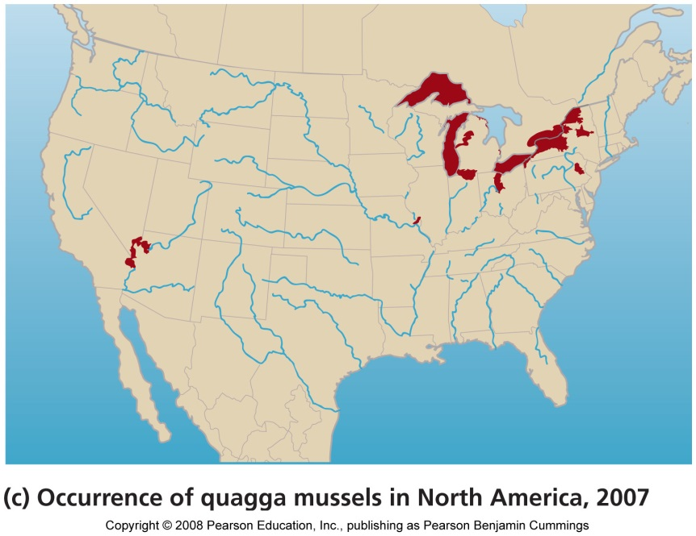
Two invasive mussels

Slide 50
Controlling invasive species
Techniques to control invasive species
  Remove manually
  Toxic chemicals
  Drying them out
  Depriving of oxygen
  Stressing them
    Heat, sound, electricity, carbon dioxide, ultraviolet light
Prevention, rather than control, is the best policy

Slide 51
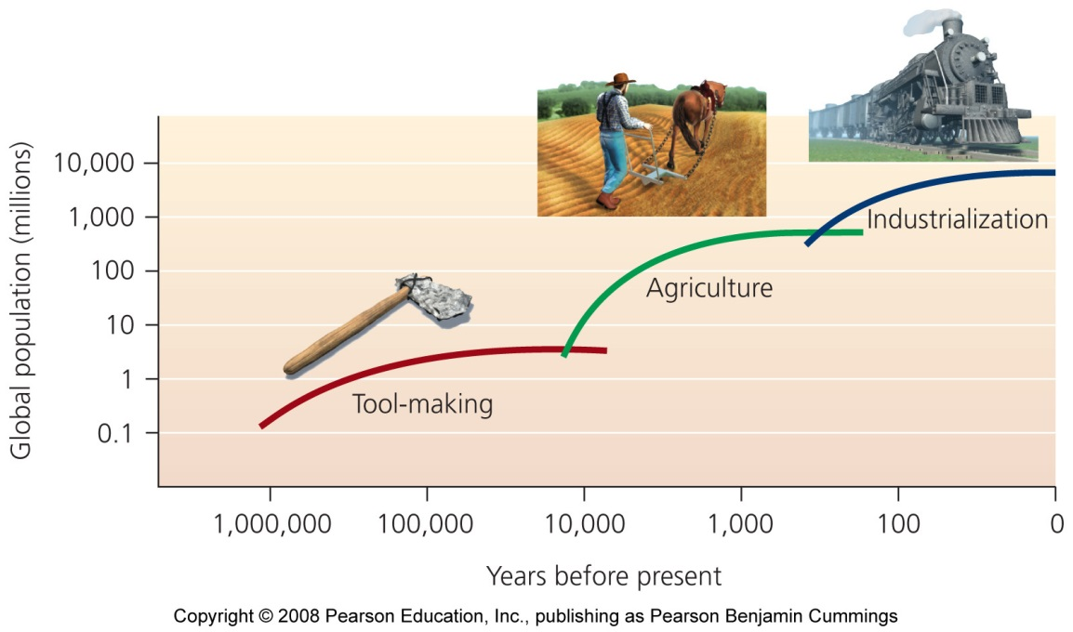
Demography
All population principles apply to humans
  Environmental factors limit population growth
Humans can raise the environment’s carrying capacity through technology
  How many humans can the world sustain? 1 – 33 billion
  Population growth can’t continue forever

Slide 52
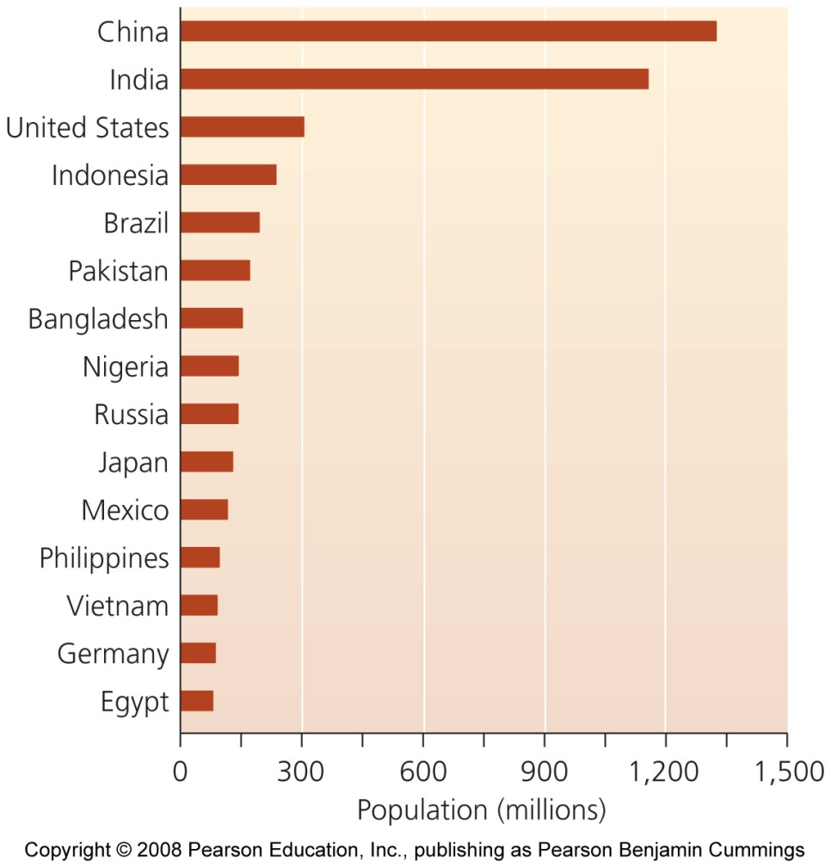
Demography
Demography = the application of population ecology to the study of humans
  Demographers study population size,
  Density and distribution,
  Age structure, sex ratio,
  And birth, death, immigration, and emigration rates

Slide 53
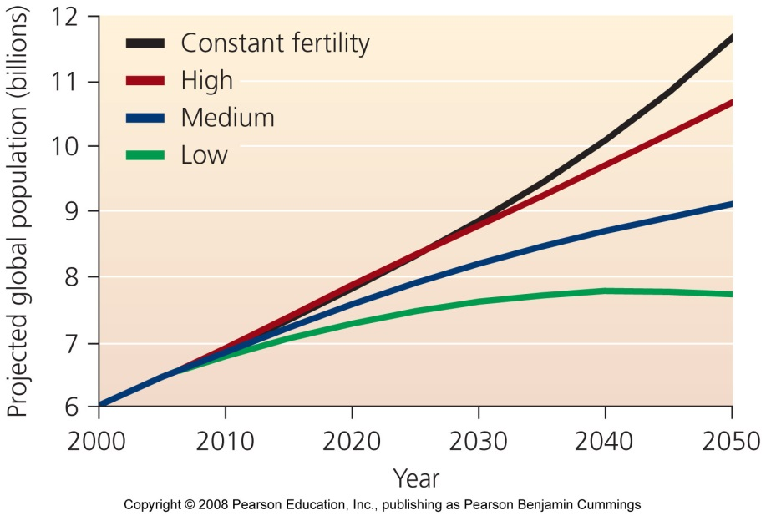
Population size and density
Nobody knows the ultimate human population size
But numbers are not the only important aspect
Highest population density is in temperate, subtropical, and tropical biomes
  Some areas are heavily impacted by urbanization, pollution, and fossil fuel use

Slide 54
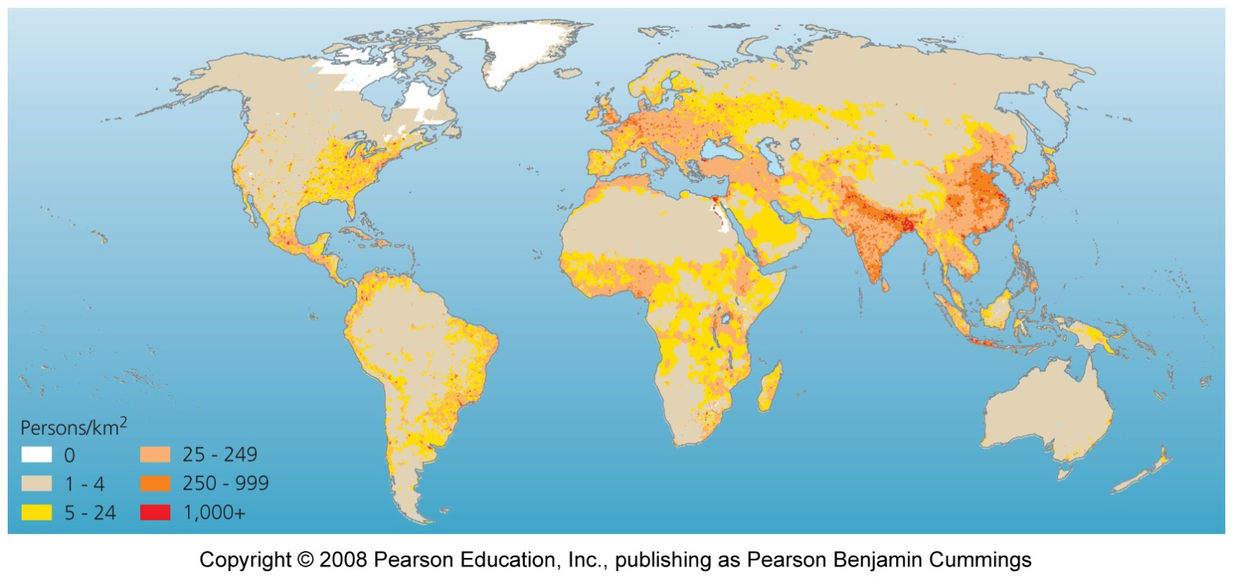
Population distribution
Increased density impacts the environment, but relieves pressure in less-populated areas
Humans are unevenly distributed around the globe
  Unpopulated areas tend to be environmentally sensitive (high S value in the IPAT equation)

Slide 55
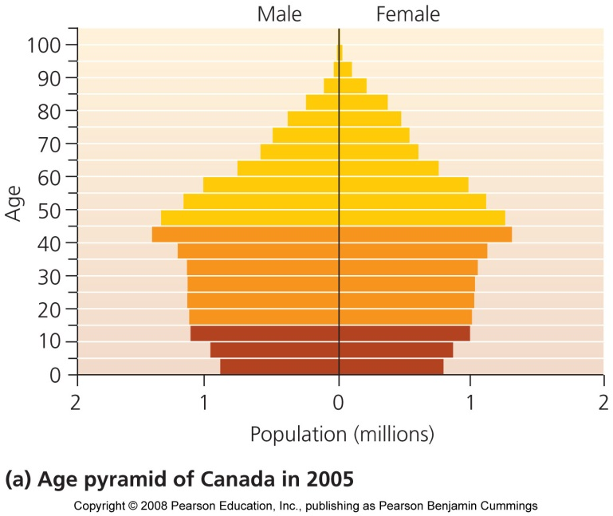
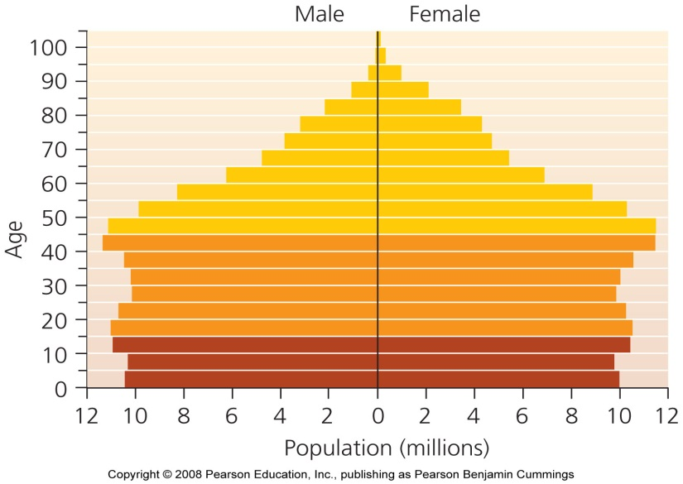
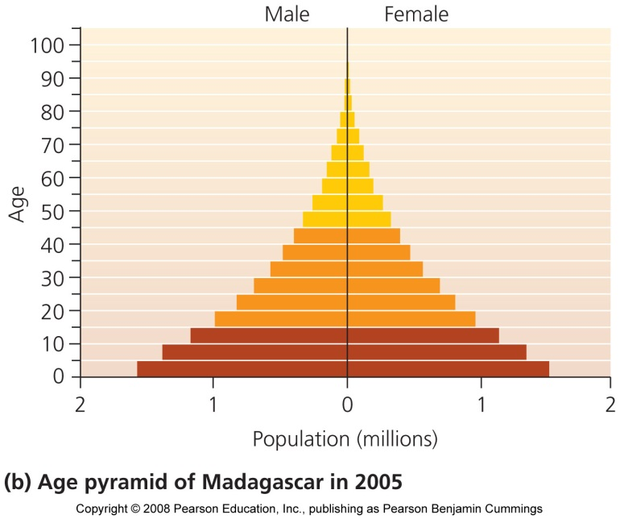
Age structure affects future population size
Having many individuals in young age groups results in high reproduction and rapid population growth
Age pyramid of the U.S. in 2005

Slide 56
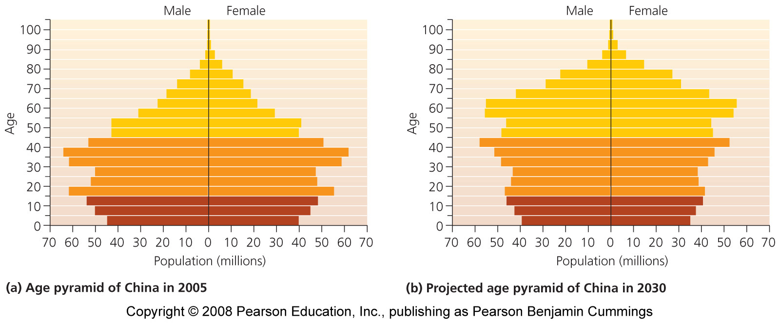
A changing age structure poses challenges
Many populations are getting older
  Older people need care and financial assistance
  But, also reduces the number of dependent children and crime rates

Slide 57
Sex ratios
Naturally occurring sex ratios for humans slightly favors males (100 females born to 106 males)
In China, 120 boys were reported for 100 girls
  Cultural gender preferences, combined with the government’s one-child policy, led to selective abortion of female fetuses
  Had the undesirable social consequences of many single Chinese men
  Teenage girls were kidnapped and sold as brides

Slide 58
Population growth depends on various factors
Whether a population grows, shrinks, or remains stable depends on:
  Rates of birth, death, and migration
  Birth and immigration add individuals
  Death and emigration remove individuals
Technological advances led to dramatic decline in human death rates
  Widening the gap between birth rates and death rates resulting in population expansion

Slide 59
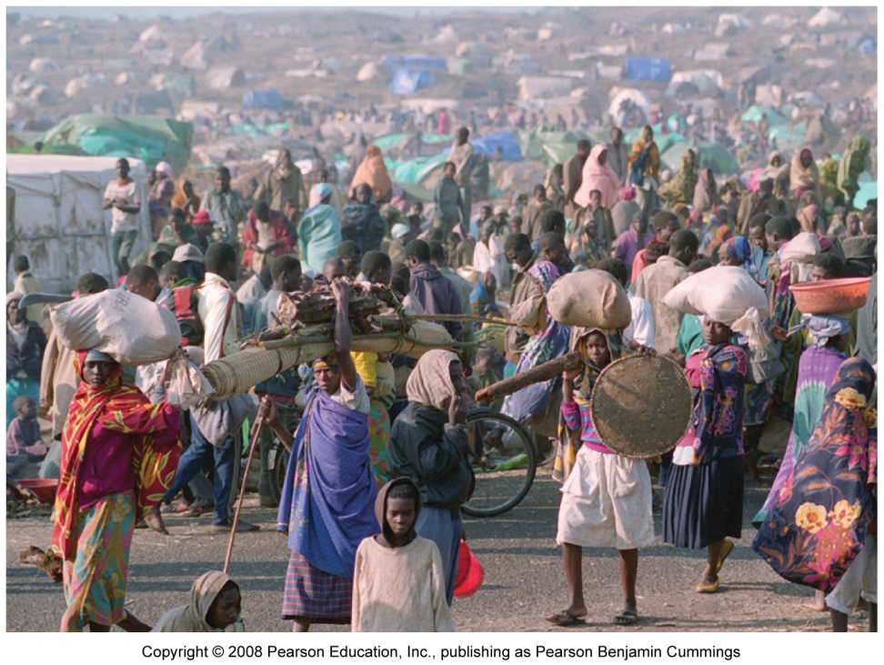
Immigration and emigration play large roles
Refugees flee their home country as a result of war, civil strife, and environmental degradation
  25 million escape poor environmental conditions
  Movement causes environmental problems with no incentives to conserve resources

Slide 60
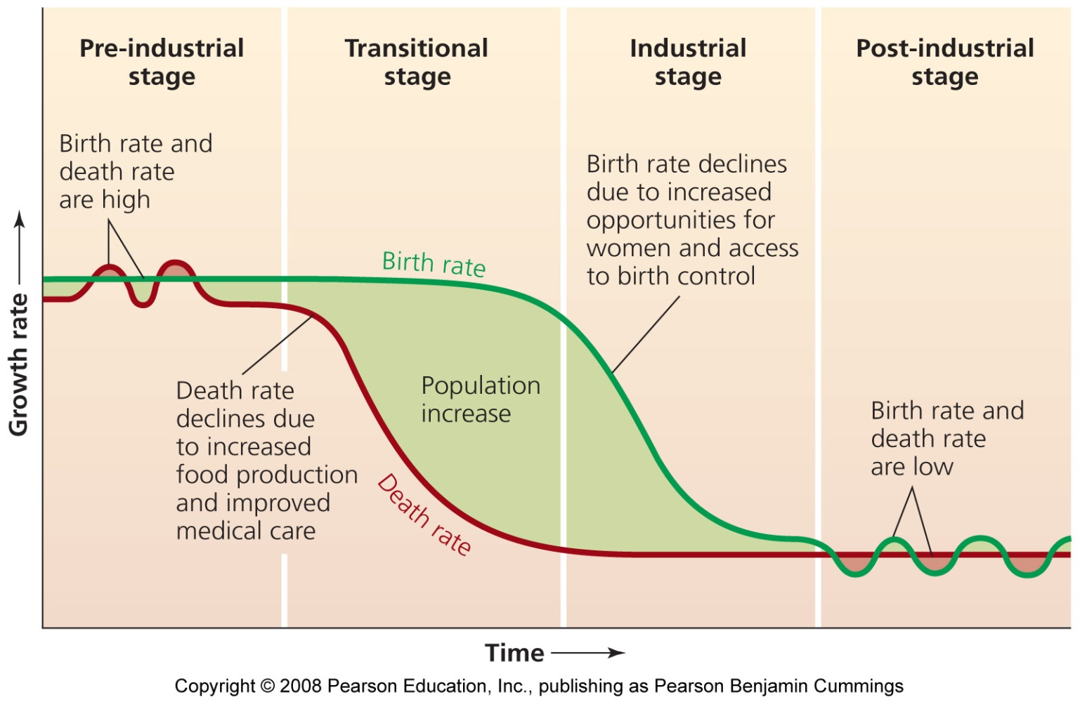
The demographic transition’s four stages
Population growth is seen as a temporary phenomenon

Slide 61
To Review
I would check out the end of chapter questions, see if you can form reasonable answers to them BEFORE STUDYING.
Focus on information you’re weak on or we didn’t fully cover in class
Eat. Sleep. Don’t have distractions when you study.

