Slide 1
Sidereal vs. Synodic Motion
Plus… some keplar stuff…

Slide 2
Sidereal motion
The word sidereal derives from the Latin word for “star”. This is because sidereal motion is motion with respect to the stars.
One sidereal day is the time it takes for a star in the sky to come back to the same place in the sky. Because, for all intents and purposes, the sky is “fixed”, a sidereal day is when the earth rotates 360°.
A sidereal day is 23 hours 56 minutes and 4.09 seconds long.

Slide 3
Sidereal Motion
A sidereal year is the time it takes for the sun to return to the same position with respect to the stars.
Due to the precession of the equinoxes the sidereal year is about 20 minutes longer than the tropical year.
The tropical year is the interval at which seasons repeat and is the basis for the calendar year.

Slide 4
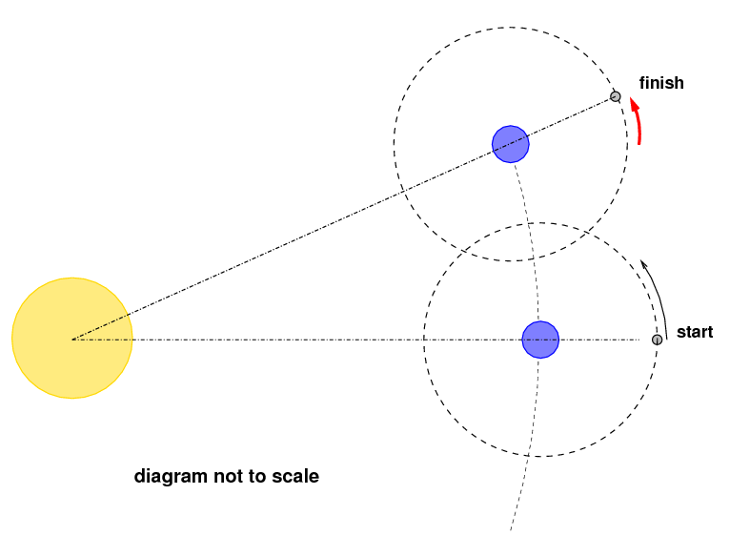

Slide 5
Synodic Motion
The word synodic derives from the Greek word for meeting or assembly. It is motion relative to a conjunction or alignment of sorts.
A synodic or solar day is the time it takes the sun to successively pass the meridian (astronomical noon).
A mean solar day is 24 hours (the “mean” is there to average over the effect of the analemma). The earth has to rotate more than 360° for the sun to come back to “noon”.

Slide 6
Analemma
deviation of the Sun from its mean motion in the sky, as viewed from a fixed location on the Earth. Due to the Earth's axial tilt and orbital eccentricity, the Sun will not be in the same position in the sky at the same time every day.

Slide 7
Synodic year
A synodic year is the time it takes for a planet-sun alignment to reoccur.
For the case of the sun, it is the time it takes the sun to come to the same place on the ecliptic (equinox to equinox) and is called a Tropical Year.
A tropical year is 365.242 mean solar days (366.242 sidereal days). It is just over 20 minutes shorter than a sidereal year (again, the effect of precession).

Slide 8
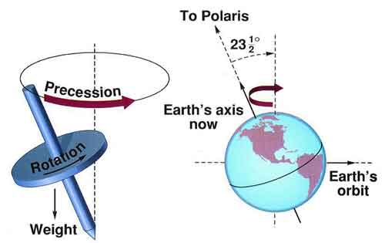
What do I mean by precession?

Slide 9
Leap Year (optional)
Because a tropical year is 365.242 mean solar days long, the vernal equinox would be later and later every year if our calendar year were strictly 365 days long.
In an attempt to keep the Vernal Equinox very near March 21st, the Leap Year was introduced.
According to the Gregordian calendar a leap year occurs every 4 years except years evenly divisible by 100, unless that year is evenly divisible by 400. The year 1900 was not a leap year, but 2000 was.

Slide 10
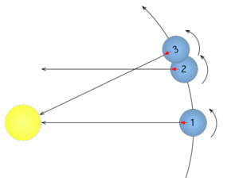
1→ 2: globe rotates 360° (sidereal)
1 → 3: globe repoints to sun. (synodic)

