Slide 2
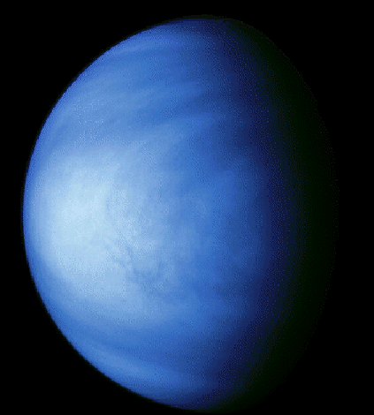
Full view of Venus
Venus is the second planet from the Sun. With a nearly circular orbit, it an orbits the sun every 225 days. Venus is peculiar in that its axis rotation is retrograde (in the opposite sense of the Earth and all other planets except Uranus) and because it is very slow: a Solar day on Venus corresponds to 117 Earth days while a Sidereal day (rotation relative to the fixed stars) on Venus corresponds to 243 days.
Notes:
http://csep10.phys.utk.edu/astr161/lect/venus/venus.html
This is that weird sidereal vs. solar day stuff. I believe the solar day is 114 days or so. Please verify and change.

Slide 3
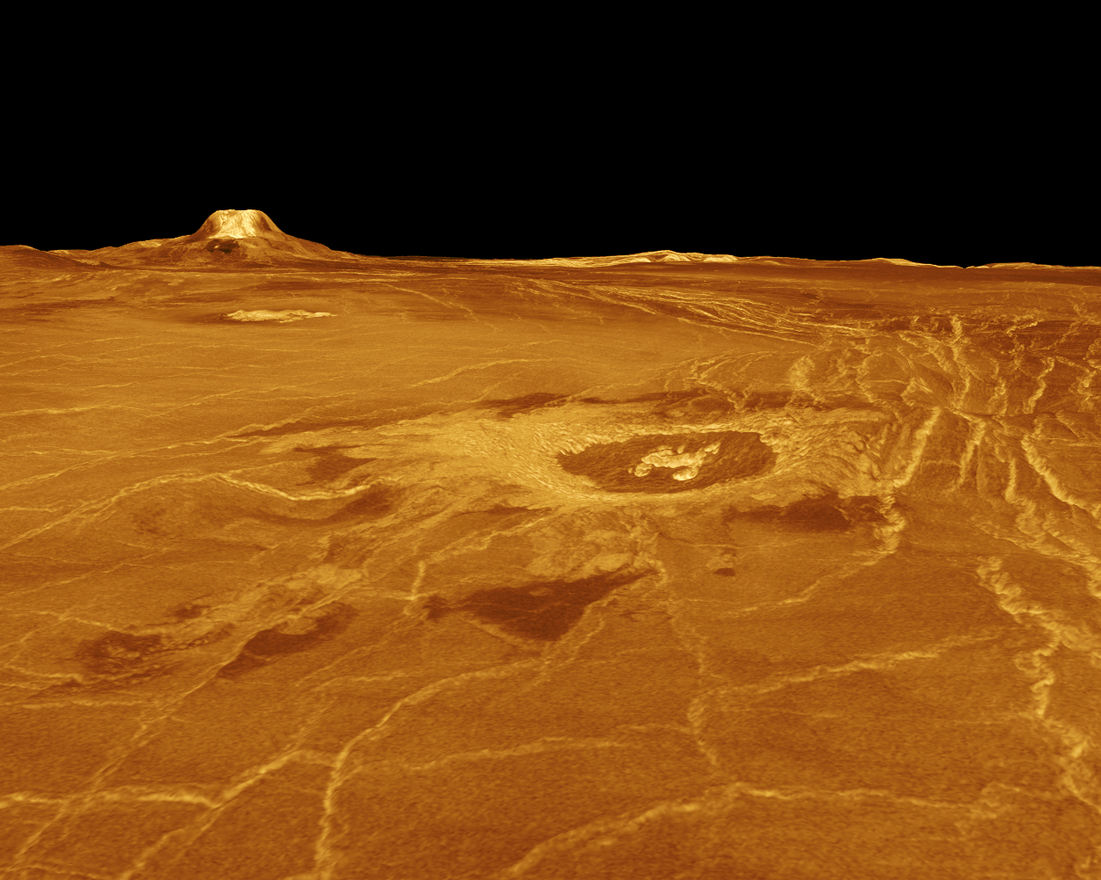
Surface of Venus
In the background is Gula Mons, a 1.86 mile high volcano. The impact crater Cunitz, named for the astronomer and mathematician Maria Cunitz, is visible in the center of the image. The crater is 30 miles in diameter. The digital elevation map is used to enhance small-scale structure.
Notes:
http://www.solarviews.com/eng/venus.htm
I believe the height in this reconstructed image from radar is exaggerated. We should say that in the caption.

Slide 4
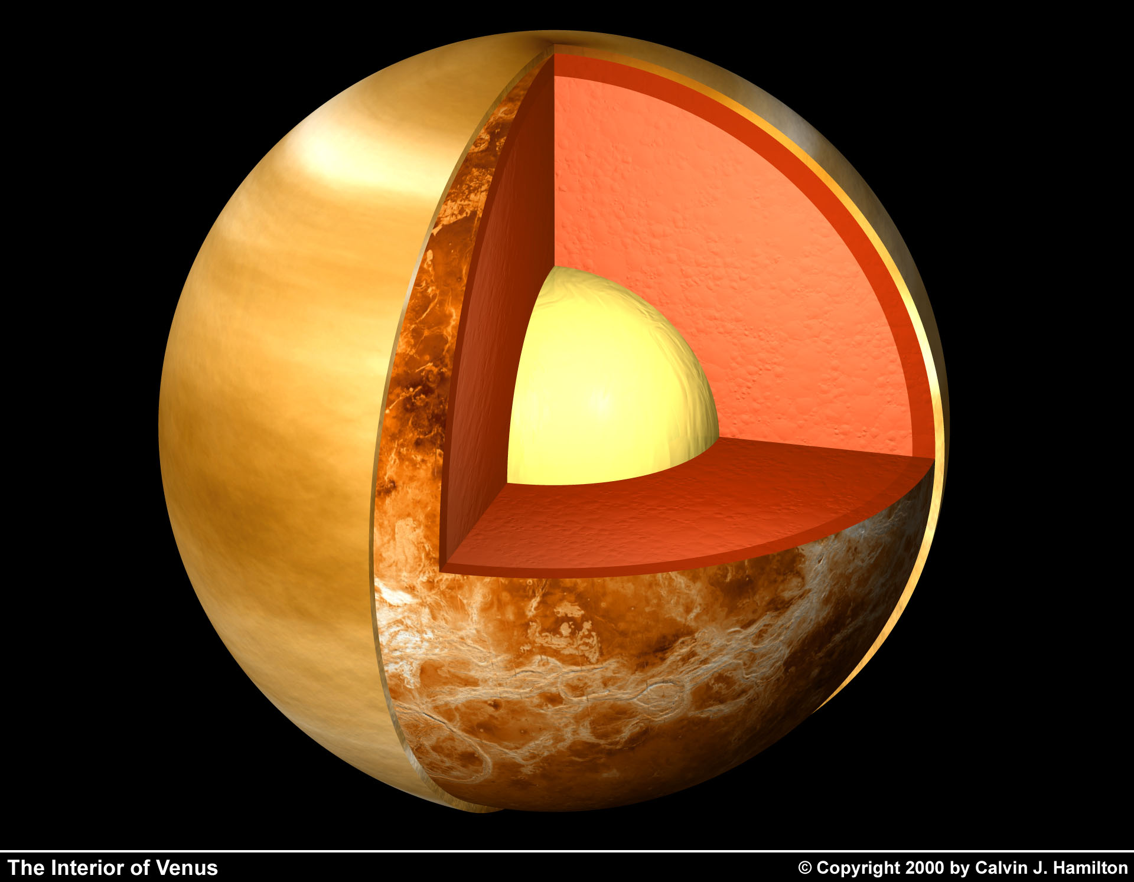
Interior of Venus
This rendering shows a cutaway view of the possible internal structure of Venus. The image used for the outer atmospheric layer was created from 10 images taken by the Mariner spacecraft.
Notes:
http://www.solarviews.com/eng/venus.htm

Slide 5
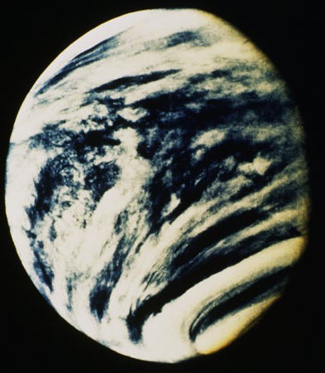
Atmosphere of Venus
The atmosphere of Venus is composed of about 96% carbon dioxide, with most of the remainder being nitrogen. The atmosphere appears to be relatively clear until the cloud deck starts about 50 km above the surface. The clouds are composed of sulphuric acid and various other corrosive compounds, and the atmosphere contains little water.
Notes:
http://archive.ncsa.uiuc.edu/Cyberia/Bima/venus.html
http://csep10.phys.utk.edu/astr161/lect/venus/atmosphere.html
We should find some graphics for this text. In fact the text should be a pop up in the flash versions of this presentation.

Slide 6
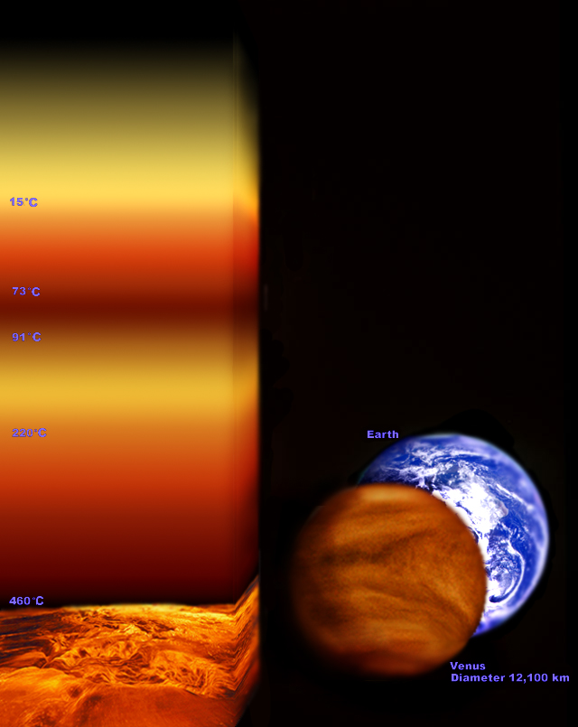
Atmosphere of Venus
The pressure of the atmosphere is about 90 times that of the Earth at the surface, and the surface temperatures on Venus are around 500 degrees Celsius, exceeding that of Mercury and hot enough to melt soft metals. Calculations indicate that for the temperatures to be so high there must be a mechanism in the Venusian atmosphere that traps solar radiation very effectively.
Notes:
http://www.windows.ucar.edu/tour/link=/venus/atmosphere.html
http://csep10.phys.utk.edu/astr161/lect/venus/atmosphere.html

Slide 7
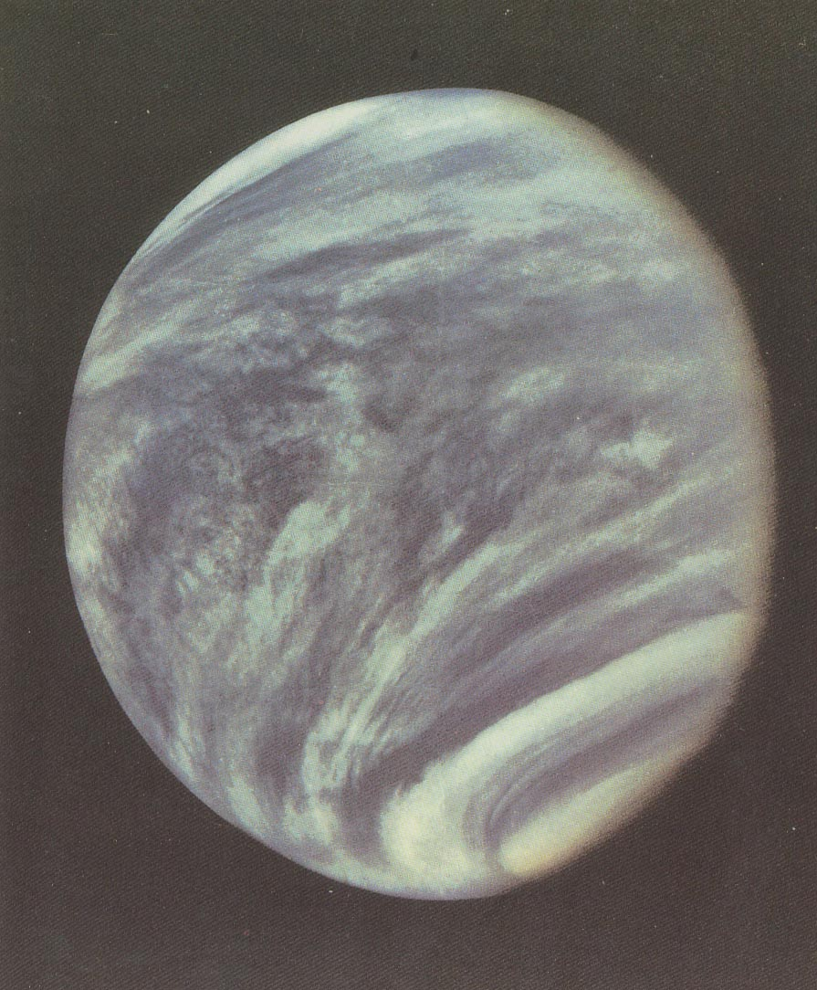
Atmosphere and surface of Venus
There are high-velocity winds in the upper atmosphere, but the atmosphere below the cloud deck appears to be relatively stagnant, with only very weak winds blowing at the surface. Convection driven by differential solar heating should give rise to winds of only a few meters per second, so the high velocity upper level winds, and the contrasting stagnation of the lower atmosphere, are not well understood.
Notes:
http://www.hubbletelescope.btinternet.co.uk/venusgallery.shtml
http://csep10.phys.utk.edu/astr161/lect/venus/atmosphere.html
http://csep10.phys.utk.edu/astr161/lect/venus/surface.html
Again this text should be paired with graphics.

Slide 8
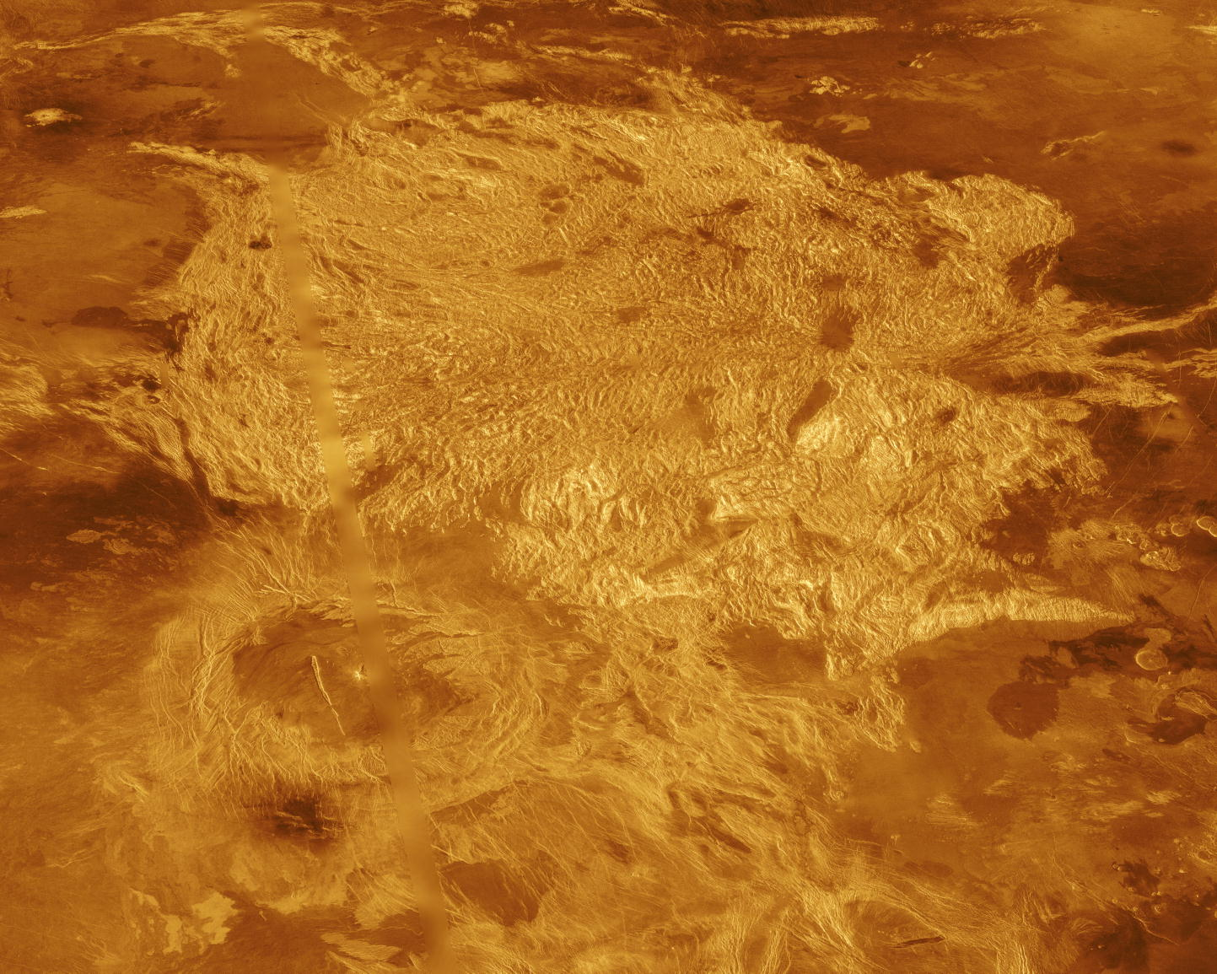
Atmosphere and surface of Venus
The surface of Venus is rather smooth in many places, though not nearly as smooth as originally expected. However, we find evidence for some of the same geological features found on Earth: canyons, volcanoes, lava flows, rift valleys, mountains, craters, and plains.
Notes:
http://www.solarviews.com/eng/venus.htm
http://csep10.phys.utk.edu/astr161/lect/venus/atmosphere.html

Slide 9
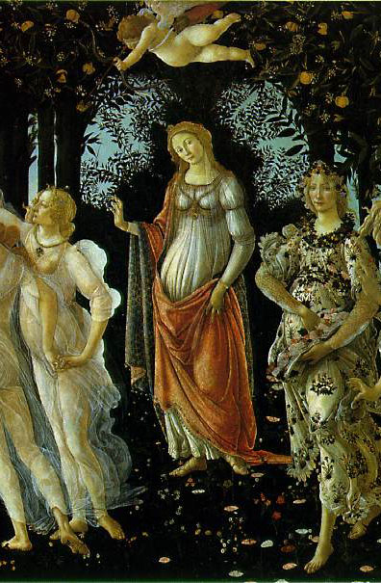
Venus Mythology
Venus is named after the Roman goddess of love and beauty. The planet was so named because it was the brightest of the planets known to the ancients. Venus is commonly called the “evening star” or the “morning star” (depending on which side of the sun it happens to be on). It is considered the brightest and most beautiful object in the heavens next to the sun and moon, and is far brighter than any star. Originally the Greeks thought Venus was two different planets.
Notes:
artchive.com
http://www.wordsources.info/ve
nus.html
I don’t like the graphic very much.

Slide 10
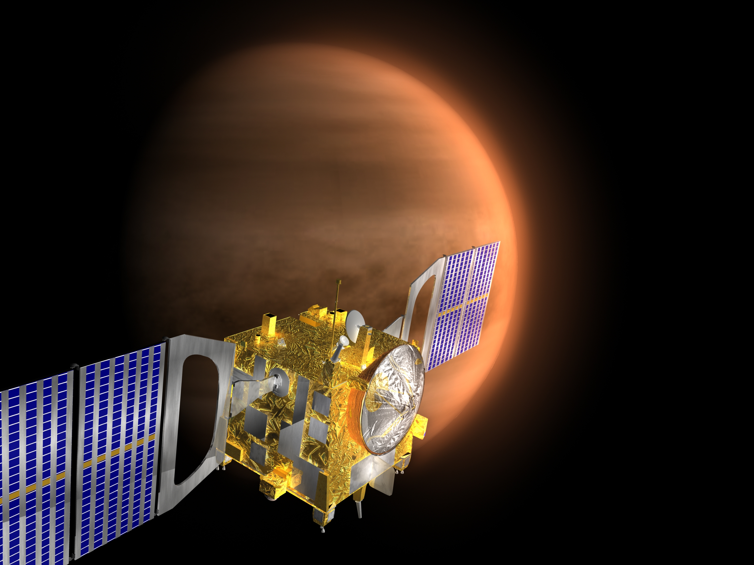
Venus Express
Artist's impression of Venus Express.
The Venus Express was launched on October 26, 2005. After a six month cruise to Venus the spacecraft will enter the orbit of Venus in April 2006, where it will spend the next 500 days investigating the atmosphere of Venus.
Notes:
http://sci.esa.int/science-e/www/object/index.cfm?fobjectid=31141&farchive_objecttypeid=18,19,22&farchive_objectid=30912
This should be updated to reflect that this has indeed launched.

Slide 11
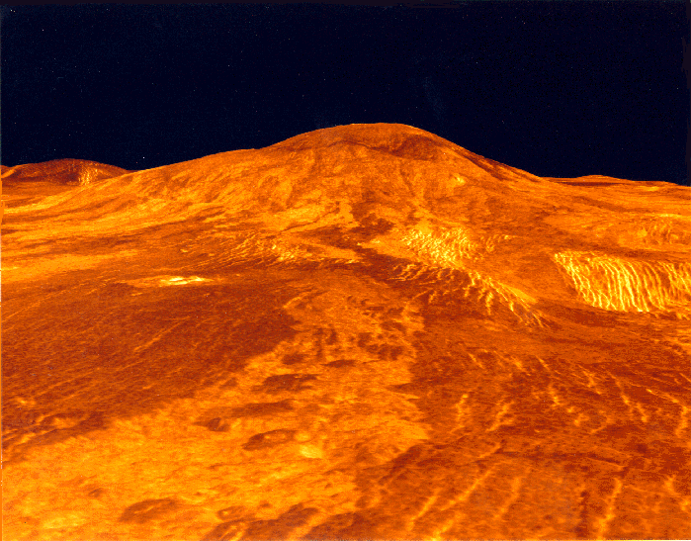
Volcano on Venus
Computer generated 3-D view of Sif Mons volcano, Venus.
Notes:
http://www.astrosurf.com/tresluna/page%20venus/Sif%20Mons.htm

Slide 12
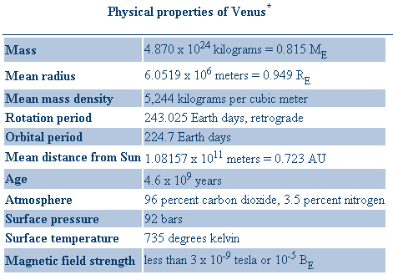
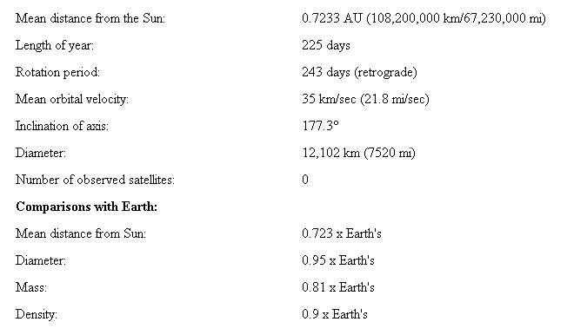
Facts about Venus
*
*
*
*
o
462 C

Slide 13
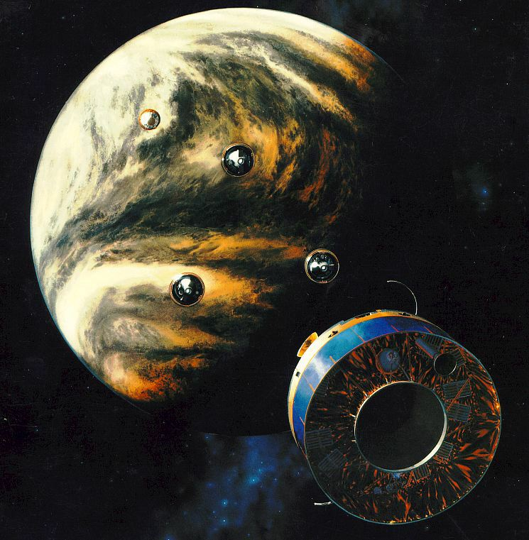
Venus Atmospheric Missions
Mariner 10 – Fly-by in 1973
Pioneer Venus – 5 probes in 1978
Vega 1 and 2 – 2 probes in 1985
Galileo – Fly-by in 1990
Europe’s Venus Express
(orbits in April 2006)
Messenger
(fly-bys October 2006 & June 2007)

Slide 14
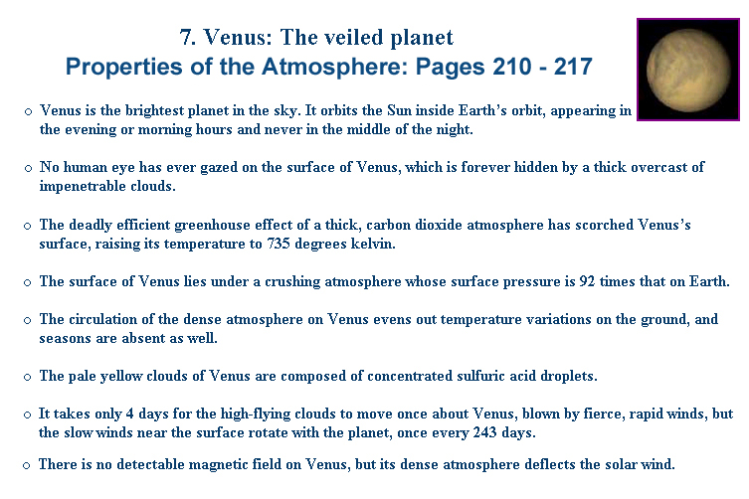

Slide 15
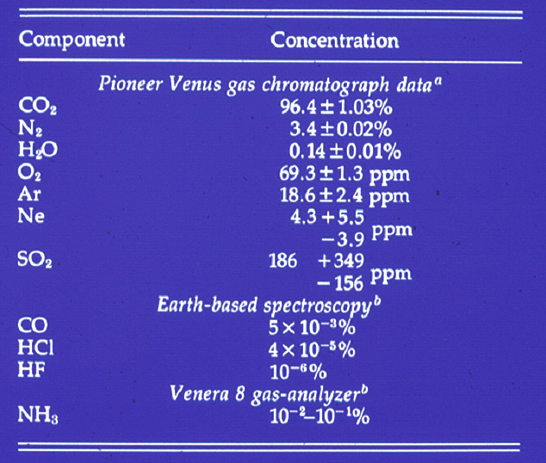
*
*
*
*

Slide 16
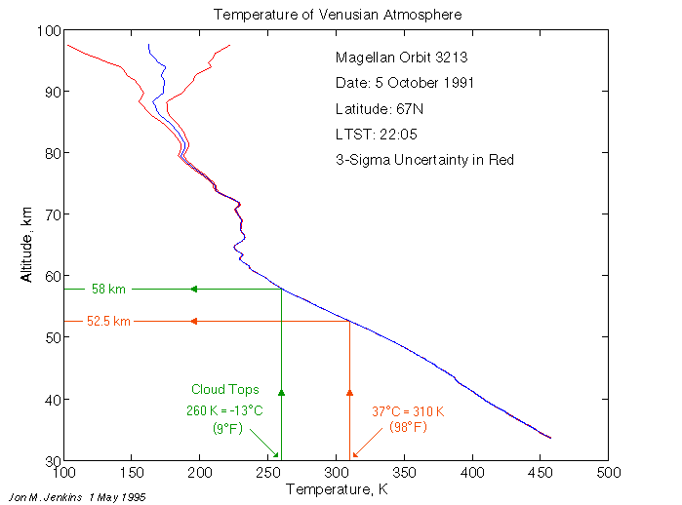
Cloud Tops
o
45 km = 100 C

Slide 17
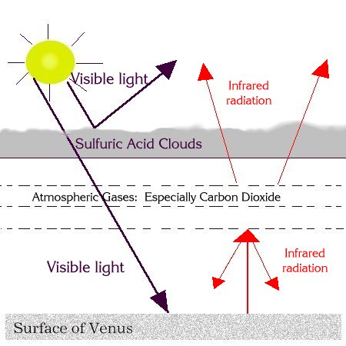
The “Greenhouse Effect” on Venus

Slide 18
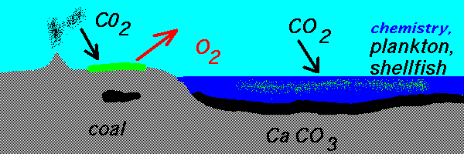
Carbon dioxide cycle on Earth keeps us from being like Venus
But this cycle would not work if there’s no liquid water!

Slide 19
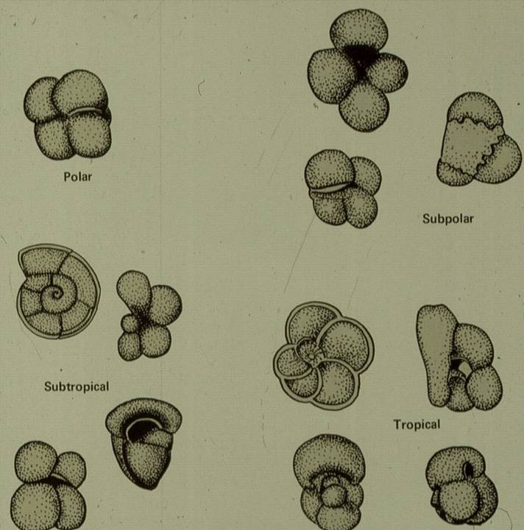
Single-celled floating organisms like these foraminifera construct fragile CaCO₃ shells.
When the organisms die, their shells sink to the ocean floor and form limestone deposits, thus trapping CO₂.

Slide 20
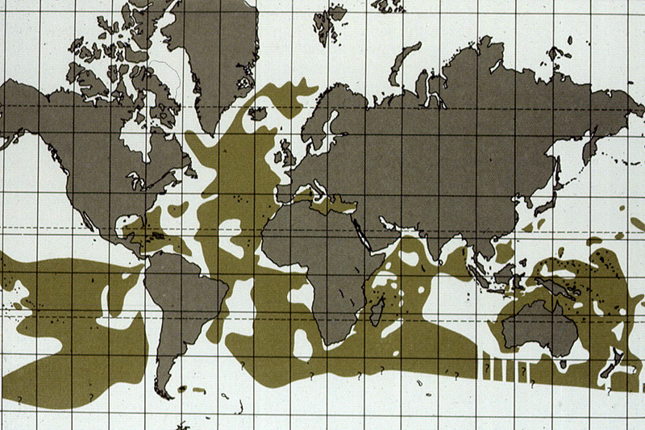
Limestone deposits in today’s oceans

