Slide 1
Common Arrangement Plants

Slide 3
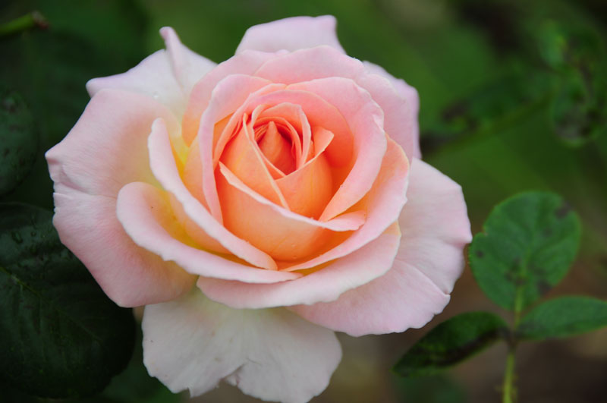
Roses
Types: Tea, lady, ….lots. Check out gethsemanegardencenter.com

Slide 4
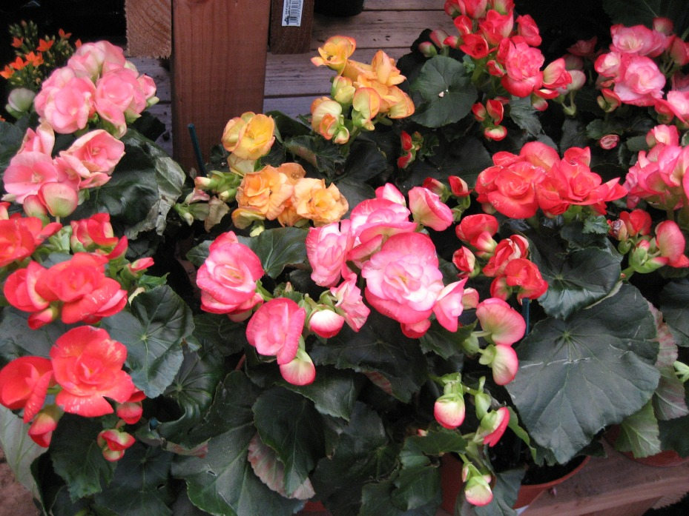
Begonias

Slide 5

Daisys

Slide 6

lilacs

Slide 7
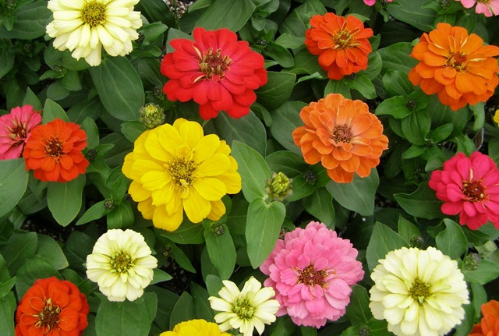
Zinnias

Slide 8
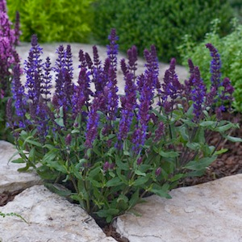
Blue Salvia

Slide 9

Violets

Slide 10
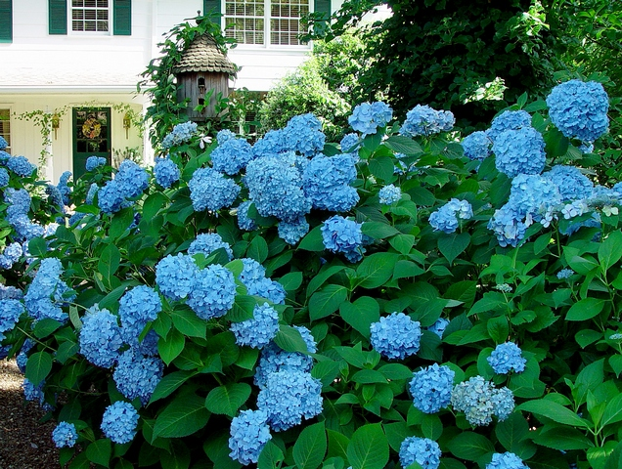
Hydrangeas

Slide 11
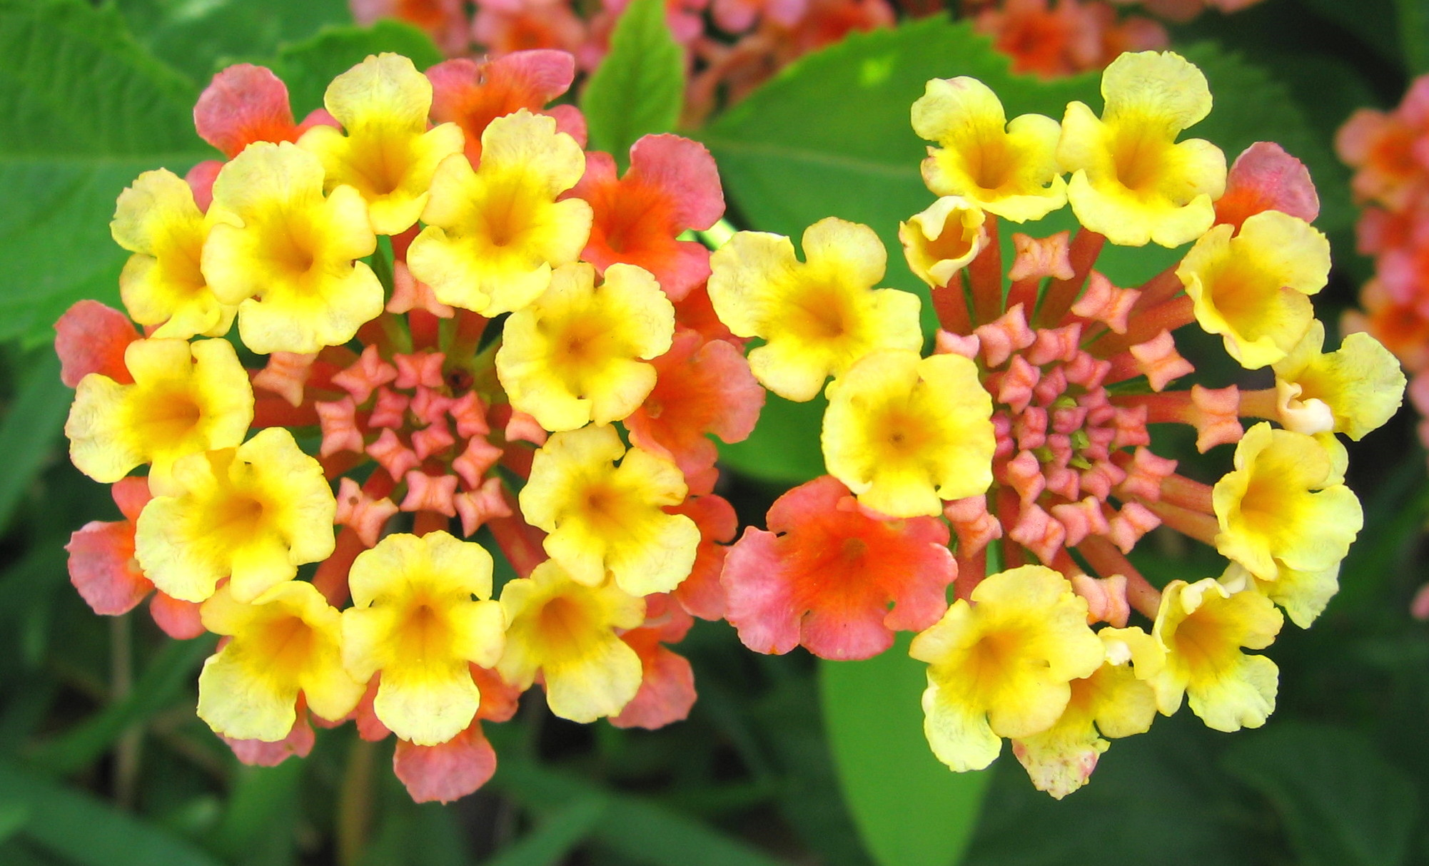
Lantanas

Slide 12
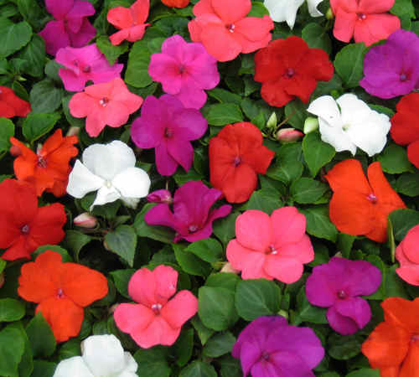
Impatiens

