Slide 2
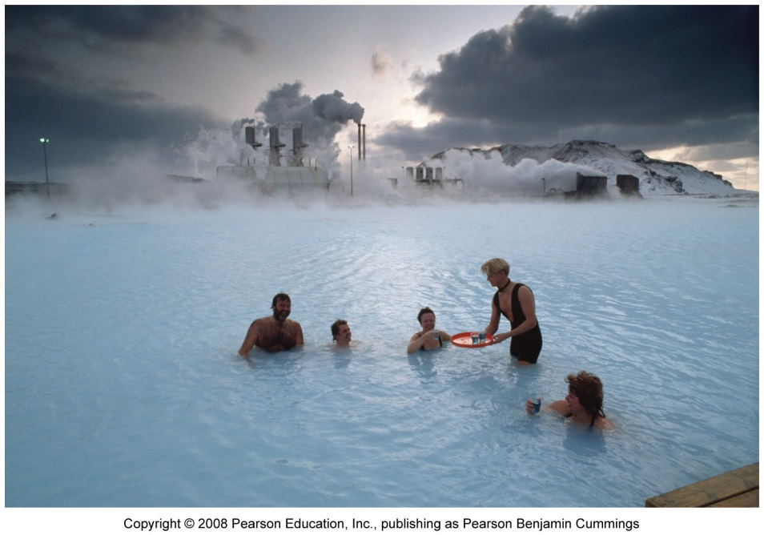
This lecture will help you understand:
The major sources of renewable energy
Solar energy
Wind energy
Geothermal energy
Ocean energy
Hydrogen fuel cells

Slide 3
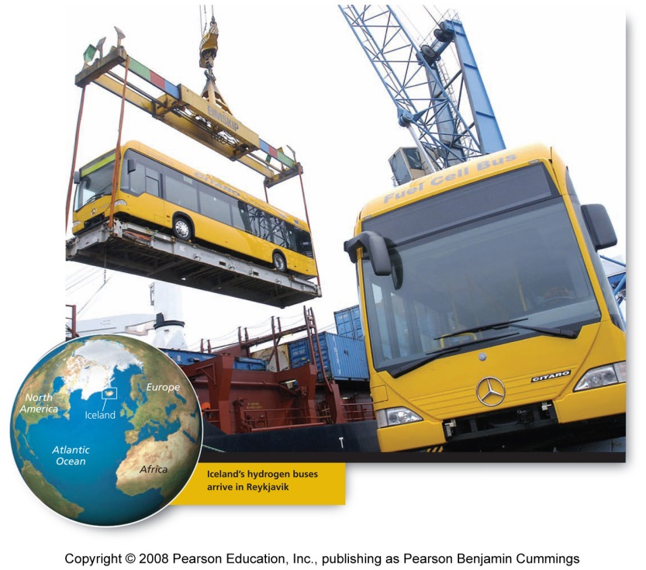
Central Case: Iceland moves toward a hydrogen economy
Iceland aims to convert to an economy based completely on renewable energy
Iceland has excellent sources of geothermal energy and hydropower
It also uses imported fossil fuels
By setting an example, and getting a head start, leaders hope to make Iceland the “Kuwait of the North” and get rich by exporting hydrogen fuel

Slide 4
“New” renewable energy sources
“New” renewables are a group of alternative energy sources that include
  Energy from the Sun, wind, geothermal heat, and movement of the ocean water
They are commonly referred to as “new” because:
  They are not yet used on a wide scale
  Their technologies are still in a rapid phase of development
  They will play a much larger role in our energy use in the future

Slide 5
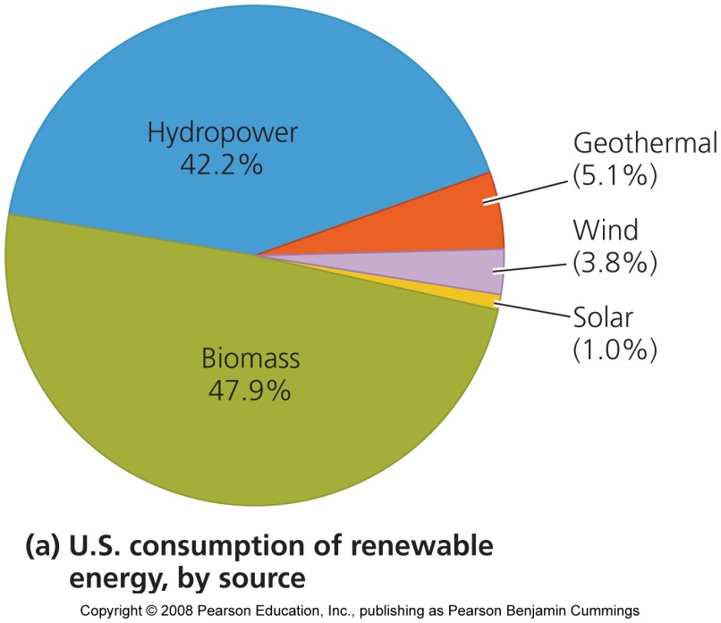
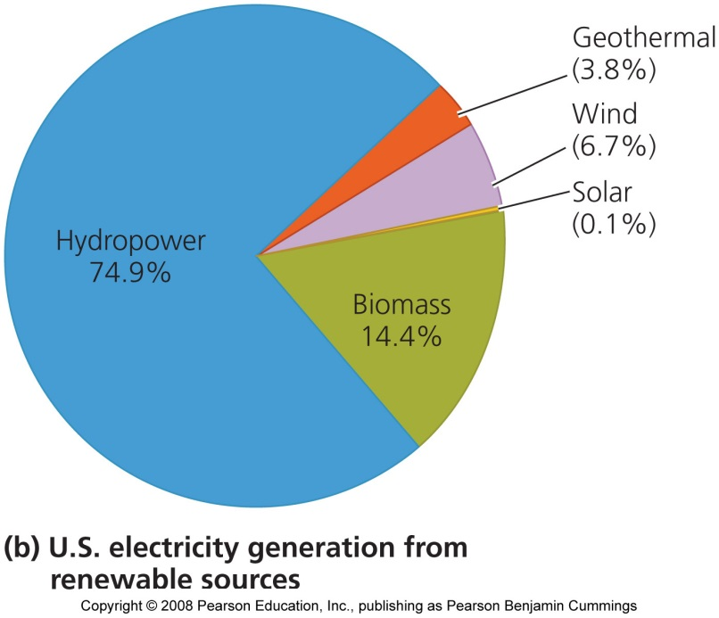
New renewables provide little of our power
We obtain only one half of 1 percent from the new renewable energy sources
Nations and regions vary in the renewable sources they use
In the U.S., most renewable energy comes from hydropower and biomass

Slide 6
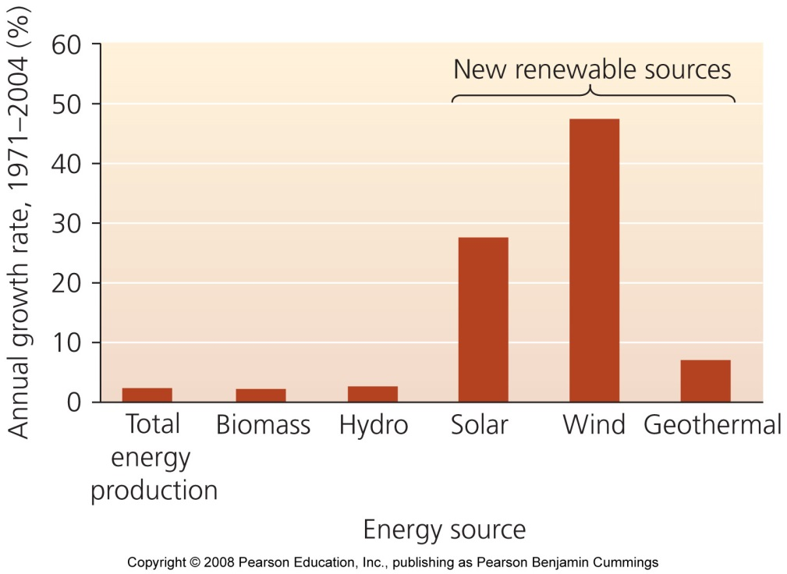
The new renewables are growing fast
They are growing at much faster rates than conventional sources
  Wind power is the fastest growing
  However, since these sources began at low levels, it will take time to build them up

Slide 7
Use has expanded quickly because of:
Growing concerns over diminishing fossil fuels
The environmental impacts of fossil fuel combustion
Advances in technology make it easier and less expensive
Benefits of the new renewables include:
  They alleviate air pollution and greenhouse gas emissions that can cause climate change
  They are inexhaustible, unlike fossil fuels
  Help diversify a country’s energy economy
  They create jobs and are sources of income and taxes, especially in rural areas

Slide 8
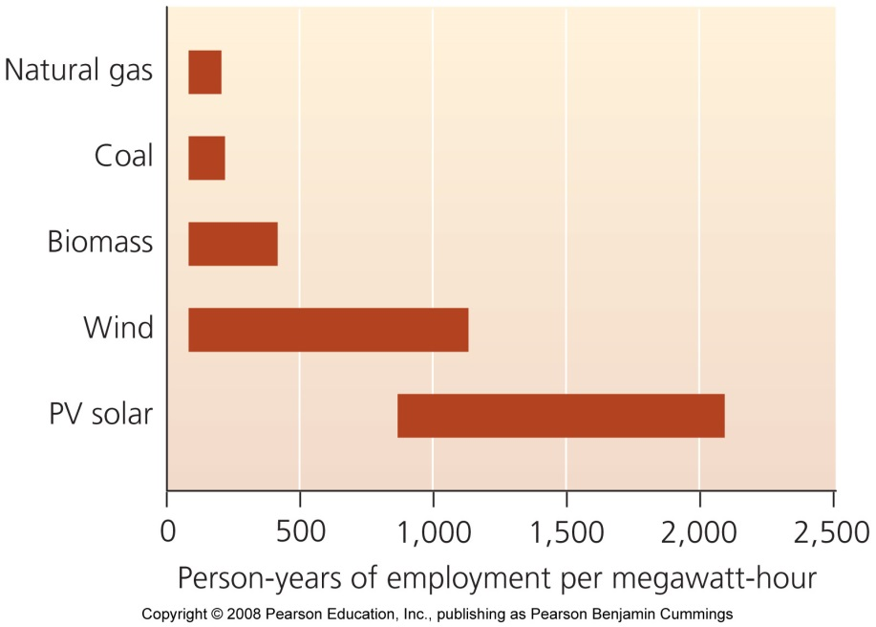
New energy sources create jobs
New technologies require more labor per unit of energy output
  More jobs will be generated than remaining with a fossil fuel economy
Rapid growth will continue as:
  Population and consumption grow, energy demand increases, fossil fuel supplies decline, and people demand a cleaner environment

Slide 9
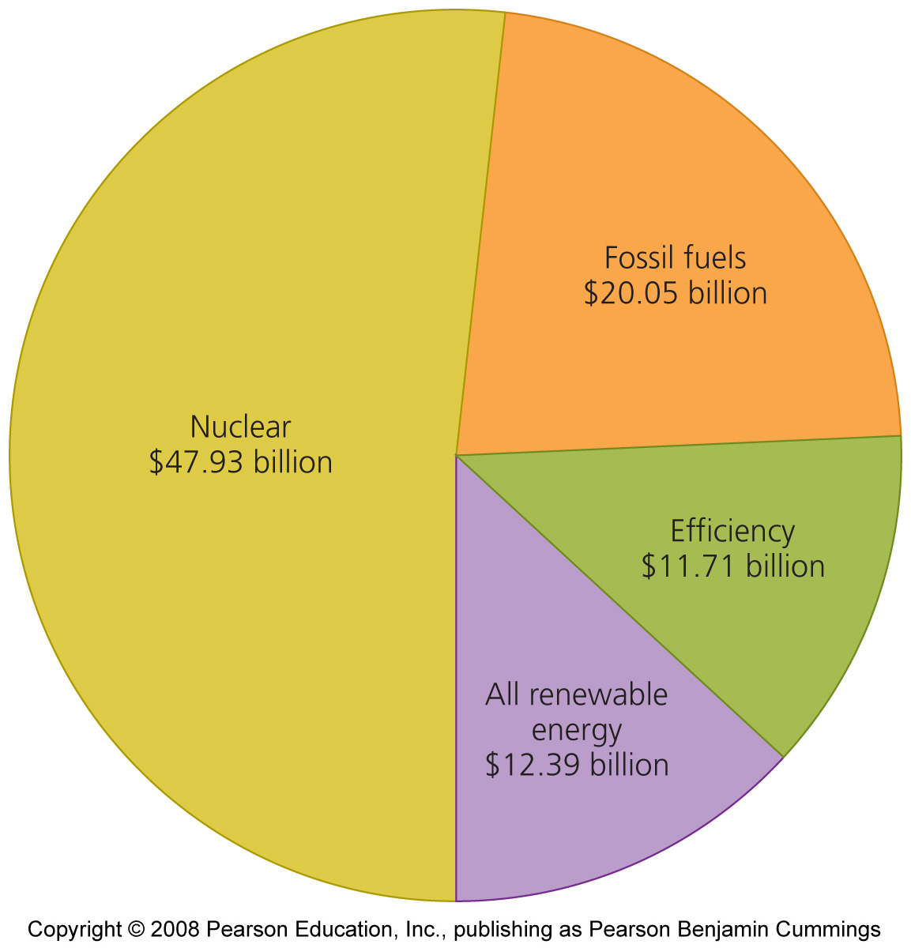
Our transition must begin soon
Technological and economic barriers prevent an overnight switch to renewables
  Renewables receive little government help
  Need infrastructure for renewables
  Transition needs to be gradual; companies are unwilling to rapidly change
Transitioning too slowly will cause fossil fuel depletion, and renewables will not be able to compensate
  We could have disrupted economies and a degraded environment

Slide 10
Solar energy
Sun provides energy for almost all biological activity on Earth
Each square meter of Earth receives about 1 kilowatt of solar energy = 17 times more than a lightbulb
  There is great potential in solar energy
Passive solar energy = the most common way to harness solar energy
  Buildings are designed to maximize direct absorption of sunlight in winter and keep cool in summer
Active solar energy collection = uses technology to focus, move, or store solar energy
Solar energy has been used for hundreds of years

Slide 11
Passive solar heating is simple and effective
Low south-facing windows maximize heat in the winter
  Overhangs on windows block light from above in the summer
Thermal mass = construction materials that absorb, store, and release heat
Planting vegetation in strategic locations
By heating buildings in winter and cooling them in summer, passive solar methods conserve energy and reduce costs

Slide 12
Active solar energy collection
Flat plate solar collectors (solar panels) = one active method for harnessing solar energy
  Installed on rooftops
  Dark-colored, heat-absorbing metal plates
    Water, air, or antifreeze pass through the collectors, transferring heat throughout the building
    Heated water is stored and used later

Slide 13
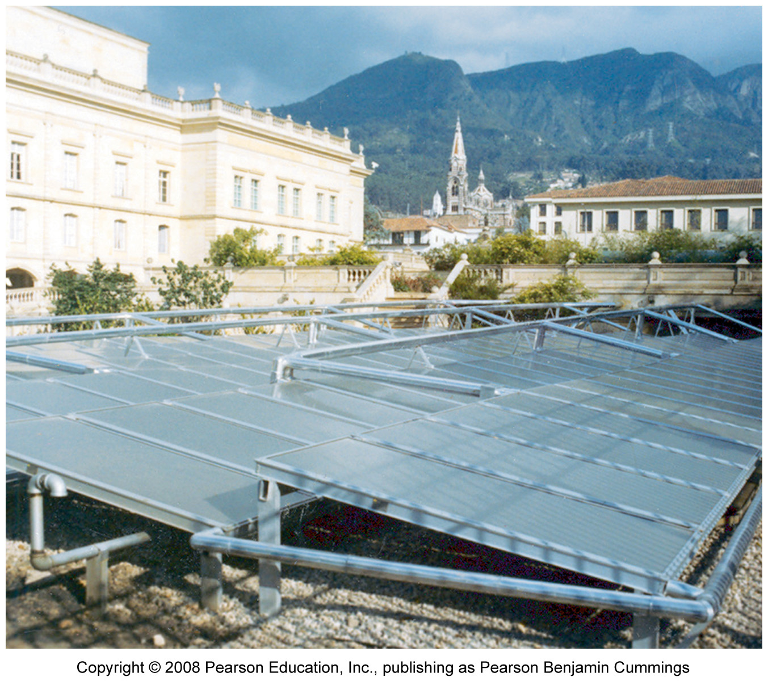
Solar energy use is increasing
1.5 million homes and businesses heat water with solar panels, mostly for swimming pools
Solar panels are used far from any sort of electrical grid to help boil water and power rural hospitals
Solar power need not be expensive or in regions that are always sunny

Slide 14
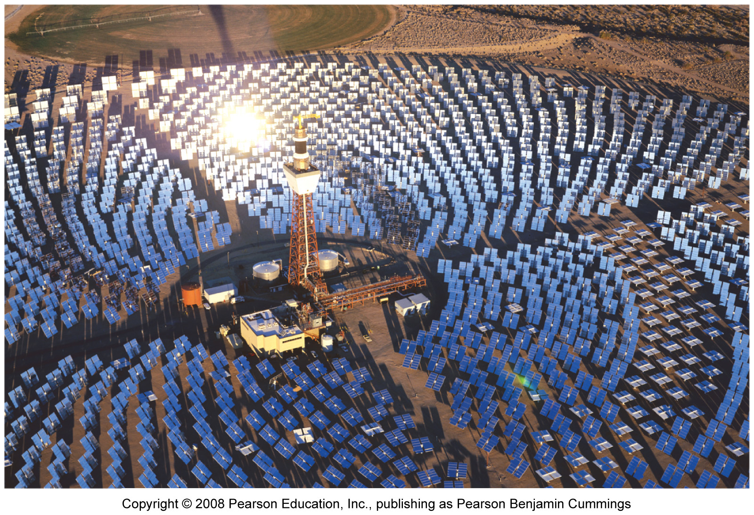
Concentrating solar rays magnifies energy
Focusing solar energy on a single point magnifies its strength
Solar cookers = simple, portable ovens that use reflectors to focus sunlight onto food
Power tower = mirrors concentrate sunlight onto receivers to create electricity
Solar-trough collection systems = mirrors focus sunlight on oil in troughs
  Superheated oil creates steam to produce electricity

Slide 15
Photovoltaic cells generate electricity
Photovoltaic cells = collect sunlight and convert it into electrical energy
  These are used with wind turbines and diesel engines
Photovoltaic (photoelectric) effect = occurs when light strikes one of a pair of metal plates in a PV cell, causing the release of electrons, creating an electric current
A PV cell has two silicon plates, the n-type layer (rich in electrons) and the p-type layer (electron poor)
  Sunlight causes electrons to flow from the n-type to the p-type layer, generating electricity

Slide 16
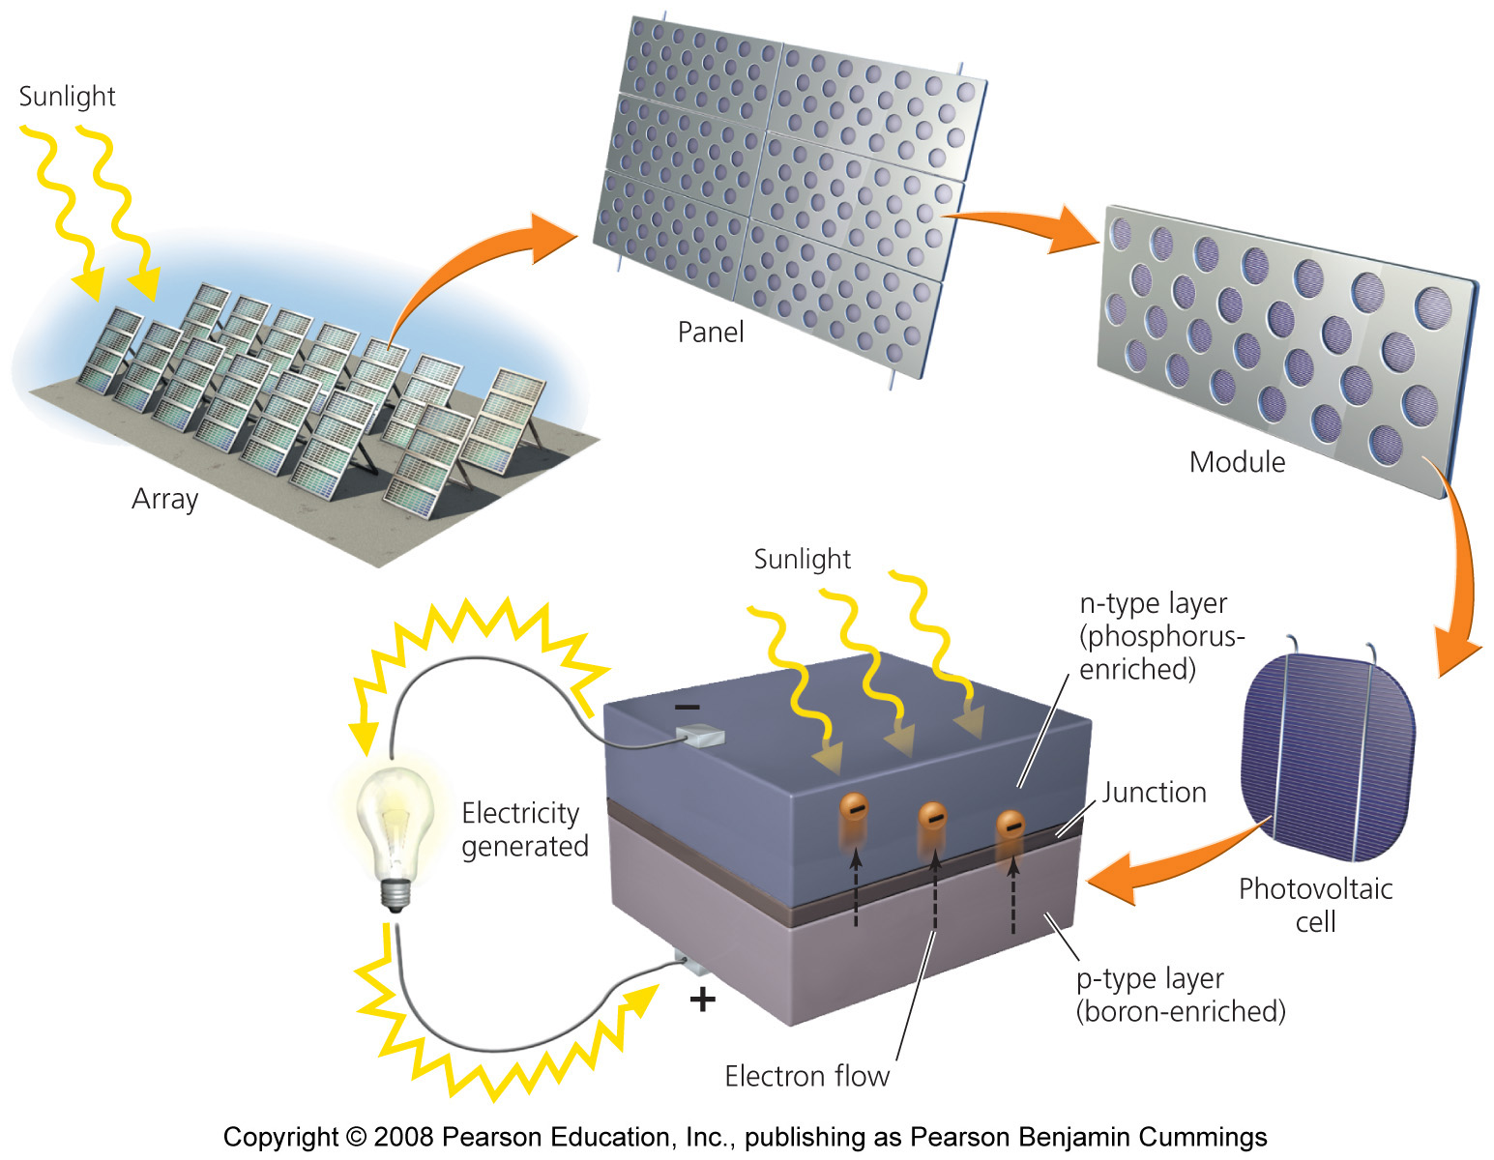
A typical photovoltaic cell

Slide 17
Solar power is little used but fast growing
Solar energy was pushed to the sidelines as fossil fuels dominated our economy
  Funding for research and development has been erratic
  Because of a lack of investment, solar energy contributes only a miniscule amount of energy
Solar energy is attractive in developing nations
  Hundreds of millions don’t have electricity
Some multinational companies are investing in solar energy

Slide 18
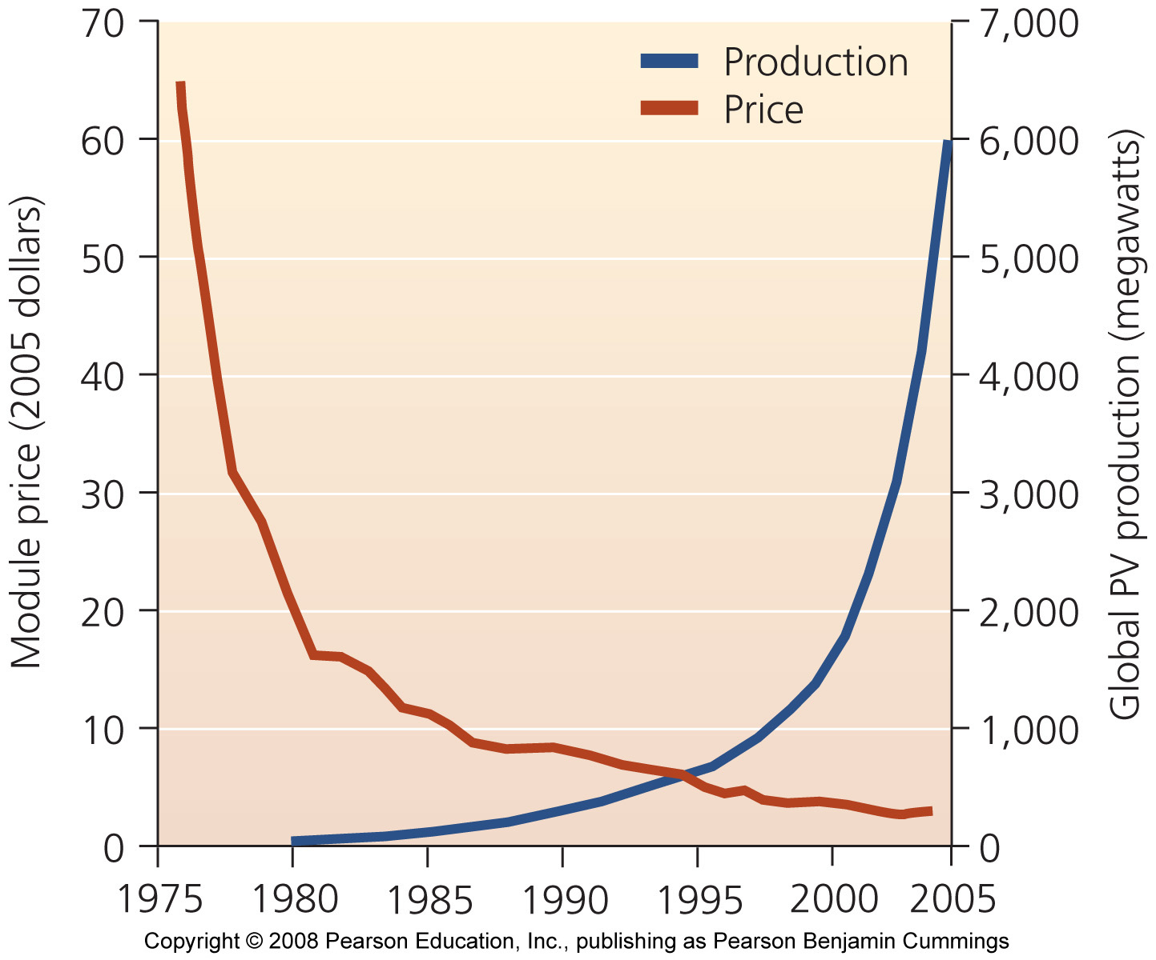
Solar energy will continue to grow
Japan and Germany lead the world in PV installation
The U.S. may recover its leadership, given a 2005 federal tax credit and some state initiatives
Solar energy use should increase
  As prices fall, technologies improve and governments enact economic incentives

Slide 19
Solar power offers many benefits
The Sun will burn for 4 - 5 billion more years
Solar technologies are quiet, safe, use no fuels, contain no moving parts, and require little maintenance
They allow local, decentralized control over power
Developing nations can use solar cookers, instead of gathering firewood
Net metering = PV owners can sell excess electricity to their local power utility
New jobs are being created
Solar power does not emit greenhouse gases and air pollution

Slide 20
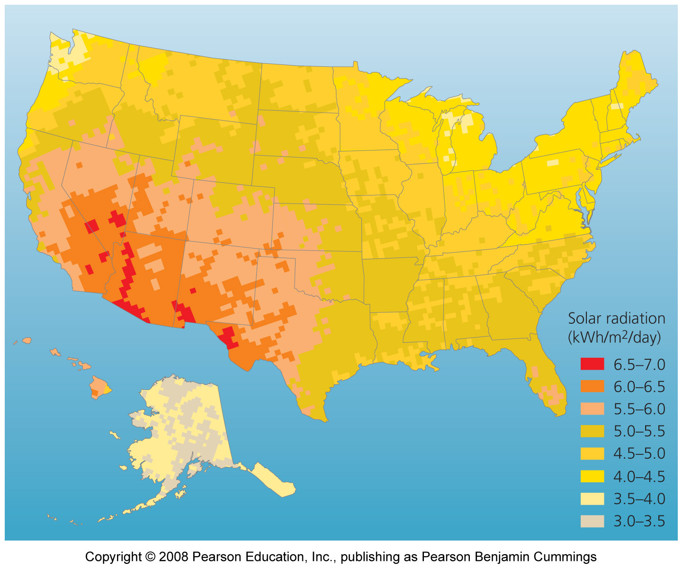
Location is a drawback
Not all regions are sunny enough to provide enough power, with current technology
  Daily and seasonal variation also poses problems

Slide 21
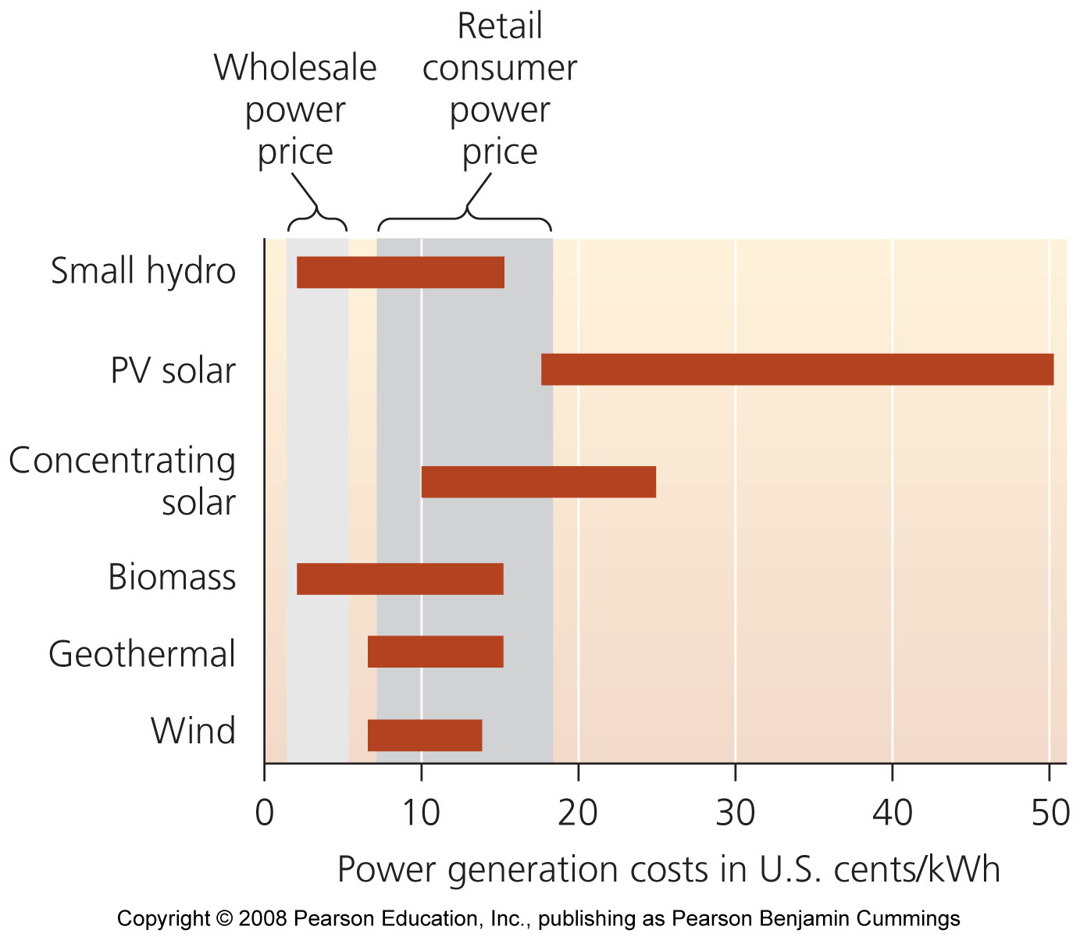
Cost is a drawback
Up-front costs are high and solar power remains the most expensive way to produce electricity
  The government has subsidized fossil fuels and nuclear energy at the expense of solar energy

Slide 22
Wind has long been used for energy
Wind turbines = devices that harness power from wind
Windmills have been used for 800 years to pump water
The first windmill to generate electricity was built in the late 1800s
After the 1973 oil embargo, governments funded research and development
Today, wind power produces electricity for the same price as conventional sources

Slide 23
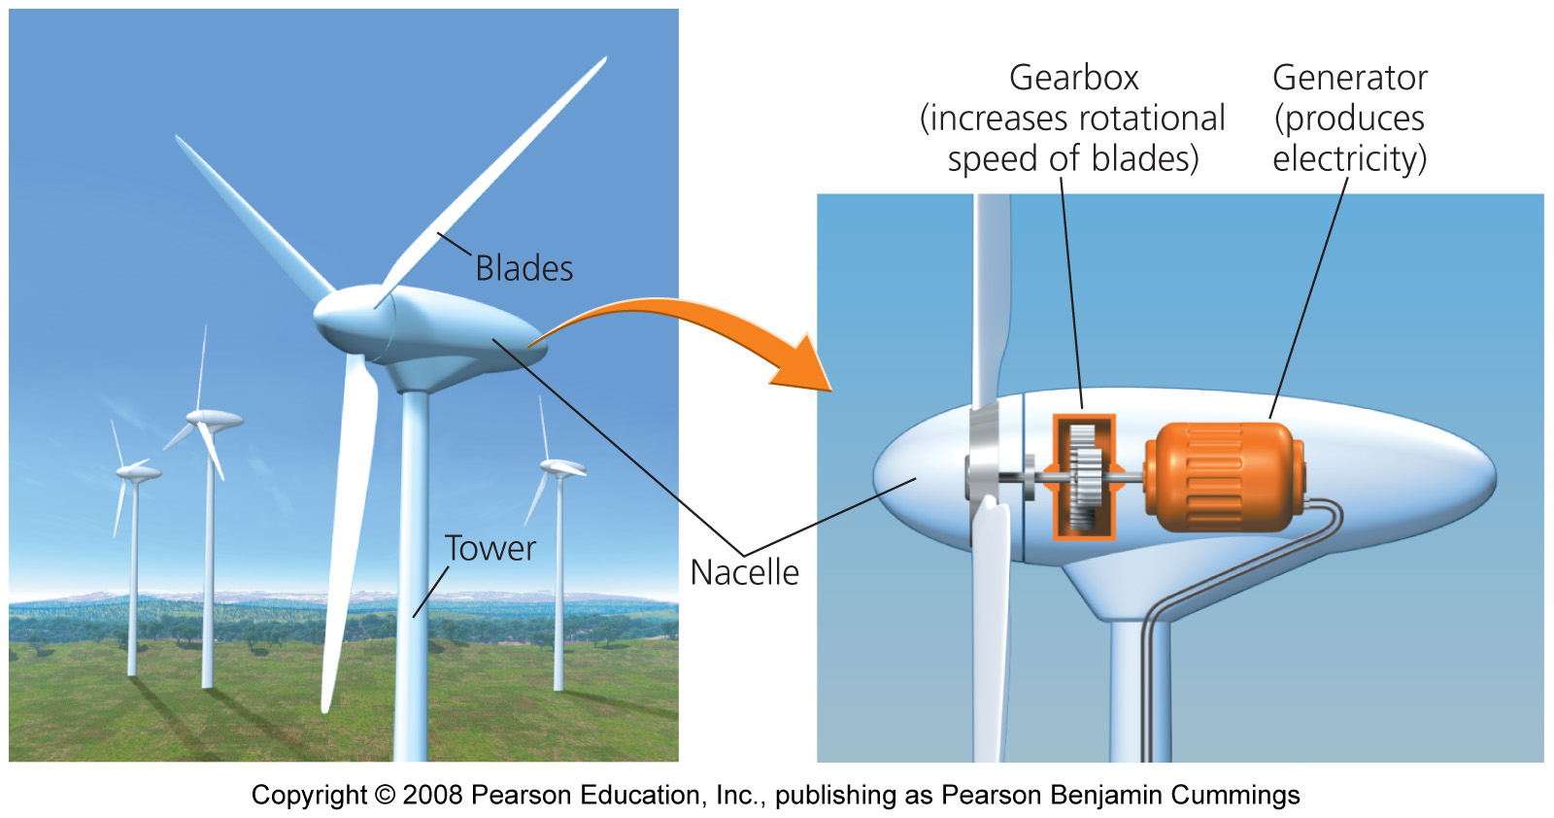
Modern wind turbines convert kinetic energy
Wind blowing into a turbine turns the blades of the rotor, which rotate machinery inside a compartment (nacelle) on top of a tall tower
Towers are 40 - 100 m (131 - 328 ft) tall
  Higher is better to minimize turbulence and maximize wind speed

Slide 24
Wind farms
Wind farms = turbines erected in groups of up to hundreds of turbines
Turbines harness wind as efficiently as possible
  Different turbines turn at different speeds
  Slight increases in wind velocity yield significant power output

Slide 25
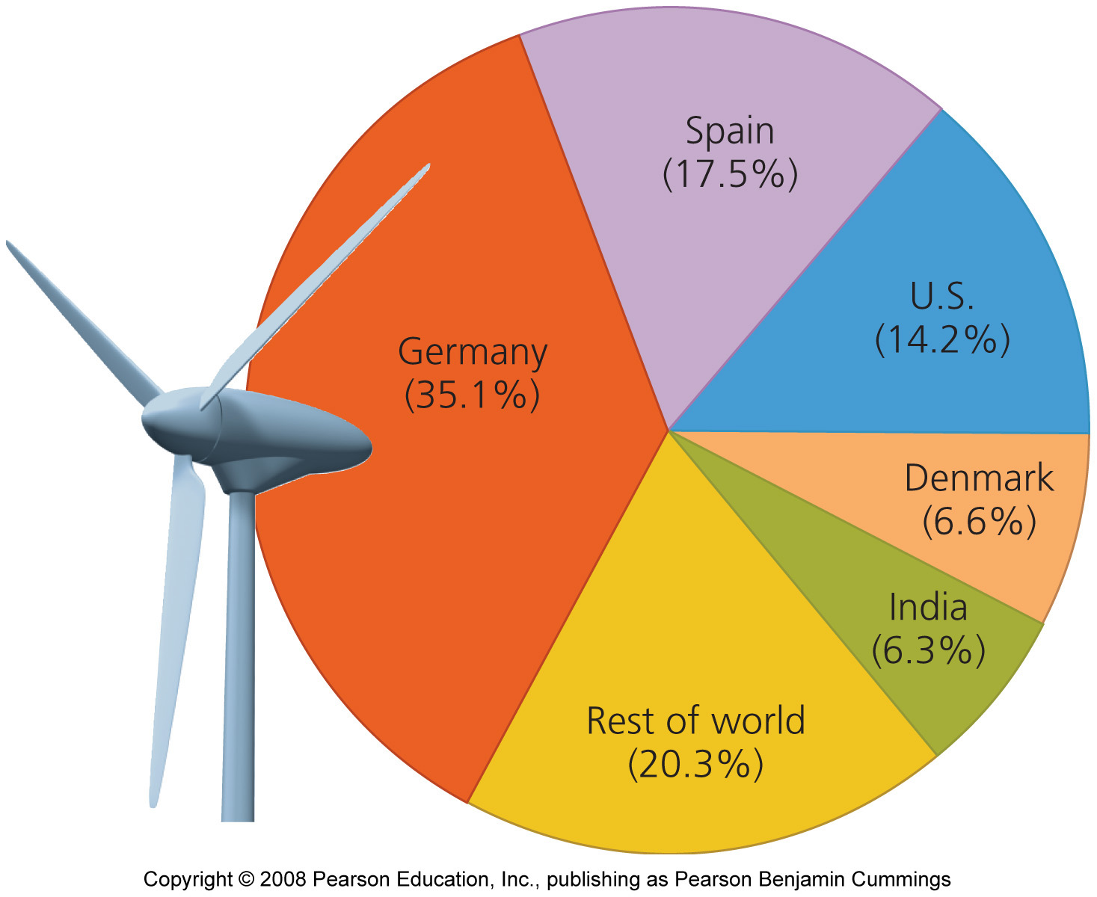
Wind is the fastest-growing energy sector
Wind power grew 25% per year globally between 2000 and 2005
  Five nations account for 80% of the world’s wind power
California and Texas produce the most wind power in the U.S.
  Wind power could be expanded to meet the electrical needs of the entire U.S.

Slide 26
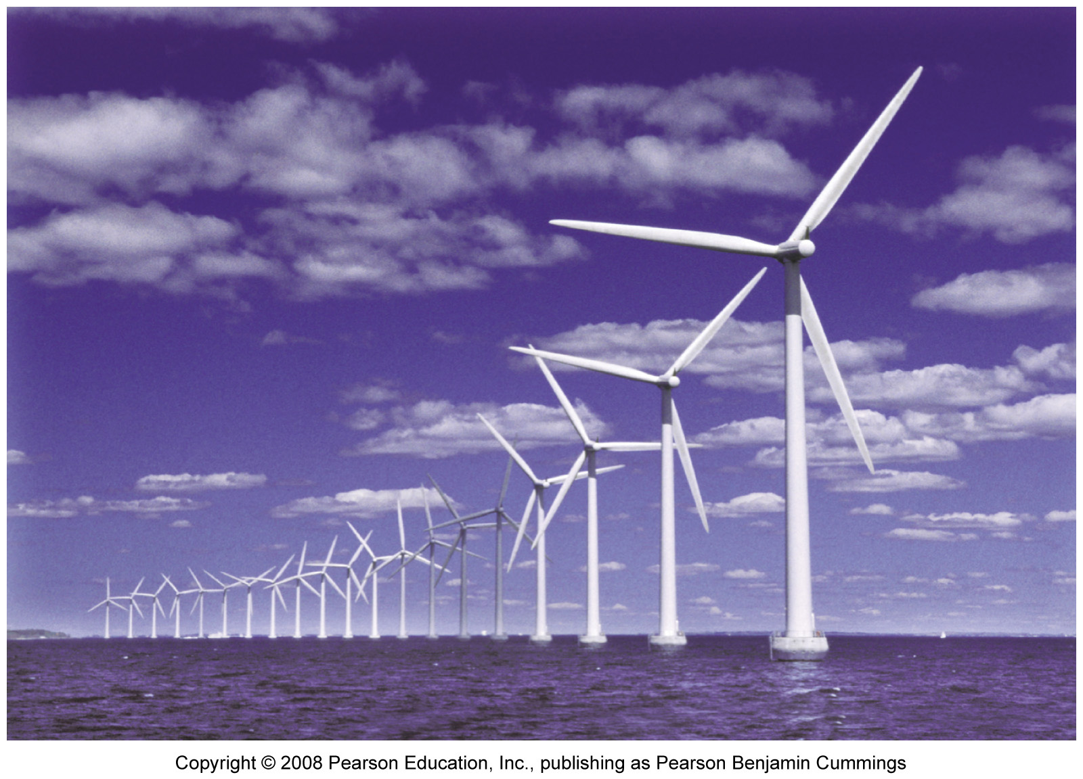
Offshore sites can be promising
Wind speeds are 20% greater over water than over land
There is less air turbulence over water than land
Costs to erect and maintain turbines in water are higher, but the stronger, less turbulent winds produce more power and make offshore wind more profitable
Currently, turbines are limited to shallow water

Slide 27
Wind power has many benefits
Wind produces no emissions once installed
It prevents the release of CO₂
It is more efficient than conventional power sources
Turbines also use less water than conventional power plants
Farmers and ranchers can lease their land
  Produces extra revenue
  Landowners can still use their land for other uses
Advancing technology is also driving down the cost of wind farm construction

Slide 28
Wind power has some downsides
We have no control over when wind will occur
  Causes major limitations in relying on it for electricity
Companies have to invest a lot of research before building a costly wind farm
Good wind sources are not always near population centers that need energy
When wind farms are proposed near population centers, local residents often oppose them
Wind turbines also pose a threat to birds and bats, which can be killed when they fly into rotating blades

Slide 29
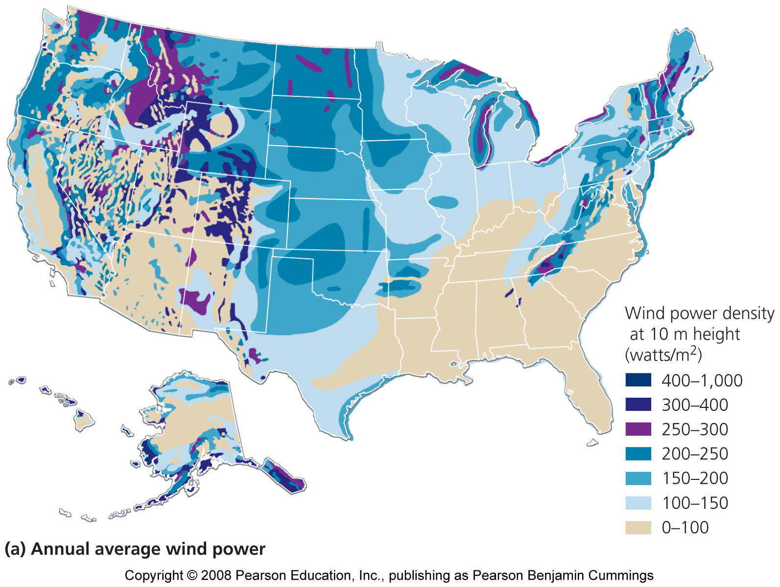
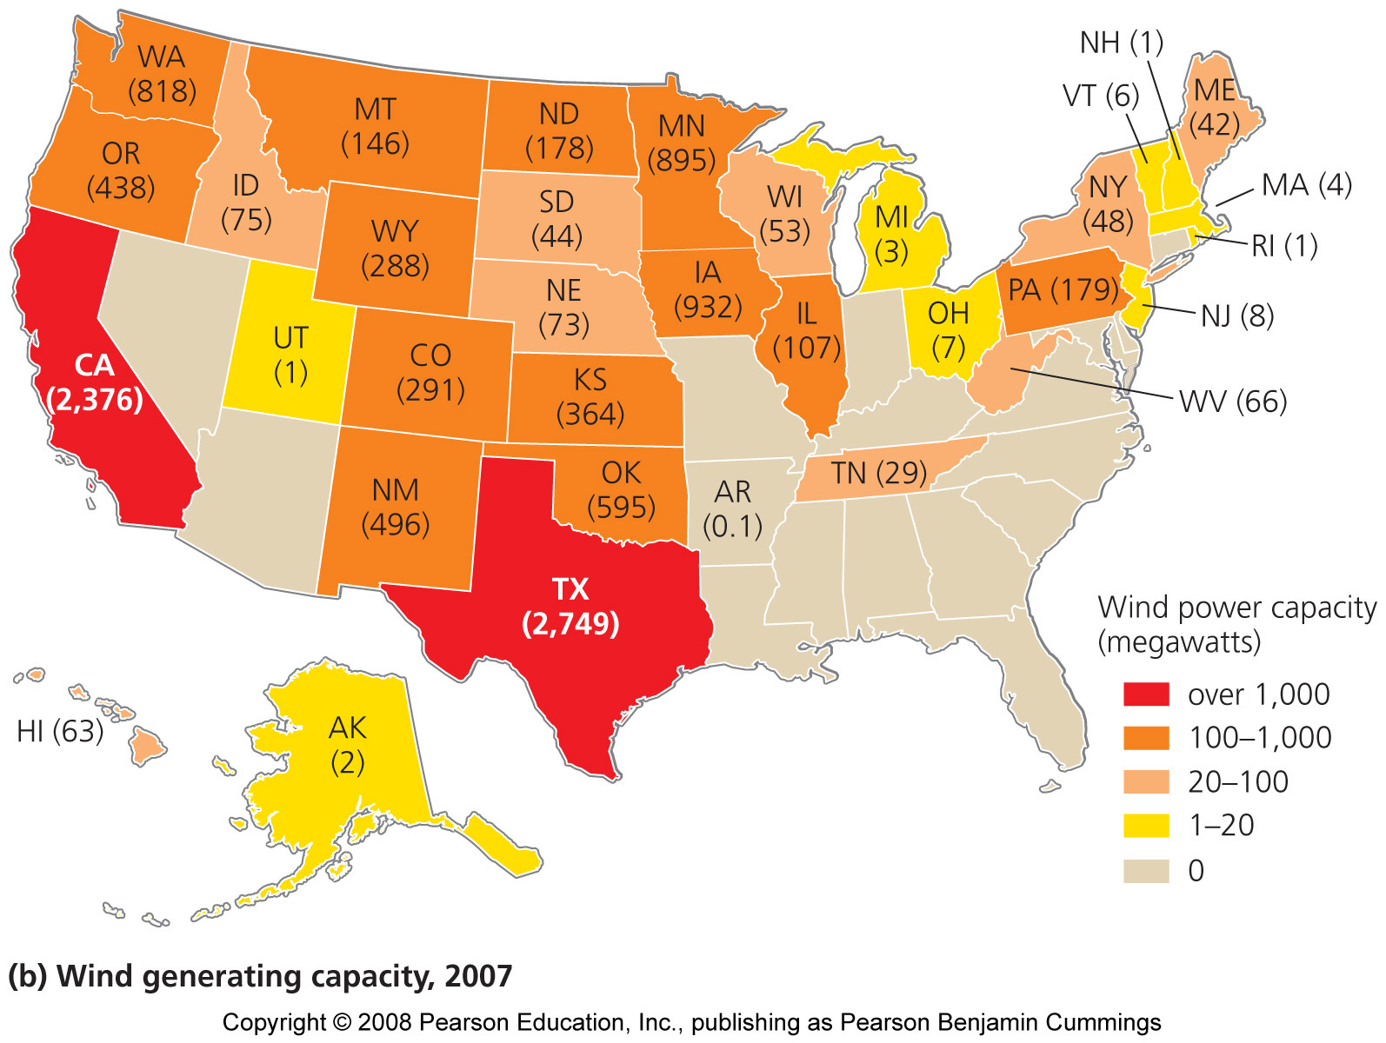
U.S. wind-generating capacity
Wind's capacity to generate power varies according to wind speed

Slide 30
Geothermal energy
Renewable energy that does not originate from the Sun
  It is generated from deep within the Earth
Radioactive decay of elements under extremely high pressures deep inside the planet generates heat
  This heat rises through magma, fissures, and cracks
Geothermal power plants use heated water and steam for direct heating and generating electricity

Slide 31
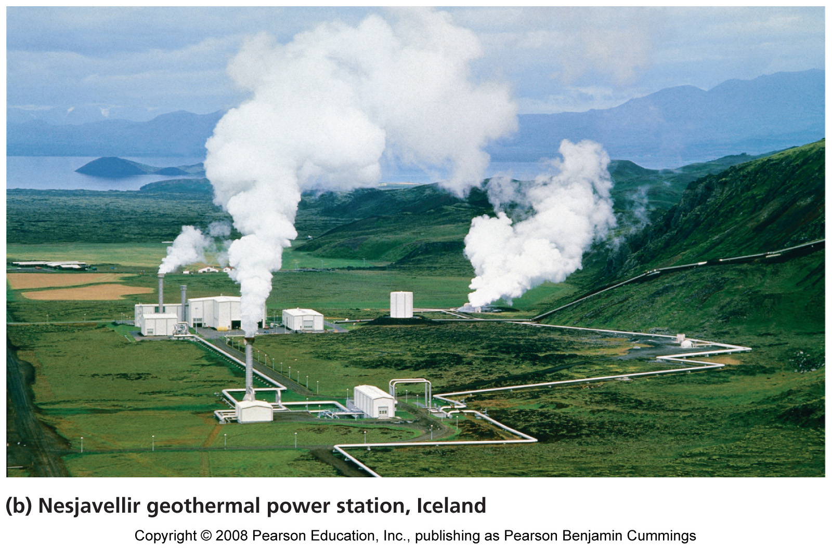
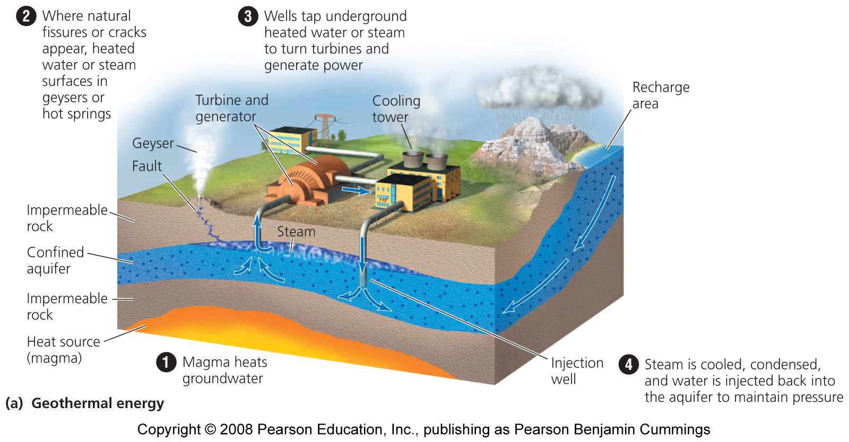
The origins of geothermal energy

Slide 32
Geothermal energy is renewable in principle
But if a geothermal plant uses heated water faster than groundwater is recharged, the plant will run out of water
  Operators have begun injecting municipal wastewater into the ground to replenish the supply
Patterns of geothermal activity shift naturally
  An area that produces hot groundwater now may not always do so

Slide 33
Geothermal energy produces heat and electricity
Most often wells are drilled hundreds or thousands of meters toward heated groundwater
  Water at temperatures of 150 – 370 degrees Celsius is brought to the surface and converted to steam, which turns turbines that generate electricity
Hot groundwater can be used directly to heat buildings
  Cheap and efficient

Slide 34
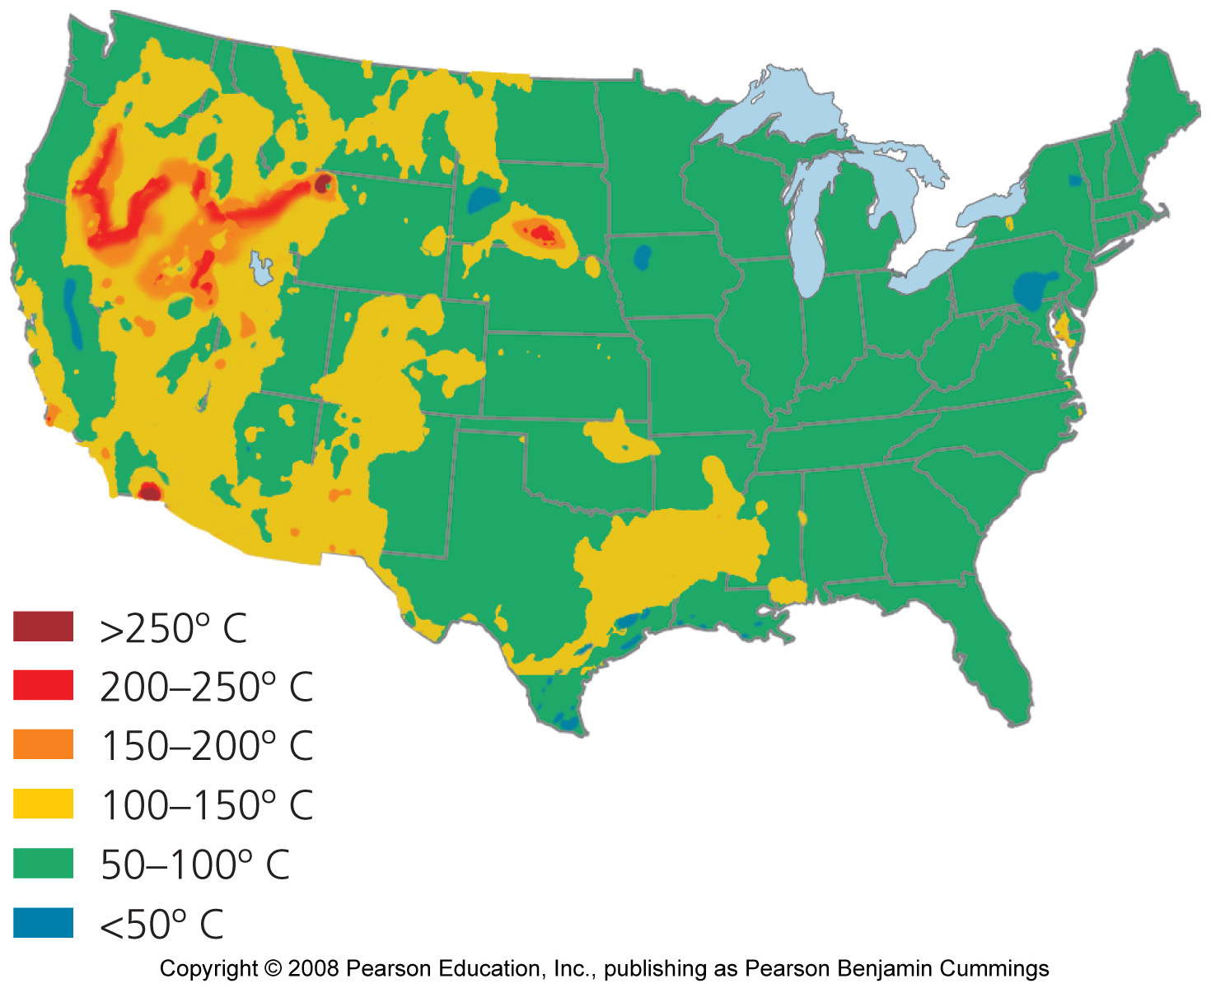
Geothermal energy is greatest in the U.S. west

Slide 35
Heat pumps are highly efficient
Geothermal ground source heat pumps (GSHPs) use thermal energy from near-surface sources of earth and water
  The pumps heat buildings in the winter by transferring heat from the ground into buildings
  In the summer, heat is transferred through underground pipes from the building into the ground
  Highly efficient, because heat is simply moved

Slide 36
Use of geothermal power is growing
Currently, geothermal energy provides less than 0.5% of the total energy used worldwide
  It provides more power than solar and wind combined
  But, much less than hydropower and biomass
Geothermal energy in the U.S. provides enough power to supply electricity to more than 4 million people
The U.S., Japan, and China lead the world in geothermal power use

Slide 37
Geothermal power has benefits and limits
Benefits:
  Reduces emissions
  It does emit very small amounts of gases
Limitations:
  May not be sustainable
  Water is laced with salts and minerals that corrode equipment and pollute the air
  Limited to areas where the energy can be trapped

Slide 38
We can harness energy from the oceans
Scientists are devising ways to use kinetic energy from the natural motion of ocean water to generate electrical power
The rising and falling of ocean tides twice each day throughout the world moves large amounts of water
  Differences in height between low and high tides are especially great in long narrow bays
  These areas are best for harnessing tidal energy by erecting dams across the outlets of tidal basins

Slide 39
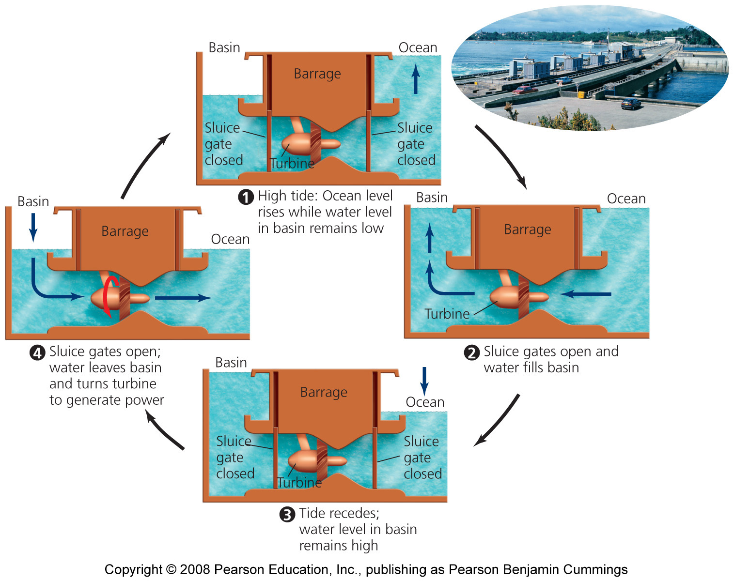
Energy can be extracted from tidal movement

Slide 40
Wave energy
Can be developed at a greater variety of sites than tidal energy
The motion of wind-driven waves at the ocean’s surface is harnessed and converted from mechanical energy into electricity
Many designs exist, but few are adequately tested
Some designs are for offshore facilities and involve floating devices that move up and down the waves
  Wave energy is greater at deep ocean sites, but transmitting electricity to shore is very expensive

Slide 41
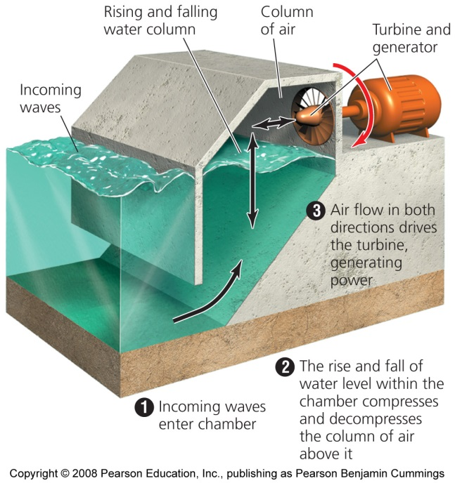
Coastal onshore facilities
Waves are directed into narrow channels and elevated reservoirs; electricity is generated when water flows out
Another design uses rising and falling waves to push air in and out of chambers, turning turbines to generate electricity
  No commercial wave energy facilities are operating
A third design uses the motion of ocean currents, such as the Gulf Stream
  Currently being tested in Europe

Slide 42
The ocean stores thermal energy
Each day, the tropical oceans absorb an amount of solar radiation equal to the heat content of 250 billion barrels of oil
The ocean’s surface is warmer than deep water
  Ocean thermal energy conversion (OTEC) is based on this gradient in temperature
  Closed cycle approach = warm surface water evaporates chemicals, which spin turbines
  Open cycle approach = warm surface water is evaporated in a vacuum and its steam turns turbines
  Costs remain high and no facility is commercially operational

Slide 43
A hydrogen economy
The development of fuel cells and hydrogen fuel shows promise to store energy in considerable quantities
  To produce clean, efficient electricity
A hydrogen economy would provide a clean, safe, and efficient energy system
  By using the world’s simplest and most abundant element as fuel

Slide 44
An energy system based on hydrogen
Electricity generated from renewable sources could be used to produce hydrogen
Vehicles, computers, cell phones, home heating, and countless other applications could be powered
Basing an energy system on hydrogen could alleviate dependence on foreign fuels and help fight climate change
Governments are funding research into hydrogen and fuel cell technology to produce vehicles that run on hydrogen

Slide 45
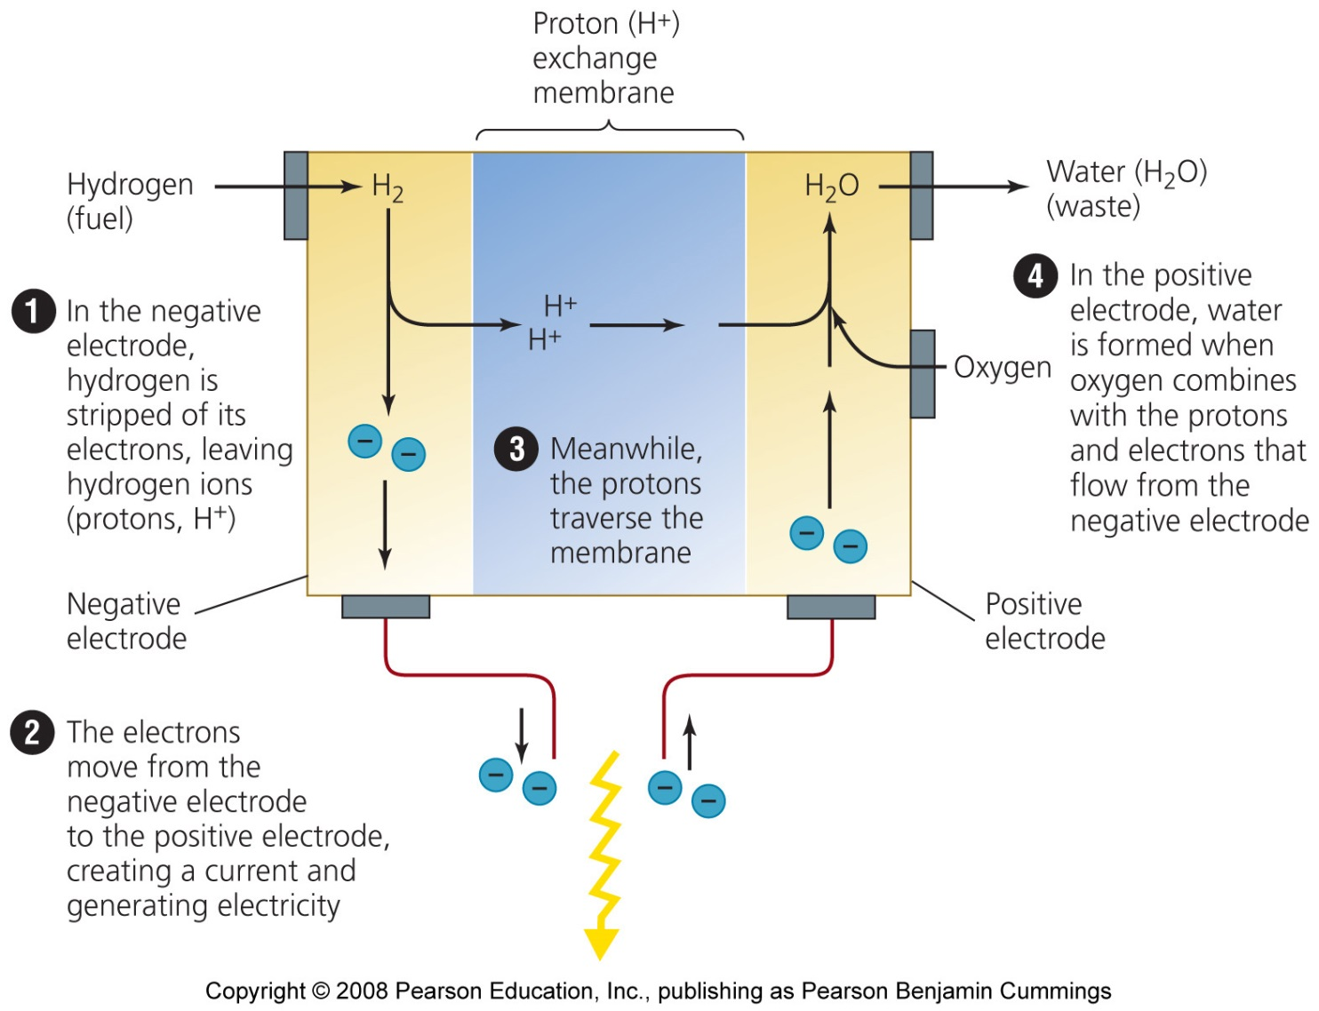
A typical hydrogen fuel cell

Slide 46
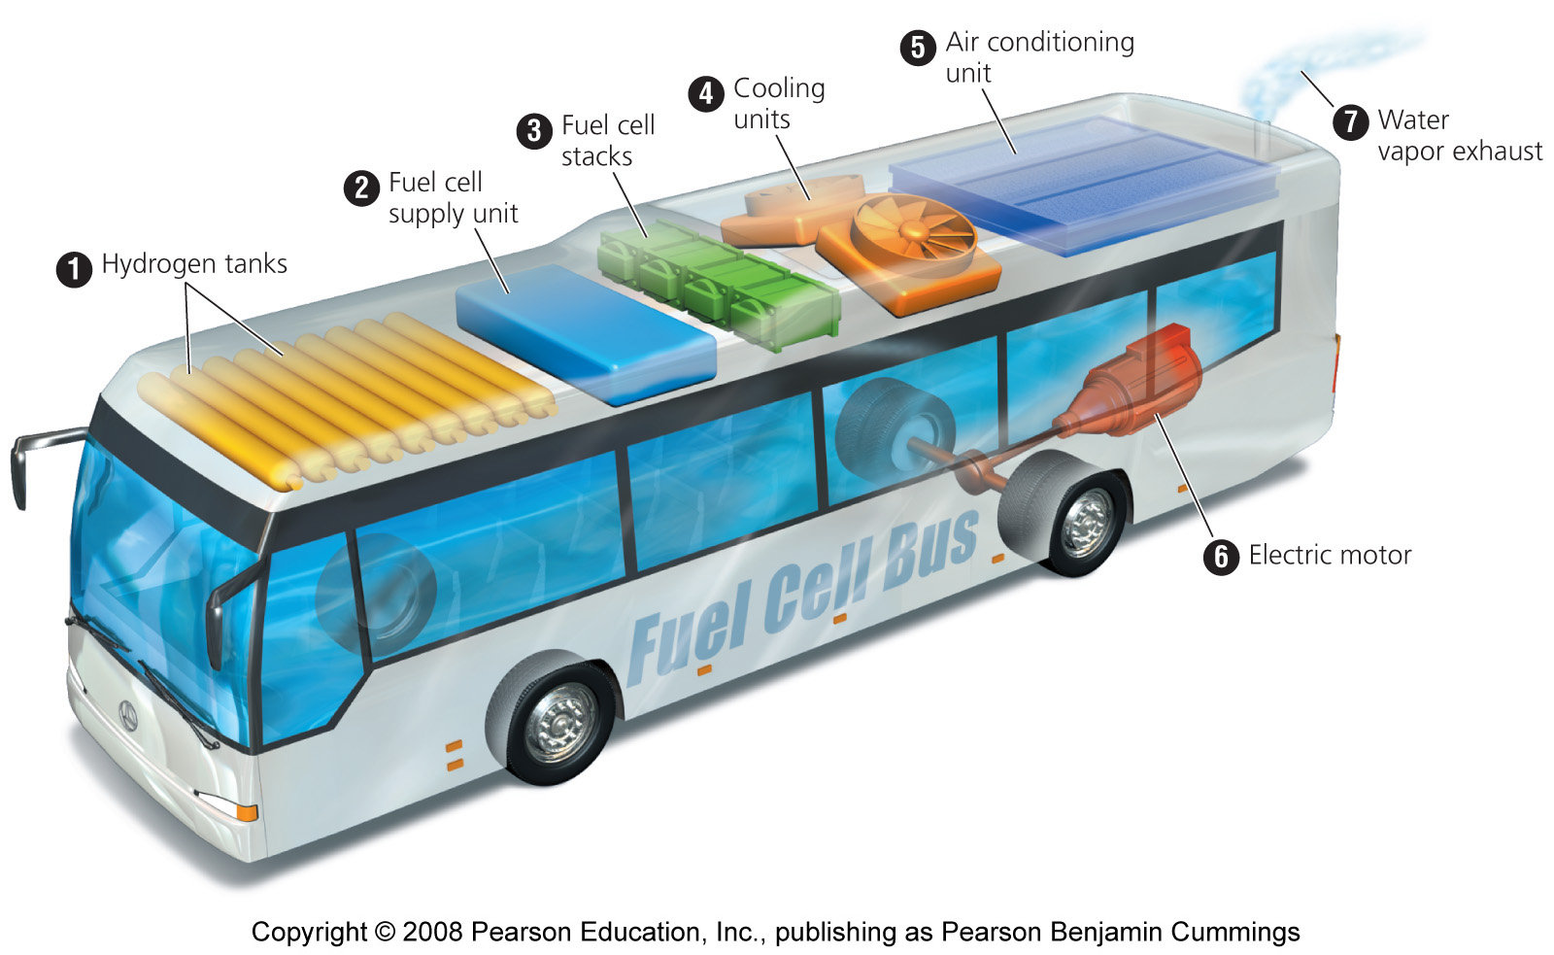
A hydrogen-fueled bus

Slide 47
Production of hydrogen fuel
Electrolysis = electricity is input to split hydrogen atoms from the oxygen atoms of water molecules:
    2H₂O ⇒ 2H₂ + O₂
  Produces pure hydrogen
  Will cause some pollution depending on the source of electricity, but less than than other processes

Slide 48
Other ways of obtaining hydrogen
Hydrogen can also be obtained from biomass and fossil fuels, such as methane (CH₄)
  CH₄ + 2H₂O ⇒ 4H₂ + CO₂
Results in emissions of carbon-based pollution
Whether a hydrogen-based energy system is environmentally cleaner than a fossil fuel system depends on how the hydrogen is extracted
Leakage of hydrogen could deplete stratospheric ozone

Slide 49
Fuel cells produce electricity
Once isolated, hydrogen gas can be used as a fuel to produce electricity within fuel cells
The chemical reaction involved in that fuel cell is the reverse of electrolysis
  2H₂ + O₂ ⇒ 2H₂O
The movement of the hydrogen’s electrons from one electrode to the other creates electricity

Slide 50
Hydrogen and fuel cells have many benefits
We will never run out; hydrogen is the most abundant element in the universe
Can be clean and nontoxic to use
May produce few greenhouse gases and other pollutants
Can be no more dangerous than gasoline in tanks
Cells are energy efficient
Fuel cells are silent and nonpolluting and won’t need to be recharged

Slide 51
Conclusion
The coming decline of fossil fuels and the increasing concern over global climate change has convinced many people we need to shift to renewable energy
Renewable sources include solar, wind, geothermal, and ocean energy sources and hydrogen fuel
Renewable energy sources have been held back by inadequate funding and by artificially cheap prices for nonrenewable resources

