Slide 1
Toxicology

Slide 2
There are many types of environmental hazards
Environmental health = assesses environmental factors that influence human health and quality of life
  Natural and human-caused factors are both considered
Physical hazards = occur naturally in our environment
  Earthquakes, volcanoes, fires, floods, droughts
  We can’t prevent them, but we can prepare for them
  We increase our vulnerability by deforesting slopes (landslides), channelizing rivers (flooding), etc.
  We can reduce risk by better environmental choices

Slide 3
Chemical and biological environmental hazards
Chemical = synthetic chemicals such as pesticides, disinfectants, pharmaceuticals
  Harmful natural chemicals also exist
Biological = result from ecological interactions
  Viruses, bacteria, and other pathogens
  Infectious (communicable, or transmissible) disease = other species parasitize humans, fulfilling their ecological roles
  We can’t avoid risk, but we can reduce the likelihood of infection

Slide 4
Cultural environmental hazards
Cultural = result from the place we live, our socioeconomic status, our occupation, our behavioral choices
  Smoking, drug use, diet and nutrition, crime, mode of transportation

Slide 5

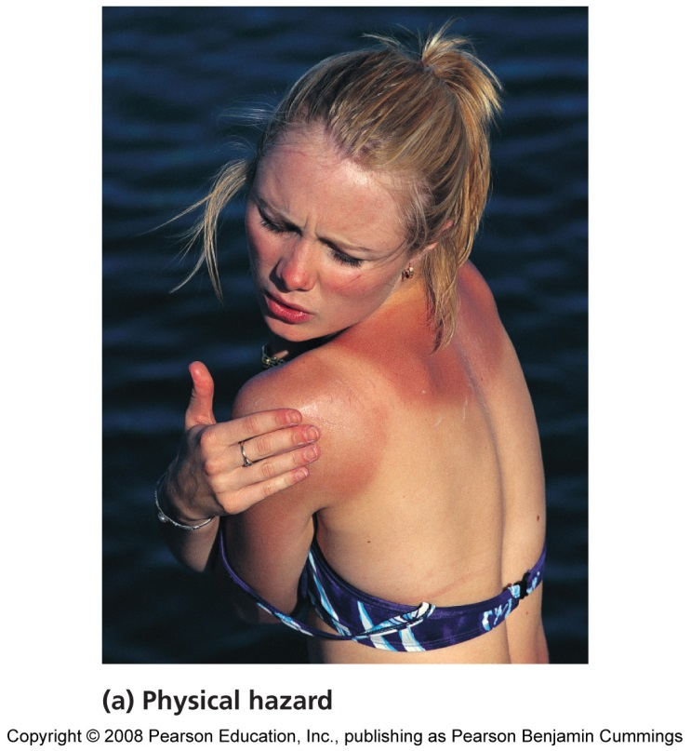
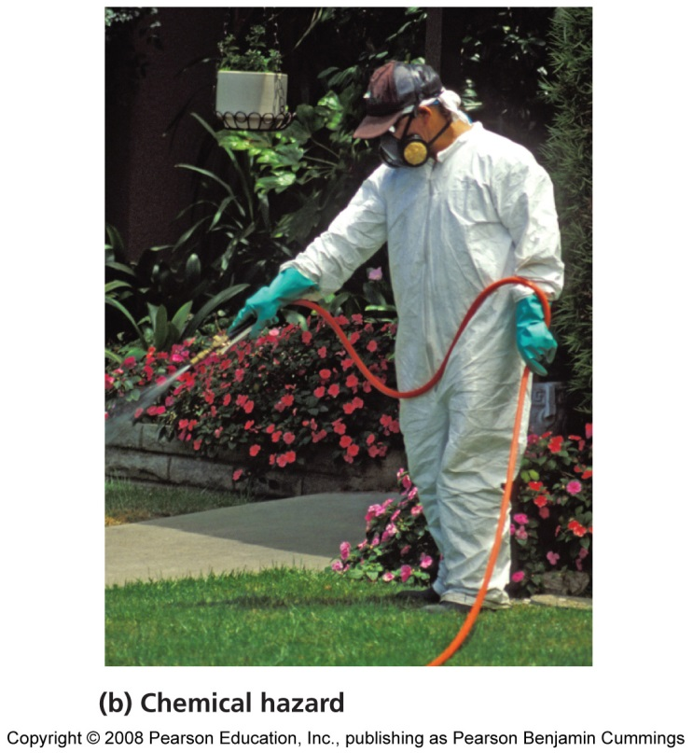
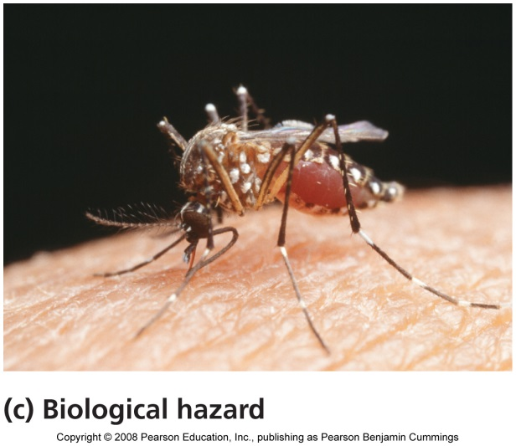
Four types of environmental hazards

Slide 6
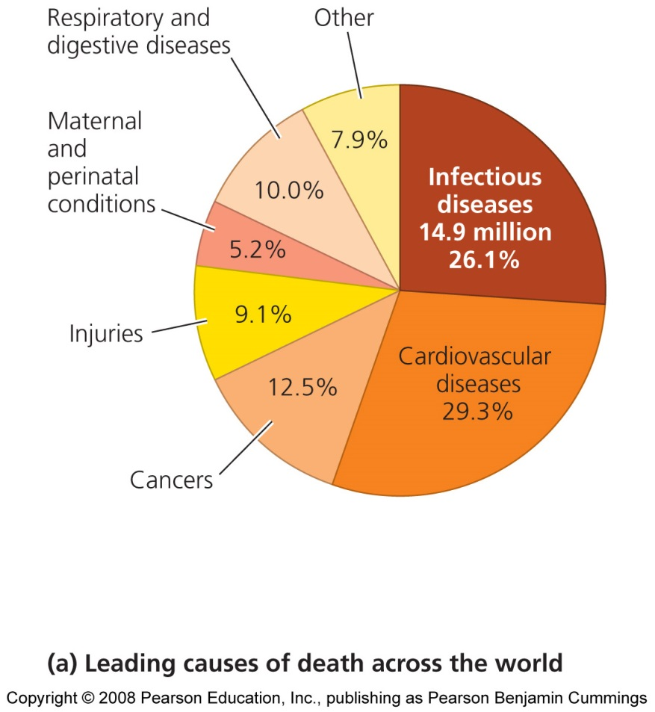
Disease is a major focus of environmental health
Despite our technology, disease kills most of us
Disease has a genetic and environmental basis
  Cancer, heart disease, respiratory disorders
  Poverty and poor hygiene can foster illnesses

Slide 7
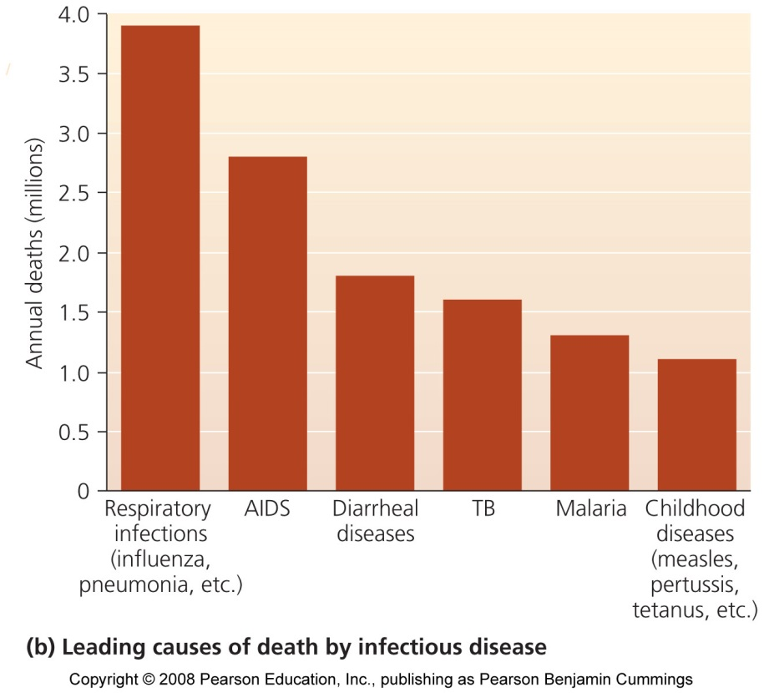
Infectious diseases kill millions
Infectious diseases kill 15 million people per year
  Half of all deaths in developing countries
  Developed countries have better hygiene, access to medicine, and money
Vector = an organism that transfers pathogens to a host

Slide 8
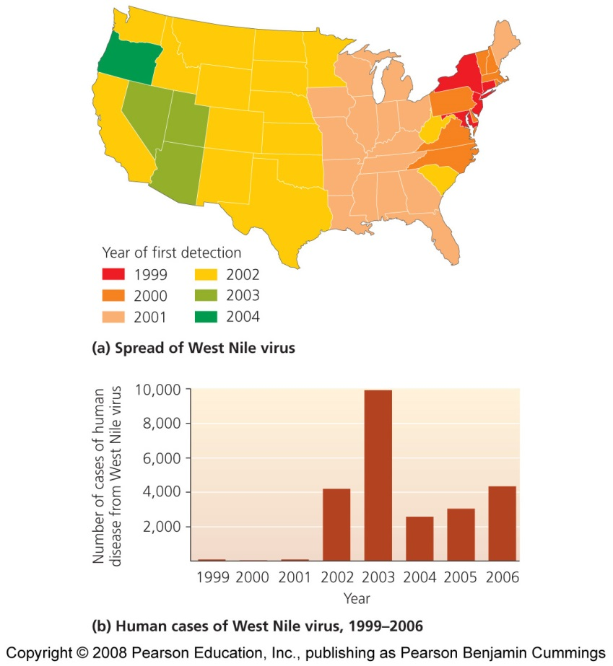
Many diseases are increasing
Tuberculosis, acquired immunodeficiency syndrome (AIDS), and the West Nile virus
Our mobility spreads diseases
Diseases are evolving resistance to antibiotics
Climate change will expand the range of diseases
To predict and prevent diseases, experts deal with complicated interrelationships

Slide 9
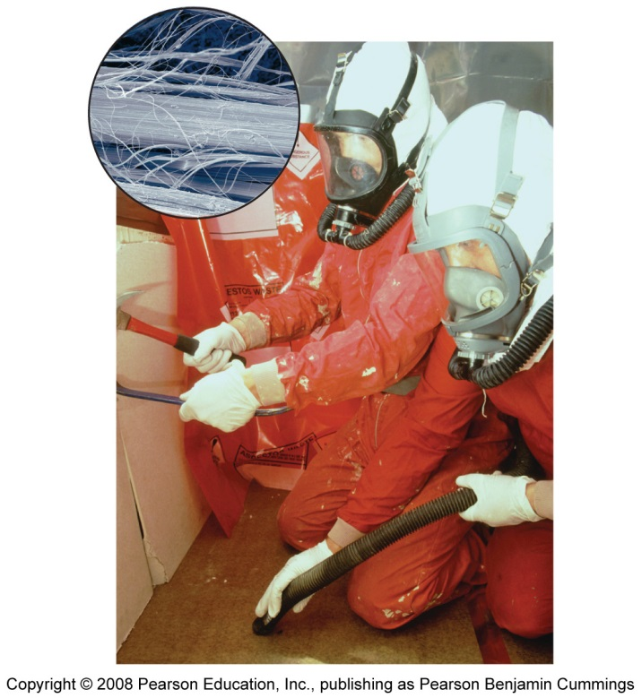
Environmental health hazards exist indoors
Radon = a highly toxic, radioactive gas that is colorless and undetectable
  Can build up in basements
Lead poisoning = from lead pipes
  Damages organs; causes learning problems, behavior abnormalities, and death
Asbestos = insulates, muffles sounds, and resists fire
  Asbestosis = scarred lungs may cease to function

Slide 10
A recently recognized hazard
Polybrominated diphenyl ethers (PBDEs) = has fire-retardent properties
  Used in computers, televisions, plastics, and furniture
  Persist and accumulate in living tissue
  Endocrine disruptors = compounds that mimic hormones and interfere with the functioning of animals’ endocrine (hormone) systems
  Affect brain and nervous system development, and may cause cancer

Slide 11
Toxicology is the study of poisonous substances
Toxicology = the study of the effects of poisonous substances on humans and other organisms
Toxicity = the degree of harm a toxicant can cause
  “The dose makes the poison” = toxicity depends on the combined effect of the chemical and its quantity
  Analogous to pathogenicity or virulence = the degree of harm of biological hazards that spread disease
Toxicant = any toxic agent

Slide 12
Environmental toxicology
Deals with toxic substances that come from or are discharged into the environment
Studies the health effects on humans, other animals, and ecosystems
  Focus mainly on humans, using other animals as test subjects
  Can serve as indicators of health threats
Don’t forget, chemicals have given us our high standard of living

Slide 13
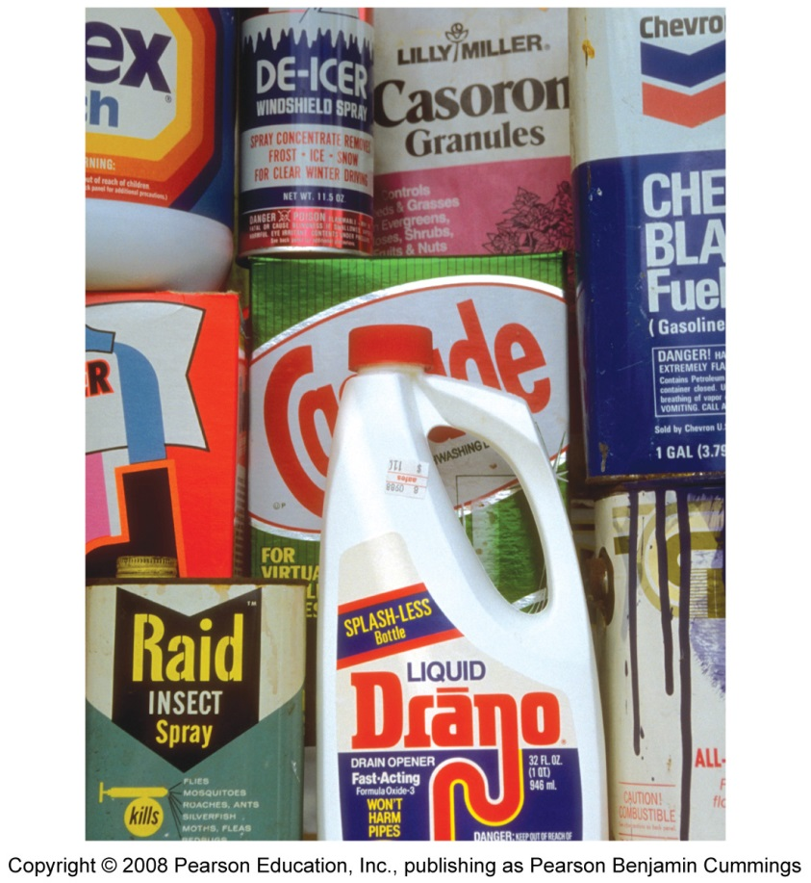
Toxic agents in the environment
The environment contains countless natural chemicals that may pose health risks
But, synthetic chemicals are also in our environment
  Every human carries traces of industrial chemicals
80% of U.S. streams contain at least trace amounts of 83 wastewater contaminants

Slide 14
Very few chemicals have been thoroughly tested
100,000 chemicals are on the market today
  72,000 industrial
  8,700 food additives
  2,000 new chemicals introduced per year
We don’t know the effects, if any, they have

Slide 15
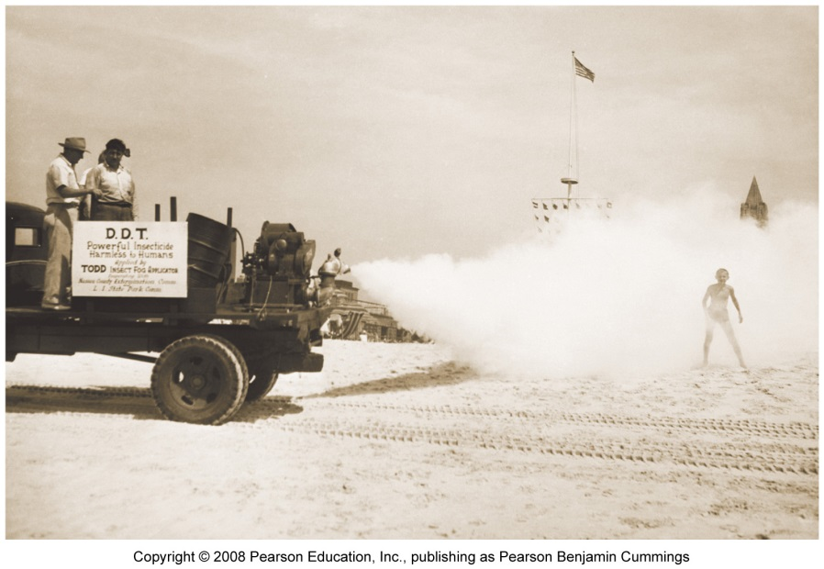
Silent Spring began public debate over chemicals
Rachel Carson published Silent Spring in 1962
  Brought together studies to show DDT risks to people, wildlife, and ecosystems
  In the 1960s, pesticides were mostly untested and were sprayed over public areas, assuming they would do no harm
The book generated significant social change

Slide 16
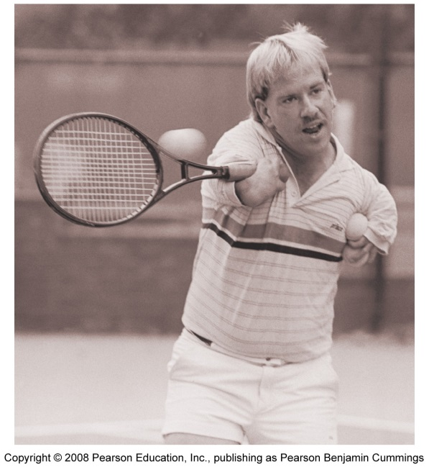
Types of toxicants
Carcinogens = cause cancer
Mutagens = cause DNA mutations
  Can lead to severe problems, including cancer
Teratogens = cause birth defects
Allergens = overactivate the immune system
Neurotoxins = assault the nervous system
Endocrine disruptors = interfere with the endocrine (hormone) system

Slide 17
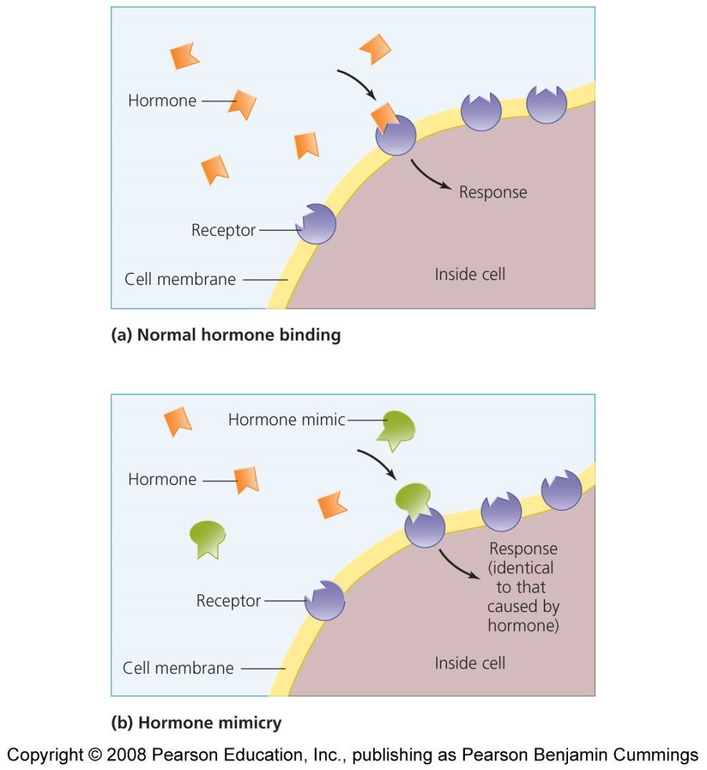
Endocrine disruption may be widespread
Theo Colburn wrote Our Stolen Future in 1996
  Synthetic chemicals may be altering the hormones of animals
  This book integrated scientific work from various fields
  Shocked many readers and brought criticism from the chemical industry

Slide 18
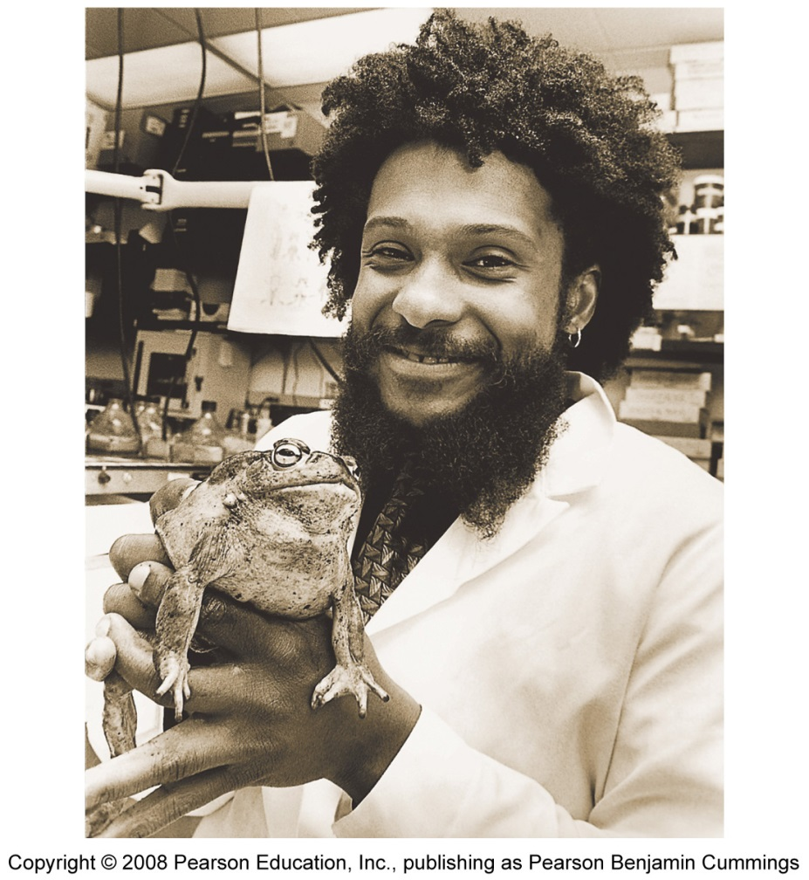
Evidence for hormone disruption
Frogs also have gonadal abnormalities
  Male frogs became feminized from atropine concentrations well below EPA guidelines
PCB-contaminated human babies were born weighing less, with smaller heads

Slide 19
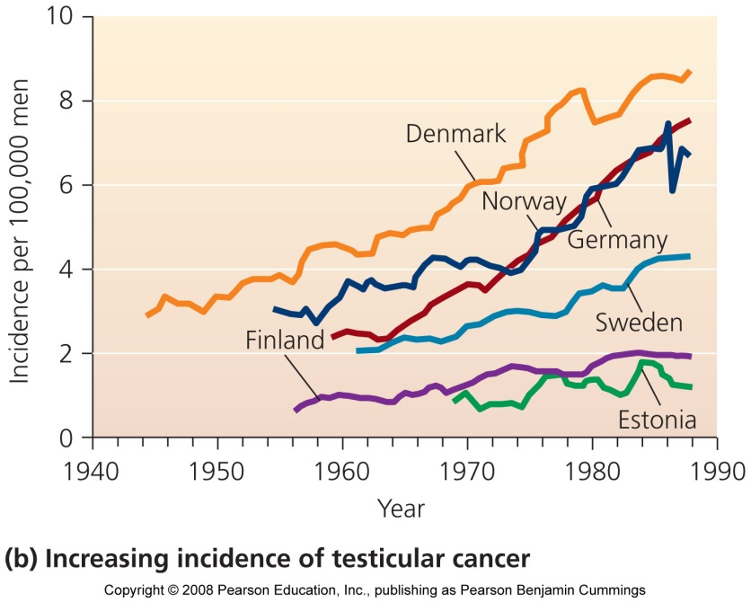
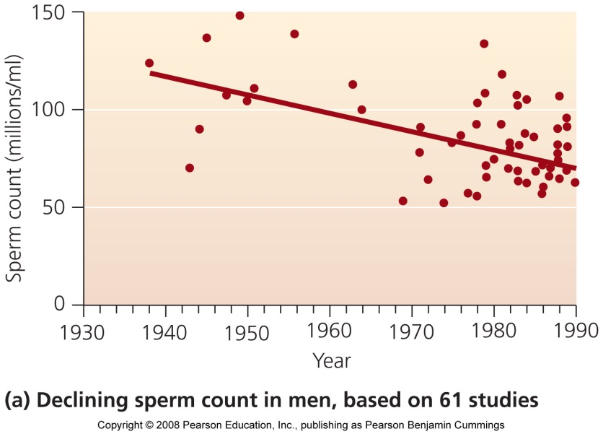
Male sperm counts are dropping
Scientists attribute the shocking drop in men’s sperm counts to endocrine disruptors
  The number and motility of sperm has dropped 50% since 1938
Testicular cancer, undescended testicles, and genital birth defects are also increasing

Slide 20
Endocrine disruption research is controversial
Research results are uncertain, which is inherent in any young field
Negative findings pose economic threats to chemical manufacturers
  Banning a top-selling chemical could cost a company millions of dollars
  Bisphenol-A, found in plastics, can cause birth defects, but the plastics industry protests that the chemical is safe
Studies reporting harm are publicly funded, but those reporting no harm are industry funded

Slide 21
Toxins may concentrate in water
Runoff carries toxins from large land areas to small volumes of surface water
Chemicals can leach into the soil
Chemicals enter organisms through drinking or absorption
  Aquatic organisms are effective pollution indicators

Slide 22
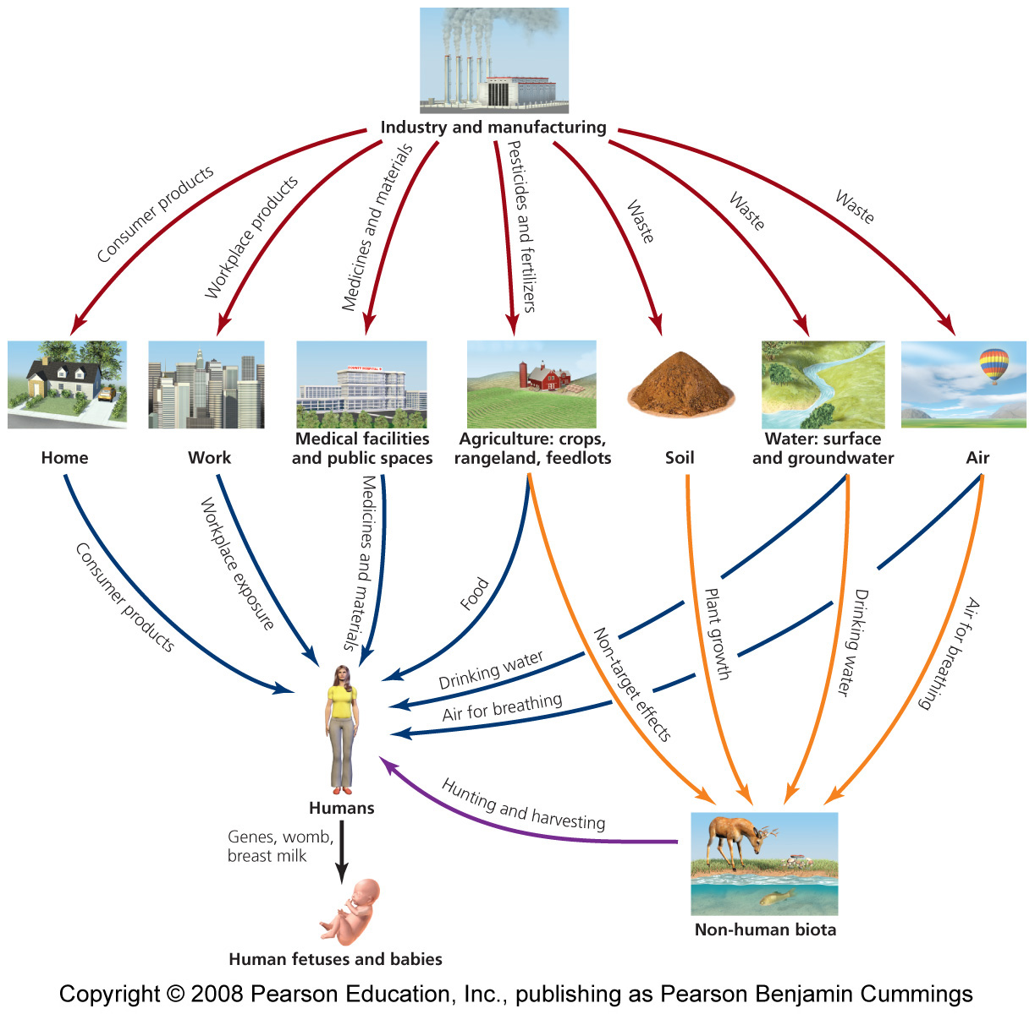
Routes of chemical transport

Slide 23
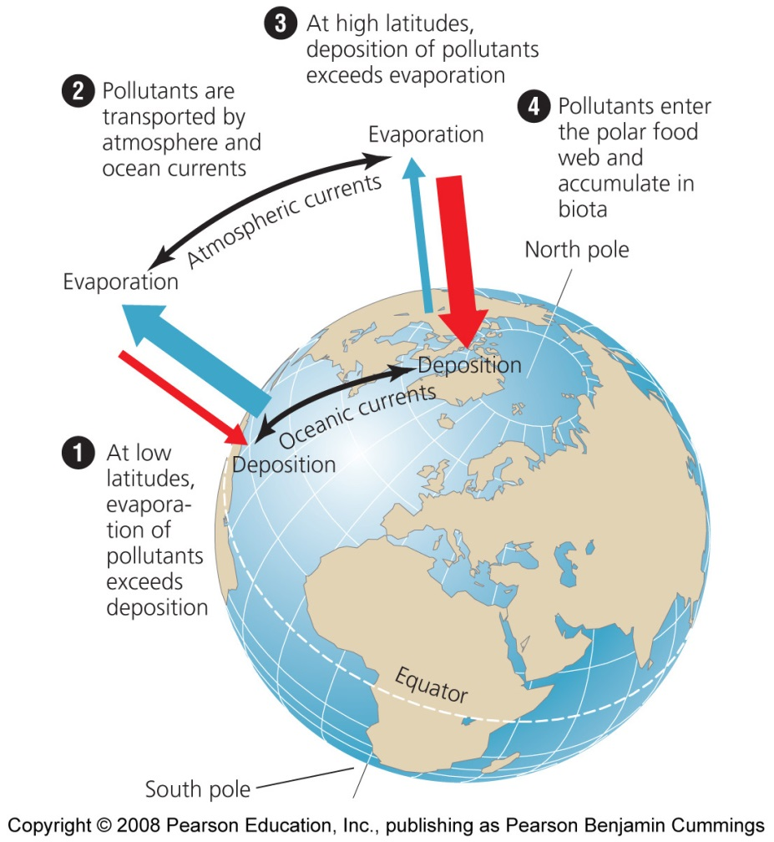
Airborne toxicants travel widely
Because chemicals can travel by air, their effects can occur far from the site of chemical use
Pesticide drift = airborne transport of pesticides
Synthetic chemical contaminants are found globally
  They appear in arctic polar bears, Antarctic penguins, and people living in Greenland

Slide 24
Some toxicants persist for a long time
Toxins can degrade quickly and become harmless
  Or, they may remain unaltered and persist for decades
  Rates of degradation depends on temperature, moisture, and sun exposure
Persistent chemicals have the greatest potential for harm
Breakdown products = toxicants degrade into simpler products
  May be more or less harmful than the original substance
  DDT degrades into DDE, which is also highly persistent

Slide 25
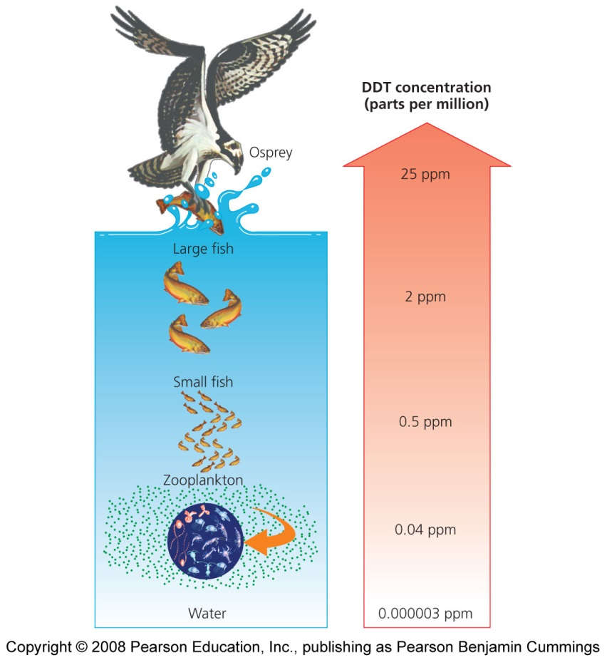
Toxicants can accumulate and biomagnify
Some toxicants can be excreted or metabolized
  Fat-soluble toxicants are stored in fatty tissues
Bioaccumulation = toxicants build up in animal tissues
Biomagnification = toxicants concentrate in top predators
  Near extinction of peregrine falcons and brown pelicans

Slide 26
Not all toxicants are synthetic
Chemical toxicants also exist naturally and in our food
  Don’t assume natural chemicals are all healthy and synthetic ones are all harmful
Some scientists feel that natural toxicants dwarf our intake of synthetic chemicals
  Natural defenses against toxins are effective against synthetic ones, too
  Critics say natural toxins are more readily metabolized and excreted, and synthetic chemicals persist and accumulate

Slide 27
Wildlife studies
Museum collections provide data from times before synthetic chemicals were used
Measurements from animals in the wild can be compared to controlled experiments in the lab
Scientists can first measure effects in the lab, then look for correlations in the wild
Conspicuous mortality events can trigger research
  Many sea otters died and washed ashore
  Research showed they died from parasites carried in sewage runoff containing cat litter

Slide 28
Human studies
Case histories = studying sickened individuals directly
  Autopsies
  Don’t tell about future risks
Epidemiology = large-scale comparisons between groups of people
  Studies between exposed and unexposed people last for years
  Yield accurate predictions about risk
Animals are used as test subjects
  Some people object to animal research
  New techniques (human cell cultures, bacteria, etc.) may replace some live-animal testing

Slide 29
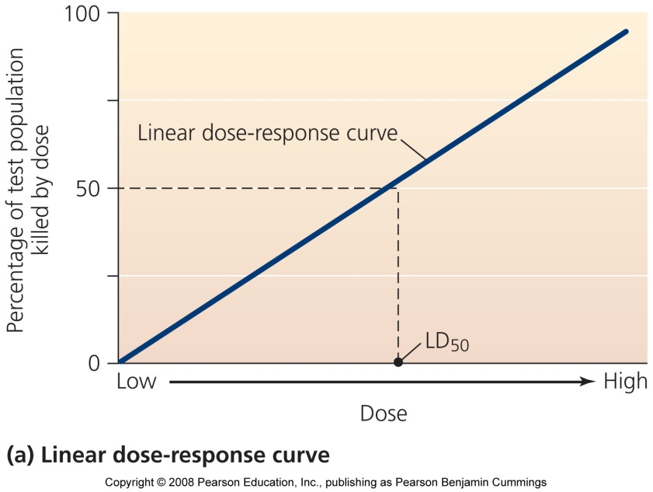
Dose-response analysis
Dose-response analysis = measuring how much effect a toxicant produces at different doses
  Animal testing
  Dose = the amount of toxicant the test animal receives
  Response = the type or magnitude of negative effects of the animal
  Dose-response curve = the plot of dose given against response

Slide 30
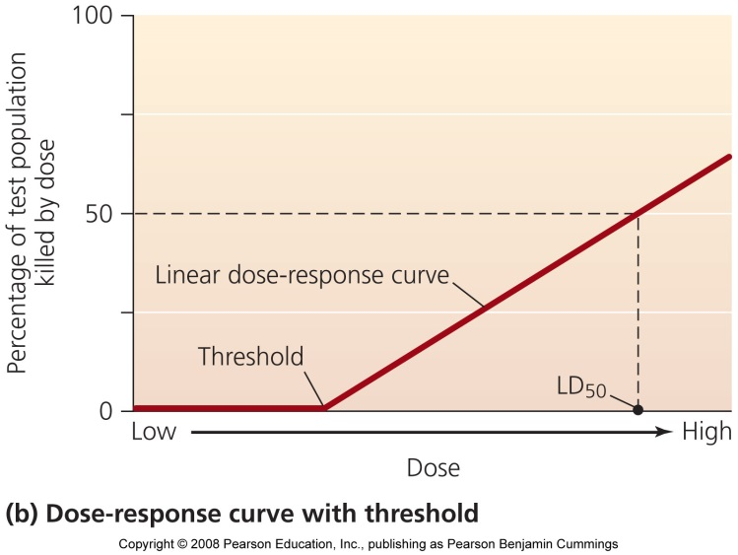
Dose response curves
LD₅₀/ED₅₀= the amount of toxicant required to kill (affect) 50% of the subjects
Threshold = the dose level where certain responses occur
  Organs can metabolize or excrete low doses of a toxicant
  Some toxicants show a J-shaped, U-shaped, or inverted curve
Scientists extrapolate downward from animal studies to estimate the effect on humans
  Regulatory agencies set allowable limits well below toxicity levels in lab studies

Slide 31
Individuals vary in their responses to hazards
Different people respond differently to hazards
  Affected by genetics, surroundings, etc.
  People in poor health are more sensitive
  Sensitivity also varies with sex, age, and weight
  Fetuses, infants, and young children are more sensitive
Standards for responses are set by the Environmental Protection Agency (EPA)
  Often, standards are not low enough to protect babies

Slide 32
The type of exposure affects the response
Acute exposure = high exposure for short periods of time to a hazard
  Easy to recognize
  Stem from discrete events: ingestion, oil spills, nuclear accident
Chronic exposure = low exposure for long periods of time to a hazard
  Hard to detect and diagnose
  Affects organs gradually: lung cancer, liver damage
  Cause and effect may not be easily apparent

Slide 33
Mixes may be more than the sum of their parts
We can’t determine the impact of mixed hazards
  They may act in ways that cannot be predicted from the effects of each in isolation
Synergistic effects = interactive impacts that are more than or different from the simple sum of their constituent effects
  Mixed toxicants can sum, cancel out, or multiply each other’s effects
  New impacts may arise from mixing toxicants

Slide 34
Risk assessment
Risk = the probability that some harmful outcome will result from a given action
  Exposure to environmental health threats doesn’t automatically produce an effect
  Rather, it causes some probability (likelihood) of harm
Probability entails
  Identity and strength of threat
  Chance and frequency that an organism will encounter it
  Amount of exposure to the threat
  An organism’s sensitivity to the threat

Slide 35
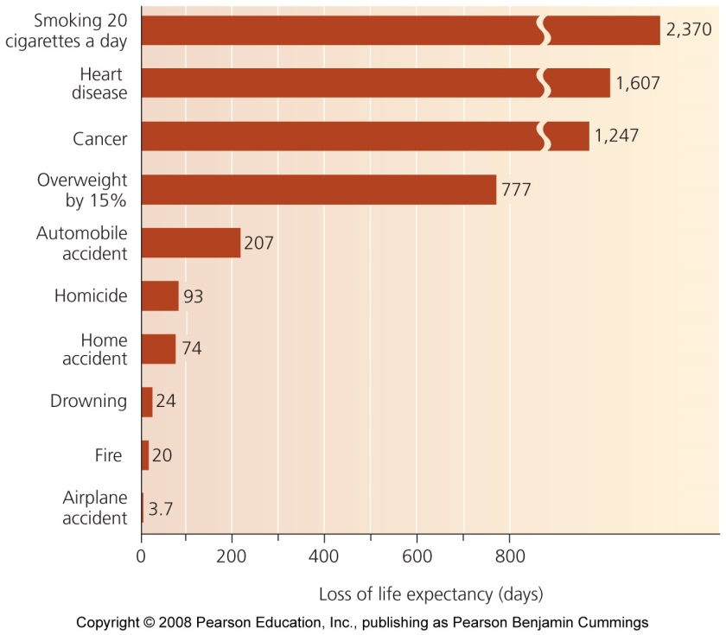
Perceiving risks
Everything we do involves some risk
We try to minimize risk, but we often misperceive it
  Flying versus driving
We feel more at risk when we cannot control a situation
  We fear nuclear power and toxic waste, but not smoking or overeating

Slide 36
Analyzing risk quantitatively
Risk assessment = the quantitative measurement of risk and the comparison of risks involved in different activities or substances
  It is a way of identifying and outlining problems
Several steps:
  Scientific study of toxicity
  Assessing an individual or population’s likely extent of exposure to the substance, including frequency, concentrations, and length of exposure
Studies are often performed by industry-associated scientists, which may undermine the study’s objectivity

Slide 37
Risk management
Combines decisions and strategies to minimize risk
Scientific assessments are considered with economic, social, and political needs and values
Developed nations have federal agencies to manage risk
  The U.S. has the Centers for Disease Control (CDC), the EPA, and the Food and Drug Administration (FDA)
Comparing costs and benefits is hard
  Benefits are economic and easy to calculate
  Health risks (costs) are hard-to-measure probabilities of a few people being affected

Slide 38
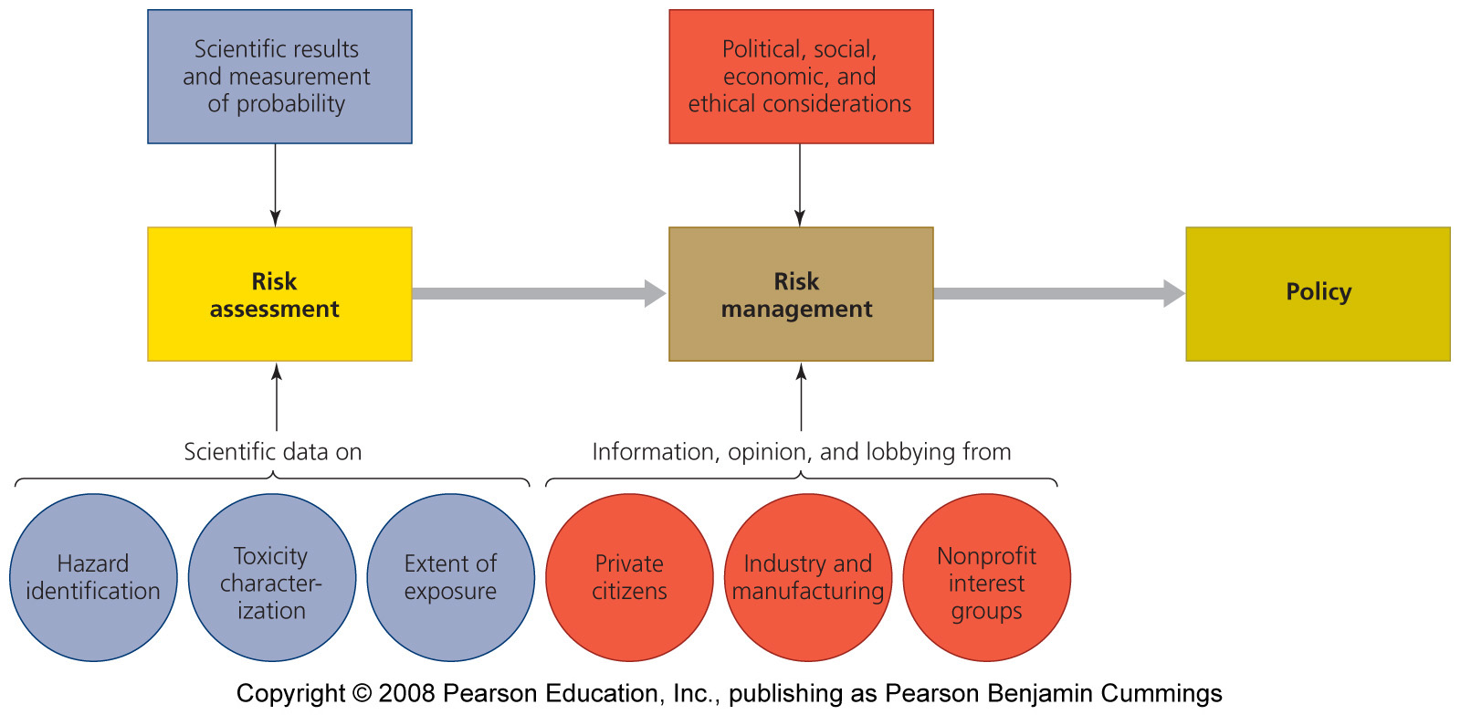
The process of risk management

Slide 39
One approach to determining safety
Innocent until proven guilty approach: product manufacturers must prove a product is safe
  Benefits: now slowing down technological innovation and economic advancement
  Disadvantage: putting into wide use some substances that may later on turn out to be dangerous

Slide 40
Another approach to determining safety
Precautionary principle approach: the government, scientists, and the public are required to prove a product is dangerous
  Assume substances are harmful until they are proven harmless
  Identifies troublesome toxicants before they are released
  But, this may impede the pace of technology and economic advance

Slide 41
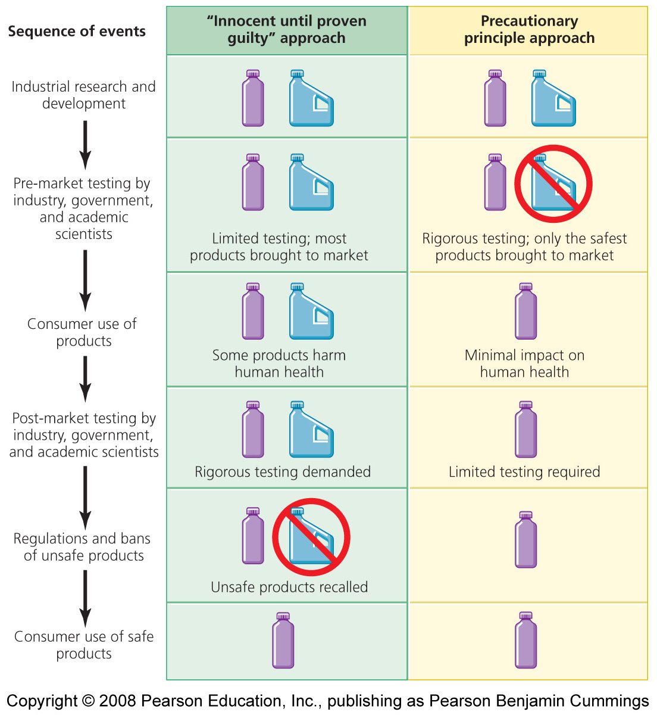
Two approaches for determining safety

Slide 42
Philosophy affects policy
Different nations use different policies; most use a mix between the “innocent until proven guilty” principle and the precautionary principle
  Europe is shifting more towards the precautionary principle
  Industries like the “innocent until proven guilty” approach because it allows them to produce more and make more money

Slide 43
The EPA regulates many substances
Federal agencies apportion responsibility for tracking and regulating synthetic chemicals
  FDA: food, food additives, cosmetics, drugs, and medical devices
  EPA: pesticides
  Occupational Safety and Health Administration (OSHA): workplace hazards
Many public health and environmental advocates fear it isn’t enough
  Many synthetic chemicals are not actually tested
  Only 10% have been tested for toxicity
  Fewer than 1% are government regulated

Slide 44
International regulation
Nations address chemical pollution with international treaties
Stockholm Convention on Persistent Organic Pollutants (POPs) was ratified by 140 nations in 2004
  Ends the release of the 12 most dangerous POPs
EU’s Registration, Evaluation, Authorization, and Restriction of Chemicals (REACH) Program
  Aims to evaluate and restrict dangerous chemicals while giving industries a streamlined regulatory system
  It will cost the chemical industry 2.8 – 5.2 billion euros (U.S. $3.8 – 7.0 billion), but will save more than 10 times that in health benefits

Slide 45
Conclusion
International agreements represent a hopeful sign that governments are working to protect society, wildlife, and ecosystems from toxic chemicals and environmental hazards
Once all the scientific results are in, society’s philosophical approach to risk management will determine what policies are enacted
A safe and happy future depends on knowing the risks that some hazards pose and on replacing those substances with safer ones

Slide 46

QUESTION: Review
Which of the following is a biological hazard?
  Earthquake
  Smoking
  Virus
  A pesticide
  All are biological hazards
Notes:
Answer: c

Slide 47
QUESTION: Review
A “vector” is defined as …
  A highly toxic, radioactive compound
  An organism that transfers pathogens to a hose
  A compound with fire-retardant properties
  A compound that mimics natural substances
Notes:
Answer: b

Slide 48
QUESTION: Review
Toxicity is …
  The study of the effects of poisonous substances
  Any toxic agent
  Any substance that causes environmental degradation
  The degree of harm a substance can cause
Notes:
Answer: d

Slide 49
QUESTION: Review
A “teratogen” causes…?
  Cancer
  Mutations
  Birth defects
  Problems in the hormonal system
Notes:
Answer: c

Slide 50
QUESTION: Review
Why is research into endocrine disrupters controversial?
  Negative findings threaten the industry’s economics
  Research is still only beginning
  Much research is funded by industry
  All of these are reasons why research is controversial
Notes:
Answer: d

Slide 51
QUESTION: Review
A human-based study that compares a group of smokers to non-smokers to determine the effects of smoking is …
  An epidemiological study
  A case study
  Not likely to be funded
  Not going to tell about future risks
Notes:
Answer: a

Slide 52

QUESTION: Interpreting Graphs and Data
Our perception, and the reality, of risk often do not match. Given this graph (reality), and your knowledge of sources of anxiety (perception), which statement is correct?
  Smoking is very dangerous and we are very anxious about it
  Smoking is not dangerous, but we are very anxious about it
  Airplane accidents are dangerous, and we are very anxious about it
  Airplane accidents are not dangerous, but we are very anxious about it
Notes:
Answer: d

Slide 53

QUESTION: Interpreting Graphs and Data
If the “low” dose = 5 units of a chemical, the “medium” dose = 10 units, and the “high” dose = 15 units, how much of the chemical is required to kill 50% of the study population?
About 5 units
About 10 units
About 15 units
You can’t tell from the graph
From The Science behind the Stories
Notes:
Answer: b

Slide 54
QUESTION: Viewpoints
Is it unethical for a country that has banned a chemical to manufacture and export it to other countries?
  Yes; if we won’t have it in the U.S., we shouldn’t make it
  Yes, but the money we get from selling it will help our economy
  No; let people decide what they want to do
  No; in fact, chemicals should not be banned in the U.S. either
Notes:
Answer: any

Slide 55
QUESTION: Viewpoints
Should the government follow the precautionary principle and force industries to prove their products are safe?
  Absolutely; it is up to industry to prove its chemicals are safe
  Maybe, if it is not too expensive
  No; let the government and scientists prove a chemical is dangerous before it is taken off the market
  No, as long as the product makes money and jobs for the industry, it should be allowed
Notes:
Answer: any

