Slide 2
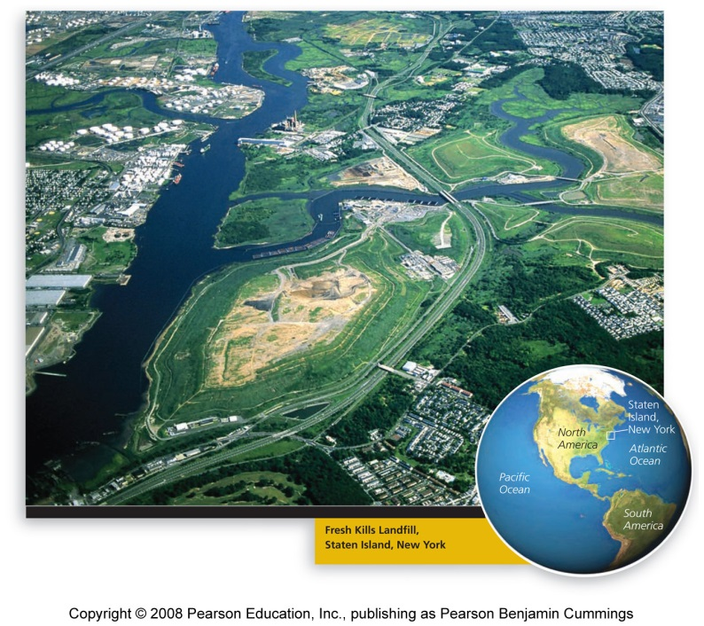
Central Case: Transforming New York’s Fresh Kills Landfill
The largest landfill in the world, it closed in 2001
Staten Island residents viewed the landfill as an eyesore and civic blemish
It was briefly reopened to bury rubble from the World Trade Center after the September 11, 2001, attack
New York plans to transform the landfill into a world-class public park

Slide 3
Approaches to waste management
Waste = any unwanted material or substance that results from human activity or process
Municipal solid waste = non-liquid waste that comes from homes, institutions, and small businesses
Industrial solid waste = waste from production of consumer goods, mining, agriculture, and petroleum extraction and refining
Hazardous waste =solid or liquid waste that is toxic, chemically reactive, flammable, or corrosive
Wastewater = water used in a household, business, or industry, as well as polluted runoff from our streets and storm drains

Slide 4
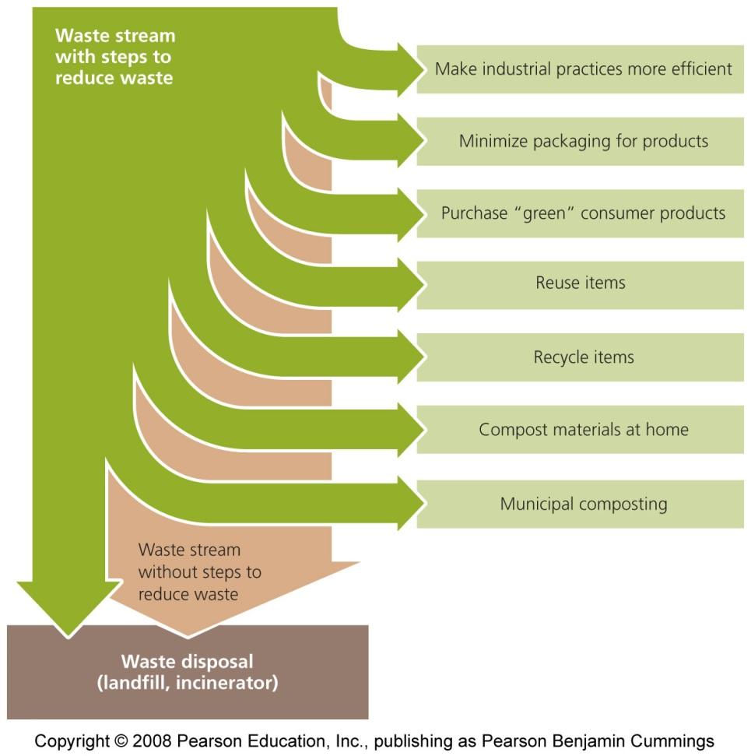
Aims in managing waste
Three main components of waste management:
  Minimizing the amount of waste we generate (source reduction)
  Recovering waste materials and finding ways to recycle them
  Disposing of waste safely and effectively
Source reduction is the preferred approach

Slide 5
Ways to reduce waste that enters waste stream
Waste stream = flow of waste as it moves from its sources toward disposal destinations
  More efficient use of materials, consume less, buy goods with less packaging, reusing goods
Recovery (recycling, composting) = next best strategy in waste management
  Recycling = sends used goods to manufacture new goods
  Composting = recovery of organic waste
  All materials in nature are recycled

Slide 6
Patterns in the municipal solid waste stream vary
Municipal solid waste is also referred to as trash or garbage
In the U.S., paper, yard debris, food scraps, and plastics are the principal components of municipal solid waste
  Even after recycling, paper is the largest component of solid waste
  Most waste comes from packaging
In developing countries, food scraps are the primary contributor
  Wealthy nations invest more in waste collection and disposal

Slide 7
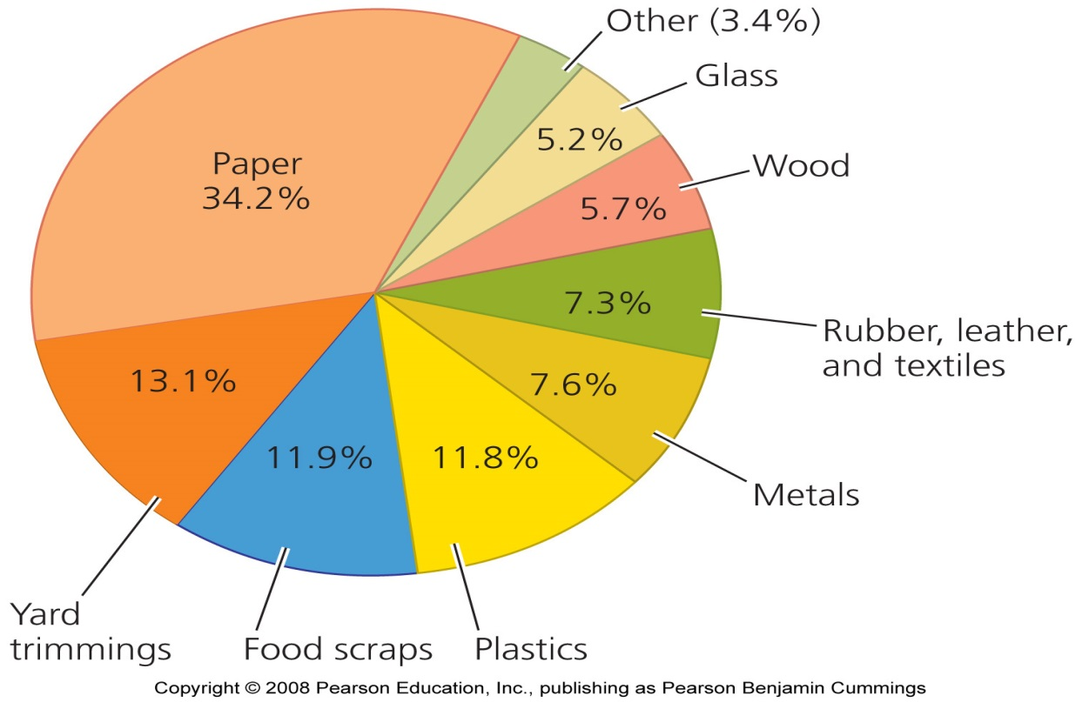
The U.S. municipal solid waste stream

Slide 8
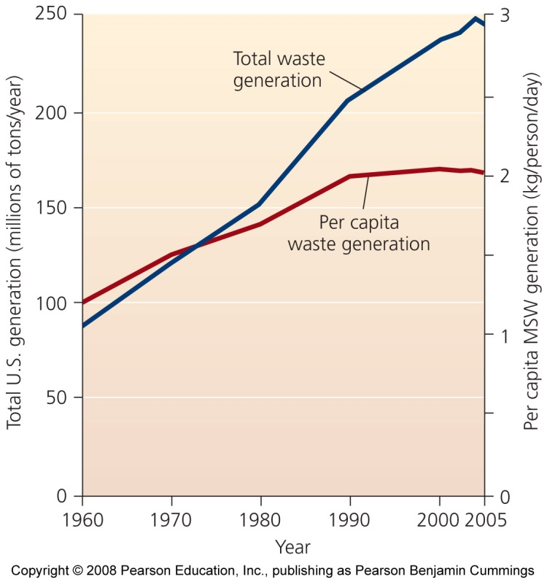
Waste generation is rising in the U.S.
In the U.S,, since 1960, waste generation has increased by 2.8 times

Slide 9
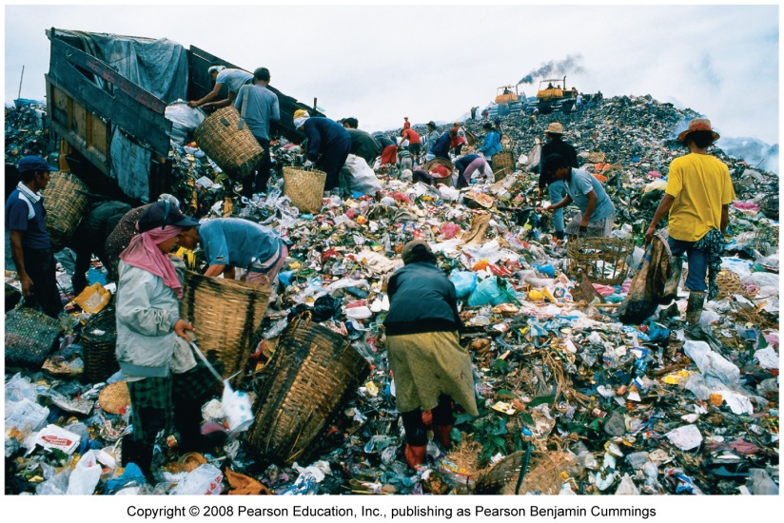
Waste generation is rising in all nations
Consumption is greatly increasing in developing nations
  Rising material standard of living and more packaging
Wealthy consumers often discard items that can still be used
  At many dumps and landfills in the developing world, poor people support themselves by selling items they scavenge

Slide 10
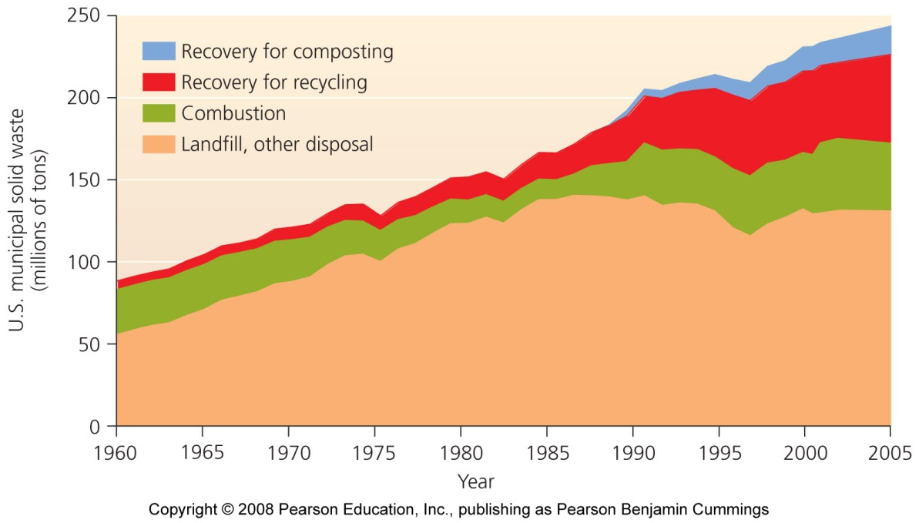
Improved disposal methods
Historically people dumped their garbage wherever it suited them
  Open dumping and burning still occur throughout the world
Most industrialized nations now bury waste in lined and covered landfills or burn it in incineration facilities
  In the U.S., recycling is decreasing pressure on landfills

Slide 11
Sanitary landfills are regulated
Sanitary landfills = waste buried in the ground or piled in large, engineered mounds
  Must meet national standards set by the EPA under the Resource Conservation and Recovery Act (RCRA) of 1976
  Waste is partially decomposed by bacteria and compresses under its own weight to make more space
  Layered with soil to reduce odor, speed decomposition, reduce infestation by pets
  When a landfill is closed, it must be capped and maintained

Slide 12
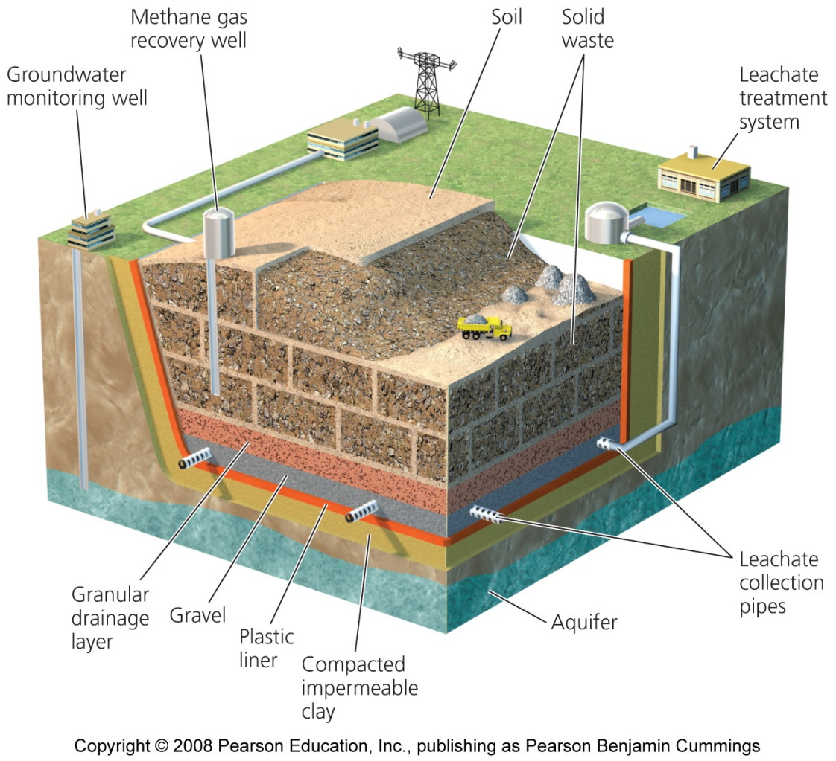
A typical sanitary landfill
To protect against environmental contamination, landfills must be located away from wetlands, earthquake-prone faults, and 20 ft above water table

Slide 13
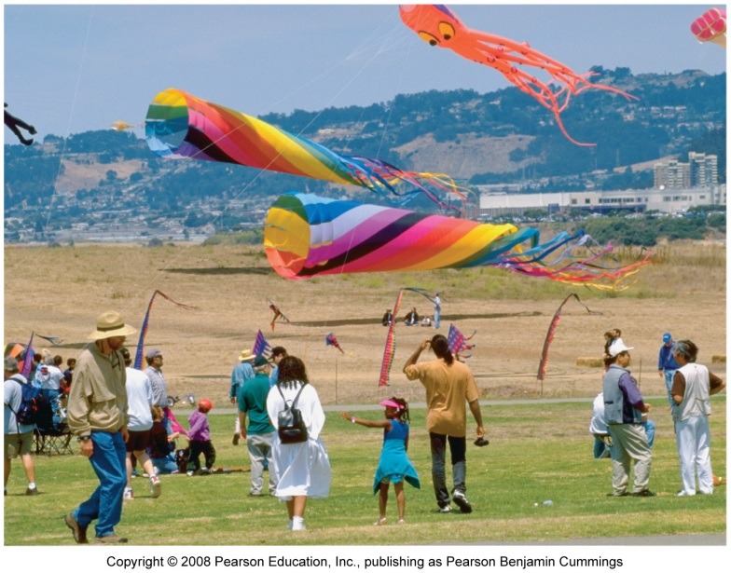
Landfills can be transformed after closure
Thousands of landfills lie abandoned
  Managers closed smaller landfills and made fewer larger landfills
In 1988, the U.S. had nearly 8,000 landfills
  Today there are fewer than 1,700
Growing cities converted closed landfills into public parks
  Flushing Meadows in Queens, New York, was redeveloped for the 1939 World’s Fair

Slide 14
Landfills have drawbacks
Experts believe that leachate will eventually escape
  The liner will become punctured
  Leachate collection systems eventually aren’t maintained
It is hard to find places suitable for landfills
  The Not-In-My-Backyard (NIMBY) syndrome
The “Garbage barge” case
  In 1987, Islip, New York’s landfills were full, and a barge traveled to empty the waste in North Carolina, which rejected the load
  It returned to Queens to incinerate the waste, after a 9,700 km (6,000 mile) journey

Slide 15
Incinerating trash reduces landfill pressure
Incineration = a controlled process in which mixed garbage is burned at very high temperatures
Incineration in specially constructed faculties can be an improvement over open-air burning of trash
  But, the remaining ash must be disposed of in a hazardous waste landfill
  Hazardous chemicals are created and released during burning
Scrubbers = chemically treat the gases produced in combustion to remove hazardous components and neutralize acidic gases

Slide 16
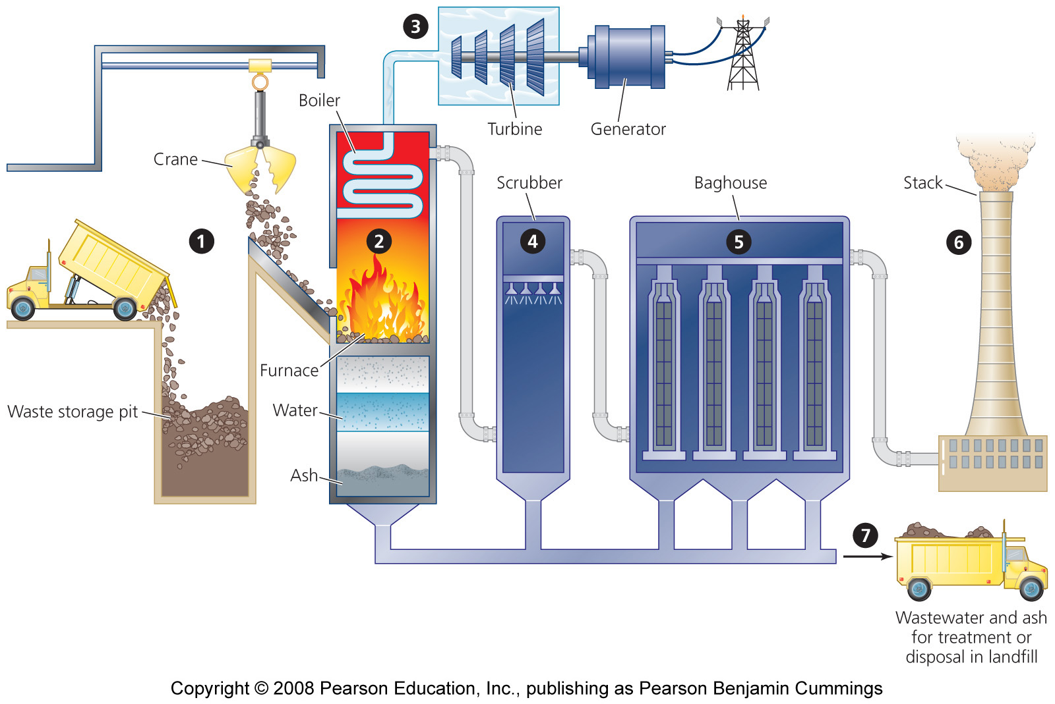
A typical solid waste incinerator

Slide 17
Many incinerators create energy
Incineration is used to reduce the volume of waste and generate electricity
Waste-to-energy facilities (WTE) = use the heat produced by waste combustion to create electricity
  More than 100 facilities are in use across the U.S.
  They can process nearly 100,000 tons of waste per day
  But, they take many years to become profitable
Companies contract with communities to guarantee a minimum amount of garbage
  Long-term commitments interfere with the communities’ later efforts to reduce waste

Slide 18
Landfills can produce gas for energy
Bacteria can decompose waste in an oxygen-deficient environment
Landfill gas = a mix of gases that consists of roughly half methane
  Can be collected, processed, and used like natural gas
  When not used commercially, landfill gas is burned off in flares to reduce odors and greenhouse emissions

Slide 19
Reducing waste is a better option
Source reduction = preventing waste generation in the first place
    Avoids costs of disposal and recycling
    Helps conserve resources
    Minimizes pollution
    Can save consumers and businesses money
Much of the waste consists of materials used to package goods

Slide 20
Waste can be reduced by manufacturers
This waste can be reduced by manufacturers if consumers:
    Choose minimally packaged goods
    Buy unwrapped fruits and vegetables
    Buy in bulk
Manufacturers can also:
    Use packaging that is more recyclable
    Reduce the size or weight of goods

Slide 21
Governments fight waste and litter
Some government take aim at a major source of litter and waste: plastic grocery bags
  Grocery bags can take centuries to decompose
  Choke and entangle wildlife
  Litters the landscape
Many governments, federal state and local, have banned non-biodegradable bags
Increasing the longevity of goods also reduces waste
  Companies maximize sales by producing short-lived goods

Slide 22
Reuse is one main strategy for waste reduction
To save waste, items can be used again or durable goods used instead of disposable ones
People can donate items to resale centers such as Goodwill Industries and the Salvation Army
Other actions include:
  Buy groceries in bulk
  Bring your own cup to coffee shops
  Buy rechargeable batteries
  Compost kitchen and yard wastes
  Rent or borrow items instead of buying them

Slide 23
Composting recovers organic waste
Composting = the conversion of organic waste into mulch or humus through natural biological processes of decomposition
  Can be used to enrich soil and help resist erosion
Home composting:
  Householders place waste into composting piles, underground pits, or specially constructed containers
  As waste is added, the heat from microbial action builds in the interior and decomposition proceeds
  Earthworms, bacteria, soil mite, sow bugs, and other organisms convert waste into high-quality compost

Slide 24
Municipal composting programs
Divert food and yard waste from the waste stream to central composting facilities
  Reduces landfill waste
  Encourages soil biodiversity
  Reduces the need for chemical fertilizers
  Makes healthier plants and more pleasing gardens

Slide 25
Recycling consists of three steps
Recycling = collecting materials that can be broken down and reprocessed to manufacture new items
  Recycling diverts 58 million tons of materials away from incinerators and landfills each year
Step 1 in the recycling loop is collection and processing of recyclable materials through curbside recycling or designated locations
  Materials recovery facilities (MRFs) = workers and machines sort items, then clean, shred and prepare them for reprocessing

Slide 26
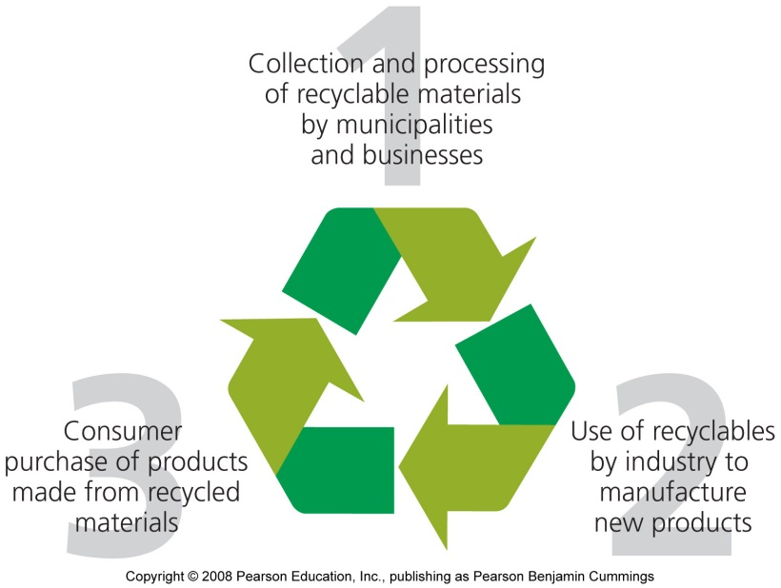
The second and third steps of recycling
Step 2 is using recyclables to produce new products
  Many products use recycled materials
In step 3, consumers purchase goods made from recycled materials
  Must occur if recycling is to function
  As markets expand, prices will fall

Slide 27
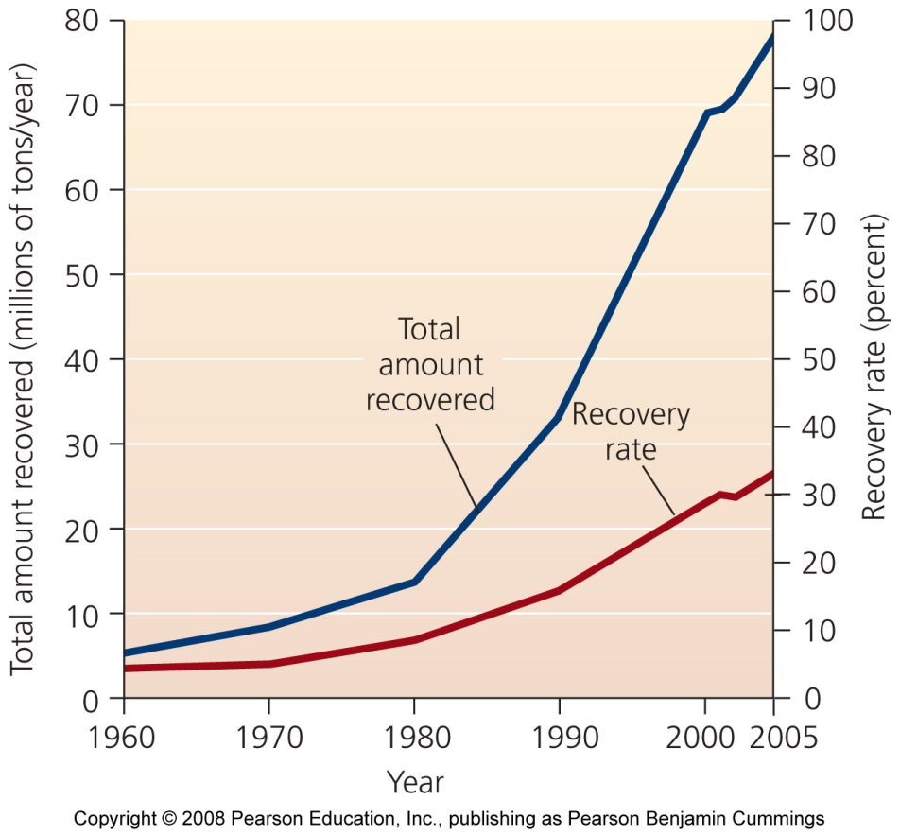
Recycling has grown rapidly and can expand
The EPA calls the growth of recycling “one of the best environmental success stories of the late 20th century”
Recycling rates vary widely, depending on the product
  67% of major appliances are recycled
  Only 6% of plastics are recycled

Slide 28
Growth in recycling results from:
A desire in municipalities to reduce waste output
The public’s desire to expand recycling
New technologies and markets make recycling more and more cost effective
Recycling is often not financially profitable because it is expensive to collect, sort and process recycled materials
  And, the more material that is recycled, the lower the price
However, market forces do not take into account the health and environmental effects of not recycling
  Enormous energy and material savings through recycling

Slide 29
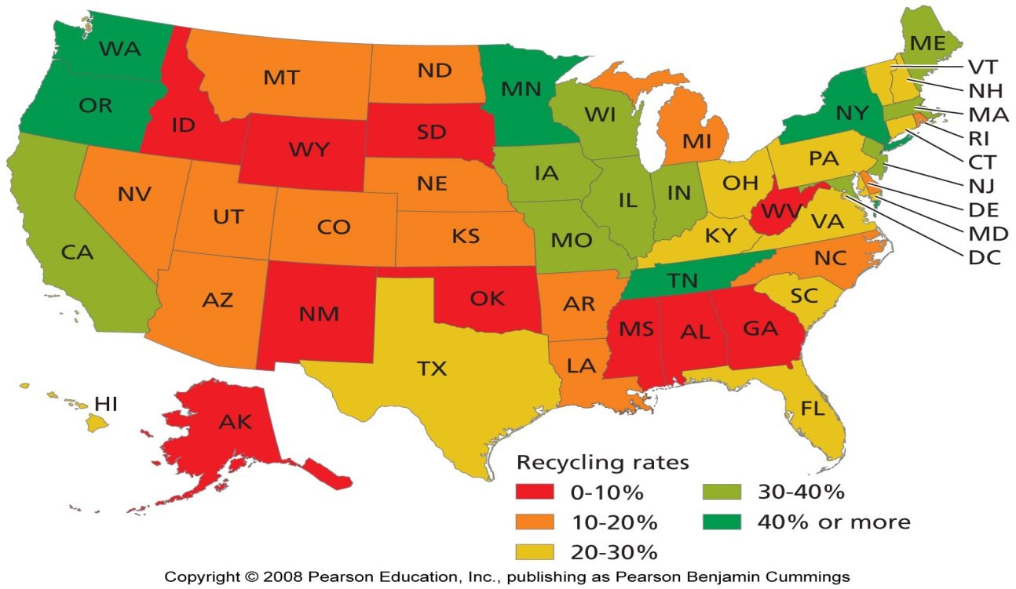
Recycling rates vary widely in the U.S.

Slide 30
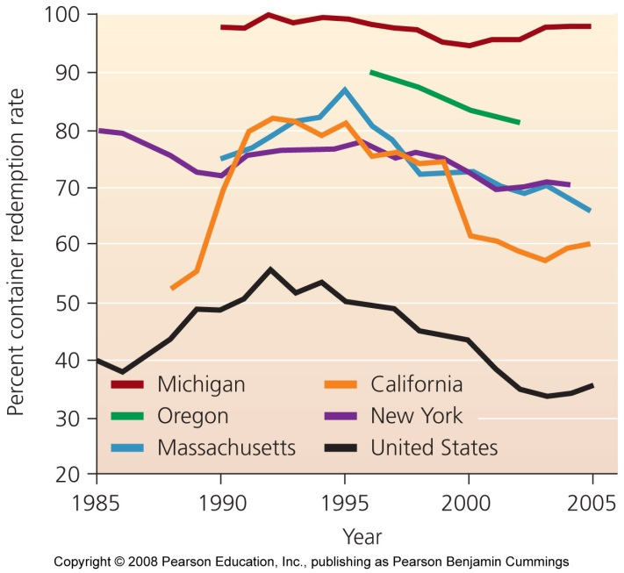
Financial incentives can address waste
Pay-as-you-throw approach = uses financial incentives to influence consumer behavior
  The less waste a house generates the less it is charged for trash collection
Bottle bills = consumers receive a refund for returning used bottles
  Challenges include including new kinds of containers and adjusting refunds for inflation

Slide 31
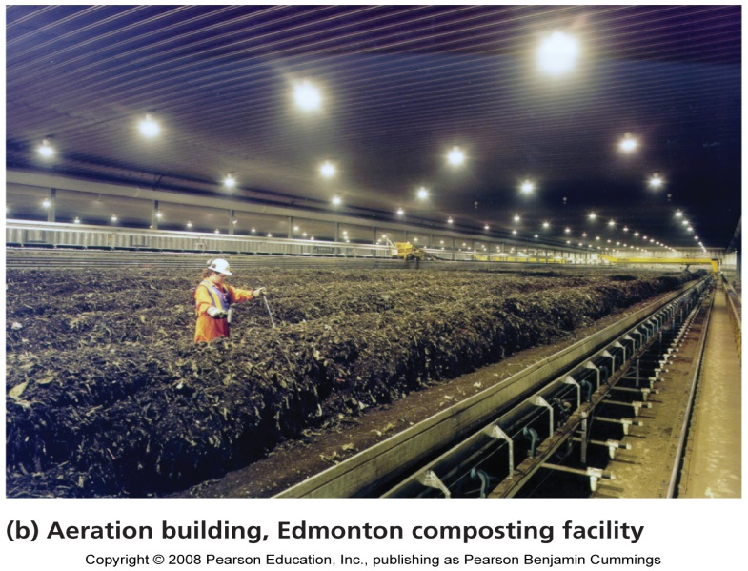
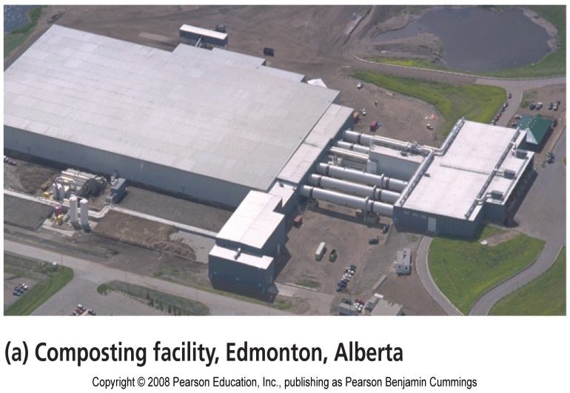
A Canadian city showcases reduction and recycling
Edmonton, Alberta, has created one of the world’s most advanced waste management programs
  Waste: 35% landfilled, 15% is recycled, 50% is composted
  81% of the people participate in curbside recycling
Produces 80,000 tons/year in its composting plant
Its state-of-the-art MRF handles 30,000 - 40,000 tons of waste annually

Slide 32
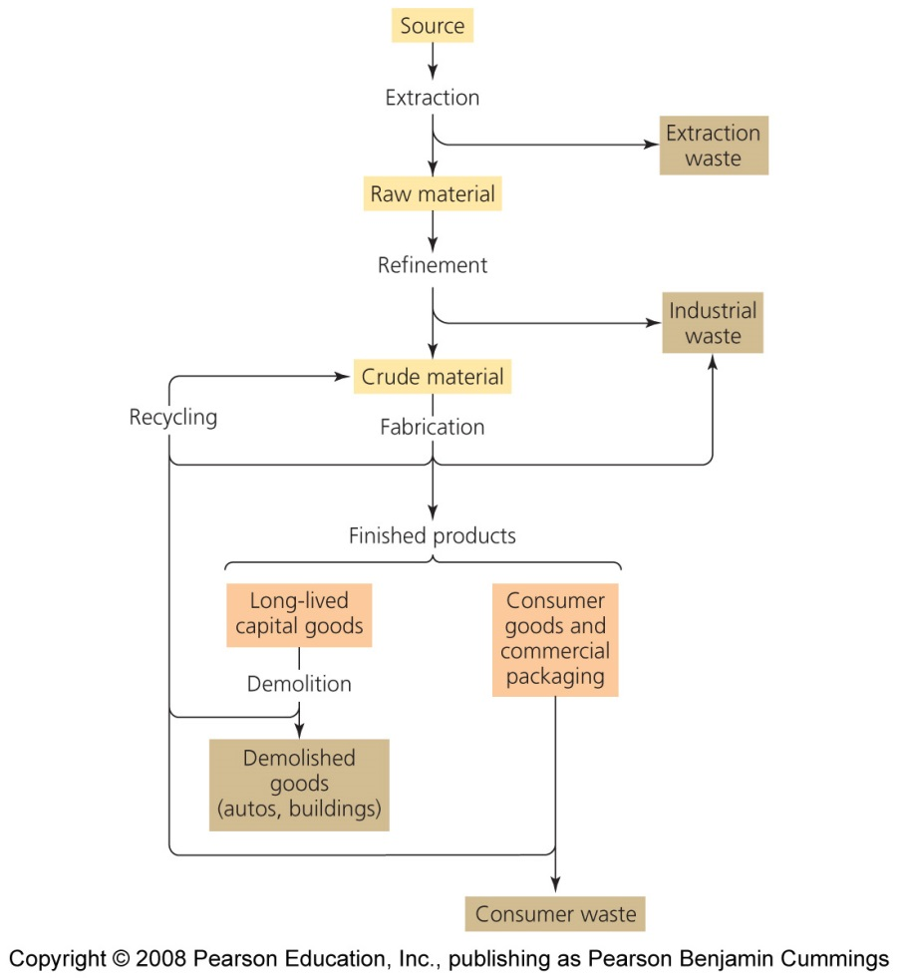
Industrial solid waste
U.S. industrial facilities generate 7.6 billion tons of waste
  97% is wastewater
The federal government regulates municipal waste
  State or local governments regulate industrial solid waste (with federal guidance)
Industrial waste = waste from factories, mining, agriculture, petroleum extraction, etc.

Slide 33
Regulation and economics influence waste
Most methods and strategies of waste disposal, reduction, and recycling are similar to municipal solid waste
Regulation varies from state to state
  In most cases, state and local regulations are less strict than federal rules
  In many areas, industries are not required to have permits, install landfill liners or leachate collection systems, or monitor groundwater for contamination

Slide 34
Physical and economic efficiency
One measure of efficiency: the amount of waste generated by a manufacturing process
  the less waste produced per unit or volume of product, the more efficient it is from a physical standpoint
Physical efficiency is not equal to economic efficiency
  Often times it is cheaper to manufacture products or perform services quickly but messily
  It can be cheaper to generate waste than to avoid waste
The rising cost of waste disposal encourage industries to decrease waste and increase physical efficiency

Slide 35
Industrial ecology
Industrial ecology = redesigning industrial systems to reduce resource inputs and to minimize physical inefficiency while maximizing economic efficiency
  Industrial systems should function like ecological systems, with little waste
Life cycle analysis = examine the life cycle of a product and look for ways to make the process more ecologically efficient
  Waste products can be used as raw materials
  Eliminating environmentally harmful products and materials
  Look for ways to create products that are more durable, recyclable, or reusable

Slide 36
Businesses are adopting industrial ecology
Businesses are using industrial ecology to reduce waste and decrease their impact on health and the environment while saving money
American Airlines switched from hazardous to nonhazardous materials in its Chicago facility
  Decreasing its need to secure permits from the EPA
  It used 50,000 reusable plastic containers to ship goods, reducing packaging waste by 90%
  Its Dallas-Ft. Worth headquarters recycled enough aluminum cans and white paper in 5 years to save $205,000

Slide 37
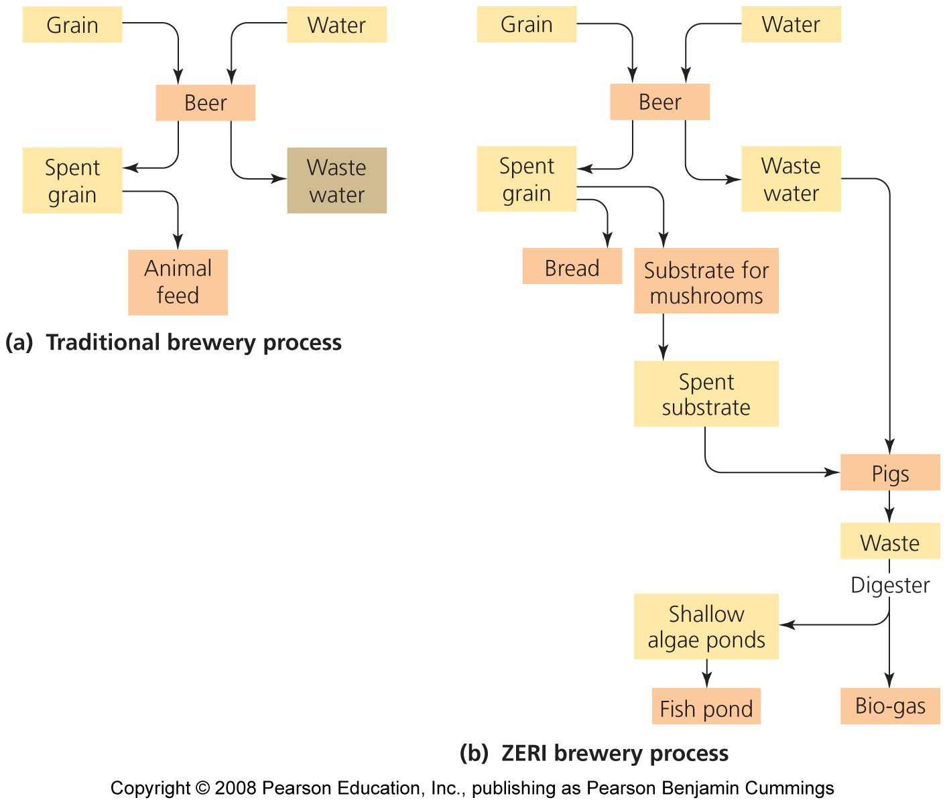
An example of industrial ecology
The Swiss Zero Emissions Research and Initiatives (ZERI) Foundation sponsors innovative projects that create goods and services without generating waste

Slide 38
Hazardous waste
Hazardous waste is defined as:
Ignitable = substances that easily catch fire (natural gas, alcohol)
Corrosive = substances that corrode metals in storage tanks or equipment
Reactive = substances that are chemically unstable and readily react with other compounds, often explosively or by producing noxious fumes
Toxic = substances that harm human health when they are inhaled, are ingested, or contact human skin

Slide 39
Hazardous wastes have diverse sources
Industry = produces the largest amount of hazardous waste
  But waste generation and disposal is highly regulated
Mining
Households = now the largest producer of hazardous waste
  Paints, batteries, oils, solvents, cleaning agents, pesticides
Small businesses
Agriculture
Utilities
Building demolition

Slide 40
Organic compounds can be hazardous
Particularly hazardous because their toxicity persists over time
Synthetic organic compounds = resist decomposition
  Keep buildings from decaying, kill pests, and keep stored goods intact
  Their resistance to decay causes them to be persistent pollutants
  They are toxic because they are readily absorbed through the skin
  They can act as mutagens, carcinogens, teratogens, and endocrine disruptors

Slide 41
Heavy metals can be hazardous
Lead, chromium, mercury, arsenic, cadmium, tin, and copper
Used widely in industry for wiring, electronics, metal plating, pigments, and dyes
They enter the environment when they are disposed of improperly
Heavy metals that are fat soluble and break down slowly can bioaccumulate and biomagnify

Slide 42
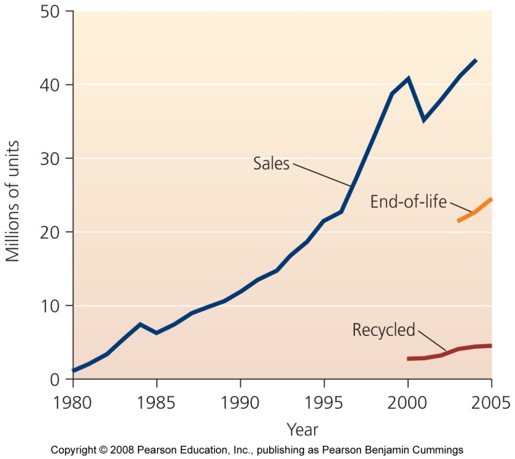
“E-waste” is a new and growing problem
Electronic waste (“e-waste”) = waste involving electronic devices
  Computers, printers, VCRs, fax machines, cell phones
  Disposed of in landfills, but should be treated as hazardous waste
  Some people and businesses are trying to use and reuse electronics to reduce waste

Slide 43
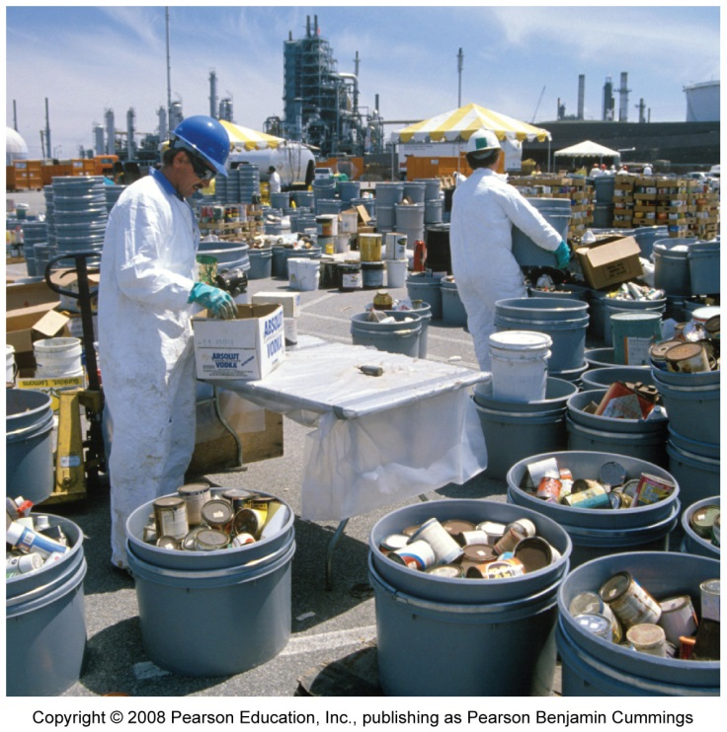
Several steps precede disposal of hazardous waste
For many years, hazardous waste was discarded without special treatment
  Public did not know it was harmful to human health
  Assumed the substances would disappear or be diluted in the environment
  Since the 1980s, cities designate sites or special collection days to gather household hazardous waste

Slide 44
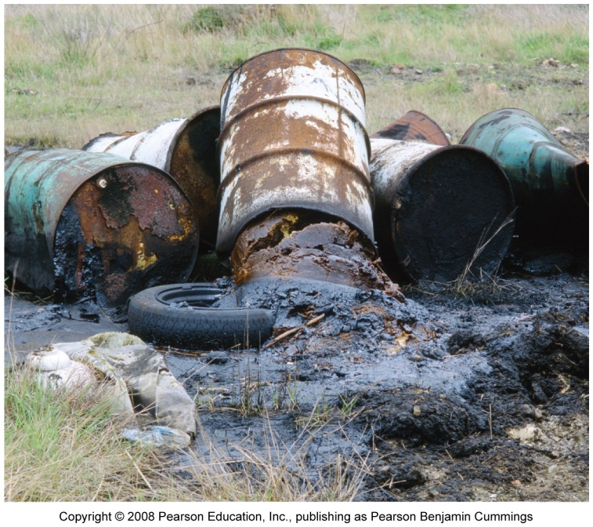
Disposing of hazardous waste
Resource Conservation and Recovery Act (RCRA) = states are required to manage hazardous waste
  Large generators of hazardous waste must obtain permits and must be tracked “from cradle to grave”
  Intended to prevent illegal dumping

Slide 45
Illegal dumping of hazardous waste
Since hazardous waste disposal is costly, it results in illegal and anonymous dumping by companies,
  Creating health risks
  Industrial nations illegally dump in developing nations
  Basel Convention, an international treaty, should prevent dumping but it still happens
High costs of disposal encourages companies to invest in reducing their hazardous waste

Slide 46
Three disposal methods for hazardous waste
These methods do nothing to lessen the hazards of the substances
  But they help keep the substance isolated from people, wildlife, and ecosystems
Landfills = must have several impervious liners and leachate removal systems
  Design and construction standards are stricter than for ordinary sanitary landfills
  Must be located far from aquifers

Slide 47
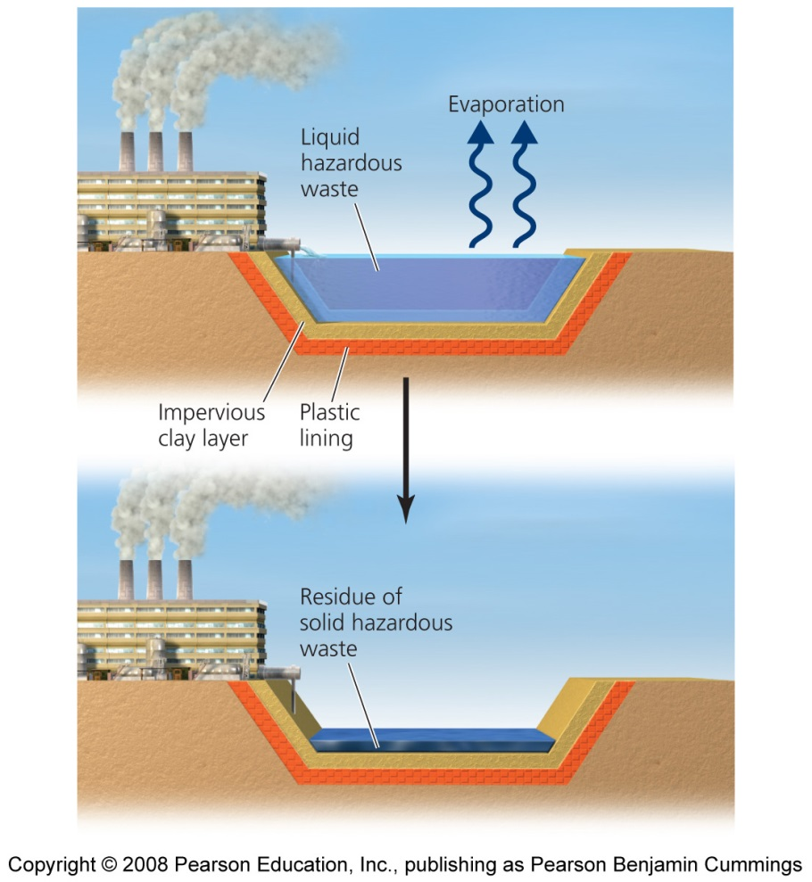
Surface impoundments
Surface impoundments = store liquid hazardous waste
Shallow depressions are lined with plastic and clay
Water containing waste evaporates, the residue of solid hazardous waste is then transported elsewhere
The underlying clay layer can crack and leak waste, and rainstorms cause overflow, contaminating nearby areas

Slide 48
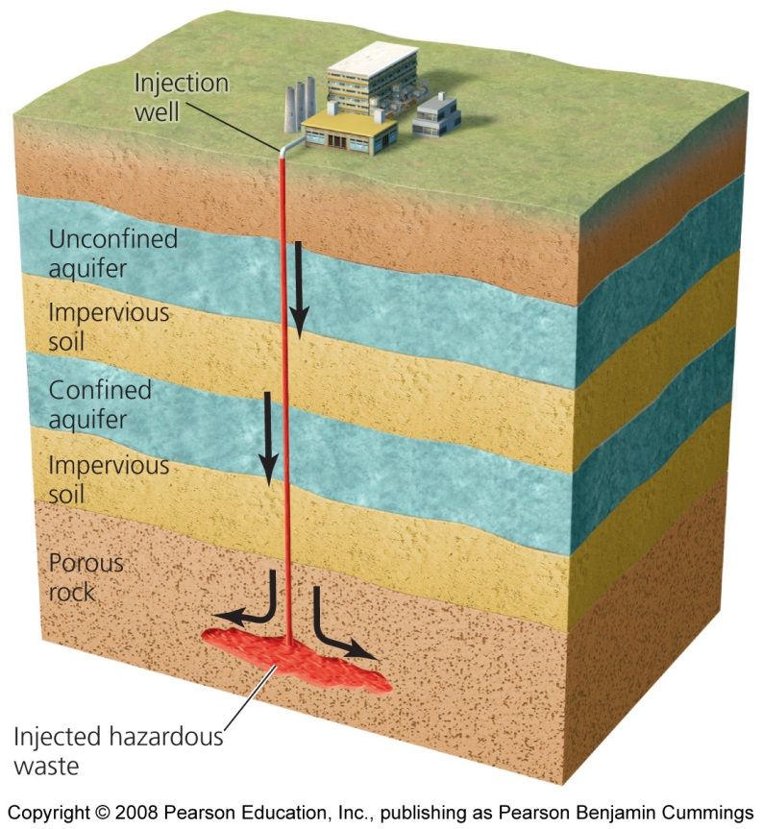
Deep-well injection
Deep-well injection = a well is drilled deep beneath the water table and waste is injected into it
  A long-term disposal method
  The well is intended to be isolated from groundwater and human contact
  However, the wells become corroded and leak waste into soil

Slide 49
Radioactive waste is especially hazardous
Radioactive waste is particularly dangerous and persistent
Yucca Mountain in Nevada is now designated as the single-site repository for all U.S. nuclear waste
The Waste Isolation Pilot Plant (WIPP) is the world’s first underground repository for transuranic waste from nuclear weapons development
  Caverns holding the waste are 655 m (2,150 ft) below ground in a huge salt formation thought to be geologically stable
  WIPP became operational in 1999 and is receiving thousands of shipments of waste

Slide 50
Contaminated sites are being slowly cleaned up
Globally, thousands of former military and industrial sites are contaminated with hazardous waste
  For most nations, dealing with these messes is too difficult, time consuming and expensive
Comprehensive Environmental Response Compensation and Liability Act (CERCLA) (1980) (Superfund)
  Established a federal program to clean up U.S. sites polluted with hazardous waste
  Experts identify polluted sites, take action to protect groundwater near these sites, and clean up the pollution

Slide 51
Superfund
Later laws charged the EPA with cleaning up brownfields = lands whose reuse or development are complicated by the presence of hazardous materials
Two events spurred creation of Superfund legislation
  In Love Canal, Niagara Falls, New York, families were evacuated after buried toxic chemicals rose to the surface, contaminating homes and an elementary school
  In Times Beach, Missouri, the entire town was evacuated after being contaminated with dioxin from waste oil sprayed on roads

Slide 52
The Superfund process
Once a Superfund site is identified, EPA scientists evaluate:
  How close the site is to human habitation
  Whether wastes are currently confined or likely to spread
  Whether the site threatens drinking water supplies

Slide 53
Superfund: harmful sites
Harmful sites are:
  Placed on the EPA’s National Priority List
  Ranked according to the level of risk to human health that they pose
  Cleaned up on a site-by-site basis as funds are available
The EPA is required to hold public hearings and inform area residents of tits findings and to receive feedback

Slide 54
Who pays for cleanup?
CERCLA operates under the polluter pays principle = polluting parties were to be charged for cleanup
  However, the responsible parties often can’t be found
  A trust fund was established by a federal tax on petroleum and chemical industries
  The fund is bankrupt, and neither the Bush administration nor Congress has moved to restore it, so taxpayers now pay all costs of cleanup
  Fewer cleanups are being completed
  An average cleanup costs $25 million and takes 12 - 15 years

Slide 55
Conclusion
Our societies have made great strides in addressing our waste problems
Modern methods of waste management are far safer for people and gentler on the environment
Recycling and composting are growing rapidly
Our prodigious consumption had created more waste than ever before
Finding ways to reduce, reuse and efficiently recycle the materials and goods that we use stands as a key challenge for the new century

